Slide 1
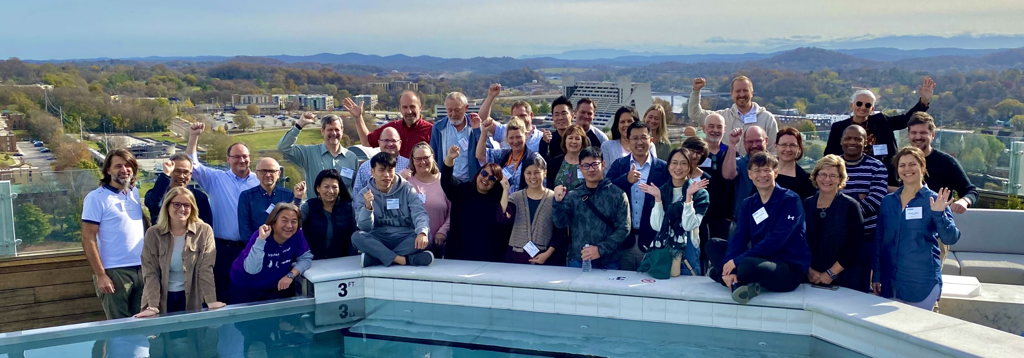


What is JACoW and What Does It Offer To Your Conference
David Button – On Behalf JACoW
Australian Nuclear Science and Technology Organisation
JACoW Team Meeting 2023
Hosted by NSRRC
HsinChu City, Taiwan from November 28th to December 1, 2023

Slide 2
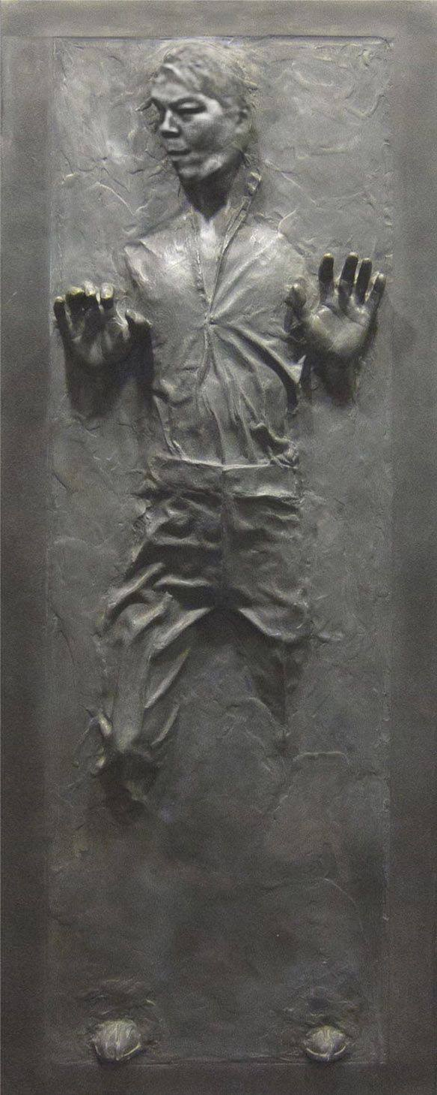
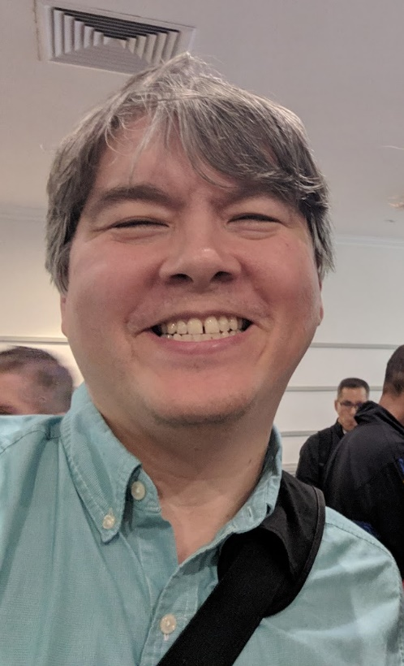
Disclaimer
Many aspects of this talk may contain traces of “Todd Satogata”
Plagiarism is unavoidable due to JACoW extensive legacy!

Slide 3
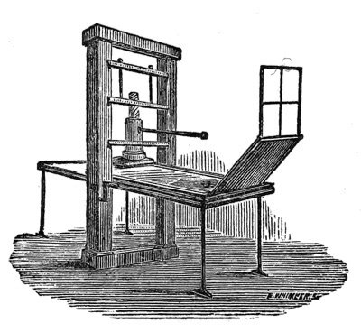
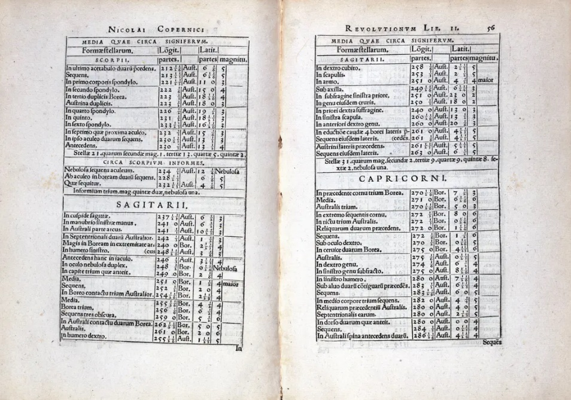
How the world changed….
Printing Powers the Scientific Revolution
TABLES FROM POLISH ASTRONOMER NICOLAUS COPERNICUS' PIONEERING TEXT “DE REVOLUTIONIBUS ORBIUM CAELESTIUM” (ON THE REVOLUTION OF HEAVENLY SPHERES), 1543, WHICH REPRESENTS HIS COMPLETE WORK.
“the printing press introduced the world to the idea of machines “stealing jobs” from workers”
The English philosopher Francis Bacon, who’s credited with developing the scientific method, wrote in 1620 that the three inventions that forever changed the world were gunpowder, the nautical compass and the printing press.

Slide 4
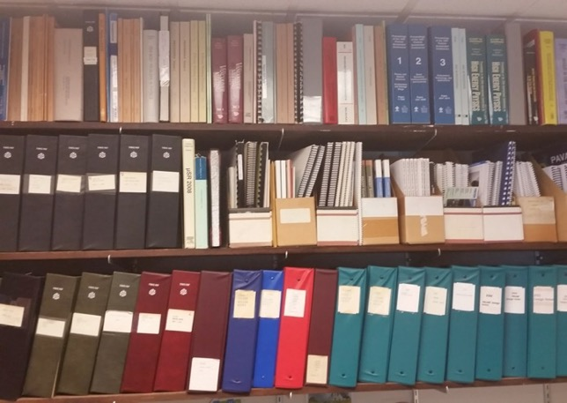

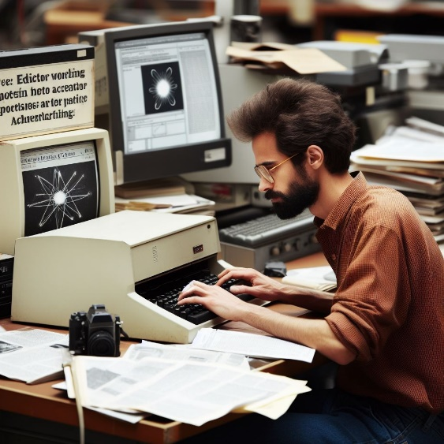
Conferences Before JACoW
Jana Thomson Office TRUMF
Conferences once printed all their proceedings
(Nearly) all the delegates got a printed, shipped copy
We’d send people to conferences to get proceedings!
Printing, shipping was a big piece of the conference budget

Slide 5
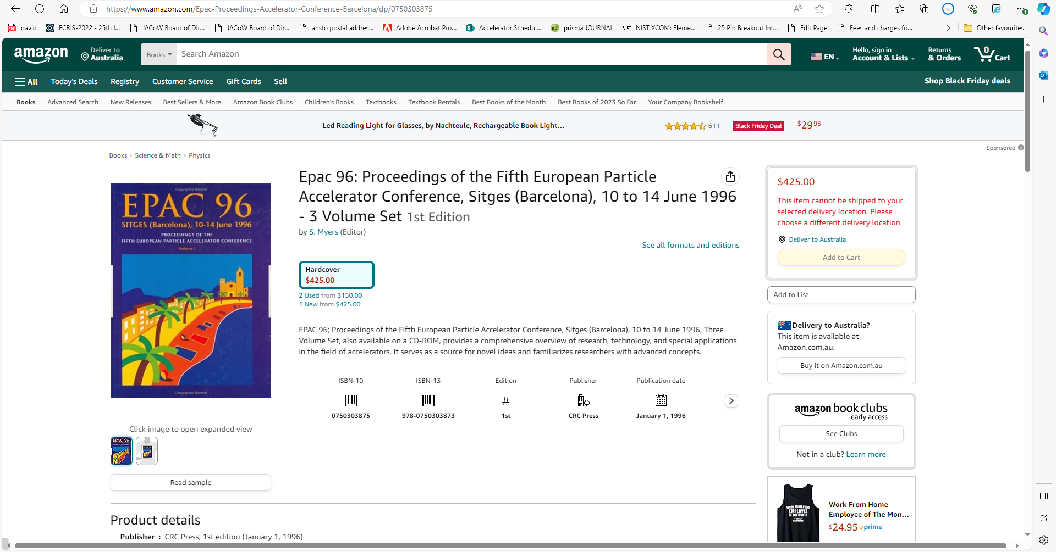
Cost to access
Proceeding copies sold through
e.g. Curran Associates, Amazon
Other hardcopies US$100-300
(or less) for recent IPACs
Was a large portion of registration
fee when all delegates received a
printed copy (in the “old days”)

Slide 6
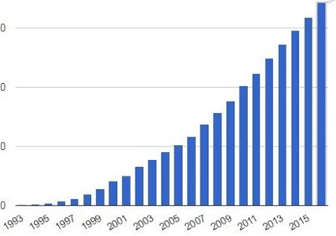

The Milestones on the Path
Internet Users: 1993-2016
1990-1: World Wide Web (CERN)
1993: PDF and Acroread made free (Adobe)
1993: Commercialization of Linux (redhat)
1994: 100 MHz PC processors (Intel)
1995-2000: Dot Com Boom
  Internet usage/access grows 25x: 15M to 350M
PAC’95 (Dallas): Camera-ready publication (paper)
EPAC’96 (Sitges): Full electronic publication (CERN)
  Templates, on-site editing, dot board (author “education”)
PAC’97 (Vancouver): The birth of JACoW
  Founded by APAC’98, EPAC’98, PAC’99

Slide 7
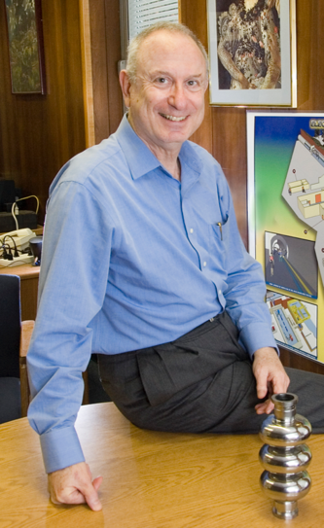
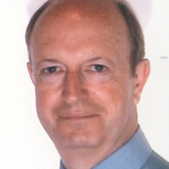
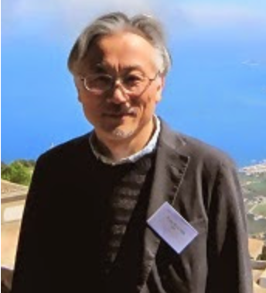
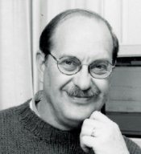
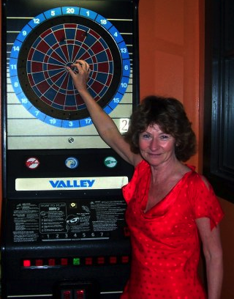
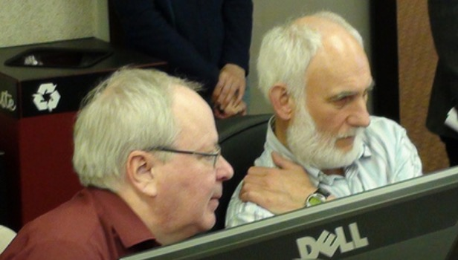
What is JACoW?
Joint Accelerator Conferences [on the] Website
The Beginnings: In the mid-nineties, with the arrival of electronic publication, PAC'95 and EPAC'96 were the first accelerator conferences to try their hand at publishing proceedings themselves.
In 1997 the JACoW collaboration was created under the chairmanship of CERN's John Poole, with
Christine Petit-Jean-Genaz as CERN secretary.
An Original Confluence of Personalities
Ilan
Ben-Zvi
Yong-Ho
Chin
Bob Siemann
Christine
Petit-Jean
Genaz
John
Poole
APAC’98
PAC’95
Lief Liljeby
Martin
Comyn
PAC’99
EPAC’98
PAC’97
EPAC’96...

Slide 8
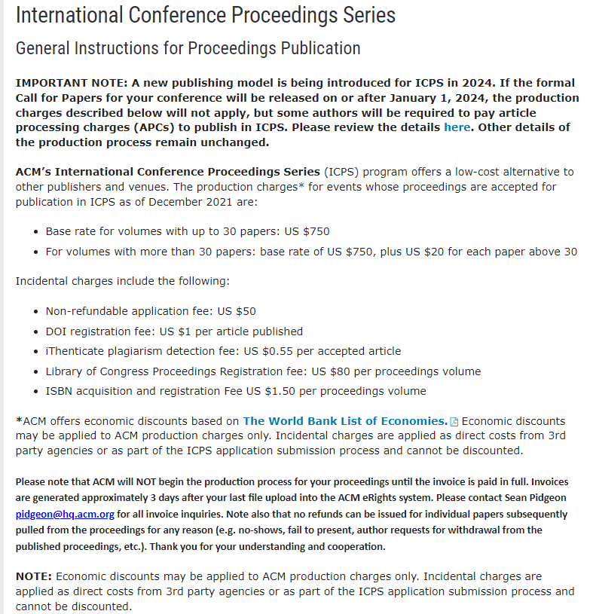
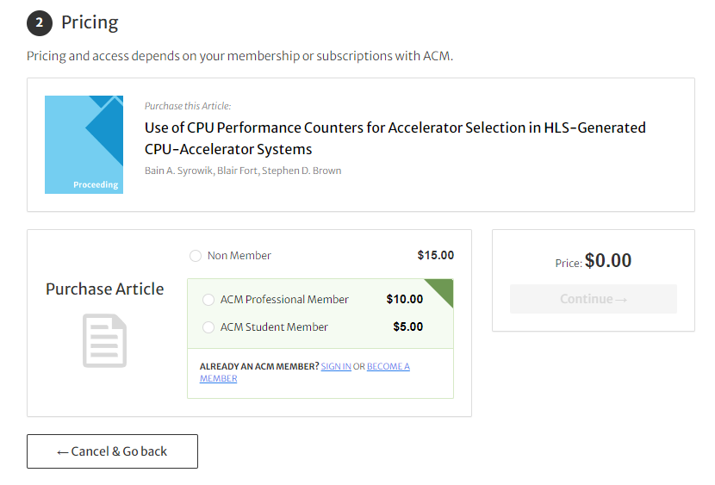
Comparison
International Conference Proceedings Series (acm.org)
As of 21 Nov 2023
Association for Computing Machinery (ACM) publishing arm
$750 + $20 per paper over 30
$750 + $20 x 1400’ish = $28-30k ($USD)
Reasonably comparable to JACoW costs!
BUT they have their own copyright, and require subscription for access
JACoW is better at a comparable up-front cost (and lower total cost)
ACM Digital Library Access

Slide 9
Comparison ACM ICPS ($USD)
New Open Access Publishing Model for ICPS Coming in 2024
In January 2024, ACM will be introducing a new Open Access publishing model for ICPS. Please refer to the FAQs for an overview of the new model. Full details of the publishing model are provided below.
The new Open Access (OA) publishing model for ICPS will apply to all conferences for which the formal Call for Papers will be issued on or after January 1, 2024.
Article Process Charges (APC);
If the corresponding author is affiliated with an institution in a lower-middle-income country (as defined by the World Bank) and at least one of the paper’s authors is an ACM member, the applicable APC is $350 per paper.
If the corresponding author is affiliated with an institution in a lower-middle-income country (as defined by the World Bank) but none of the paper’s authors is an ACM member, the applicable APC is $500 per paper.
If the corresponding author is not affiliated with an institution in a lower-middle-income country but at least one of the paper’s authors is an ACM member, the applicable APC is $700 per paper.
In all other cases, the applicable APC is $1,000 per paper.
Association for Computing Machinery (ACM) Open Access
$ 700 per x 700 articles = $490,000
$1,000 per x 700 articles = $700,000
Cost to Participants = Could be as high as $1,190,000
“The ACM OPEN model was developed with this challenge in mind. Rather than basing cost on the exact number of articles published each year, which is typically multiplied by an agreed APC price (~$2,500 - $3,000 per article for many of the large for-profit commercial publishers) to arrive at the total annual deal value to be paid to the Publisher”
New Open Access Publishing Model for ICPS Coming in 2024 (acm.org)

Slide 10
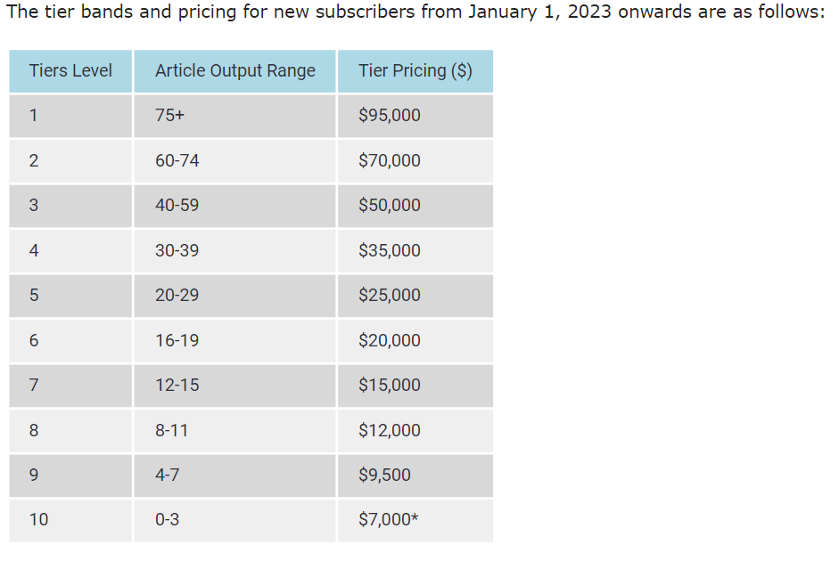
Comparison ACM ICPS ($USD)
Fixed price subscription contracts currently proposed

Slide 11
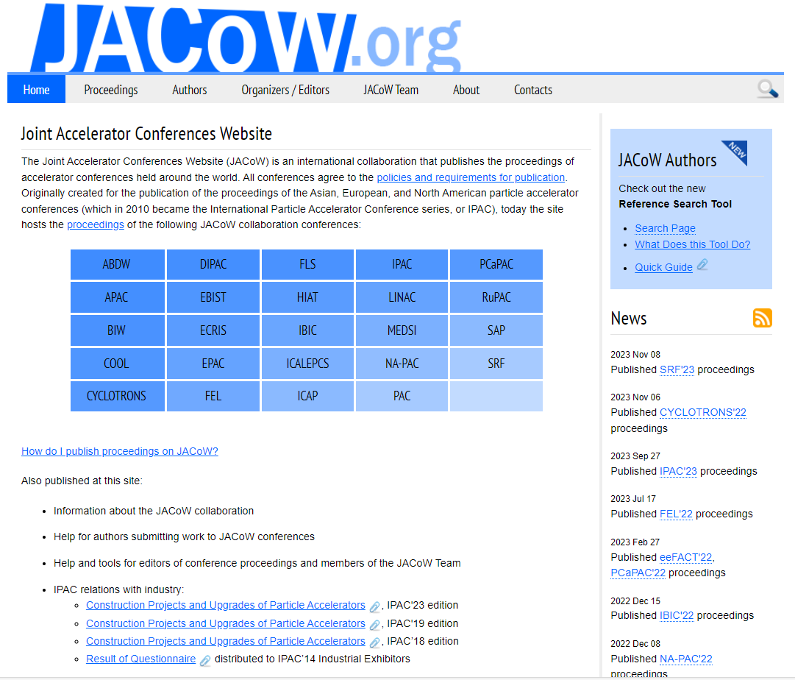
JACoW Has Always Been Open Access!
Free Creative in Common Open Access
What are the JACoW Goals
Publish high-quality sets of proceedings with access through the custom interface.
Provide long-term archival storage to ensure longevity and access to publication data.
Publish conference metadata for open archives.
Train and educate editors and authors.
Provide and maintain a repository of user profiles for accelerator conferences.
Provide support for conference organizers.
Maintain and lead community key investment in tools and infrastructure?
http://www.jacow.org/About/GoalsOfJACoW
Not ”provide!”
Consistent core goals since the founding of JACoW

Slide 12
What are the Requirements of JACoW?
http://www.jacow.org/About/PoliciesRequirementsForPublishingOnJACoW
CC-BY 4.0: https://creativecommons.org/licenses/by/4.0/
Editor/IT participation in Team Meetings (3yr cycle)
Technical paper requirements
  PDFs: proper metadata / margins / paper size / font embedding / version compatibility
Indico use not required
  Use of Indico and repository requires agreement on repository privacy, quality, integrity
  Indico new model still evolving

Slide 13
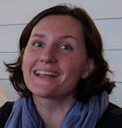
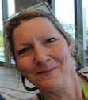
The JACoW Charter
http://www.jacow.org/About/Charter
JACoW operates according to the rules and policies of the JACoW Charter, documented on jacow.org
The charter defines less what JACoW does, and more how JACoW operates.
  Board of Directors composition, elections, responsibility and authority
  Annual Team Meeting
  Annual Stakeholder’s Meeting
    (Nearly) always at IPAC to attract broadest audience
  “The existence of the JACoW site does not detract from the rights of individual conference organisers to publish their proceedings on other web sites, storage media or hard copies of their choice.”
http://www.jacow.org/Main/Contacts

Slide 14
What is JACoW? A Website (or more)
Joint Accelerator Conferences on the Web(sites)
  Proceedings hosted by CERN and KEK
  JACoW wiki/website hosted by Elettra
  SPMS Proceedings scripts (Volker)
  SPMS servers hosted by CERN, KEK
  Indico server hosted by CERN
  Upload/download servers hosted by PSI, Jefferson Lab
  Legacy SPMS code (formerly supported by FNAL)
  Source code, request tracking hosted by sourceforge
    With investment in a functionality merge with Indico
  Reference Search Tool and Cat Scan Cloud Host supported by ANSTO (Josh Peters)
  JICT JACoW Indico Conference Tool by Elettra (Stefano)
We cannot hope to achieve our goals without the resources (hardware and time) provided by the support of national labs and conference series

Slide 15
What Is JACoW? A Collaboration
http://www.jacow.org/About/TheCollaboration
JACoW is an international collaboration
  Dedicated to prompt high-quality publication of accelerator science conference proceedings
  Many stakeholders:
    Users of JACoW proceedings/papers
    Institute representatives (Institutional ”stakeholders”)
    Conference representatives/organizers
    JACoW Team and Board of Directors
  There is often much overlap among all classes of stakeholders
http://www.jacow.org/StakeHolders/ListOfStakeholders

Slide 16
Collaboration, what does it give you?
Collection of collaborators with shared goals and needs
Grow together, uplifting the wider community
Talent development, and growing networks internationally
Self-sufficiency, community ownership
De-facto sponsorship of conferences by the community in kind
The collective can achieve far more than the individual, sharing resources and services we have a more economical advantage
As a JACoW Team Member you are a collaborator, not client

Slide 17
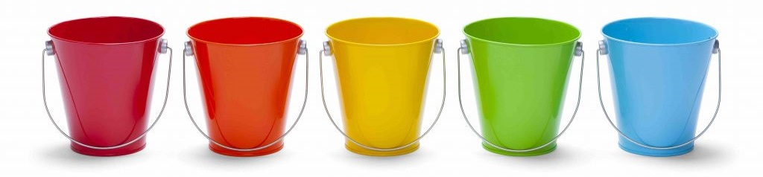
Building up Team Members
Knowledge. What you know and understand
Skills. How you apply what you know
Network. The people you know and can collaborate with
Resources. What you have in terms of assets and tools
Reputation. How the world perceives and values you

Slide 18
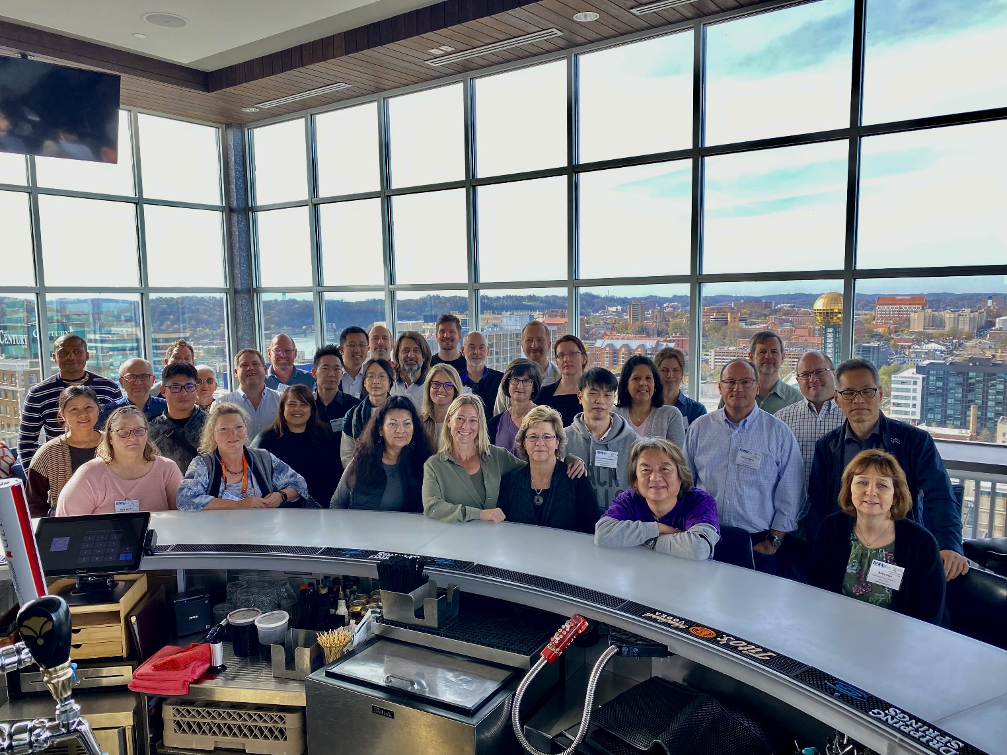
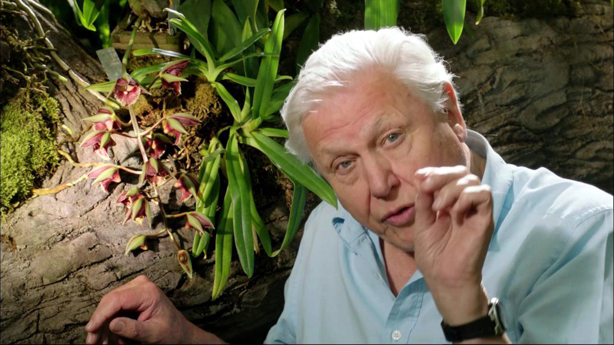
Join us at the bar….
“Here we see the team members of the JACoW collaborator in their natural habitat. These beautiful people migrate from all corners of the planet, congregating in a bar which is just an extraordinary wonder of the accelerator community”
JACoW Team Meeting, Knoxville USA, 2022

Slide 19
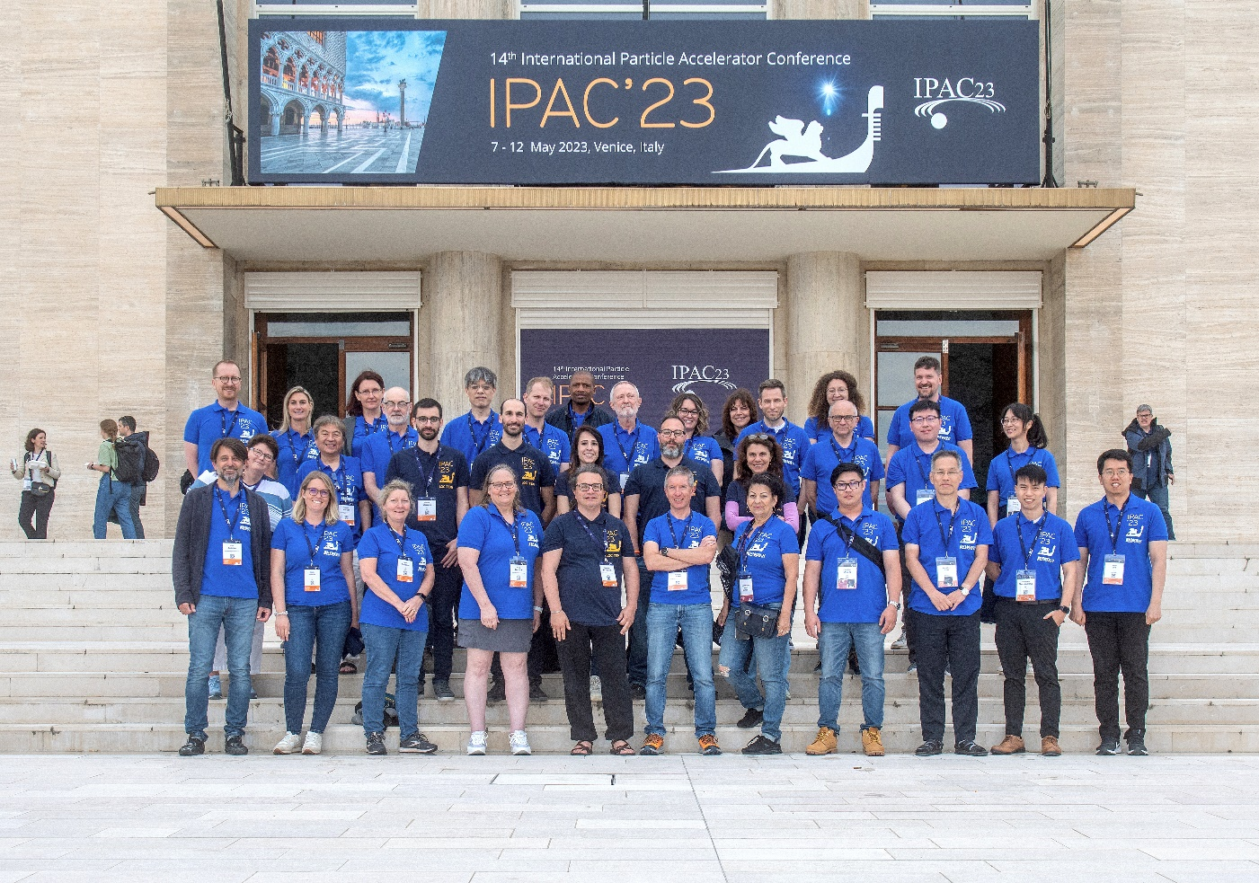
IPAC’23 JACoW Team (Venice)
http://www.jacow.org/About/TeamMembersRoles
WE are members of the JACoW team
  Producing excellent, prompt proceedings for international conferences in good camaraderie
  Coordinating support for proceedings production
    Author reception, IT, presentation management, etc

Slide 20
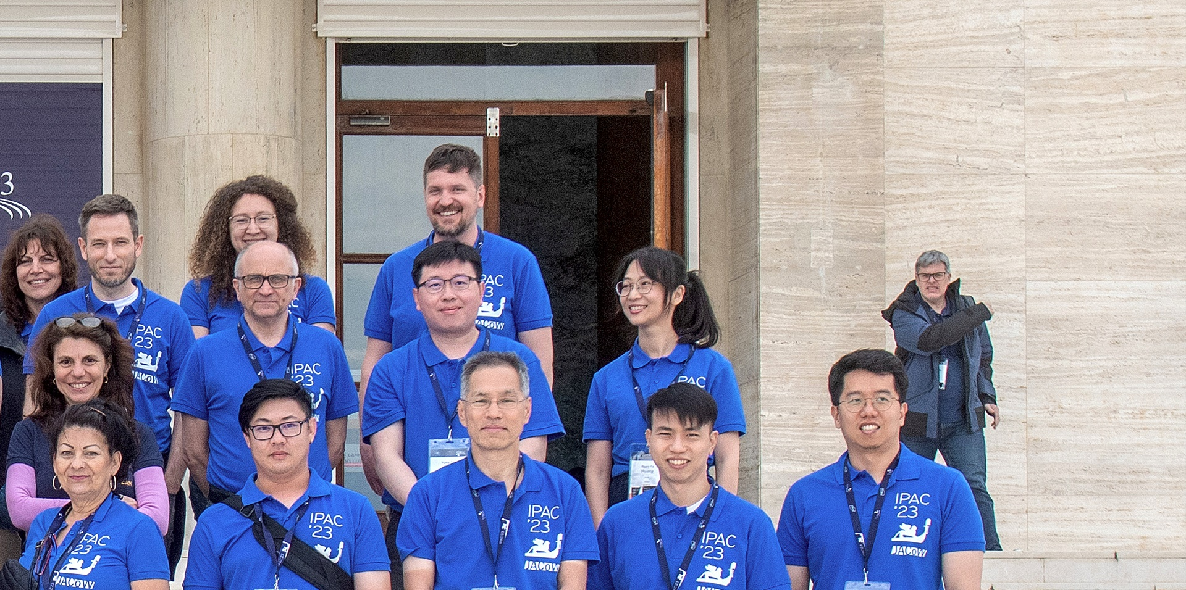
?
Red Dotted Author….?

Slide 21
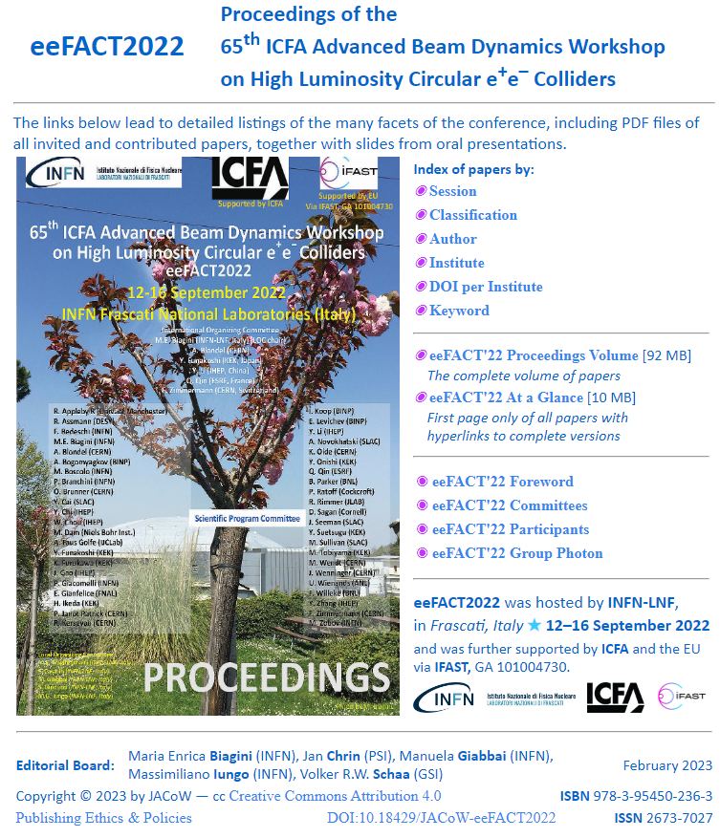
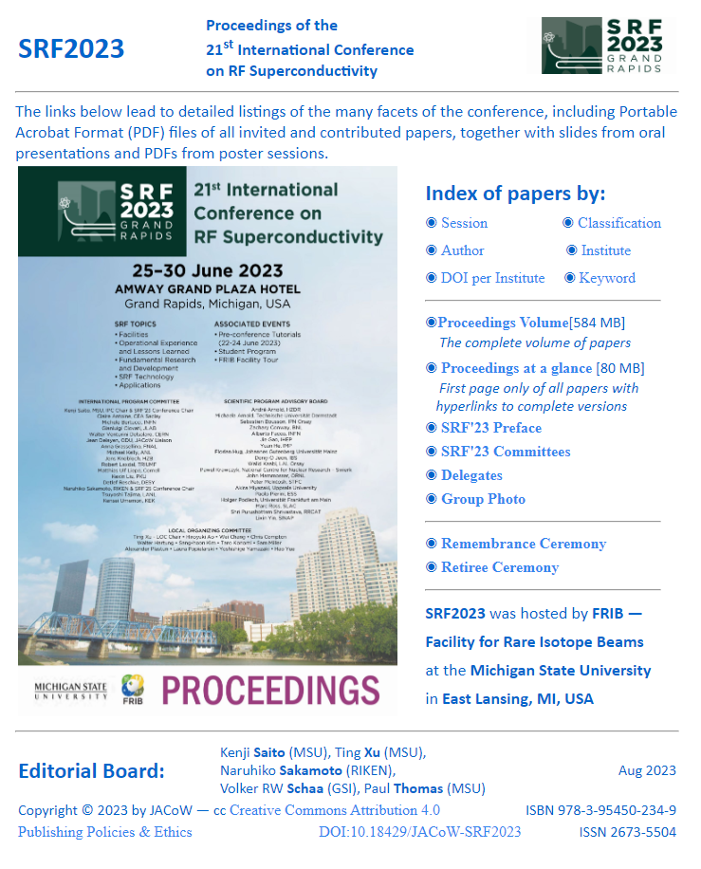
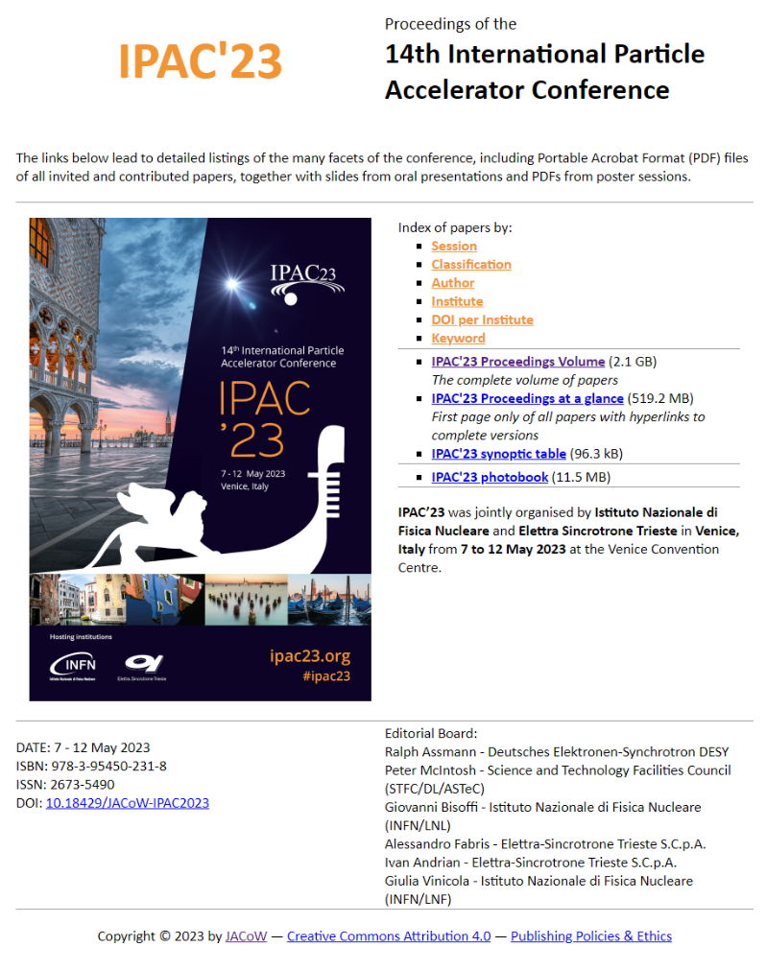
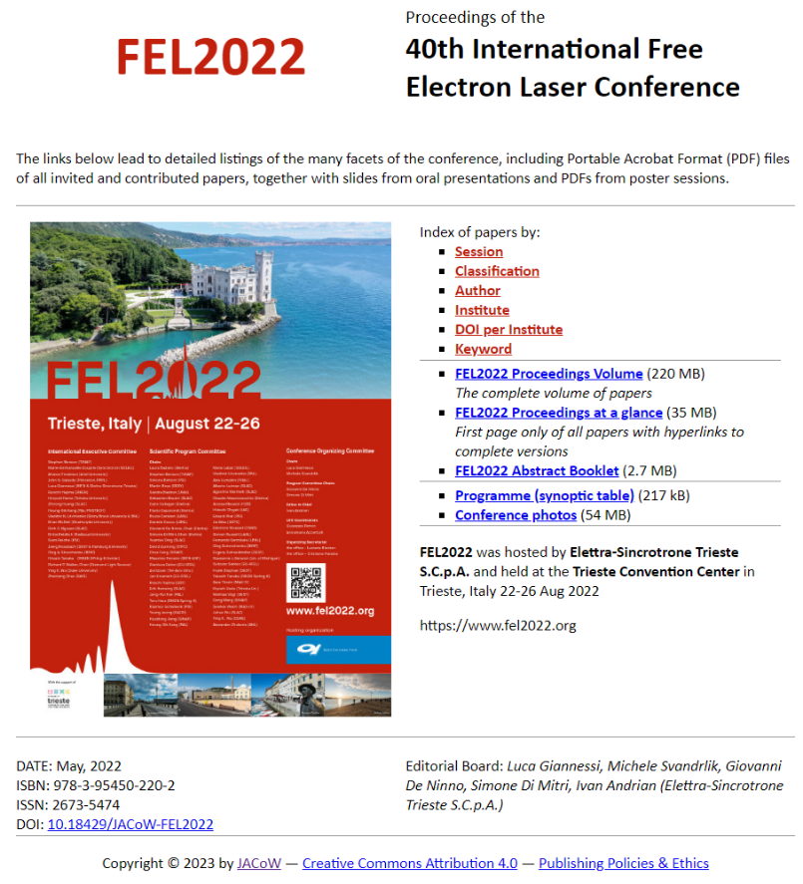
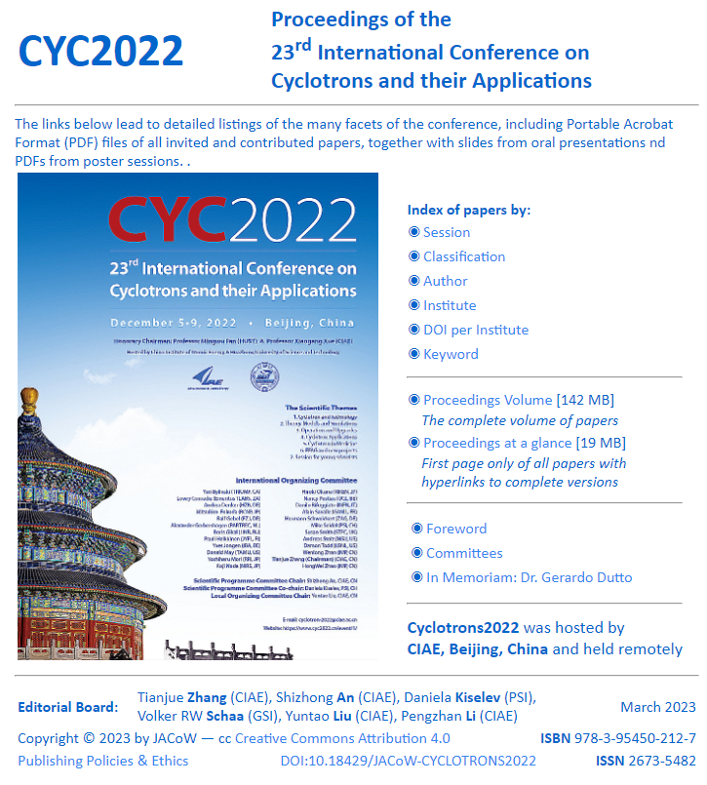
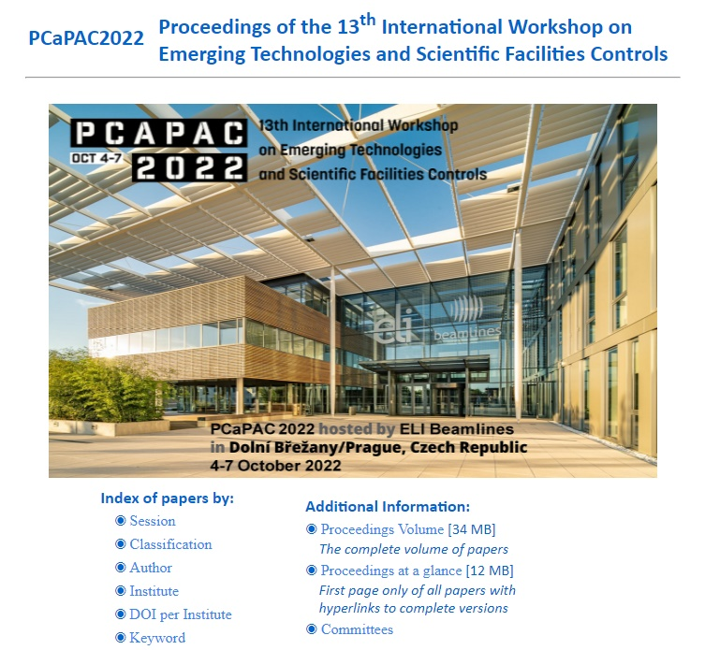
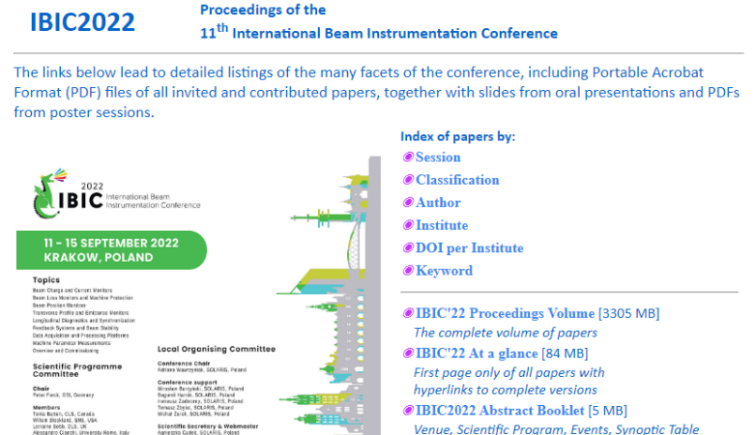
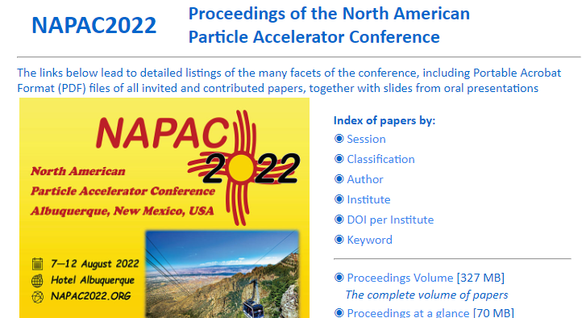
JACoW: Producing Excellent Proceedings
248 conferences and workshops on jacow.org
as of this writing
(+74,000 papers)
~8 since last TM

Slide 22
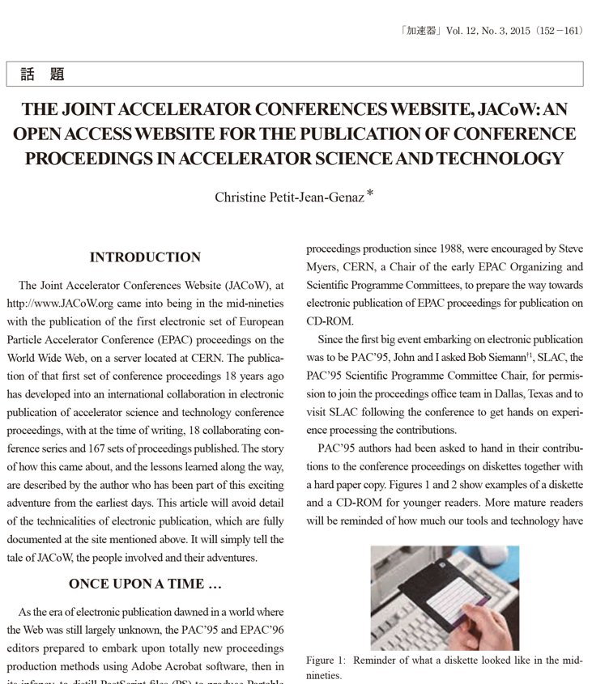
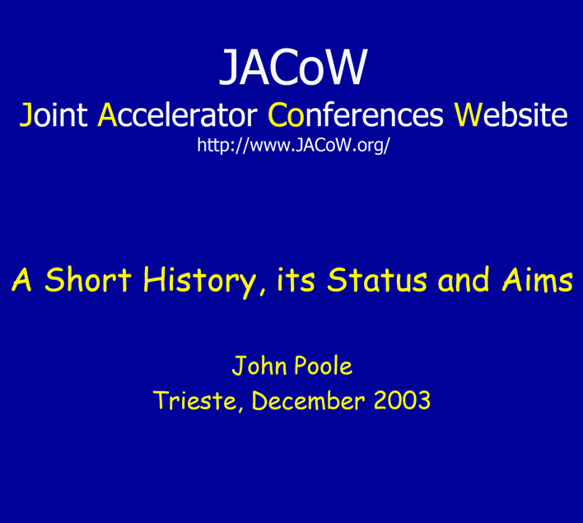
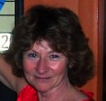
Recommended Inspirational Reading
Or, as Volker would put it, “Joint Accelerator
Conferences on the Web”
http://epaper.kek.jp/jacow/TM_2003_Trieste/slides/Seminar-JP.pdf
http://www.jacow.org/uploads/About/Article_KASOKUKI.pdf

Slide 23
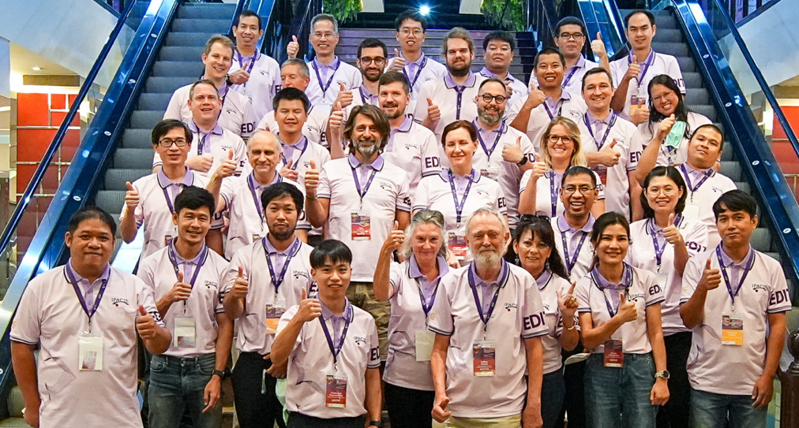
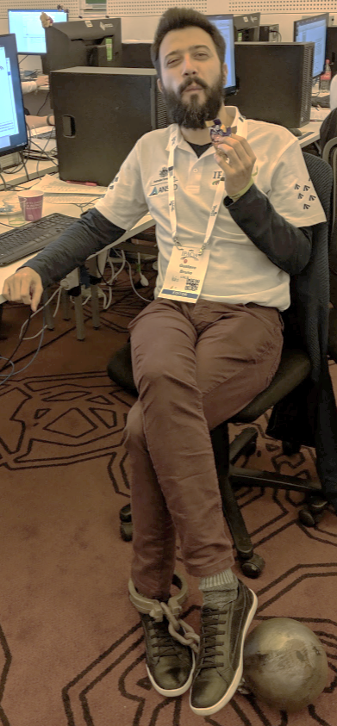
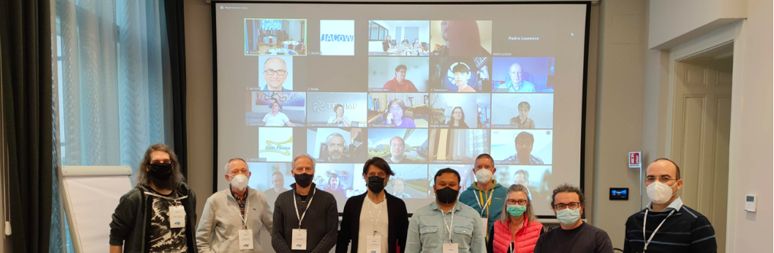
Thank You!
IPAC’22
Editorial
Team
2021 JACoW
Team Meeting
IPAC’19
salt mines

Slide 24

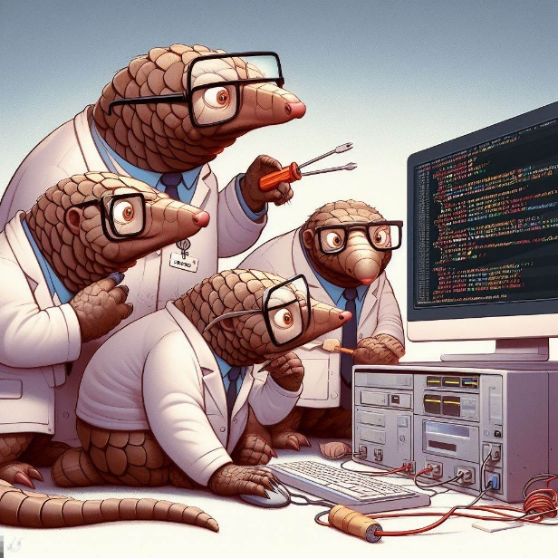

Big thank you to
National Synchrotron Radiation Research Center (NSRRC) Taiwan Team
IPAC’25 Pangolin LaTeX Editor
IPAC’25 Pangolin Editor Team
Pangolins Make the Best Debuggers
Our JACoW Seems to be Evolving

Slide 25


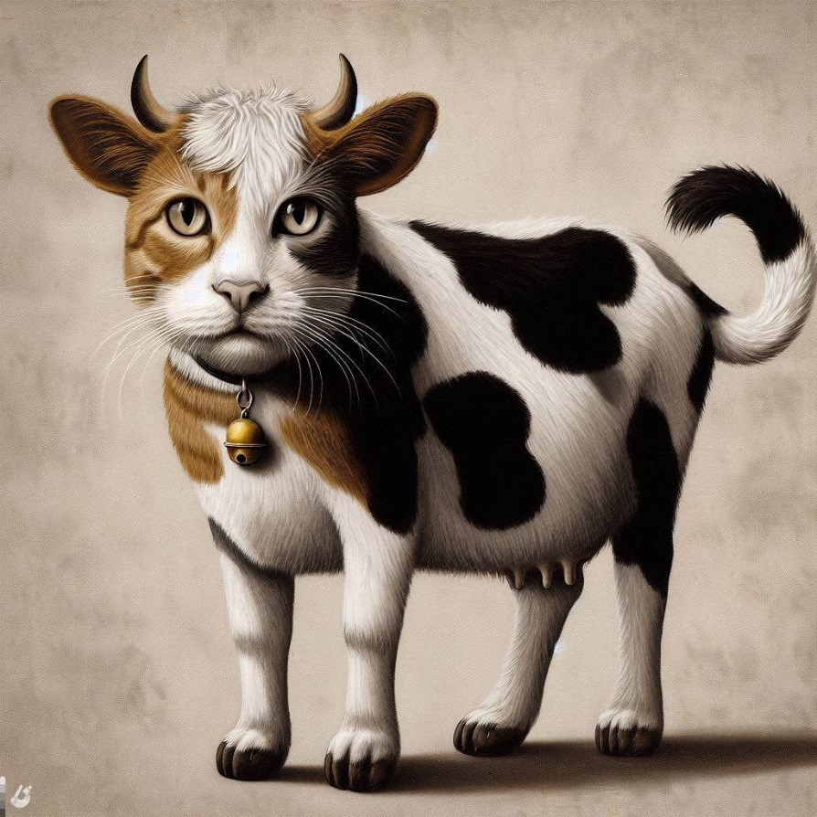
Ind-CoW

