Slide 1


Paper Processing Overview & Work Flows, and Editing Criteria
The plight of the Chief Editor
David Button
david.button@ansto.gov.au

Slide 2

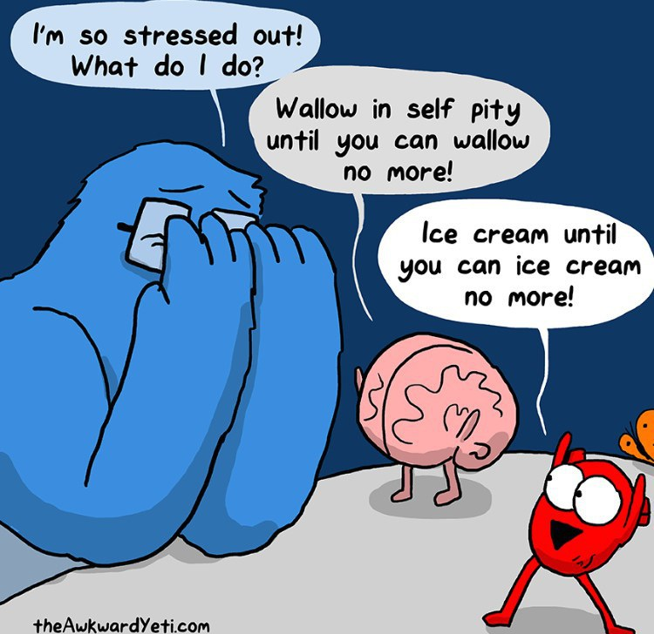

Tell Them What Your Going to Tell Them!
Existing Resources
Quality of your Proceedings
Roles
Time Lines and Activities
Basic Life Cycle of a Paper
  Setting Up Privileges
Understanding Your Work Load
Forming an Editorial Team
Introduction Talk
Proceedings Office Layout
Editing Papers
Monitoring Progress
Controlling Editing Criteria
Expectations

Slide 3

Some Disclaimers .1
I may repeat important details through my talk which maybe be covered in more detail later in this meeting by other presenters, or is already documented in the Wiki previously.

Slide 4
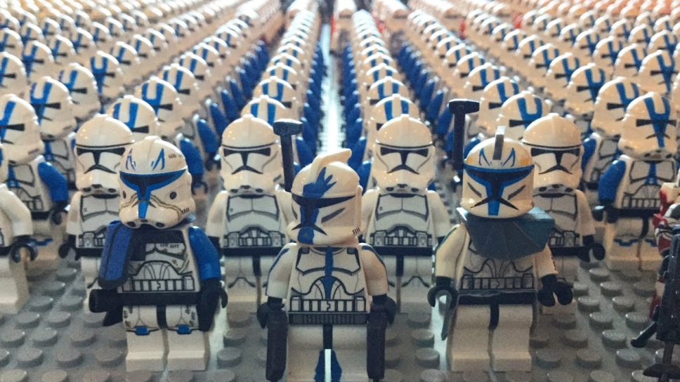
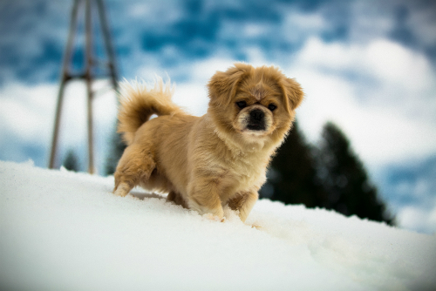

Some Disclaimers .2
This talk is biased towards IPAC conferences with a editor team “Clone Army” of approximately 26, but equally the underling base tools and procedures can apply to a “Lone Wolf” editor for a small conference.
Wednesday 5th December 2018 JACoW Team Meeting
16:00 | Speaker: Todd Satogata - Thomas Jefferson National Accelerator Facility
Scaling of Roles Tasks and Resources vs Size of your Conference

Slide 5
Some Disclaimers .3
I may repeat important details through my talk which maybe be covered in more detail later in this meeting by other presenters, or is already documented in the Wiki previously.

Slide 6


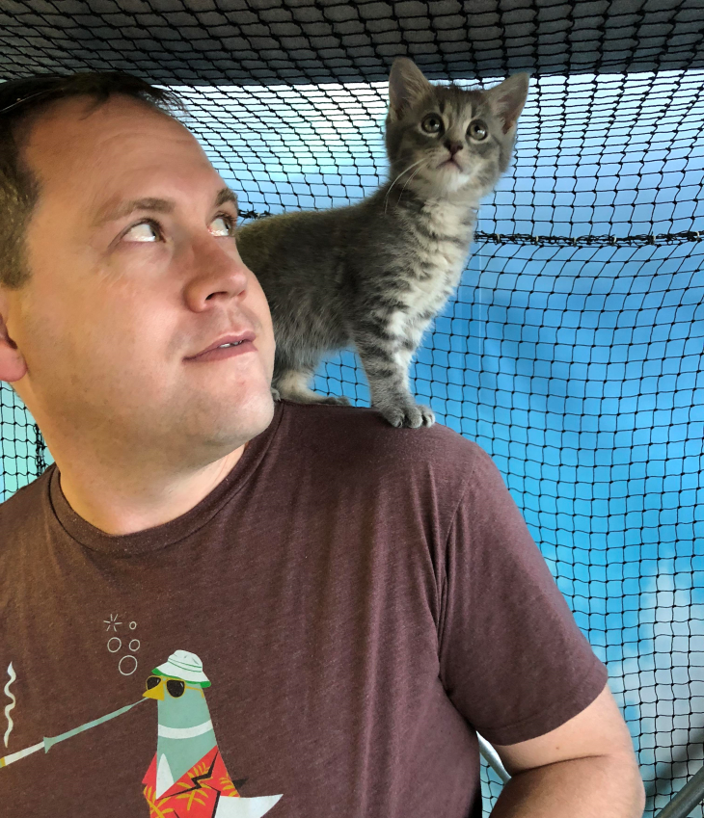

We Stand on the Shoulders of Giants!
Tools and procedures have been developed tested and reviewed over many iterations and we continue to build on the foundations the collaboration has established

Slide 7

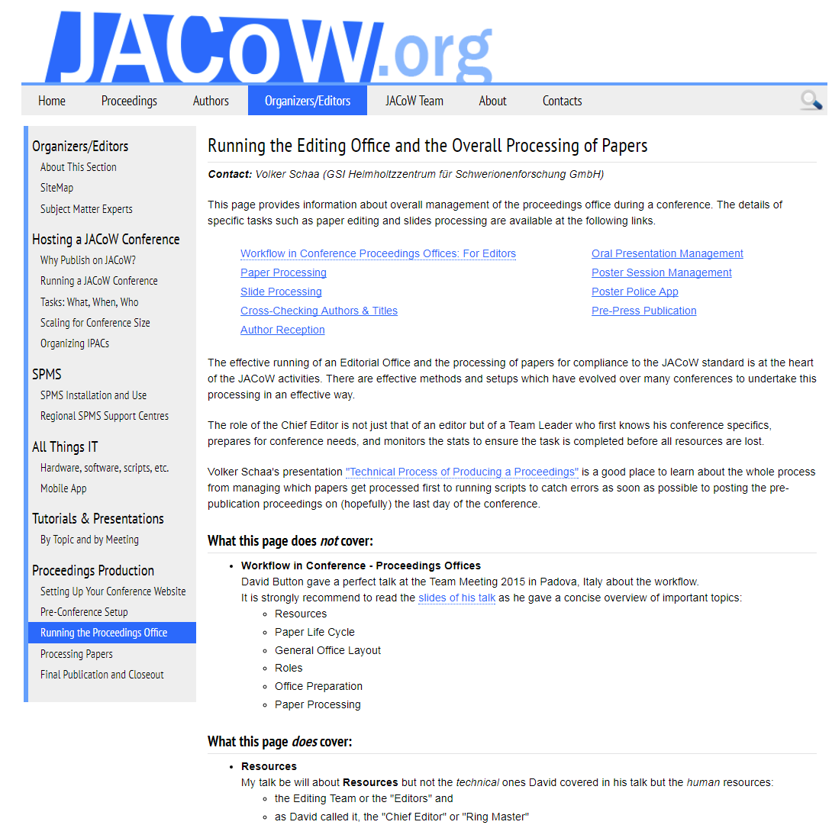

Existing Resources
Jacow.org/Editors/HomePage
Some things don’t need reinventing!
Tuesday, 4th December, JACoW TM 2018
Charlie Horak - Oak Ridge National Laboratory
Where to Get Help, and How to Work with the Wiki
Wednesday , 5th December, JACoW TM 2018
Christine Petit-Jean-Genaz - CERN
General Timelines, When and Who to do What

Slide 8
Existing Resources
Jacow.org/Editors/HomePage
Running the Editing Office and the Overall Processing of Papers (Needs Updating & Consolidation)
http://jacow.org/Editors/ProceedingsProduction
Running & Staffing Your Proceedings Office & Other Important Roles (JACoW 2017 TM)
Christine Petit-Jean-Genaz - CERN
http://www.jacow.org/JTM2017/RunningStaffingYourProceedingsOfficeOtherImportantRoles
Running the Editing Office and Processing of Papers(JACoW TM 2016)
Volker RW Schaa - GSI
www.jacow.org/JTM2016/RunningtheEditingOfficeandProcessingofPapers
Workflow in Conference Proceedings Offices : for Editors (JACoW TM 2015 [Dec])
David Button - ANSTO
https://www.jacow.org/uploads/Editors/TUC2A01_proceedings_workflow_editors.pdf
Workflow for Editors in the Proceedings Offices at JACoW Conferences (JACoW TM 2015 [Jan])
Ian Martin - Diamond Light Source Ltd
http://jacow.web.psi.ch/cgi-bin/conf/y15/tm2014/editor.zipdownload?paper_id=WEAA3&wanted_file=WEAA3_TALK.PDF&hcheck=C979B719B3ABF80340E955E8DC357808

Slide 9


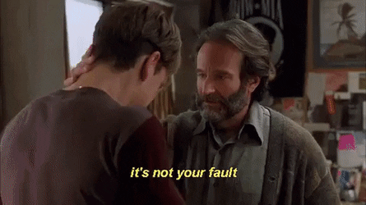
Quality of your Proceedings
You can produce proceedings only to a level that both resources and time allow. You must be pragmatic from the onset….
High Quality
Low Resourced
Low Quality
High Resourced

Slide 10

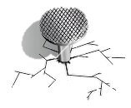
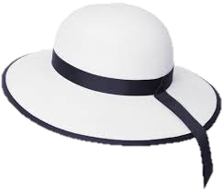



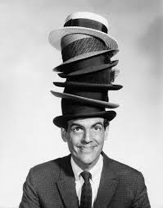

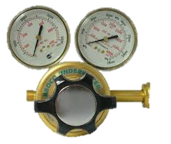



Roles
Tuesday 4th December 2018 JACoW Team Meeting
11:45 | Speaker: Todd Satogata - Thomas Jefferson National Accelerator Facility
General Overview of Running a JACoW Member Conference & SPMS’s Role
Wednesday 5th December 2018 JACoW Team Meeting
11:00 | Speaker: Christine Petit-Jean-Genaz - European Organization for Nuclear Research
General Timelines, When and Who to do What
Core Editor
16:00 | Speaker: Todd Satogata - Thomas Jefferson National Accelerator Facility
Scaling of Roles Tasks and Resources vs Size of your Conference
Trainee Editor
IT Support
Quality Editor
Presentation Processor
Chief Editor

Slide 11
Time Lines and Activities (BC)
jacow.org/Editors/Tasks [General Timelines, When and Who Does What] (Subset)
jacow.org/Main/Timeline
Action | C-
Request an SPMS Instance, set parameters, import classifications from previous instance | C-24-20
Composition of OC/SPC/LOC decided and entered in SPMS with privileges and roles | C-24-20
SPC decides Main and Sub-classifications, SPMS customisation and invited oral presentations | C-14
Conference Announcement and Call for Papers via SPMS | C-9
Deadline for Abstract Submission | C-5
Invite Editorial Staff (Core Editors, Editors, Paper Reception, Poster Session Managers, Presentations Management) | C-4
Publish the guidelines for the preparation and upload of papers and inform authors, remind concerning registered presenters Set up a pc with all software required for Editors, and clone to several pcs | C-3
Clone software setup to all pcs to be installed in Proceedings Office | C-2
Write to all contributors to warn of deadline for registration Check there is a registered presenter to for ALL contributions (policy is that to be scheduled for presentation each contributions must have a registered presenter). Write to all primary authors where there is uncertainty. If necessary, withdraw contributions that cannot be presented. | C-2 – 1.5
Enable upload of submissions via Upload Server | C-1.5
Write to Contributors to announce programme codes, remind of deadline, etc. | C-1
Deadline for submission of papers for light peer review | C-21 days
Deadline for paper submission | C-5 days
Editors begin processing at venue | C-4 days

Slide 12

Time Lines and Activities (C-5 to C+5)
When Known
Setup editor privileges for all staff
Wednesday BC C-5
Assist with venue IT Setup, bump-in
Thursday BC C-4
Welcome team, give talk about work ahead
Day after upload deadline email all outstanding authors to immediately upload
Sunday BC C-1
Welcome learn and second wave of staff, tour facilities
Start education of new editor
JACoW team and LOC thank you dinner
Monday C
Commence slide processing staff on presented slides
Milestone check 80% edited
Commence selected QA staff
Wednesday C+3
Email yellow dot Authors login to SPMS and review the edits and accept or reject, set deadline of Thursday lunchtime
Instruct core editor to start clearing red dots
JACoW stockholders meeting
JACoW team meeting planning meeting
Thursday C+4
After lunchtime convert all yellow dot papers to green dot status ready for QA
Provide feedback slides to conference review meeting
Friday C+5
Complete QA
Produce pre-press
End of conference presentation and thank you for JACoW team
Chief Editor List
General Timelines, When and Who Does What
Christine Petit-Jean-Genaz
http://jacow.org/Editors/Tasks

Slide 13
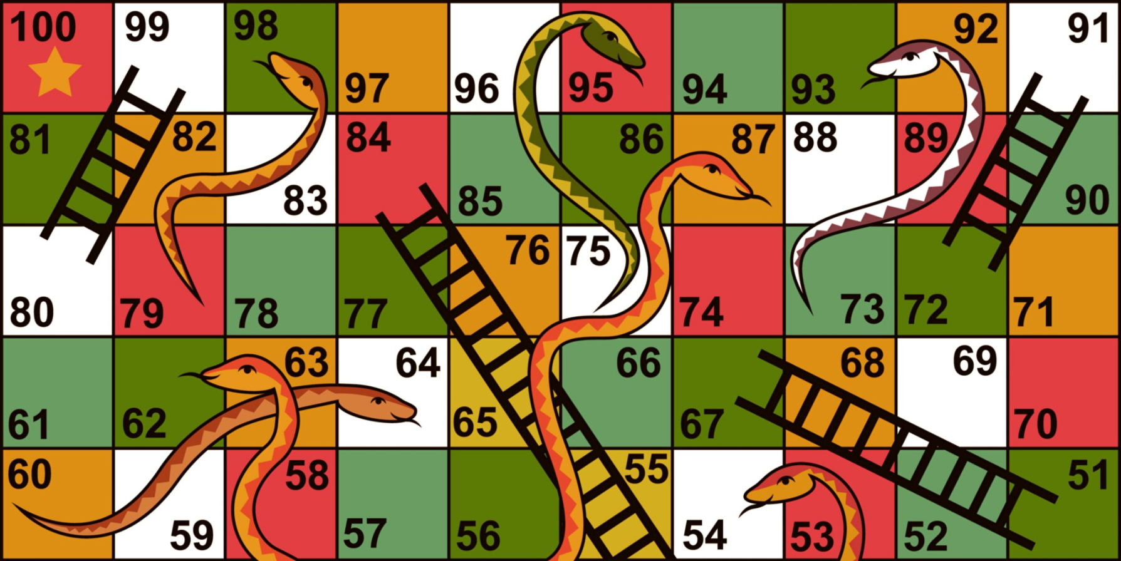


Basic Life Cycle of a Paper
Click into here
How Have we Gotten to Here?

Slide 14
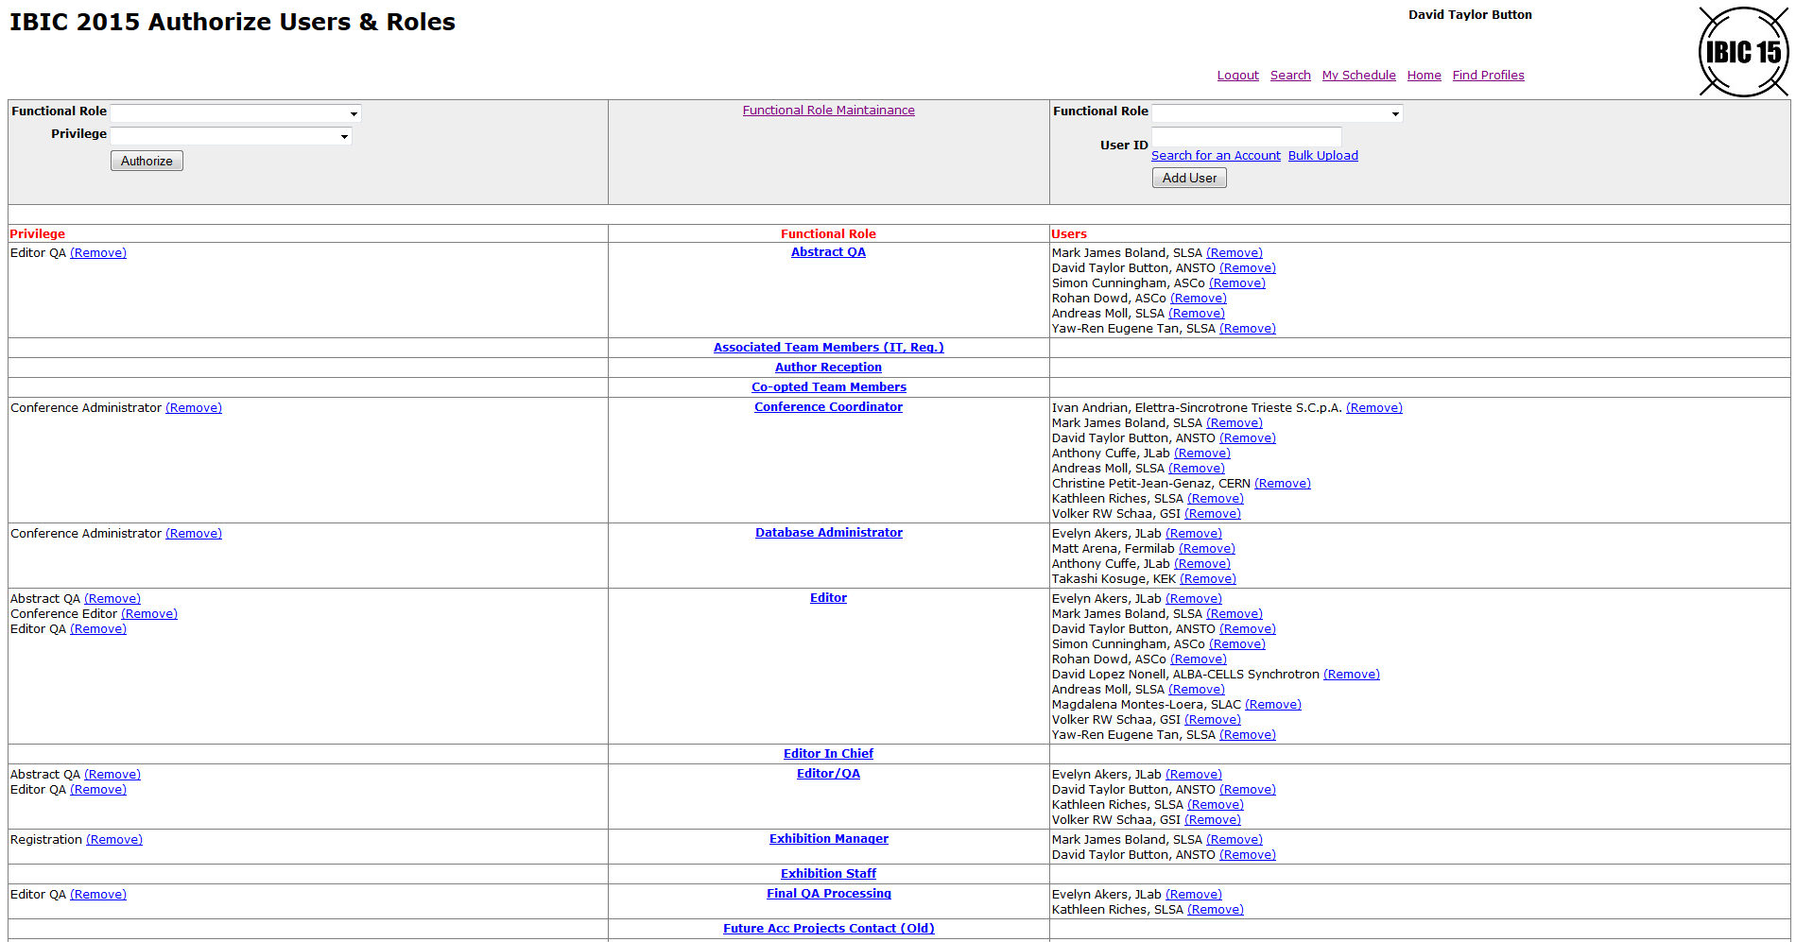
Setting Up Privileges
/authorize.html

Slide 15





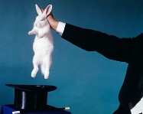
Basic Life Cycle of a Paper
Chief Editor
Programme Committee
Scientific Secretariat
Author
Author Submits Abstract
Approve Initial QA
Schedule
Assign Paper Codes
Upload Paper & Source Files
File Server
PDF, Source Files, etc..
Auto Distil PDF’s
BC
Status
C
Initial Status
PC
Editors
Upload Processed & Set Status
Download Preform Edits
Proceedings
Status
Status
Status
Accept or Reject Changes
Make Correction
Upload
Status
Status
Paper Final QA
Author/Title Check

Slide 16
Understanding Your Work Load
Papers
Volker publication statistics?

Slide 17
Forming an Editorial Team
* Be careful this is only
papers/editors, not the
work days

Slide 18
Forming an Editorial Team
* Be careful this is only
papers/editors, not the
work days
Added 4th Page for References
References
Take
More Time

Slide 19
Forming an Editorial Team
Papers
% Papers

Slide 20
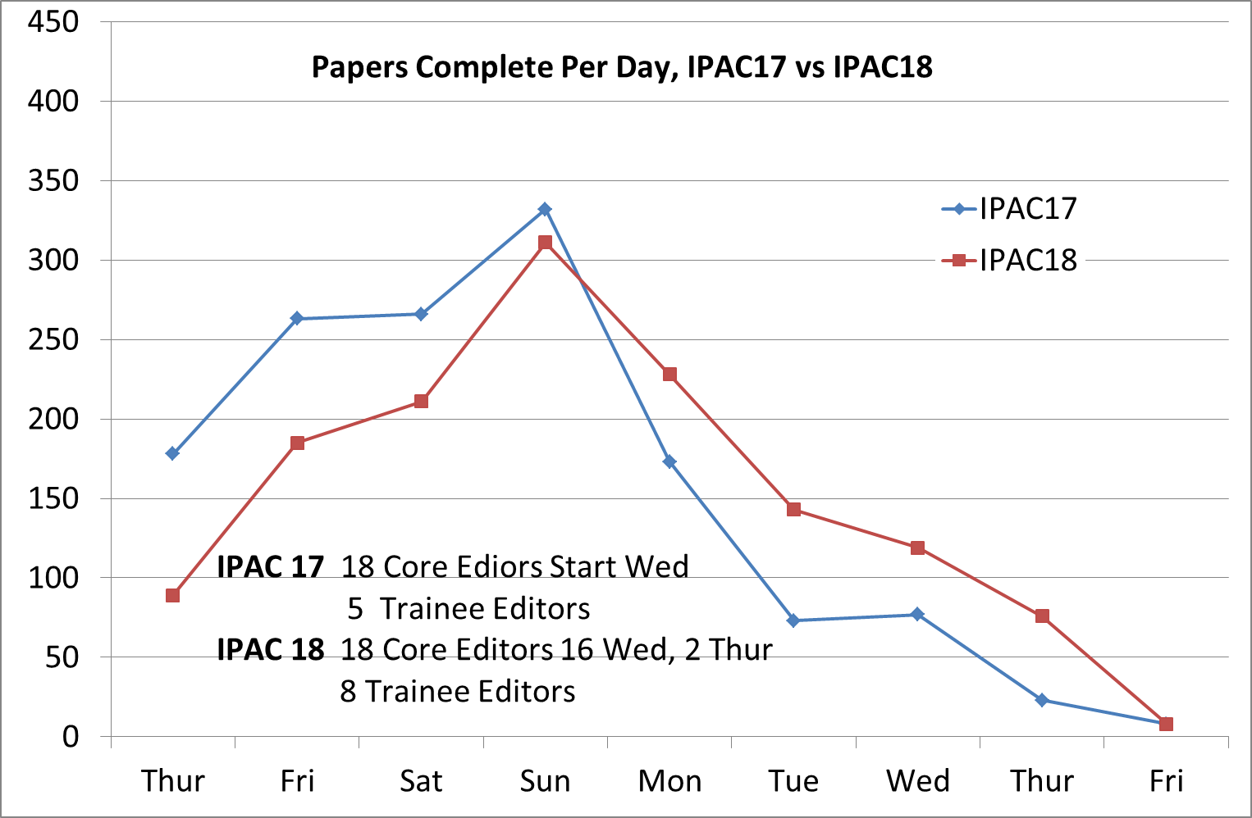
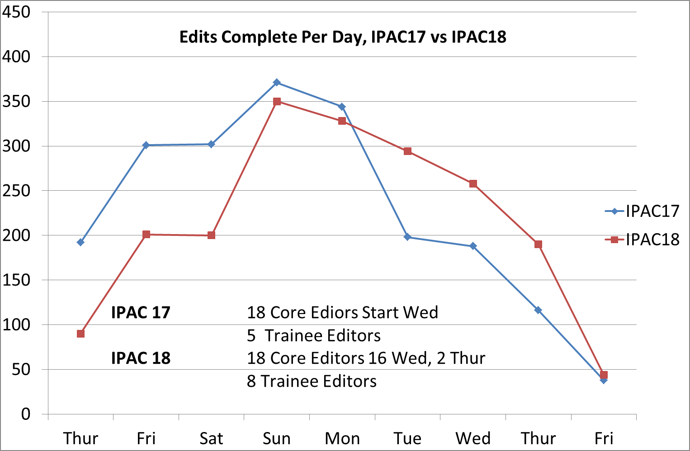
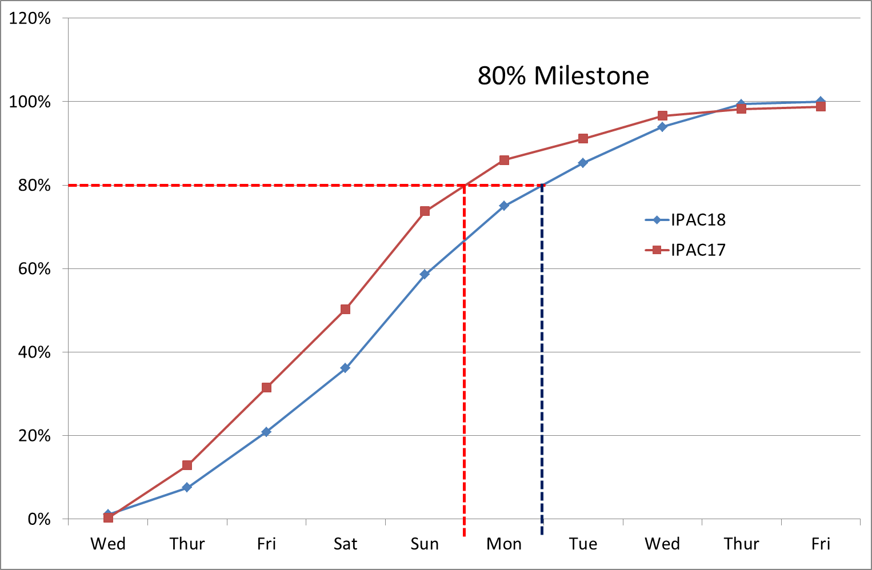
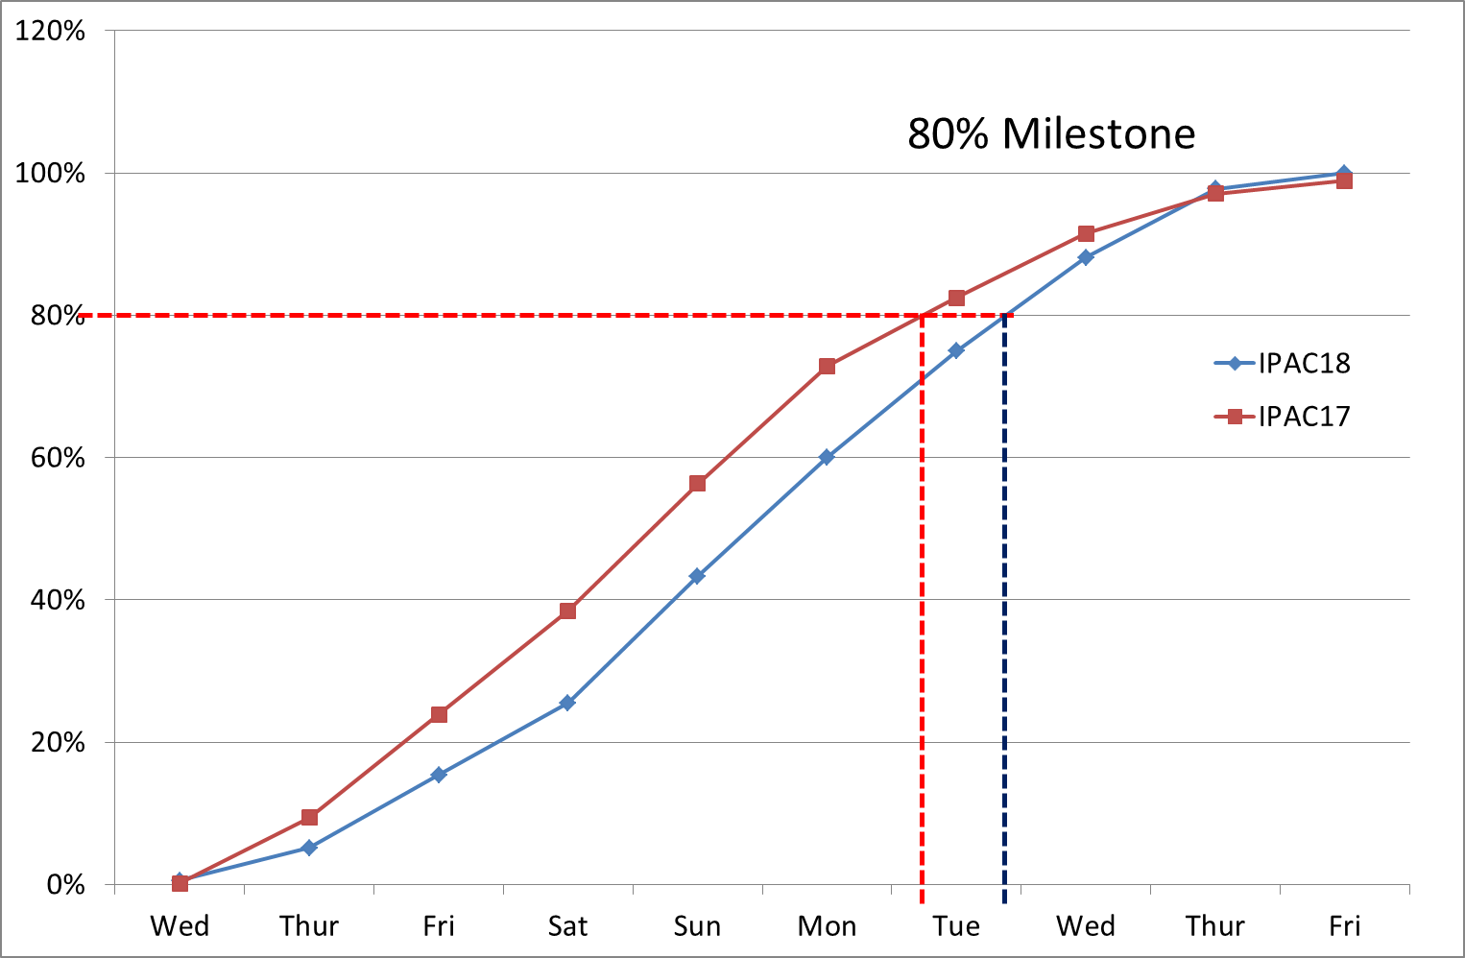
Forming an Editorial Team

Slide 21
Forming an Editorial Team
Consider who you move onto QA and when, but lets talk about this more later!
Papers Edited at IPAC
Ranking
Thanks Todd ☺

Slide 22
Forming an Editorial Team
Running & Staffing Your Proceedings Office & Other Important Roles (JACoW 2017 TM)
Christine Petit-Jean-Genaz - CERN
http://www.jacow.org/JTM2017/RunningStaffingYourProceedingsOfficeOtherImportantRoles
How many staff doing what?
Old semi-scientific calculation (a more scientific one was produced by Jan Chrin at an earlier Team Meeting):
The number of papers to be processed will be approximately 80% of the number of contributions submitted on abstract submission
80% of the 80% needs to be processed during 3 days pre-conference processing by the "core" team estimate an average of 35 papers per day per experienced editor during pre-conference processing
An example with 1000 contributions:
80% of 1000 - 800 contributions to process in total
80% of 800 - 640 papers to be processed in 3 days
640 divided by 3 days = 213 papers to be processed per day 213 divided by 35 (average number of papers per editor) = around 6 pre-conference editors for pre-conference processing
IPAC17 and IPAC18 have increased the processing work load and the level of adherence such that this number to divide the number of papers by has shifted from 35 to 20

Slide 23
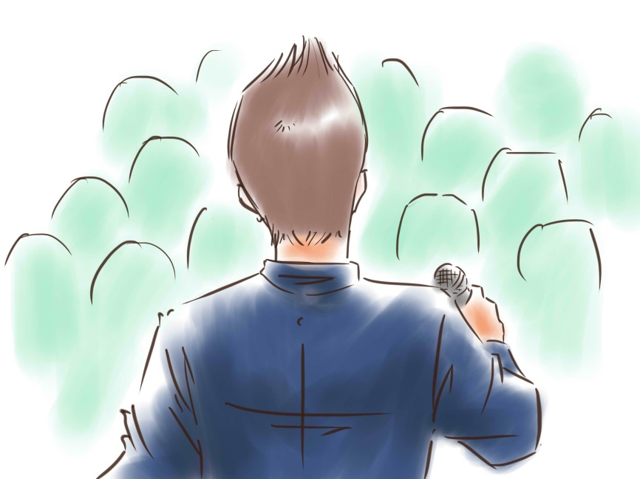
Introduction Talk (C-1)
Suggested Points to Cover
Introductory Talk
Introduce all team members
Familiarise with facilities
Identify support staff
Give overview of work volume
Give review of process and any variances
Give guidance and direction on standards
Give expectation of progress to achieve outcome
Identify who will give help, and make final call
Access and working hours
Advise of any social events
Thank them and their institutions
Answer any questions

Slide 24


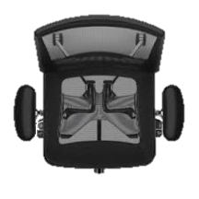



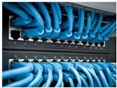
Proceedings Office Layout
Snacks + Drinks
Notice Board
Ethernet
Web Access
Windows
With View
Coffee Tea Facilities
Paper Trays
Red, Yellow, Green,
Blue QA Pass
General Stationary
Printer and Supplies
eDot Display

Slide 25
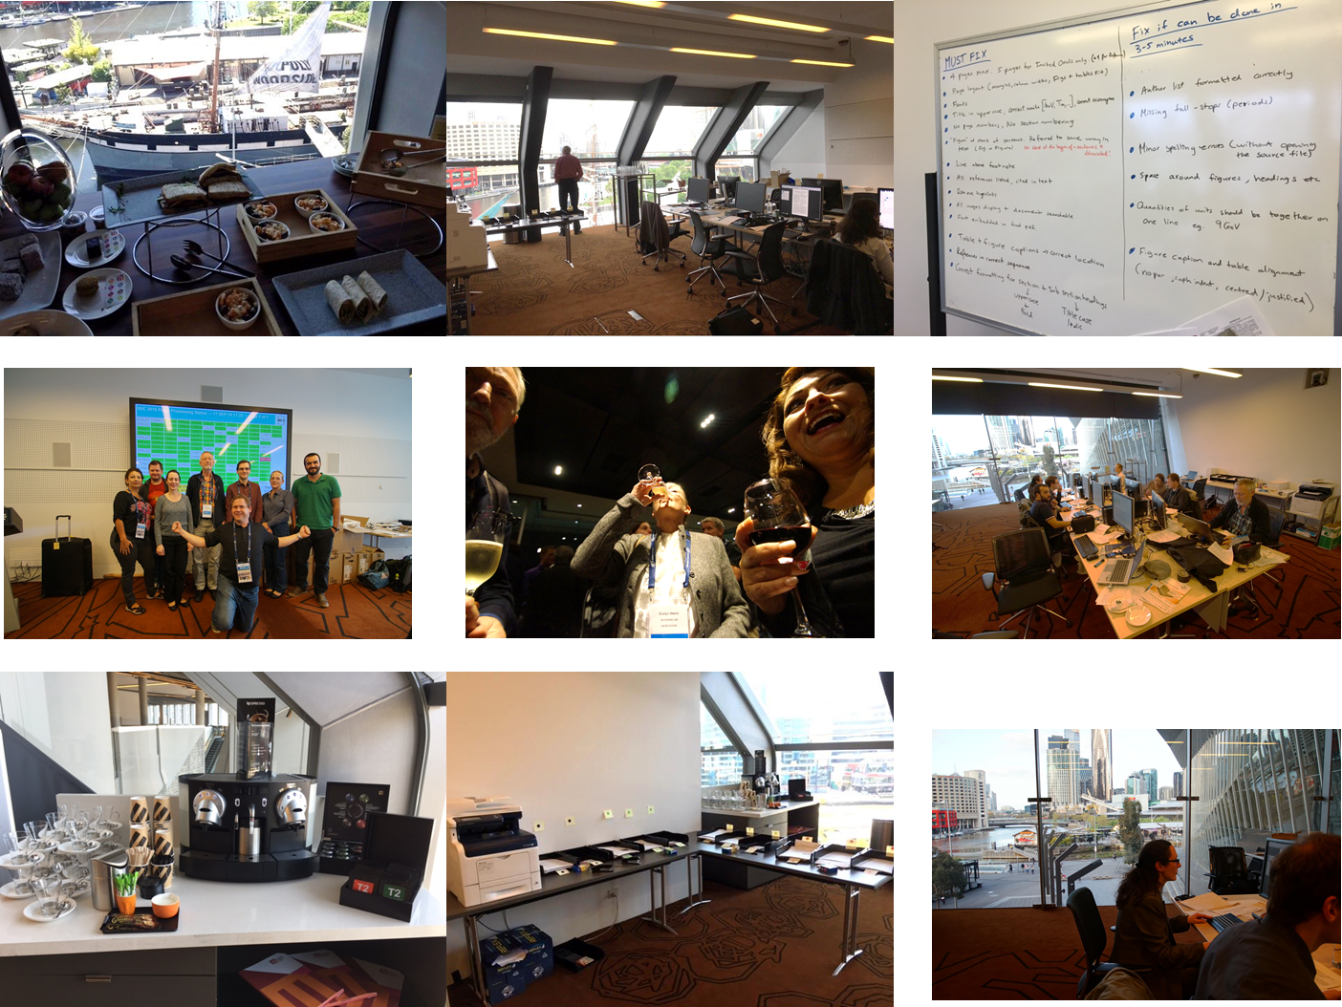
Proceedings Office Layout

Slide 26








Editing Papers
Types of Papers
  Word Documents
  Latex Documents
  Open Office
  PDF
Platforms
  Intel / Windows
  Macintosh
  Linux
http://jacow.org/Editors/BasicPaperProcessingProcedure

Slide 27
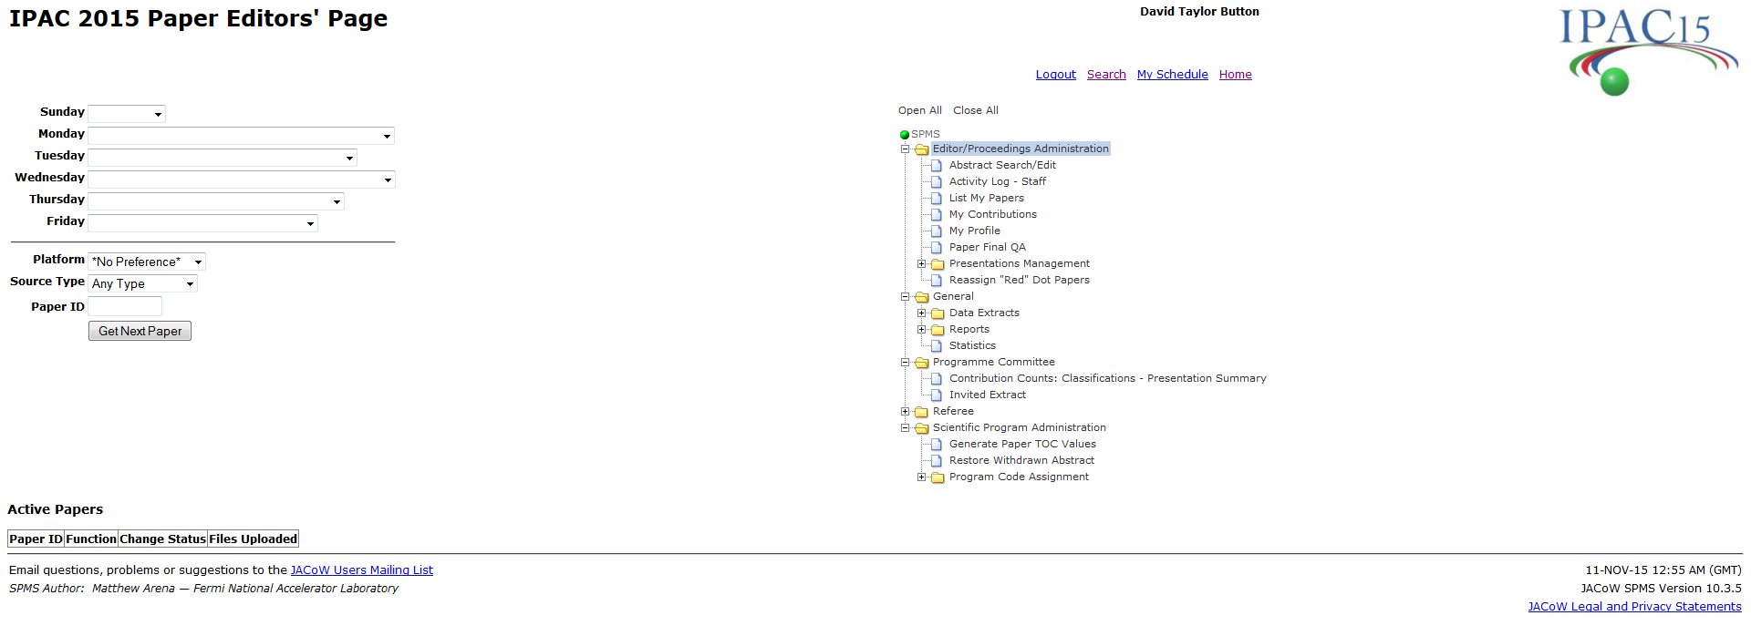
Editing Papers
/editor.html
Make sure Editors have selected platform and source type that they are familiar with

Slide 28
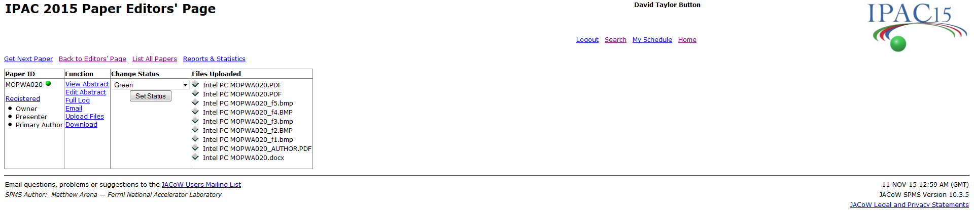
Editing Papers
3
2
1
Steps
  Download Preform Edits or Just Inspection, Rename
  Upload New File/s
  Set Status
  Note: All Papers assigned to an editor can be listed by selecting “List All Papers”.

Slide 29
Editing Papers
3
2
1
Steps
  Download Preform Edits or Just Inspection, Rename
  Upload New File/s
  Set Status
  Note: All Papers assigned to an editor can be listed by selecting “List All Papers”.

Slide 30
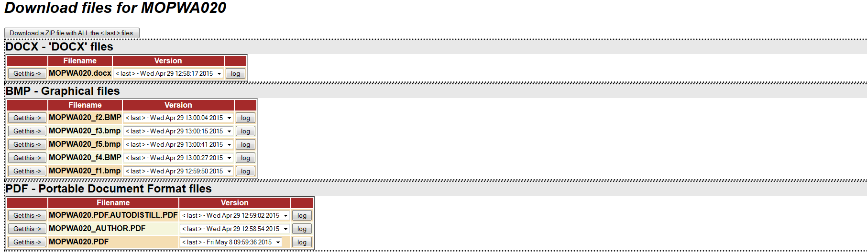
Editing Papers
Steps
  Download Preform Edits or Just Inspection, Rename
  Upload New File/s
  Set Status

Slide 31
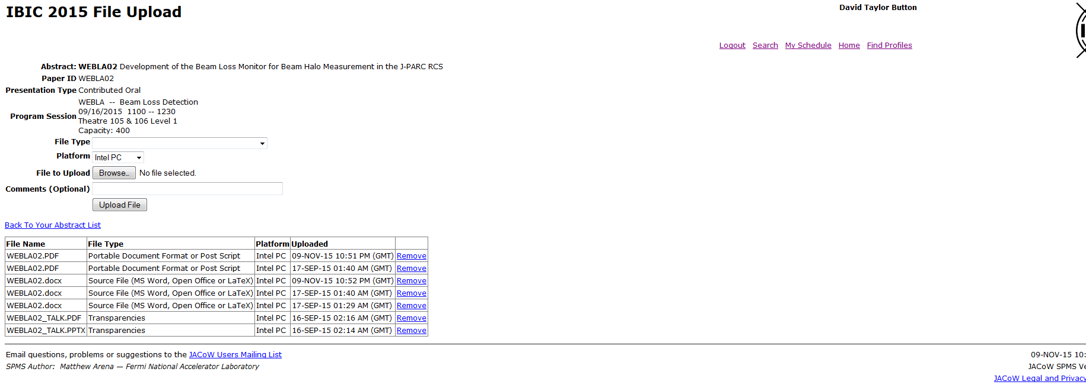
Editing Papers
Select File Type, Platform, Browse, Upload
Steps
  Download Preform Edits or Just Inspection, Rename
  Upload New File/s
  Set Status

Slide 32
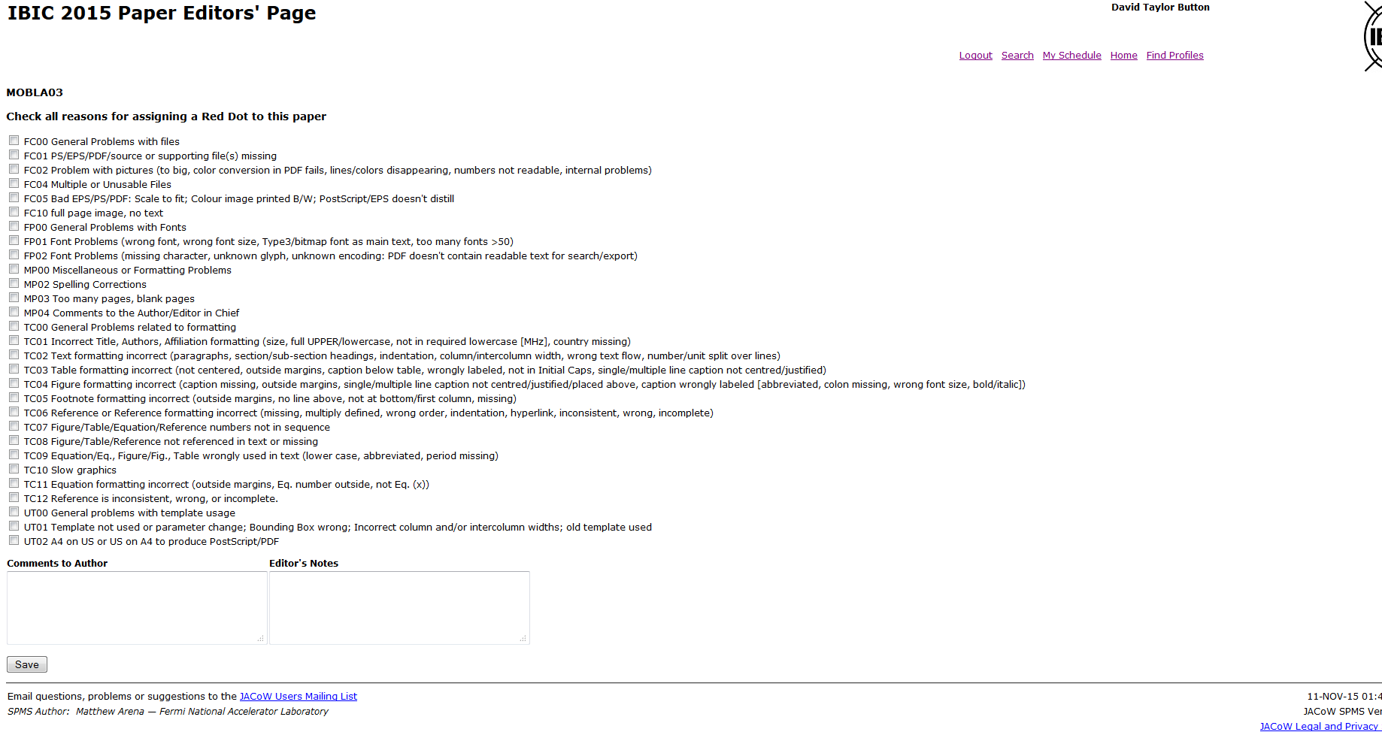
Editing Papers
Steps
  Download Preform Edits or Just Inspection, Rename
  Upload New File/s
  Set Status
Tick relevant error codes, write comment to author, and any hidden comment to team, click save

Slide 33
Editing Papers Transparencies
Slide Processing
  This is a dedicated role and requires an editor to be familiar with the process of splitting animations, creating screen videos of complex animations, and embedding videos into PDF documents.
  This topic is best to refer to “Processing Talks” on the jacow.org website.
  Possessing Slides http://www.jacow.org/JTM2016/ProcessingTransparenciesEmbeddingAnimations
Thursday 6th December 2018, JACoW TM 2018 Cape Town
09:30 | Speaker:Jan Chrin - PSI on behalf of Michaela Marx- DESY
Processing Transparencies, An Update

Slide 34
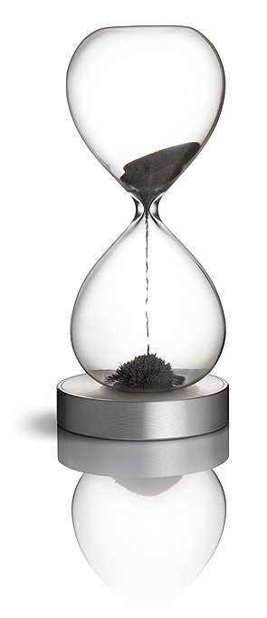
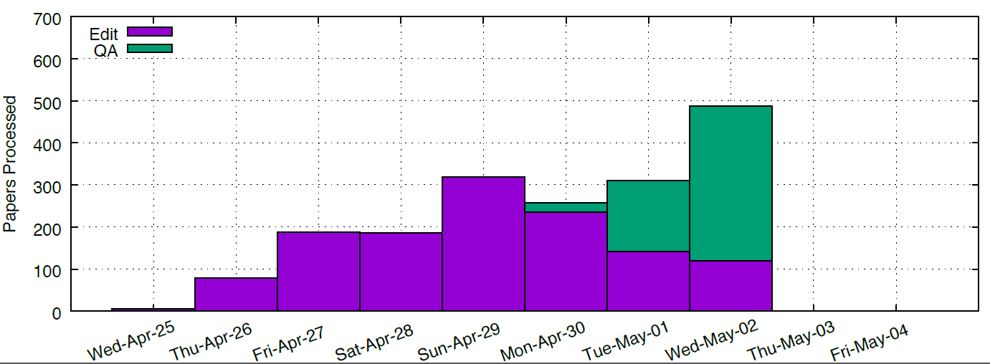
Monitoring Progress
Monitoring and Directing

Slide 35
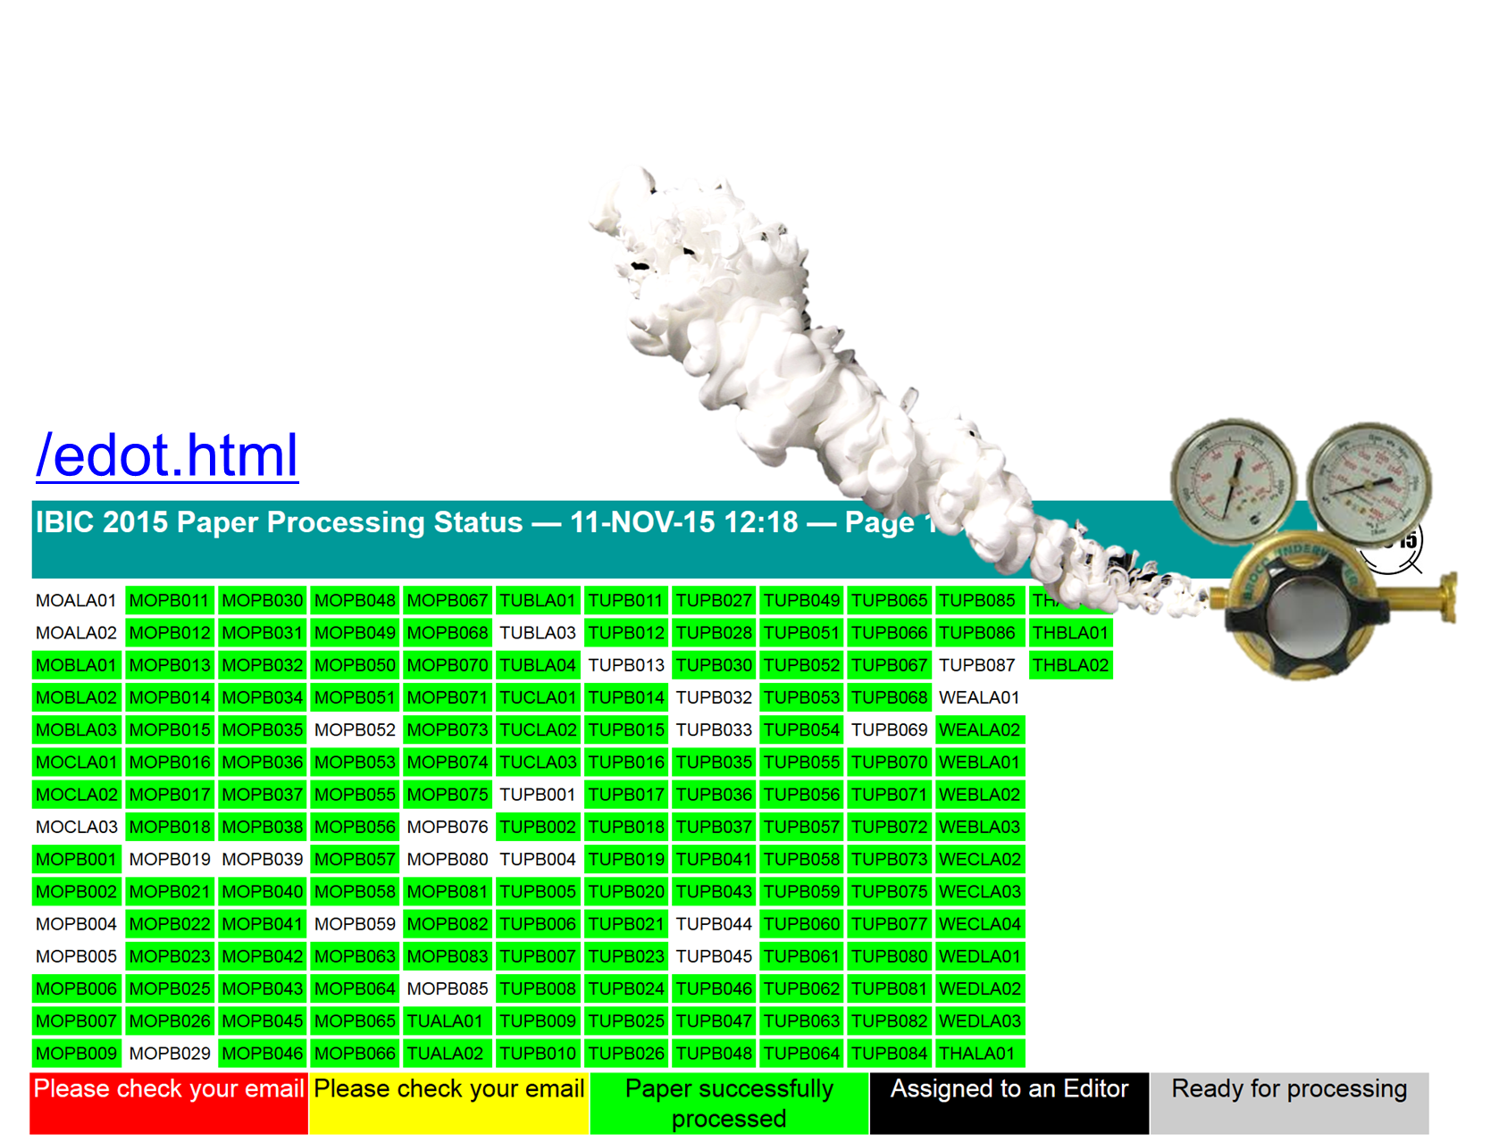
Monitoring Progress

Slide 36
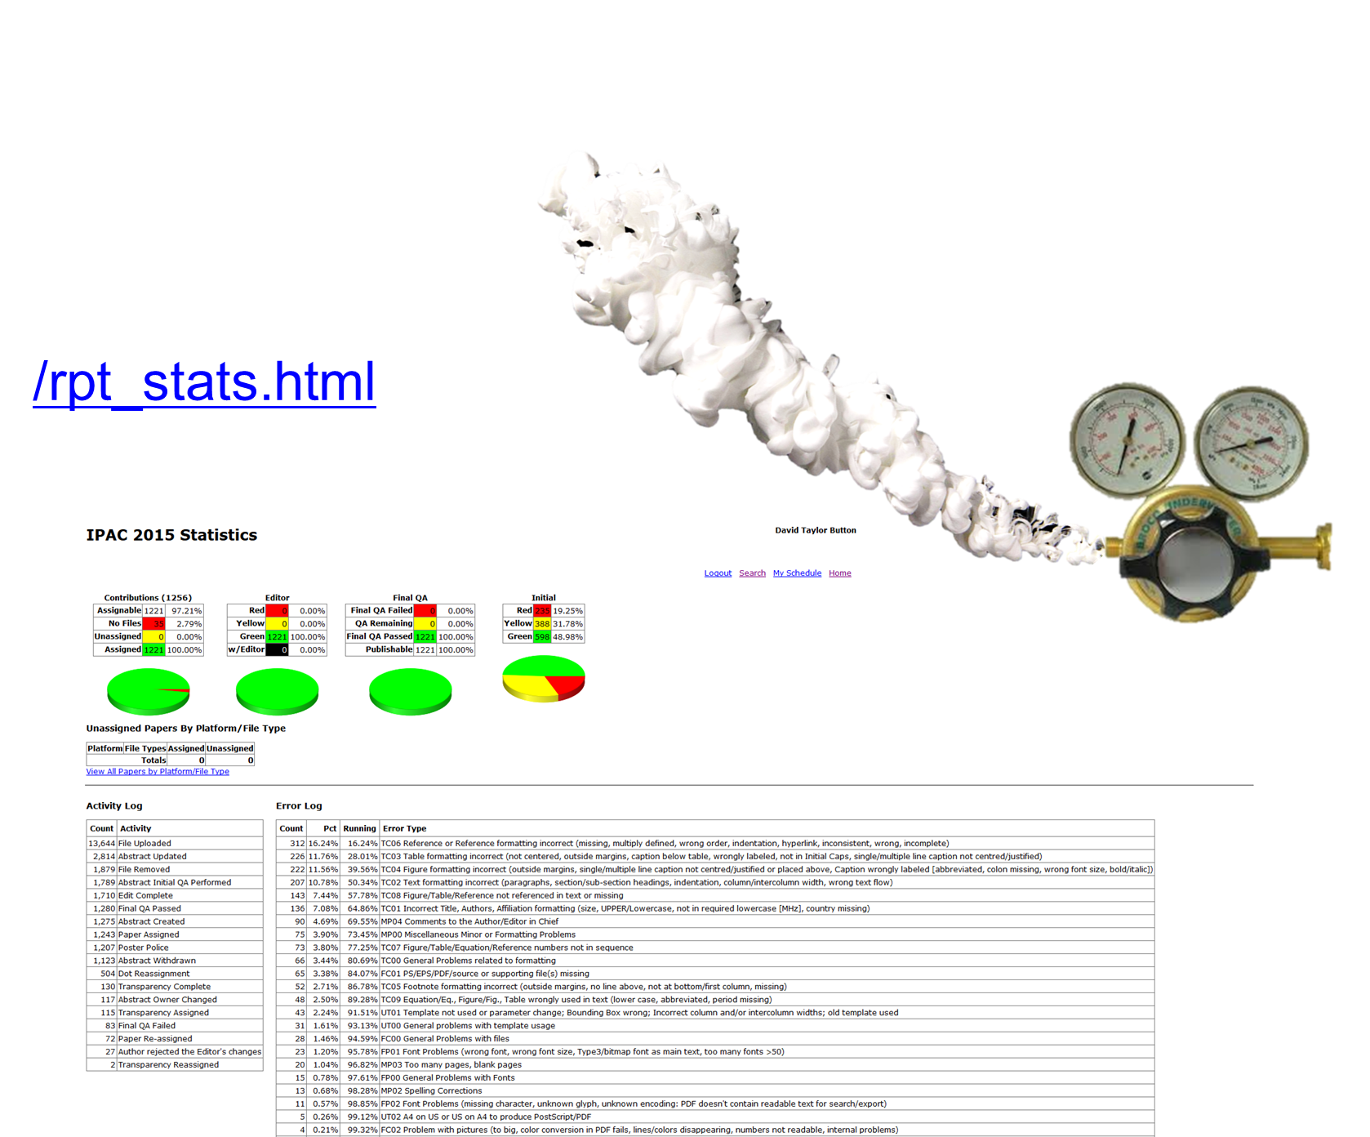
Monitoring Progress

Slide 37
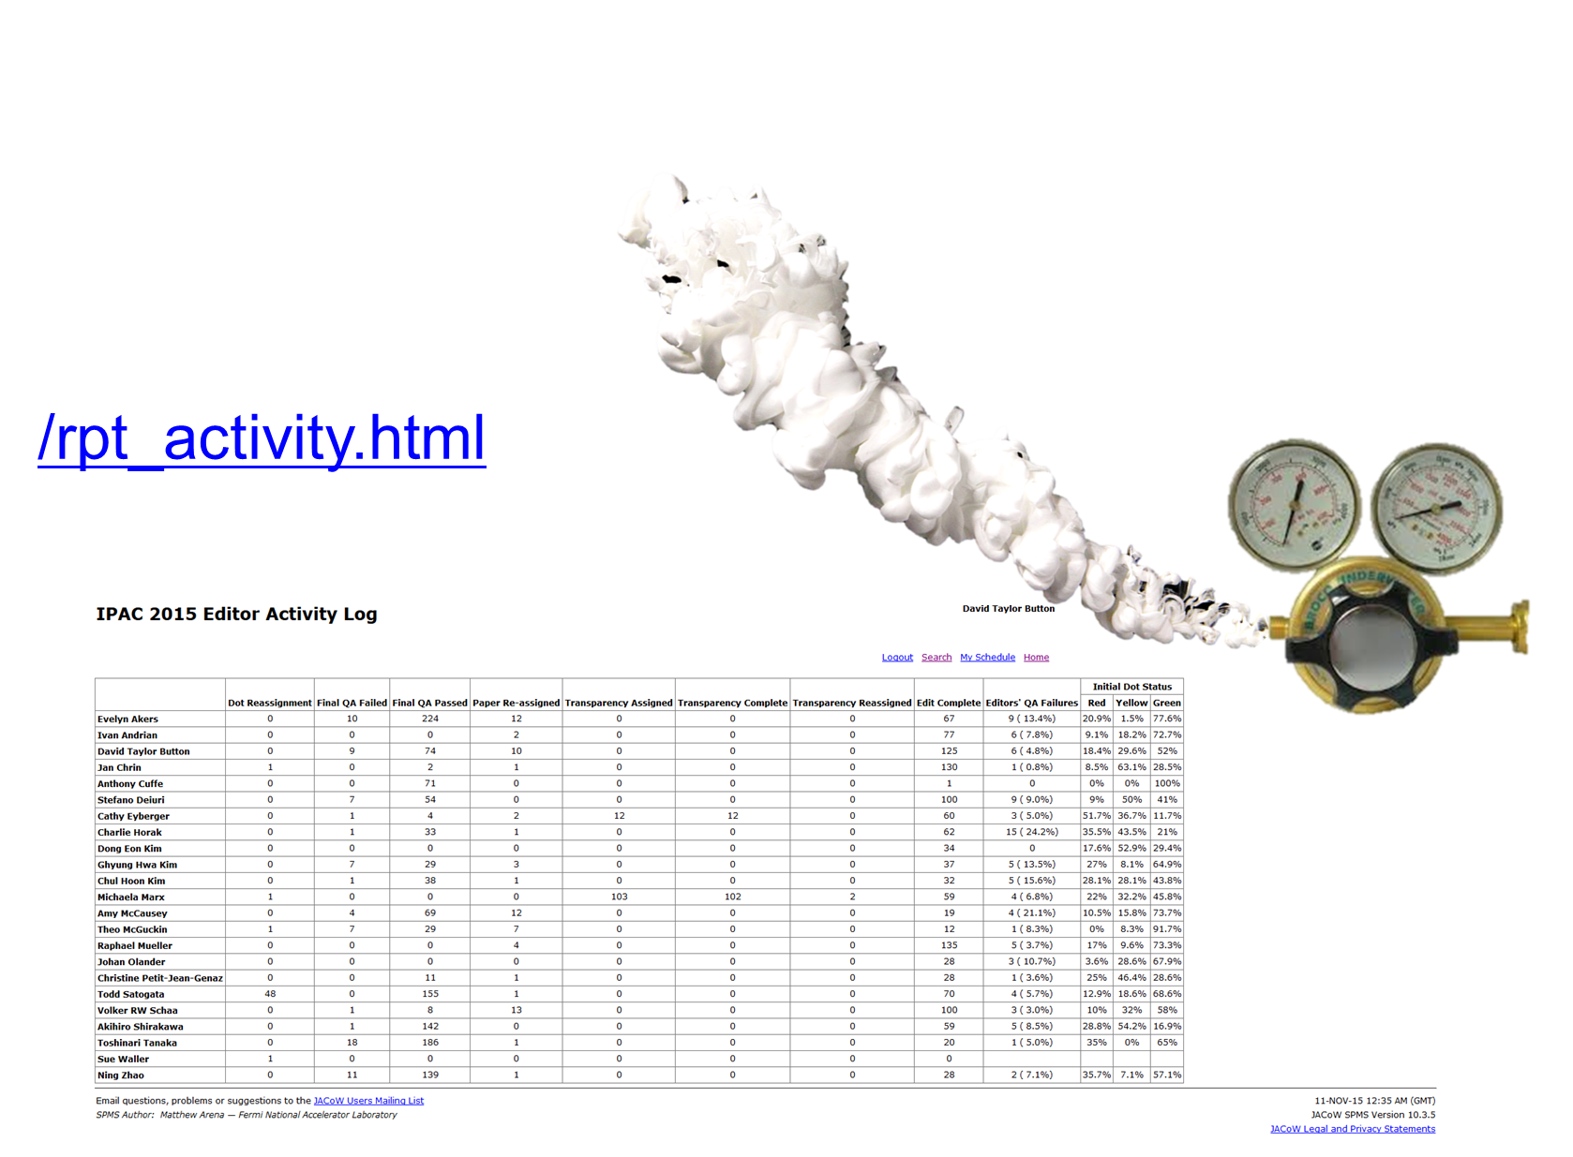
Monitoring Progress

Slide 38
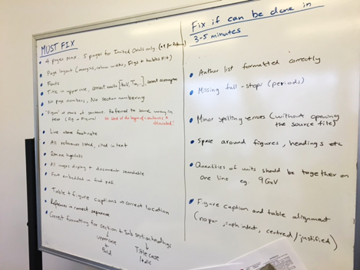


Controlling Editing Criteria

Slide 39
Controlling Editing Criteria
QA
Edit
Ian Martine Scale: from Diamond Light Source
Referenced Todd Satagata TM 2012 THAA2, Referenced Jan Chrin TM 2011 WEAC01

Slide 40
Controlling Editing Criteria
Must have for JACoW, i.e. the basic JACoW constraints
Level 0 : non-negotiable
Must have for the Conference, i.e. essential (conference) editing
Level 1 : minimalistic [if missing after edit, QA Fail]
Would be nice to have for the conference, i.e. desirable editing
Level 2 : pragmatic [if missing after edit, QA Pass]
In an ideal world would have, i.e. full adherence to template
Level 3 : pedantic [if missing after edit, QA Pass]
Ian Martine Scale: from Diamond Light Source
Referenced Todd Satagata TM 2012 THAA2, Referenced Jan Chrin TM 2011 WEAC01

Slide 41
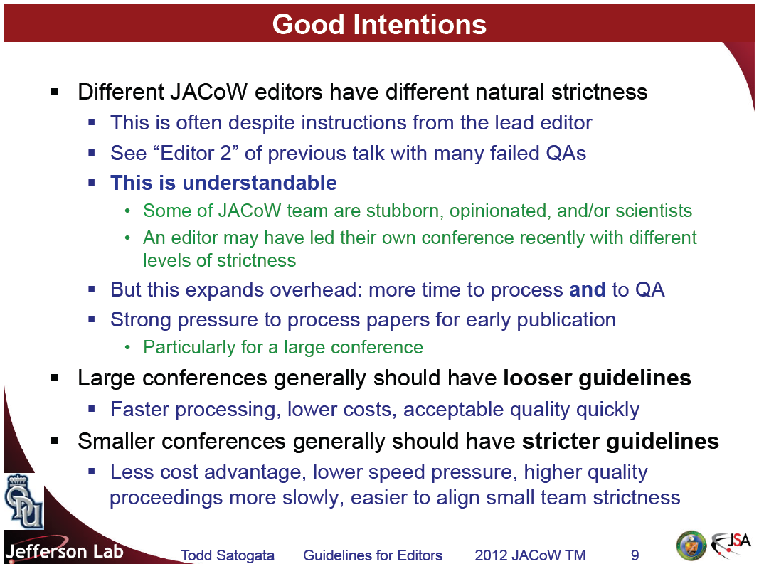
Controlling Editing Criteria
Todd Satagata TM 2012 THAA2
http://accelconf.web.cern.ch/AccelConf/JACoW/TM_2012_IFIC/TM2012/talks/thaa2_talk.pdf

Slide 42
Expectations
Support of external Labs is a de-facto sponsorship of your conference and should be appreciated and treat the staff well
Expect staff to be jet lagged on arrival
If you are invited editor please be mindful that you have an obligation to contribute and be fit a ready to work during standard hours
Must editorial offices normally open doors by 8:00am and look at closing doors anywhere from 5:00 – 6:00pm
At least plan from the onset to give your long stay editor half a day break if possible
Everyone is all on the same team, enjoy your time, and celebrate your accomplishment when you achieve your goal

