Slide 1
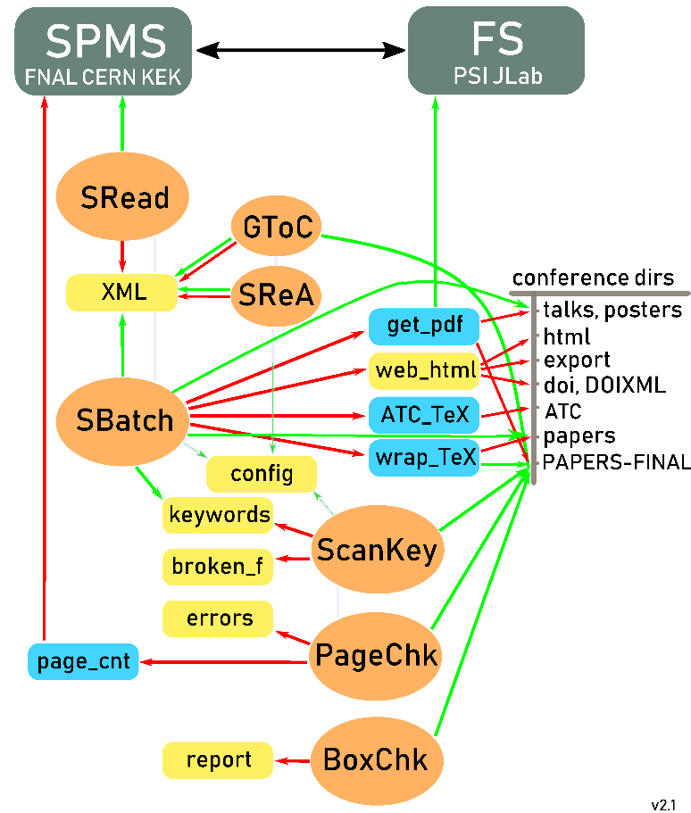
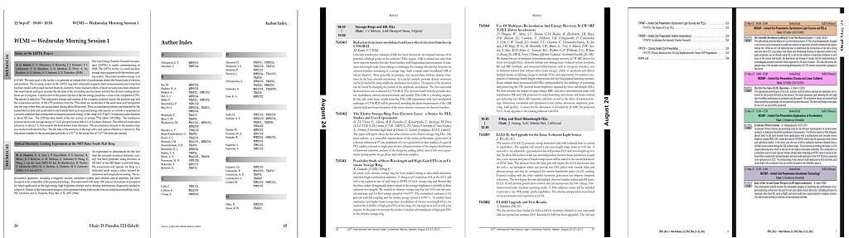
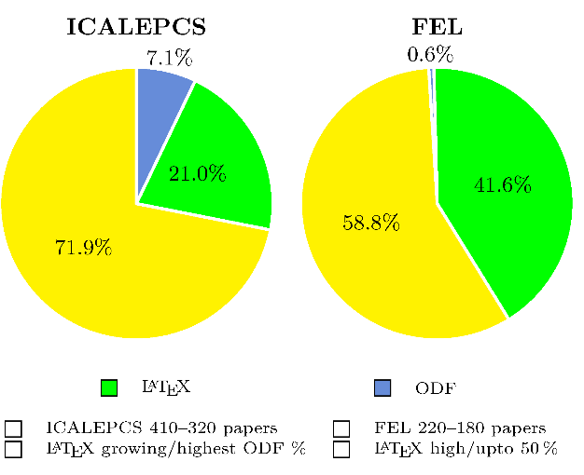
Scripting Overview
Prior/During/Post Conference
Trends in Submission Formats
Volker RW Schaa
GSI, Darmstadt, Germany
Team Meeting 2018 — Capetown, South Africa
04 Dec 2018

Slide 2
Overview
Coverage
This presentation will list the different tasks
accomplished using JPSP before, during and after the
conference. In addition actual trends of file type
submission for various conferences are shown.
  Introduction
  Pre-Conference
  During Conference
  Post Conference
  Submission Trends

Slide 3
Introduction
JPSP
JACoW Proceedings Script Package
development started 2002
first conferences: DIPAC’03, LINAC’04 and EPAC’04
name JPSP since 2006
actual version 28.3 (25 Nov 2018)
15'681 lines of Perl code

Slide 4
Installation
All tools and actions are based on an XML data export from instances
of SPMS. For downloading and extracting of information from XML the following tools and some additional files are used/needed and have to be present to use the scripts.
Utility installation
Perl, T_{E}X, PDFtools, JPSP, (curl), etc.
JPSP configuration
directories, URLs, editorial board, ISBN, SPMS passwords, ...
others
collecting logos, images for proceedings web site, ...

Slide 5
Scripts in JPSP

Slide 6
Pre-Conference
Abstract Checks
  checking ‘funny’ symbols/characters seen in SPMS,
  how they are treated using the scripts
  control of unwanted character conversions
  (108 MHz -> 10⁸ MHz, TEM_10 -> TEM₁₀, etc.)
Generating an Abstract booklet
  selecting a format (size, binding, …)
  sequence of posters
    ordered by date/session or
    posters after orals
  color setting according to synoptic table

Slide 7
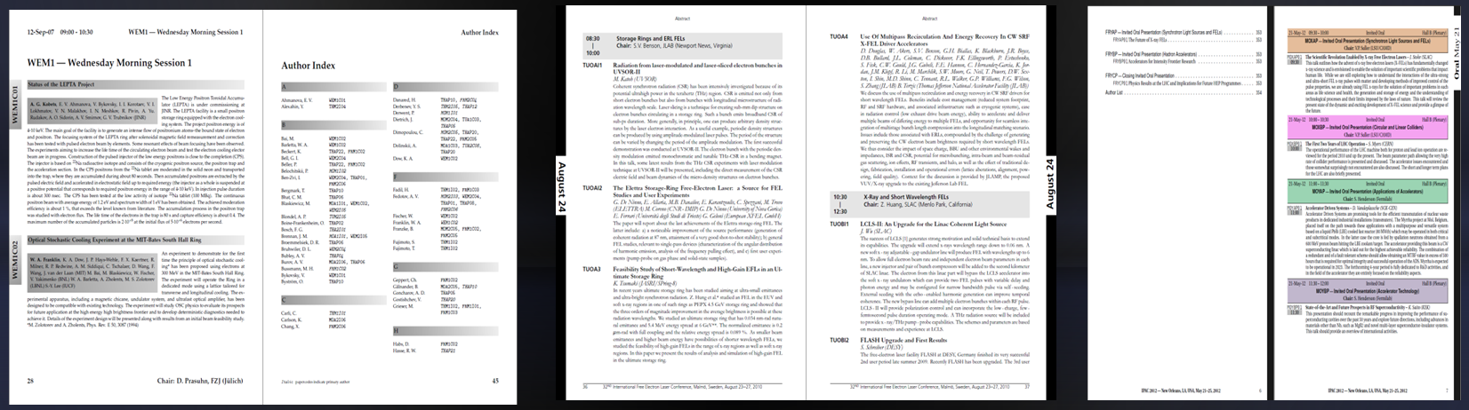
Pre-Conference
Generating Abstract booklets (selecting a format)

Slide 8
During Conference
Daily reports distributed to editors about
  "page checks" (bounding box, font embedding, etc.)
  "broken papers" (encoding issues do not allow full text search)
  "tearing boxes" (less critical these days but should be checked)
  "ATC" (Author-Title-Check)
  Author accepted YELLOW dot paper, but requests changes*
  Author rejected changes**
  Editors can only check their YELLOW dot papers by reading the SPMS log
  * only for privileged users/done by Editor in Chief
  ** done by Editor in Chief/Administrator gets the email

Slide 9
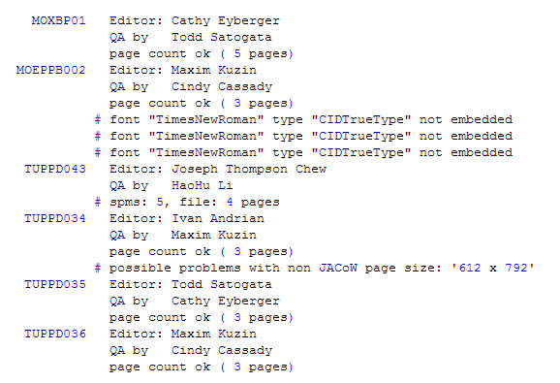
During Conference (cont.)
Daily Reports reported by page_check.pl
page size, font embedding, page numbers, too may fonts...

Slide 10
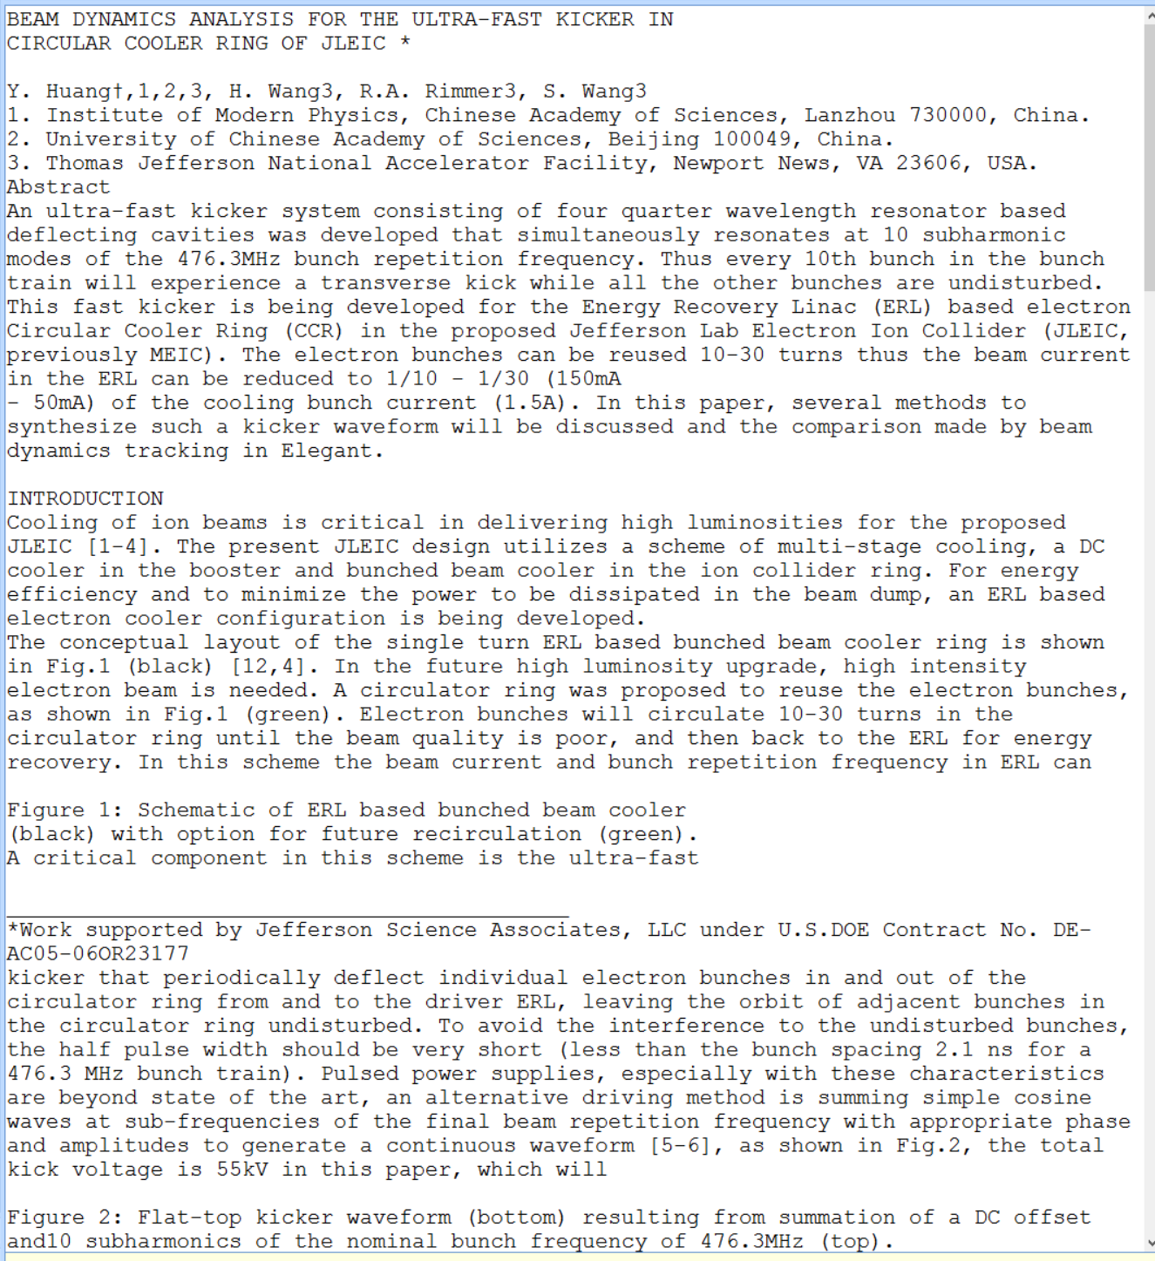
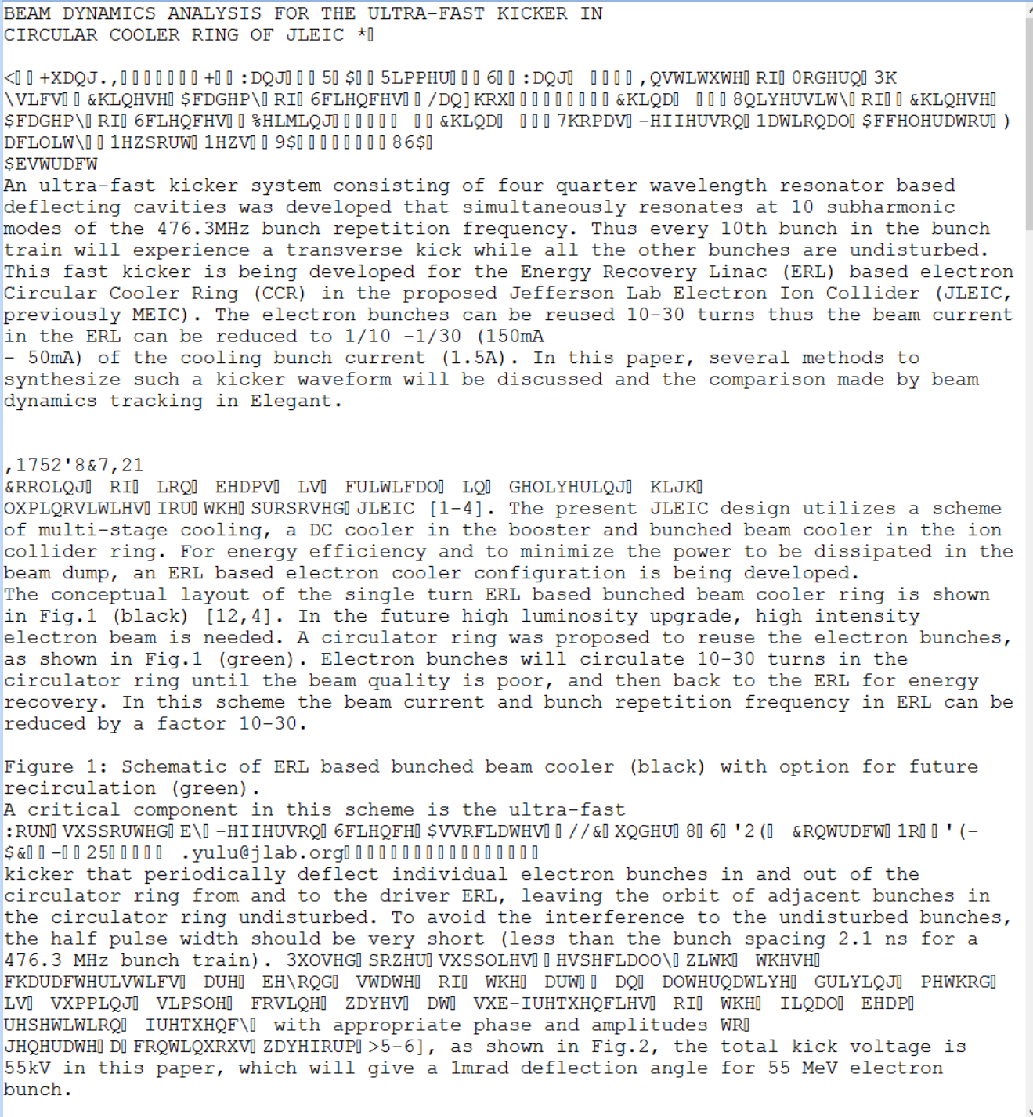
During Conference (cont.)
Broken Papers reported by scan-keywords.pl
Broken Papers: what does it mean?

Slide 11
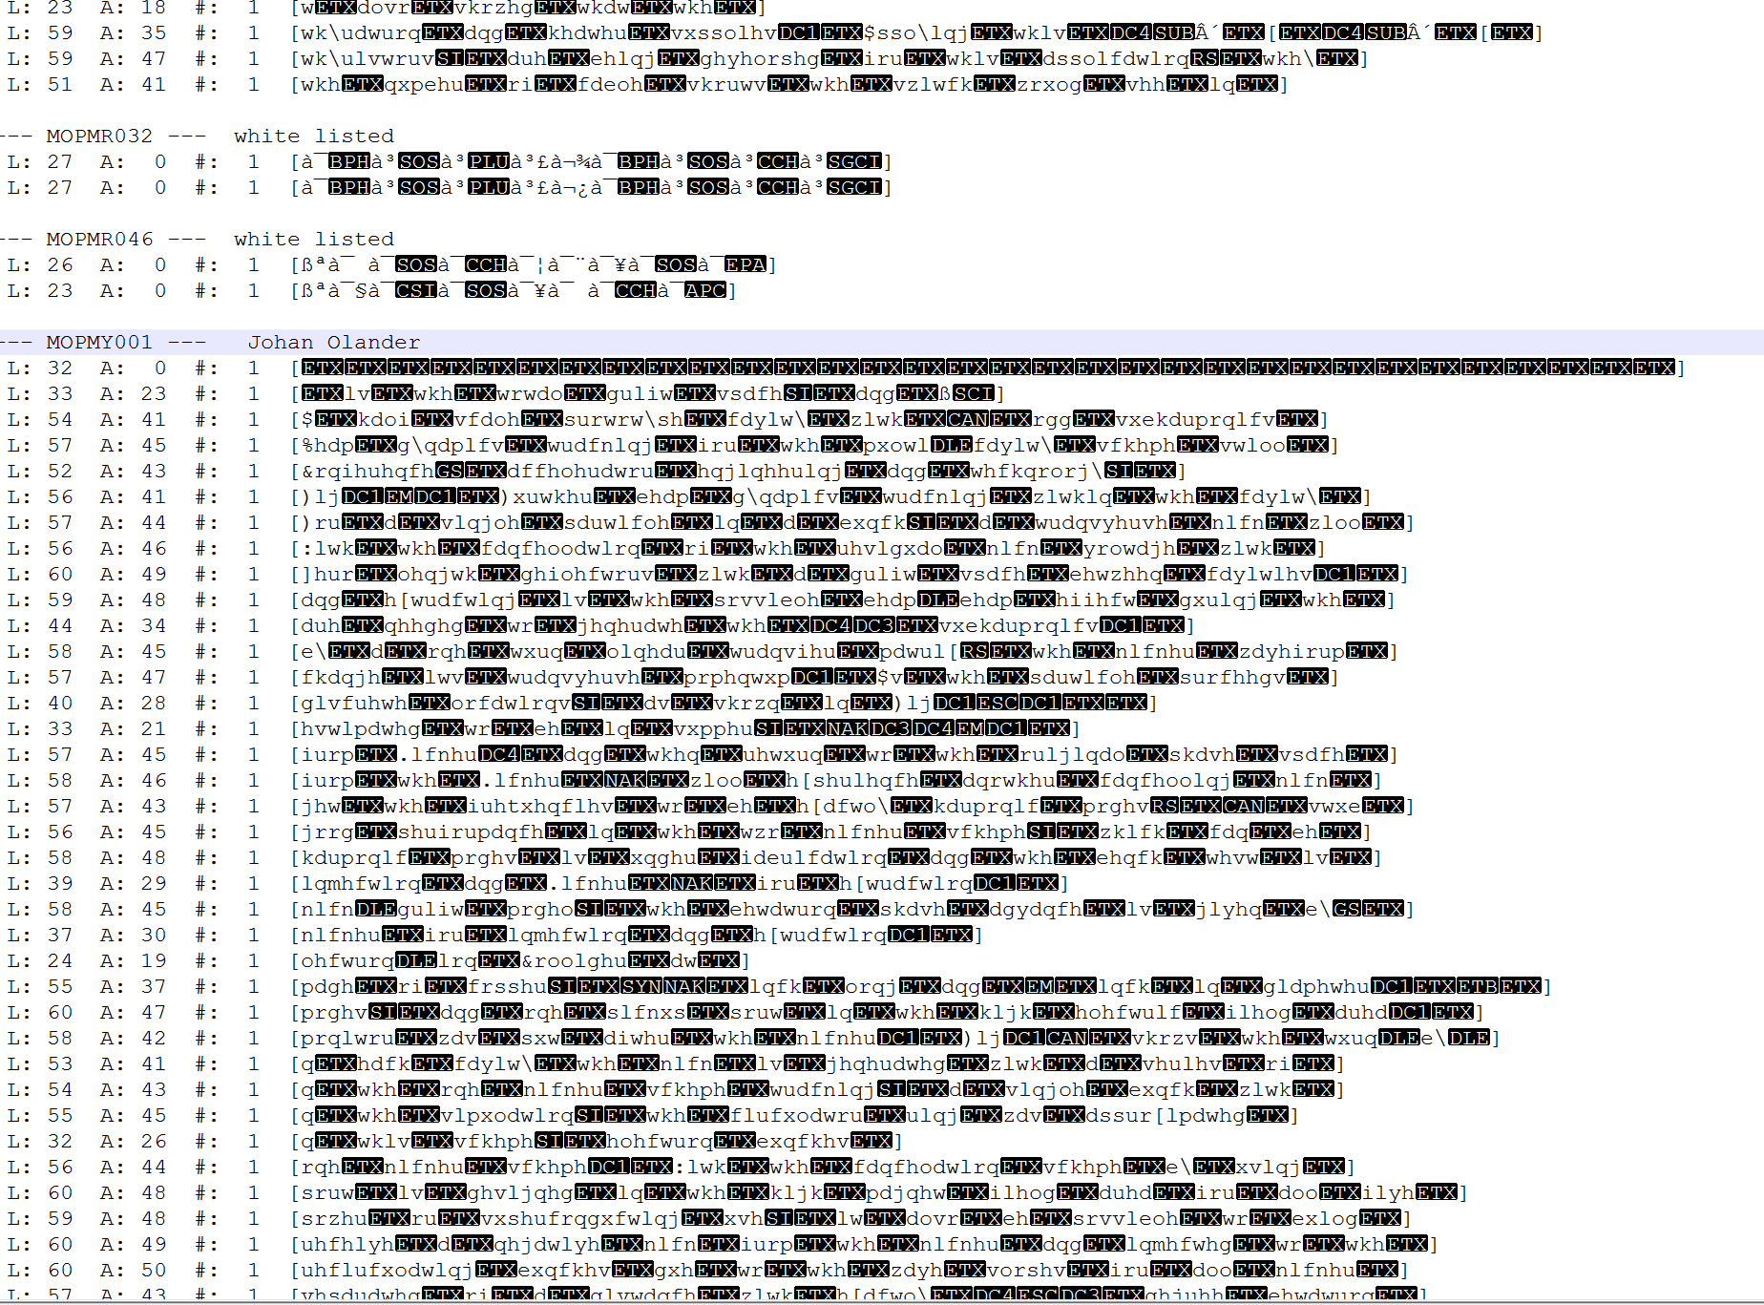
During Conference (cont.)
Broken Papers reported by scan-keywords.pl
It can happen on the Author's side or
when editing a paper in PDF. Most often
it is caused by entering a text where
the font is missing and has to be
embedded.
Depending which font (CID) and where
it is entered the encoding of the PDF
file can break.
The internal representation of a
character is not anymore 1:1 to a
readable character. As a result the
text is not anymore searchable (in
full) which is needed for the search
engine at CERN and for generating
keywords.

Slide 12
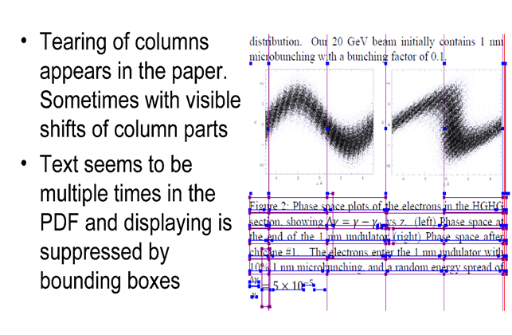
During Conference (cont.)
Tearing Boxes
reported by boxcheck.pl
This problems appears less
frequently nowadays,
it is a Word problem
there is a fix (all update to
Word have to be installed)
the PDF has to be redone
from source

Slide 13
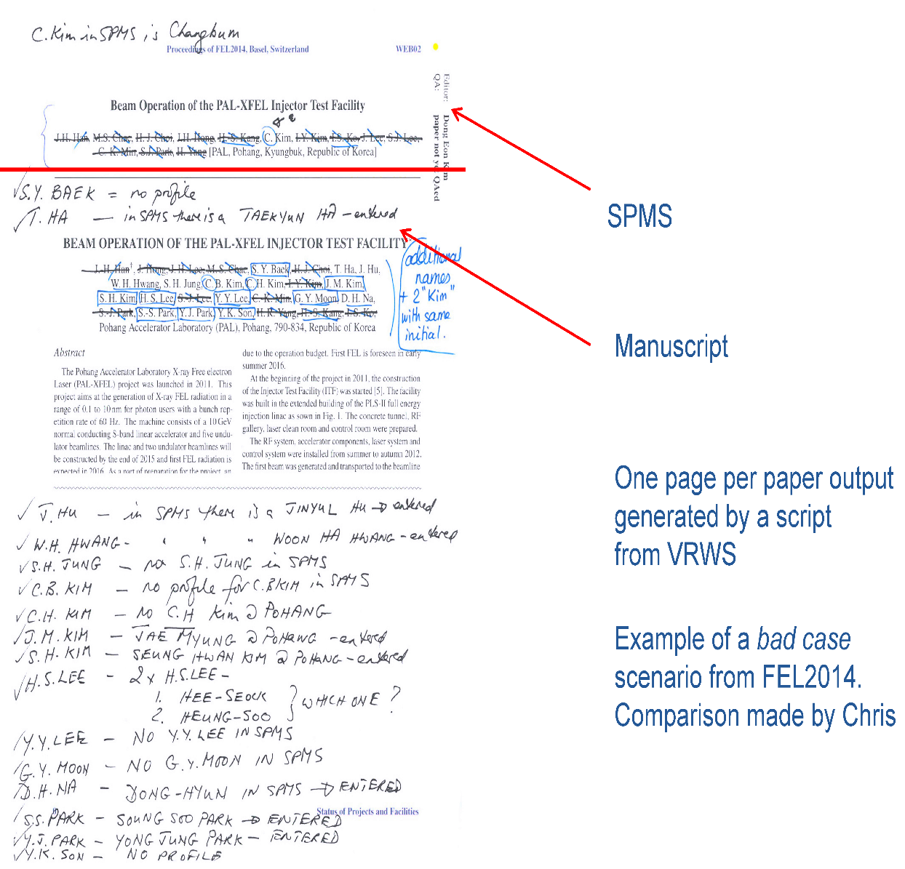
During Conference (cont.)
Author/Title Checks (ATC)
ATC is important to have
the correct title and authors
in SPMS (and finally in the
proceedings).
This task is hard to be done
by the editors as comparison
from screen to paper is harder
then striking out on paper.

Slide 14
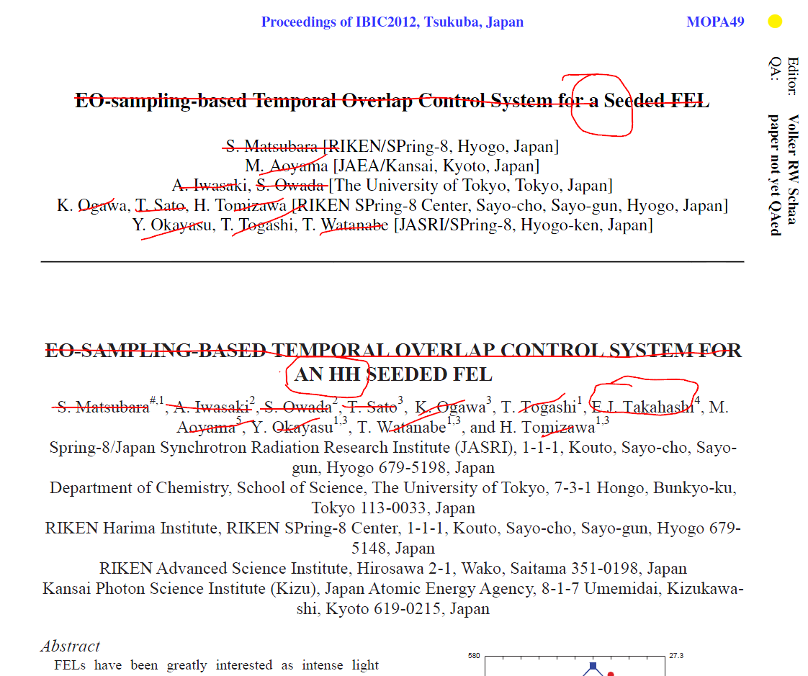
During Conference (cont.)
Author/Title Checks (done on screen using ATC)

Slide 15
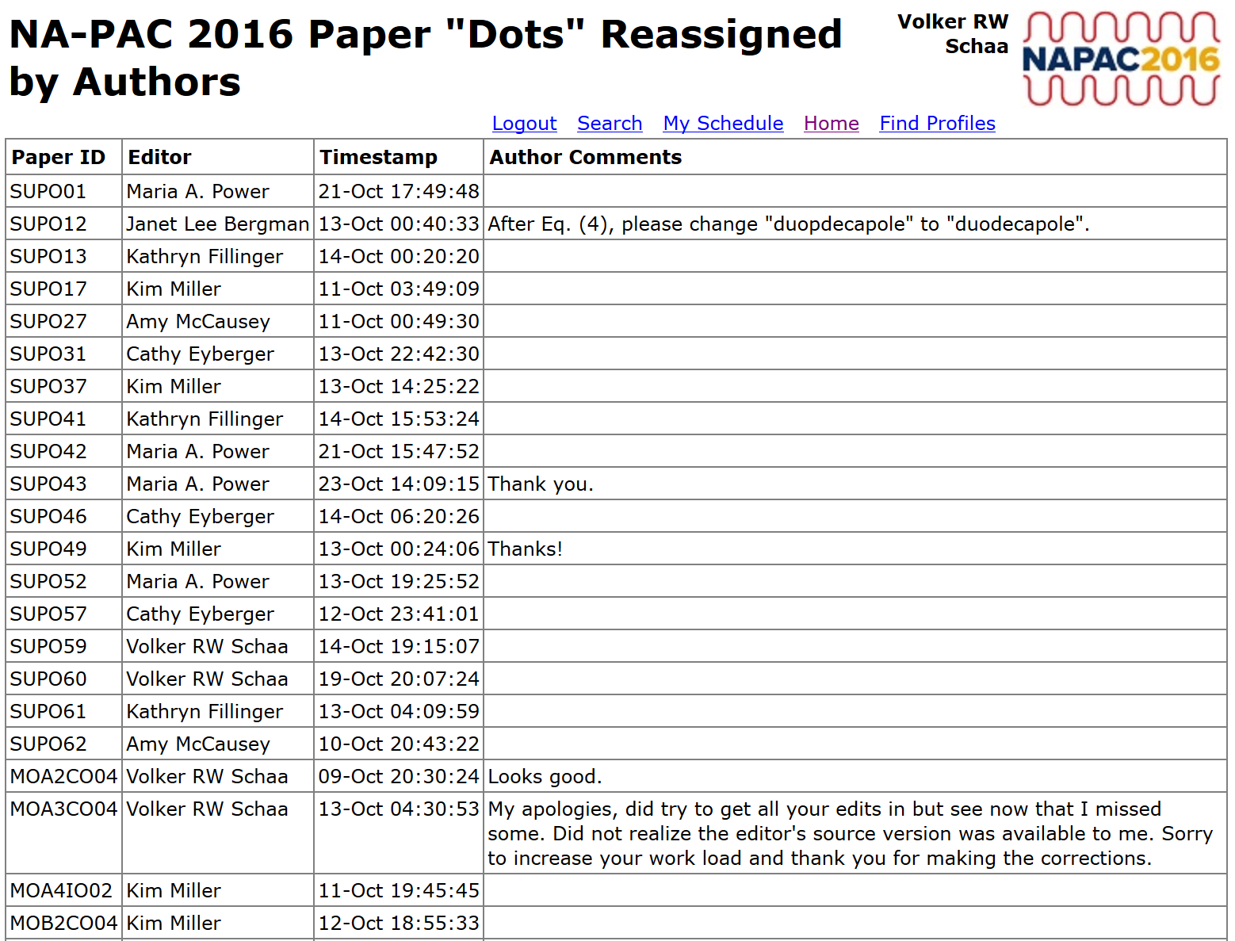
During Conference (cont.)
Author accepted YELLOW dot paper, but requests changes:
reported by /rpt_user_dot_reassign.html

Slide 16
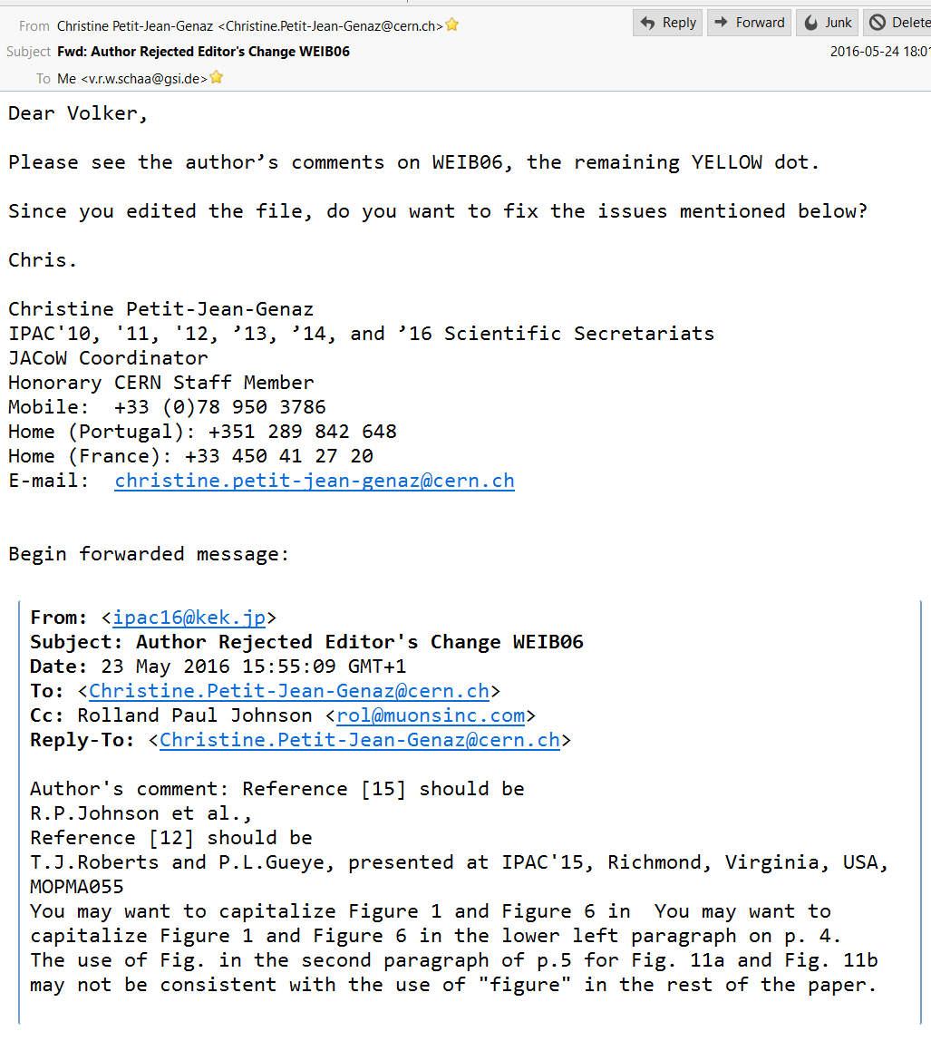
During Conference (cont.)
Author Rejected Changes:
reported by mail to Administrator
Email with rejection goes to the conference
administrator. Therefore it has to be checked
carefully for messages with the subject line:
Author Rejected Editor's Change <paper_id>
Entry in SPMS (email of administrator) to
be checked:
/params.show_cats?cat=MAIL
-> Administrators' Email Address xxx

Slide 17
Post Conference
Proceedings Entry Page
layout selection: horizontal/vertical/mixed
contents collection: Foreword, Committees, Photos, etc.
Keyword Generation
problem solving if no keywords are found
Web Page Consistency
broken links, orphaned files, etc.
Proceedings Production
INSPIRE Dataset

Slide 18
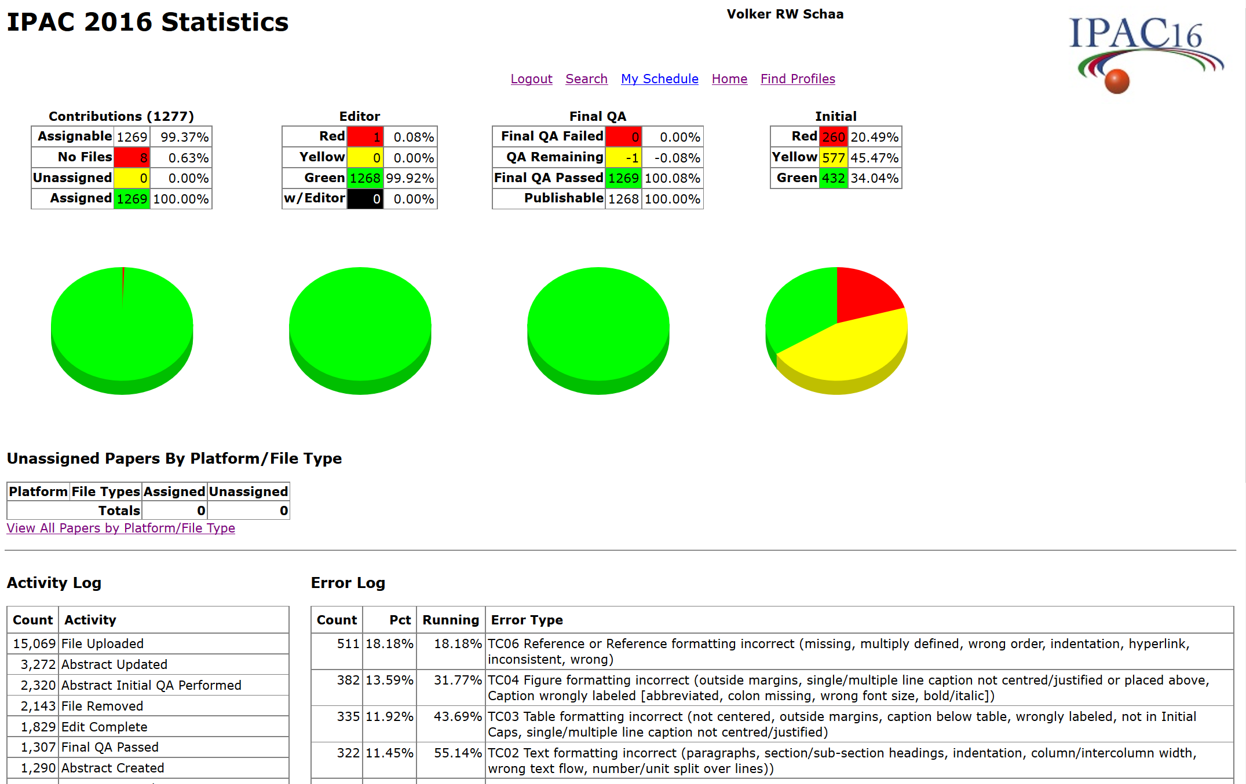
Preparations for Proceedings Publication
file threshold = 1
NO unassigned files
Your status page might look like this

Slide 19
Preparations for Proceedings Publication
File threshold = 1
NO unassigned files
No report shows a problem:
  no "broken papers“ + "page check" OK + no "tearing boxes“
All papers have GREEN status and are publishable
  QA is done; poster police entries have been made
All Author change requests are answered
Talks are published:
No author rejected publication or requested changes/removal of pages? (problematic as exchanges could be to the transparency editor’s pm or administrator; never listed in LOG)
Posters are published:
PDF files checked (displayable and fonts embedded)?

Slide 20
Preparations for Proceedings Publication (cont.)
All entries in the config file are correct
  ISBN
  conference specific data (name, site, title, date, series, number, editors, ...)
  data export enabled (DOI [production DOI:10.18429], bibliography/citation)
  skipping sessions/papers set filled correctly
  full PDF download enabled (pdf_update_only = 0)
  proceedings volume setting

Slide 21
Proceedings Entry Page
decide on layout
gather material beside proceedings
  Chairman's Foreword
  Committees list
  Participants list
  Conference photos / Group photo
prepare material
  list for committees, participants (html or pdf)
  photo album (jAlbum; size <5% of scientific material!)

Slide 22
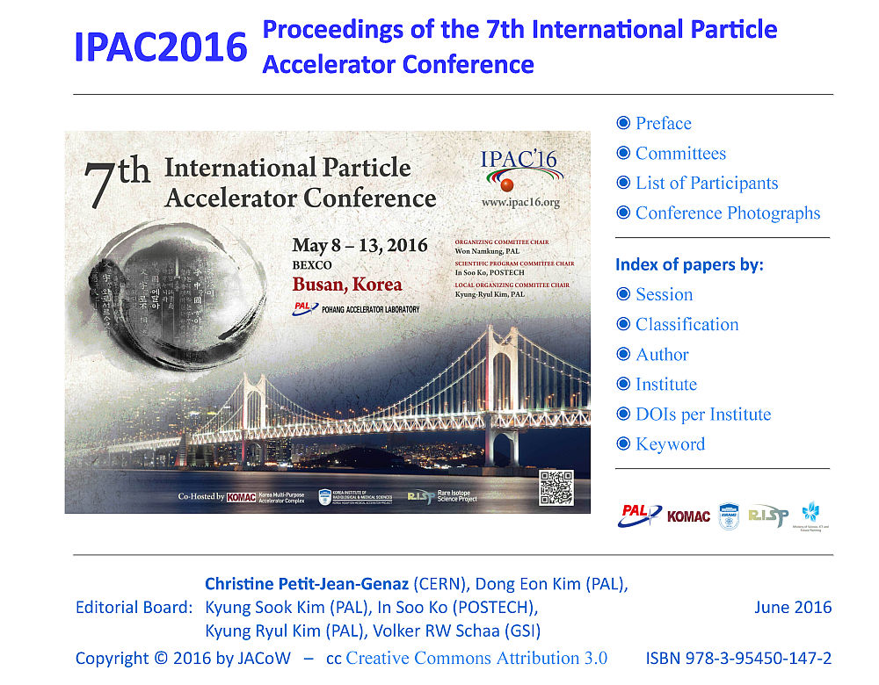
Proceedings Entry Page “horizontal”

Slide 23

Proceedings Entry Page “full horizontal”

Slide 24
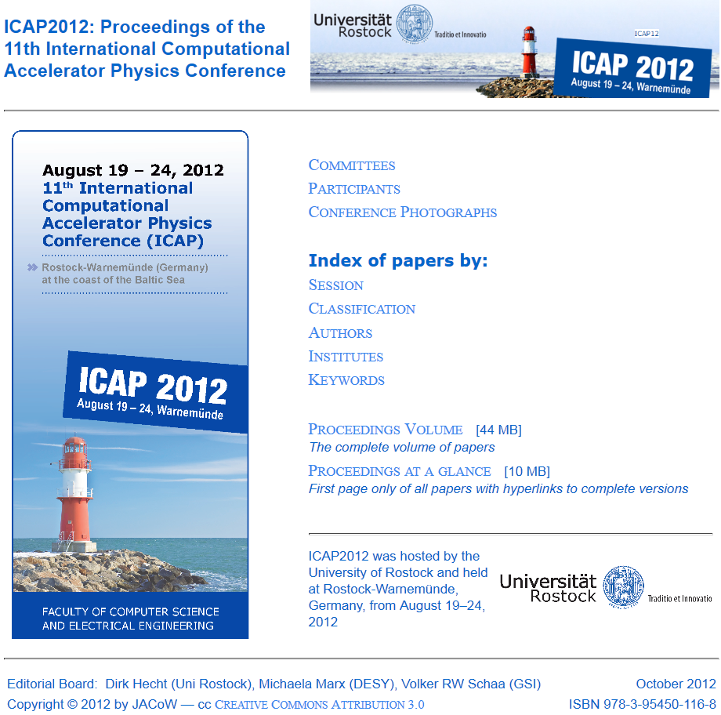
Entry page
“vertical”

Slide 25
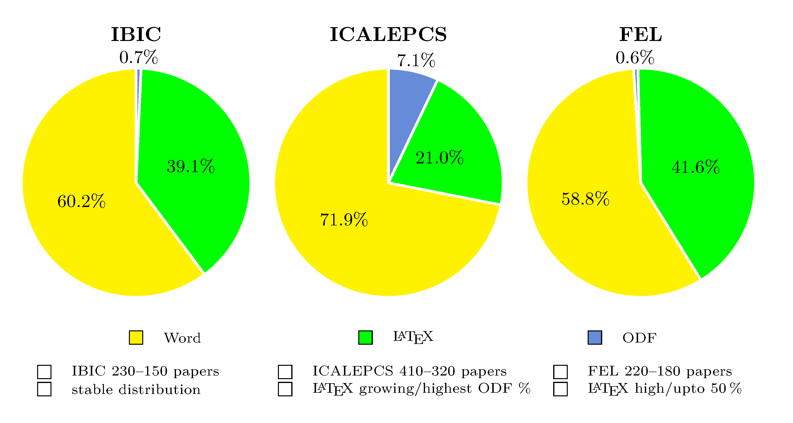
Trends in Submission Formats
Conferences in JACoW differ not only by size and topics but also in the format of the uploaded source file formats. And this even changes over time. The following slides will show the development over a time span where data were available to me.

Slide 26
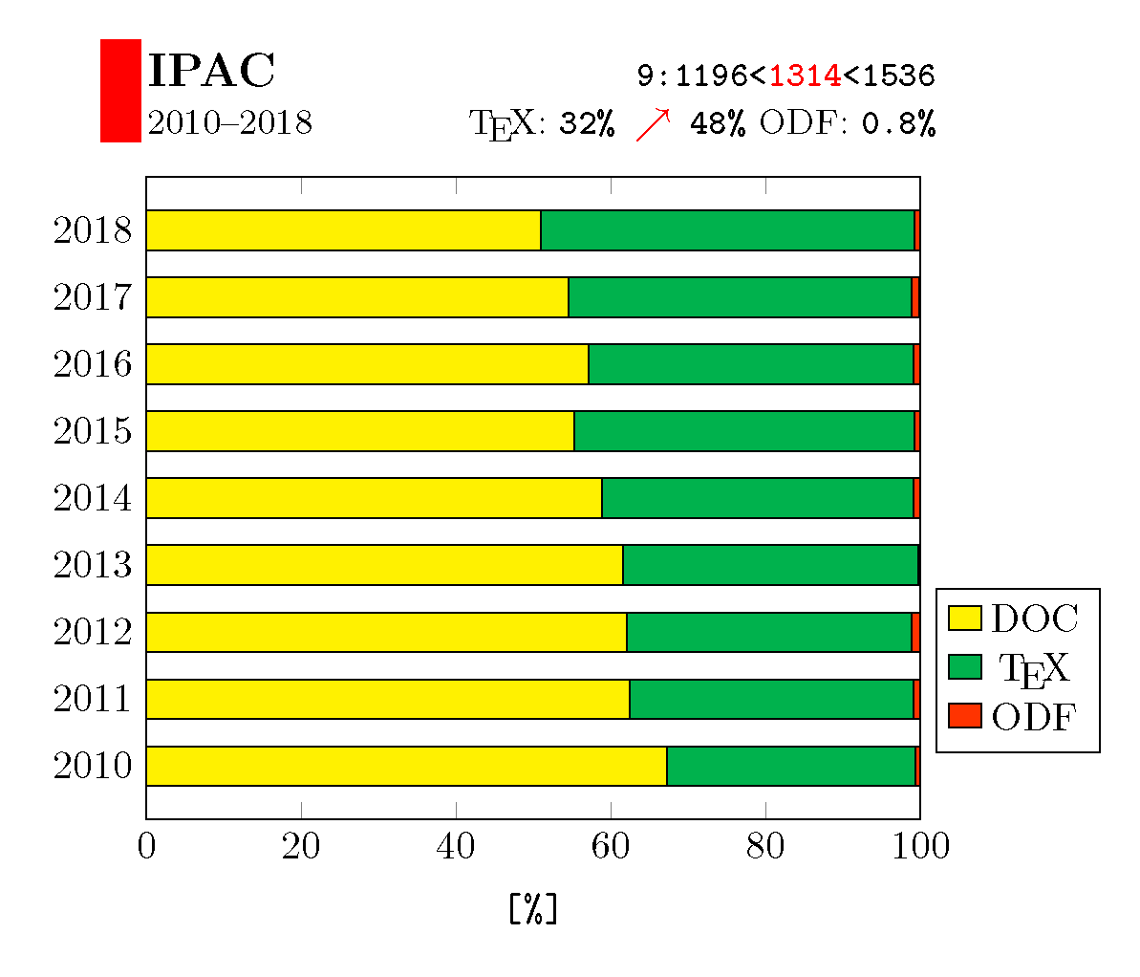
Trends in Submission Formats (IPAC)

Slide 27
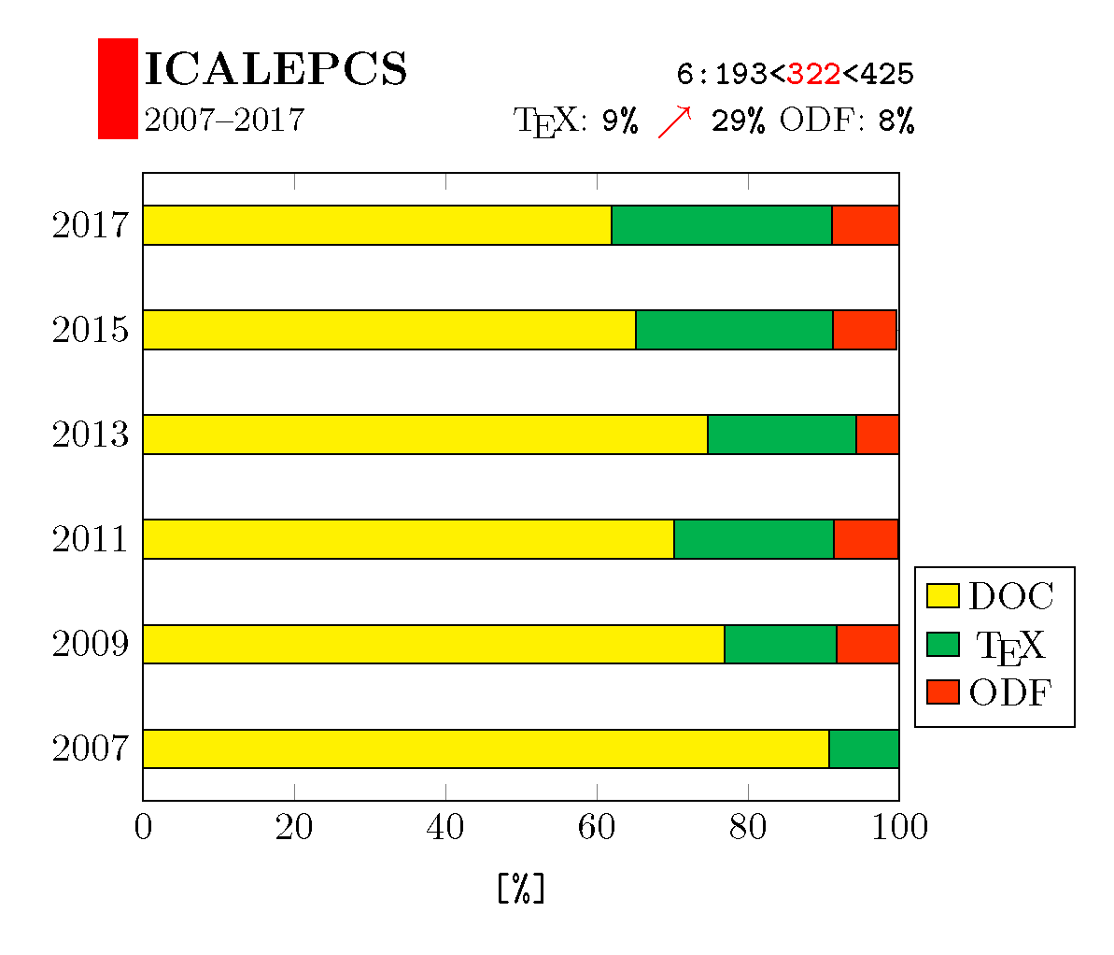
Trends in Submission Formats (ICALEPCS)

Slide 28
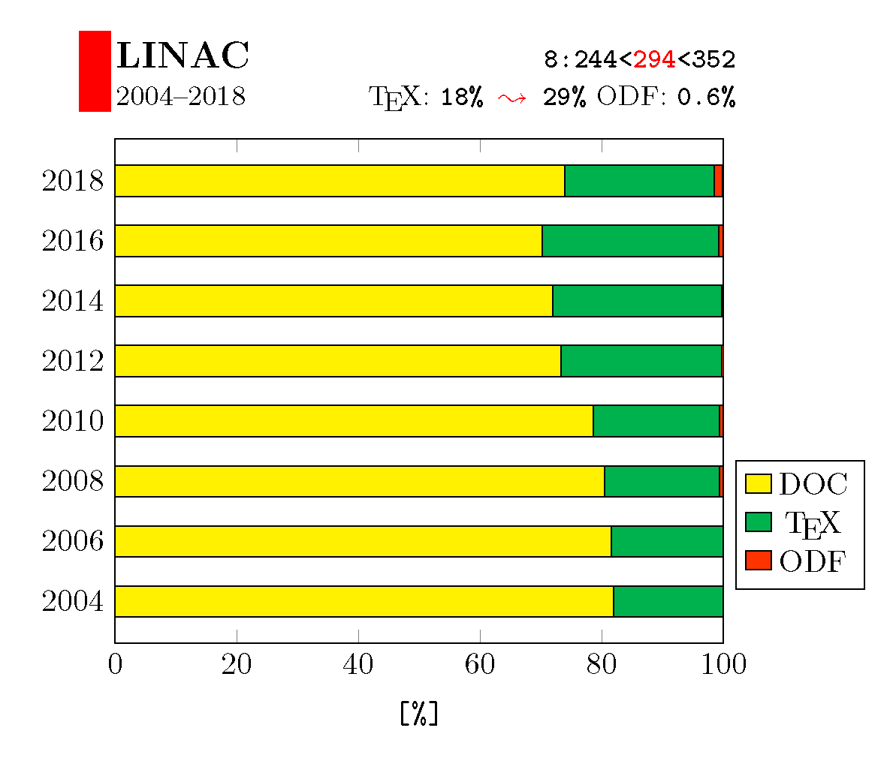
Trends in Submission Formats (LINAC)

Slide 29
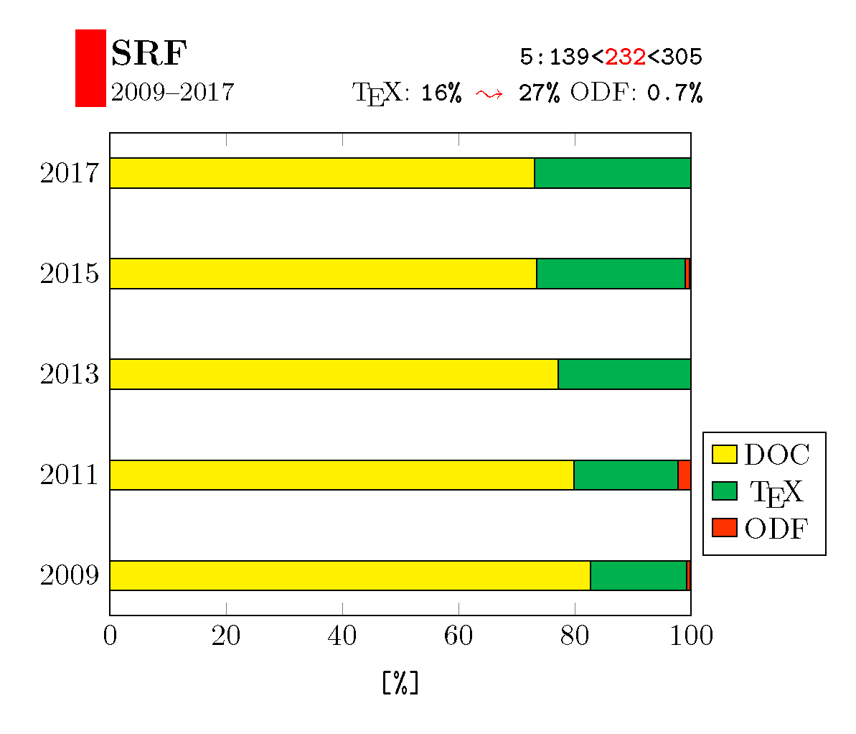
Trends in Submission Formats (SRF)

Slide 30
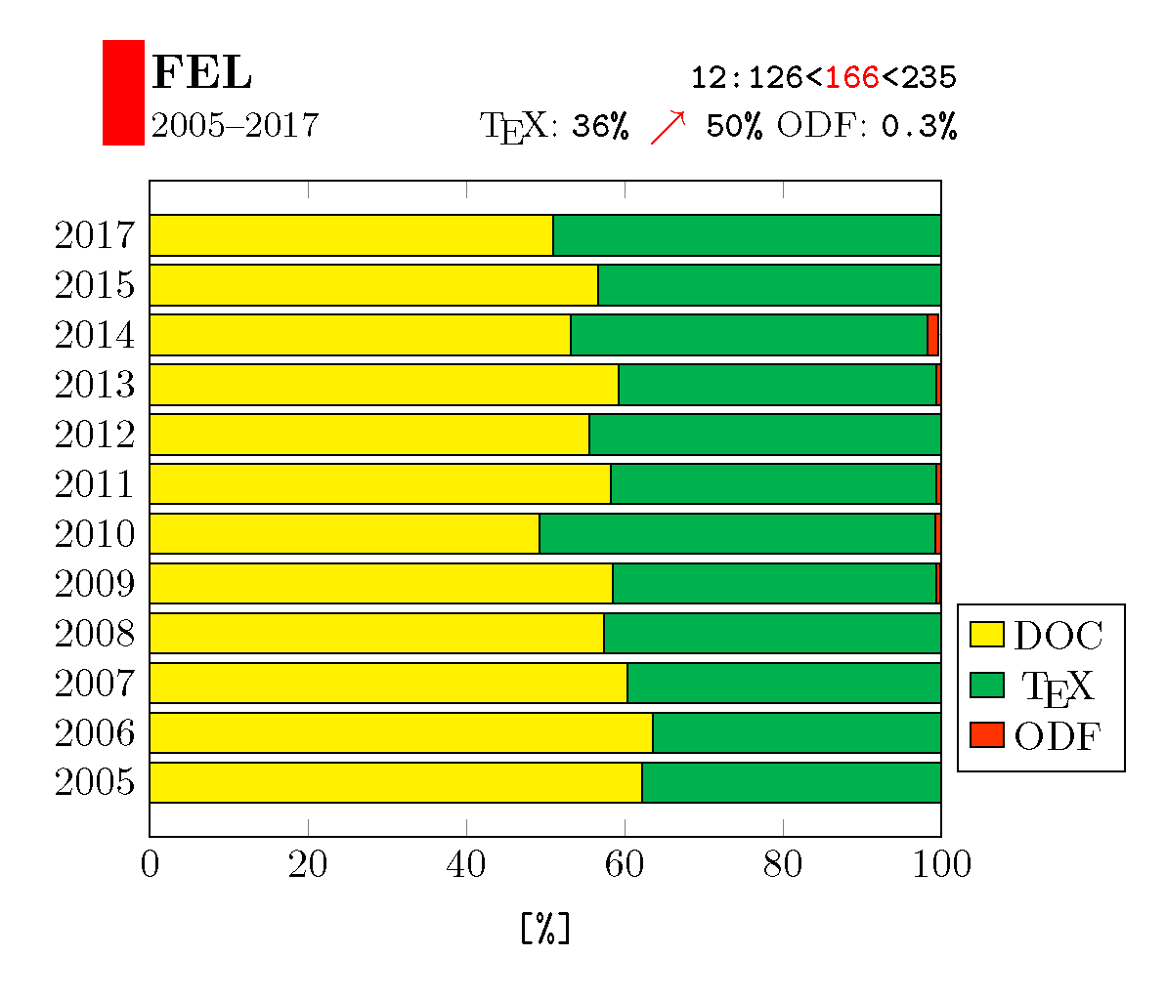
Trends in Submission Formats (FEL)

Slide 31
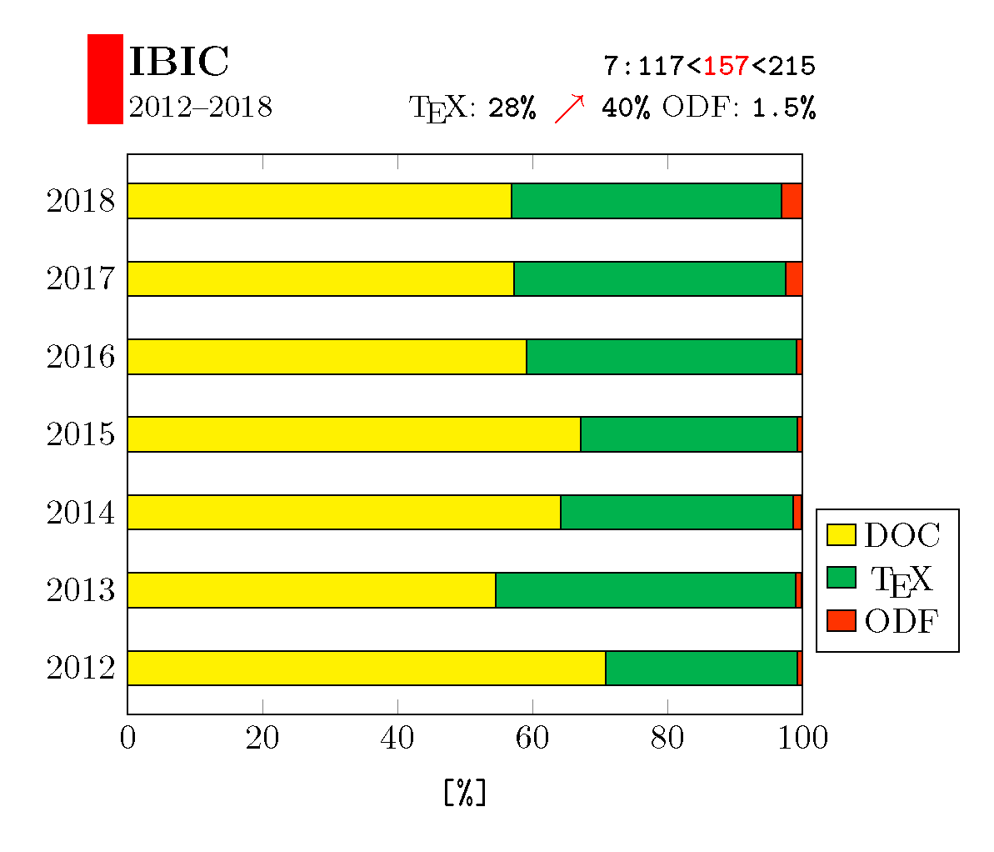
Trends in Submission Formats (IBIC)

Slide 32
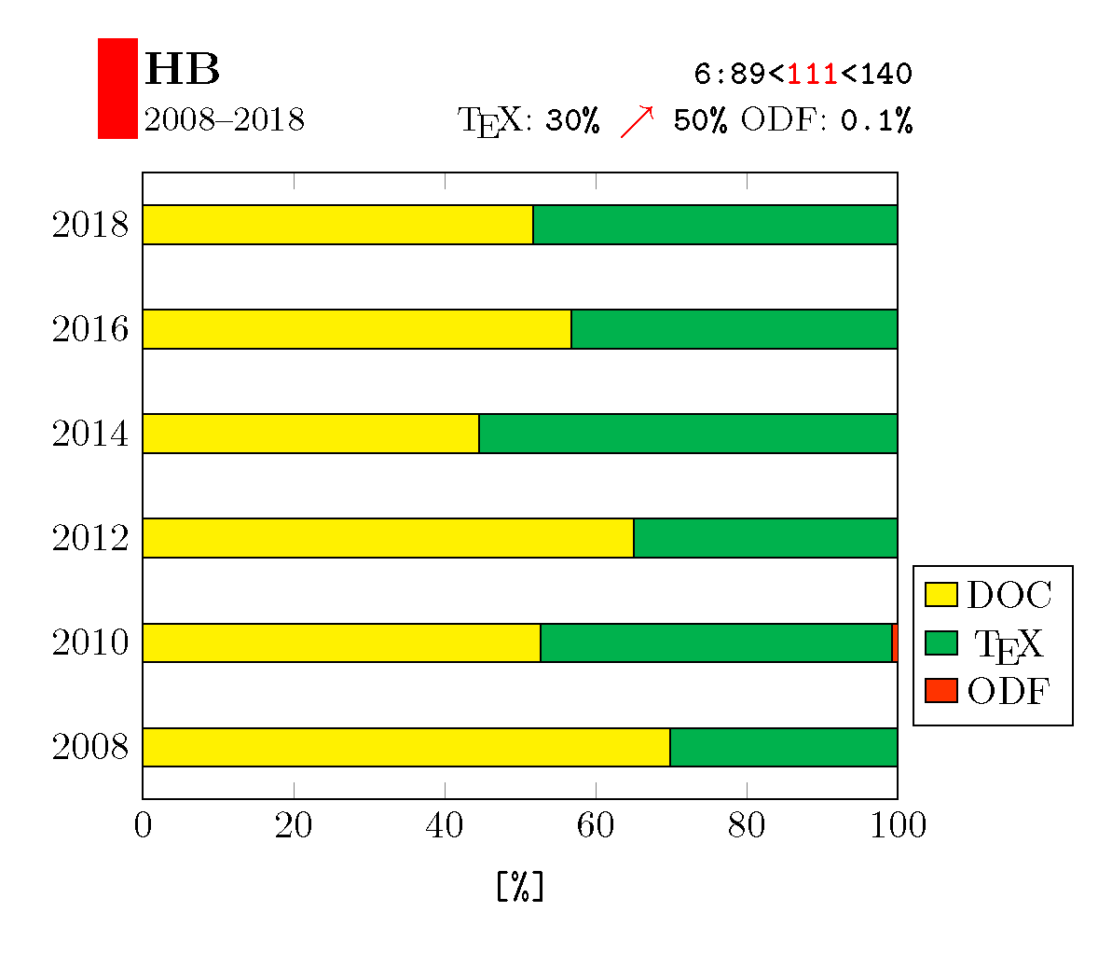
Trends in Submission Formats (HB)

Slide 33

Questions?

