Slide 1
Processsing Transparancies and Embedding Animations
Jan Chrin, Paul Scherrer Instititut
4. Dec. 2019, JACoW Team Meeting, Santos, Brazil
Notes:
This template can be used as a starter file for presenting training materials in a group setting.
Sections
Right-click on a slide to add sections. Sections can help to organize your slides or facilitate collaboration between multiple authors.
Notes
Use the Notes section for delivery notes or to provide additional details for the audience. View these notes in Presentation View during your presentation.
Keep in mind the font size (important for accessibility, visibility, videotaping, and online production)
Coordinated colors
Pay particular attention to the graphs, charts, and text boxes.
Consider that attendees will print in black and white or grayscale. Run a test print to make sure your colors work when printed in pure black and white and grayscale.
Graphics, tables, and graphs
Keep it simple: If possible, use consistent, non-distracting styles and colors.
Label all graphs and tables.

Slide 2
Who’s Who, What’s Where
 | Task | Contact information
Michaela Marx | Wiki Pages IPAC lead | michaela.marx@desy.de
Raphael Müller | Software for video embedding | r.mueller@gsi.de
Jan Chrin | User orientation tutorial | jan.chrin@psi.ch
Notes:
Keep it brief. Make your text as brief as possible to maintain a larger font size.

Slide 3




Getting to know your task: from PowerPoint to PDF
Input →
A new PDF document with
- all fonts embedded,
- intermediate and back-up slides removed
- videos embedded
Output →
Notes:
This is another option for an Overview slides using transitions.

Slide 4
PDF/A compliant documents for long-term archiving
PDF/A is an ISO PDF version specialized for use in the long-term preservation of electronic documents.
PDF/A prohibits features unsuitable for long-term archiving, e.g., font linking (as opposed to font embedding). All information necessary for displaying the document is embedded in the file, including all content (text, images and graphics), fonts, and color information.
However, PDF/A conformance also includes that:
Audio and video content is forbidden (!)
Notes:
Give a brief overview of the presentation. Describe the major focus of the presentation and why it is important.
Introduce each of the major topics.
To provide a road map for the audience, you can repeat this Overview slide throughout the presentation, highlighting the particular topic you will discuss next.

Slide 5
Prerequisites
PPspliT - Split animations add-in for PowerPoint
http://www.dia.uniroma3.it/~rimondin/downloads.php
Video encoding - process that converts a video file from one format to another, to make videos viewable across different platforms and devices
https://handbrake.fr/downloads.php
https://sourceforge.net/projects/virtualdub/
Mac fonts - may be required for proper rendering of talks developed on Mac (new url)
http://winweb.desy.de/home/mpymax/www/JACoW/
Install the MAC fonts into folder C:\Windows\fonts on your PC
Notes:
Give a brief overview of the presentation. Describe the major focus of the presentation and why it is important.
Introduce each of the major topics.
To provide a road map for the audience, you can repeat this Overview slide throughout the presentation, highlighting the particular topic you will discuss next.

Slide 6
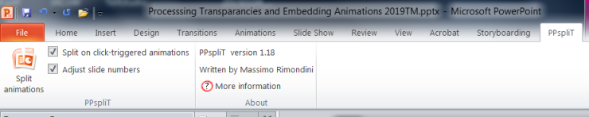
PPSpliT
http://www.dia.uniroma3.it/~rimondin/downloads.php
PPspliT is a PowerPoint add-in that splits each slide into several slides, one for each animation effect that is applied to the shapes
Install and restart ppt – PPspliT tab created
To run the add-in just click the Split animations button on the left.
Remove superfluous intermediate transparencies
Notes:
Give a brief overview of the presentation. Describe the major focus of the presentation and why it is important.
Introduce each of the major topics.
To provide a road map for the audience, you can repeat this Overview slide throughout the presentation, highlighting the particular topic you will discuss next.

Slide 7
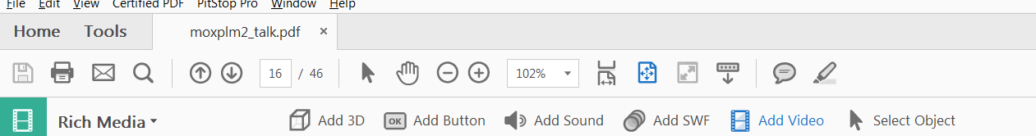
Embedding Videos
Videos must be MPEG-4 (H.264) compliant
(.mp4, .m4p, .m4v, .mov, …)
Select Tools -> Rich Media -> Add Video
Drag or double-click to select the area on the page where you want the video to appear (the media is to be placed in this area). An Insert dialog box opens that prompts you for the location of the media file to embed.
Notes:
Give a brief overview of the presentation. Describe the major focus of the presentation and why it is important.
Introduce each of the major topics.
To provide a road map for the audience, you can repeat this Overview slide throughout the presentation, highlighting the particular topic you will discuss next.

Slide 8
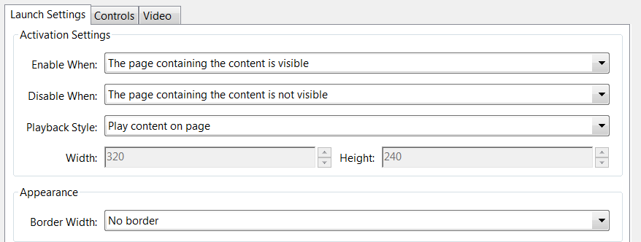
Embedding Videos (cont.)
Snap To Content Proportions
Ensures that the play area retains the height and width ratios of the original video or interactive content
Show Advanced Options
Opens the dialog for additional settings such as launch settings and playback controls.
Notes:
Give a brief overview of the presentation. Describe the major focus of the presentation and why it is important.
Introduce each of the major topics.
To provide a road map for the audience, you can repeat this Overview slide throughout the presentation, highlighting the particular topic you will discuss next.

Slide 9


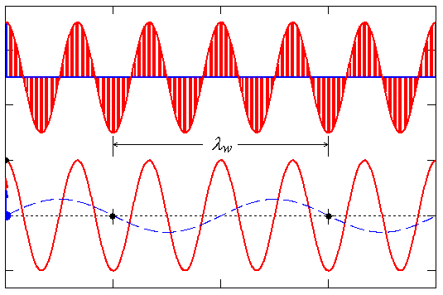
Embedding Videos (cont.)
If not MPEG-4 (H.264) then several tools exist to convert to the required video format
Handbrake video transcoder to convert avi and wmv files to MPEG-4
https://handbrake.fr/downloads.php
Virtual Dub video capture / video
processing utility https://sourceforge.net/projects/virtualdub/
Animated gif:
Use Virtual Dub to convert gif to avi
and then Handbrake to convert avi to mpeg4
Notes:
Give a brief overview of the presentation. Describe the major focus of the presentation and why it is important.
Introduce each of the major topics.
To provide a road map for the audience, you can repeat this Overview slide throughout the presentation, highlighting the particular topic you will discuss next.

Slide 10
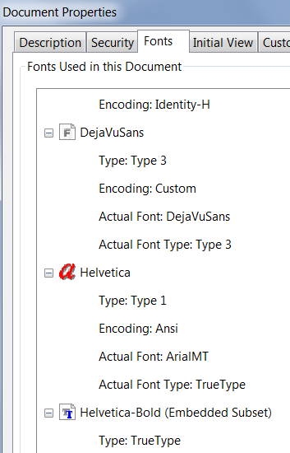
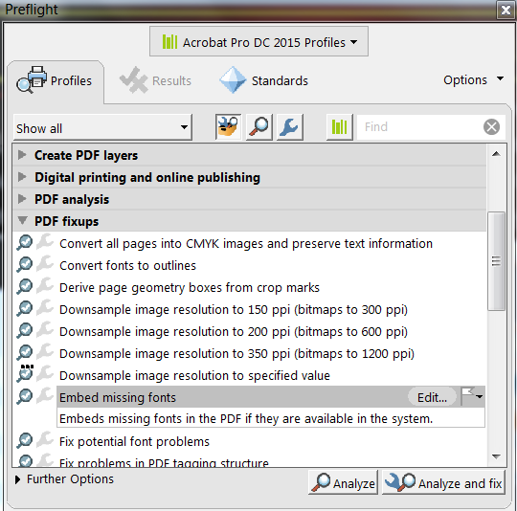
Check for missing fonts
Check for missing fonts with Ctrl-d
Then Shift-Ctrl-x, and select
Embed missing fonts
and click Analyze and fix
v. Enfocus PitStop Pro 2017
From Pitstop Pro tab Click Fix Missing Fonts tab
or Ctrl-Alt-V to Embed missing fonts
Notes:
Give a brief overview of the presentation. Describe the major focus of the presentation and why it is important.
Introduce each of the major topics.
To provide a road map for the audience, you can repeat this Overview slide throughout the presentation, highlighting the particular topic you will discuss next.

Slide 11
Handling Page Sizes Correctly (when printing to pdf)
Default PPT Slide format is 4:3
Some contributions may have different aspect rations:
e.g., 16:9 or any other custom size
When printing to pdf, the pdf settings must correspond to the actual “on-screen” size
Notes:
Give a brief overview of the presentation. Describe the major focus of the presentation and why it is important.
Introduce each of the major topics.
To provide a road map for the audience, you can repeat this Overview slide throughout the presentation, highlighting the particular topic you will discuss next.

Slide 12
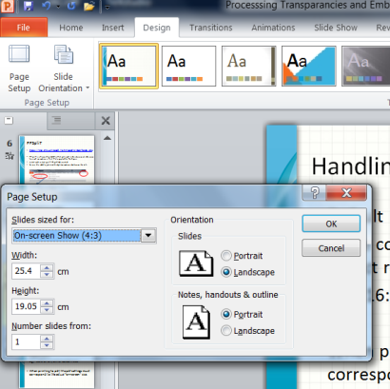
Handling Page Sizes Correctly (cont.)
First check Page Setup for Size of Slides:
.
-> Design
-> Page Setup
On-screen Show(4:3)
width 25.4 cm
height 19.05 cm
Notes:
Give a brief overview of the presentation. Describe the major focus of the presentation and why it is important.
Introduce each of the major topics.
To provide a road map for the audience, you can repeat this Overview slide throughout the presentation, highlighting the particular topic you will discuss next.

Slide 13
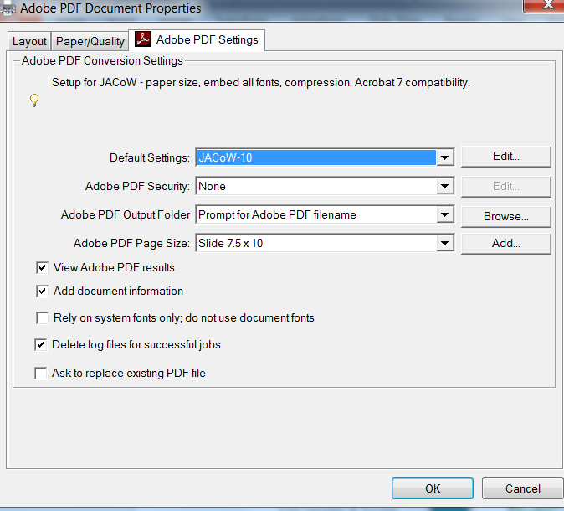
Handling wide-screen slides (cont.)
Select Matching Adobe PDF Page Size
in pdf settings
.
Slide 7.5 x 10
height 25.4 cm
width 19.05 cm
Height and width reversed
in comparison to values
retrieved from ppt page setup
Notes:
Give a brief overview of the presentation. Describe the major focus of the presentation and why it is important.
Introduce each of the major topics.
To provide a road map for the audience, you can repeat this Overview slide throughout the presentation, highlighting the particular topic you will discuss next.

Slide 14
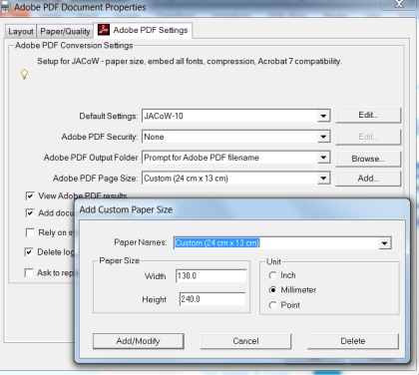
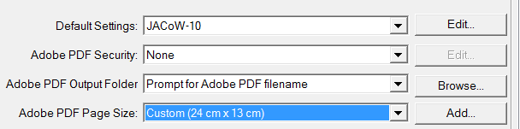
Handling Page Size Correctly (cont.)
PPT Page Setup | Adobe Page Size
On-screen Show (4:3) | Slide 7.5 x 10
On-screen Show (16:9) | 14.29 cm x 25.4 cm
Custom size (24 x 13 cm) | 13.0 cm x 24.0 cm
Select “Custom 24x13”
when printing to Adobe pdf
Add and name new PDF Page Size
e. g. “custom 24x13”
Enter the values for width and height
in the height and width field respectively!
Notes:
Give a brief overview of the presentation. Describe the major focus of the presentation and why it is important.
Introduce each of the major topics.
To provide a road map for the audience, you can repeat this Overview slide throughout the presentation, highlighting the particular topic you will discuss next.

Slide 15
Handling Page Sizes Correctly (cont.)
Finally when viewing pdf
Ctrl-Shift-R to rotate transparencies
by 90 degrees clockwise
for correct orientation
and save to file
Notes:
Give a brief overview of the presentation. Describe the major focus of the presentation and why it is important.
Introduce each of the major topics.
To provide a road map for the audience, you can repeat this Overview slide throughout the presentation, highlighting the particular topic you will discuss next.

Slide 16
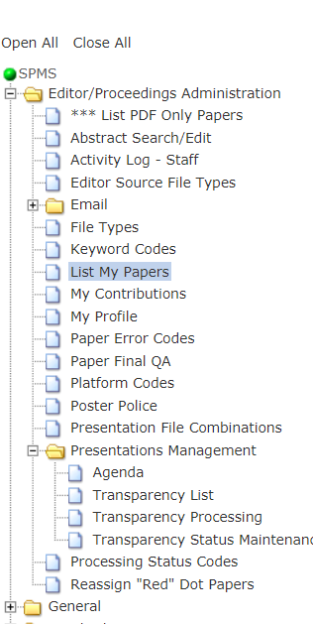
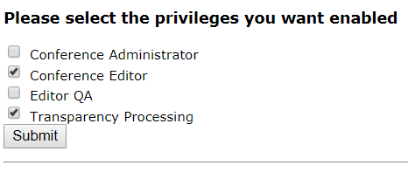
Presentation Management Privilege
Check this box to get
this privilege.
If you don’t see it as an option at SPMS log-in, ask your SPMS administrator.
Notes:
Give a brief overview of the presentation. Describe the major focus of the presentation and why it is important.
Introduce each of the major topics.
To provide a road map for the audience, you can repeat this Overview slide throughout the presentation, highlighting the particular topic you will discuss next.

Slide 17
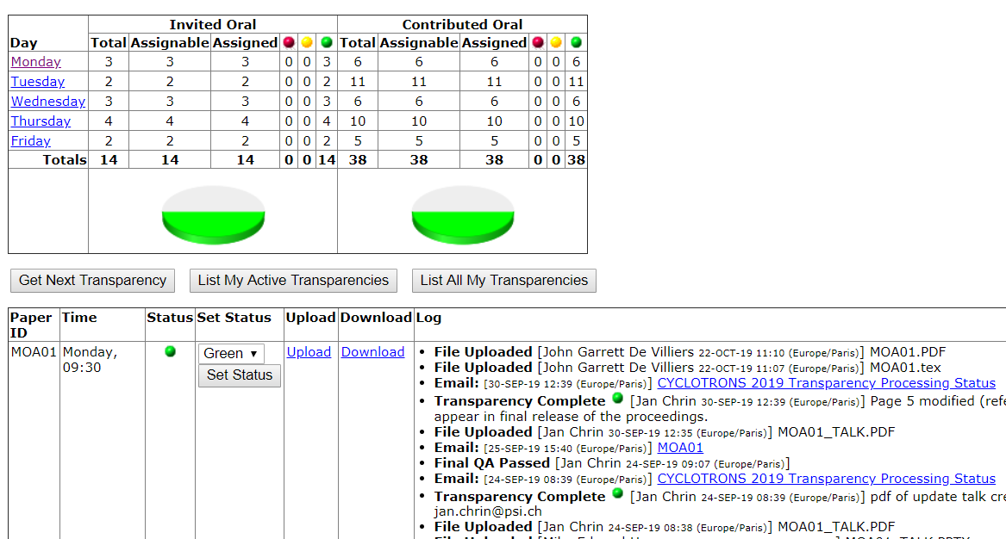
Presentation Management
Links to upload/download
pages
Notes:
Give a brief overview of the presentation. Describe the major focus of the presentation and why it is important.
Introduce each of the major topics.
To provide a road map for the audience, you can repeat this Overview slide throughout the presentation, highlighting the particular topic you will discuss next.

Slide 18
When done, send a standard response
Assign Green Dot, else red if problems, and supply a brief report.
Yellow Dot status is NOT used (even if the option is there)
Dear <Speaker>
Your PowerPoint presentation was successfully converted to pdf, with all fonts embedded, <and intermediate and back-up slides removed>, …
The PDF of your talk has been processed, with all fonts embedded, …
… and will be included in the conference/ workshop proceedings. Please check the pdf of the talk <PAPERID>_TALK.pdf, and in case of problems, please contact: email address
Notes:
Give a brief overview of the presentation. Describe the major focus of the presentation and why it is important.
Introduce each of the major topics.
To provide a road map for the audience, you can repeat this Overview slide throughout the presentation, highlighting the particular topic you will discuss next.

Slide 19

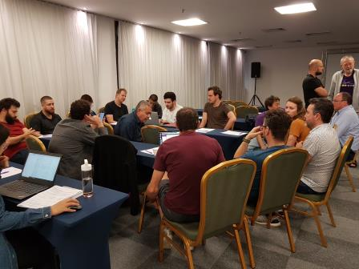

Tutorial 2-B
Wed. 4 Dec. 14.00
Room Vila
- Getting to know your task
- Familiarizing yourself with the software environment
- Tips to help you along the way

