Slide 1
JACoW TM 2018: Update on Processing Slides
- what to do before you start -
Topics
◆ install video transcoder and flash player first
(Handbrake, Adobe Flash Player, Virtual Dub, Lightshot etc)
◆ insert PPspliT
◆ print slides in High Quality
◆ install MAC Fonts on a Windows PC
◆ convert slides to the correct format
Michaela Marx, DESY, Hamburg, Germany, November 2018

Slide 2





Software you need: Video transcoder, Adobe Flash Player, a screen capture tool
Virtual Dub
VLC media player
◆ Handbrake (video transcoder to convert avi and wmv files to MPEG-4)
https://handbrake.fr/downloads.php
◆ Virtual Dub (free video capture/video processing utility)
https://sourceforge.net/projects/virtualdub/
◆ Adobe Flash Player
https://get.adobe.com/flashplayer/
other useful tools
◆ VLC Player (free cross-platform multimedia player)
https://sourceforge.net/projects/vlc/
◆ Lightshot (to take customizable screenshots)
https://app.prntscr.com/en/index.html

Slide 3
Topics
◆ install video transcoder and flash player first
(Handbrake, Adobe Flash Player, Virtual Dub, Lightshot etc)
◆ PPspliT replaced the outdated Split Animations Macro
◆ Check PPT print options - printing slides in High Quality
(for conversion from PPT to PDF using the Adobe PDF printer)
◆ Installing MAC Fonts on a Windows PC
◆ how to convert wide screen slides - 16:9 or user defined formats

Slide 4

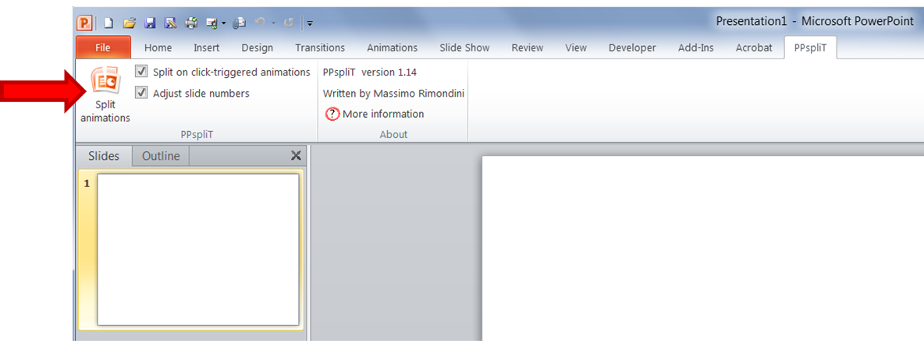
PPspliT - A New Split Animations Add-In for PowerPoint
Massimo Rimondini (from Roma Tre University in Italy) has written a split animations
macro for PowerPoint which is more accurate in splitting overlaps and therefore very useful
for processing slides in a JACoW proceedings office.
► Download the PPslitT installer from his web page at the following URL and use the
supplied password “ppsplit” to unzip the file.
http://www.dia.uniroma3.it/~rimondin/downloads.php
► After the add-in has been installed PowerPoint offers a new tab named PPspliT.
To run the add-in just click the Split animations button on the left.

Slide 5
Topics
◆ install video transcoder and flash player first
(Handbrake, Adobe Flash Player, Virtual Dub, Lightshot etc)
◆ PPspliT replaced the outdated Split Animations Macro
◆ Check PPT print options - printing slides in High Quality
(for conversion from PPT to PDF using the Adobe PDF printer)
◆ Installing MAC Fonts on a Windows PC
◆ how to convert wide screen slides - 16:9 or user defined formats

Slide 6
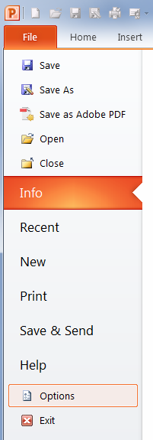
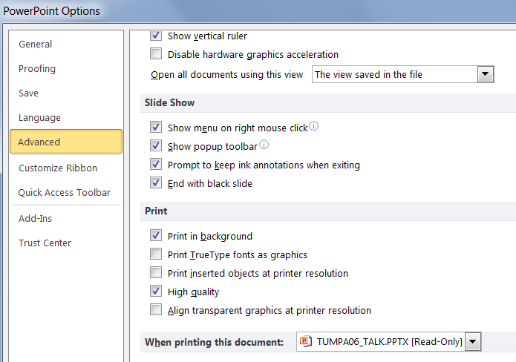
PowerPoint: How to enable the High Quality Print Option
check here

Slide 7

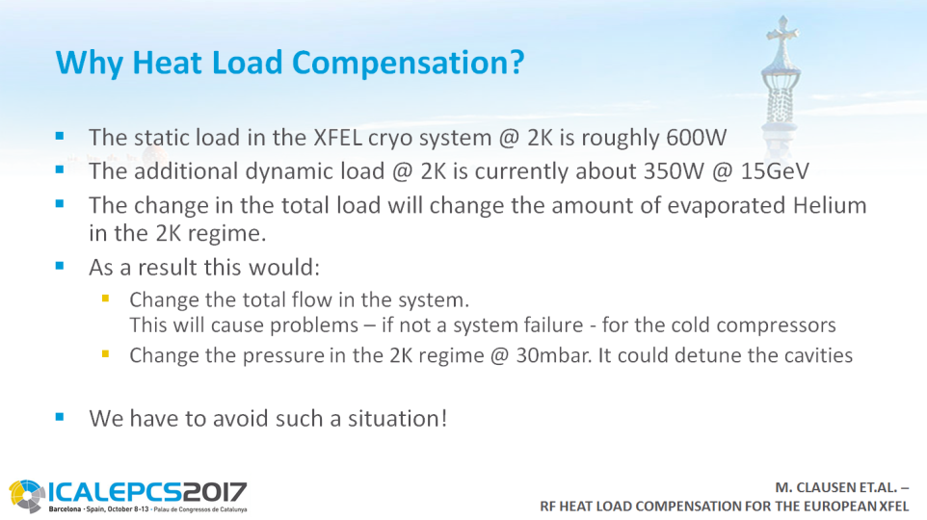

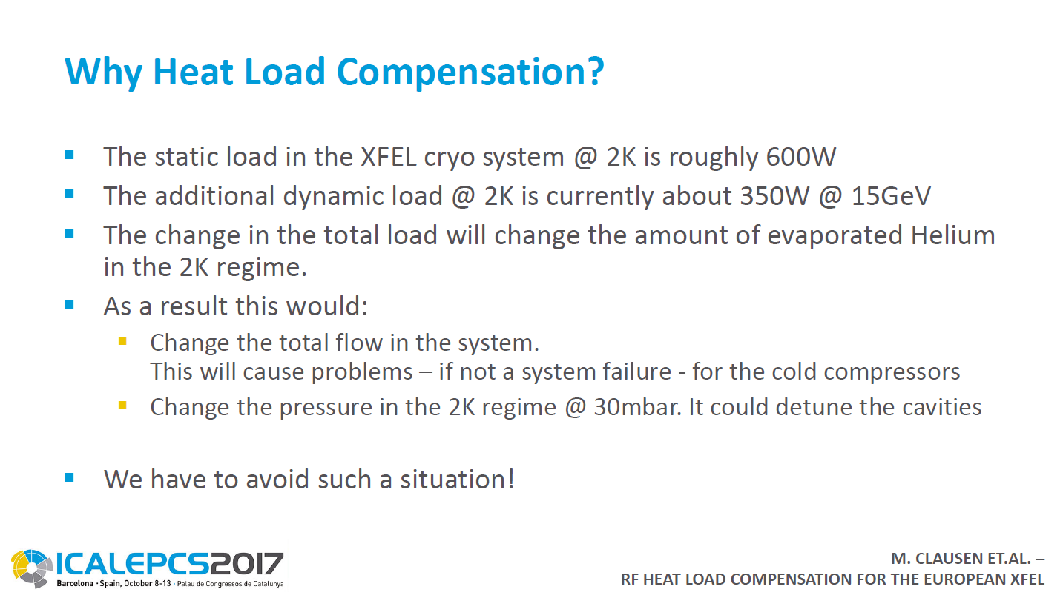
PowerPoint Print Option: “High quality” should be enabled
Example PPT slide #1: text box is transparent
PPT slide #2 => water mark background
after conversion to PDF
(by Printing to Adobe PDF)
after conversion to PDF
(by Printing to Adobe PDF)
PDF slide #1 => text box transparency disappeared
PDF slide #2 => background is gone
Notes:
This nice PPT template was provided by the ICALEPCS’17 conference for the mini oral presenters. First slide has a colorful background view of Barcelona, all following slides contain a water mark background. If the “High Quality” option is not enabled the conversion from PPT to PDF fails.

Slide 8
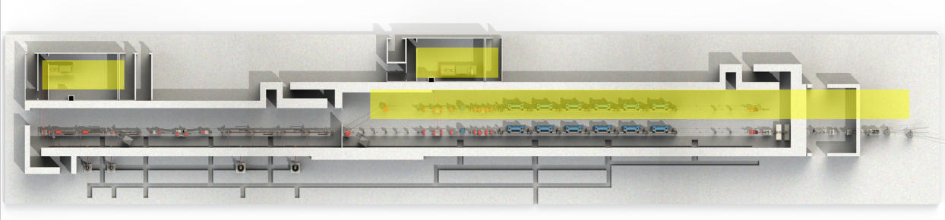
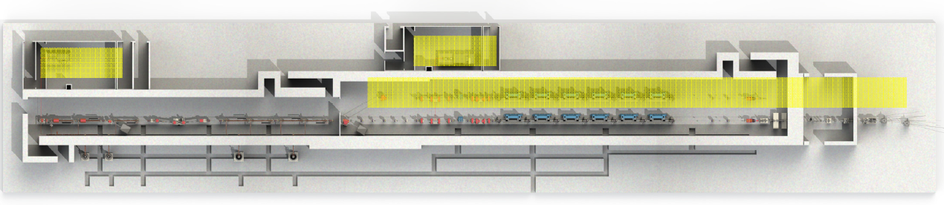
PowerPoint Print Option: “High quality” should be enabled
Example from FEL’17 presentation given by Weiqing Zhang, MOC04
image were the High Quality Print Option was enabled for conversion to PDF:
same image, but High Quality Print Option was disabled  coarse overlaps

Slide 9
Topics
◆ install video transcoder and flash player first
(Handbrake, Adobe Flash Player, Virtual Dub, Lightshot etc)
◆ PPspliT replaced the outdated Split Animations Macro
◆ Check PPT print options - printing slides in High Quality
(for conversion from PPT to PDF using the Adobe PDF printer)
◆ Installing MAC Fonts on a Windows PC
◆ how to convert wide screen slides - 16:9 or user defined formats

Slide 10
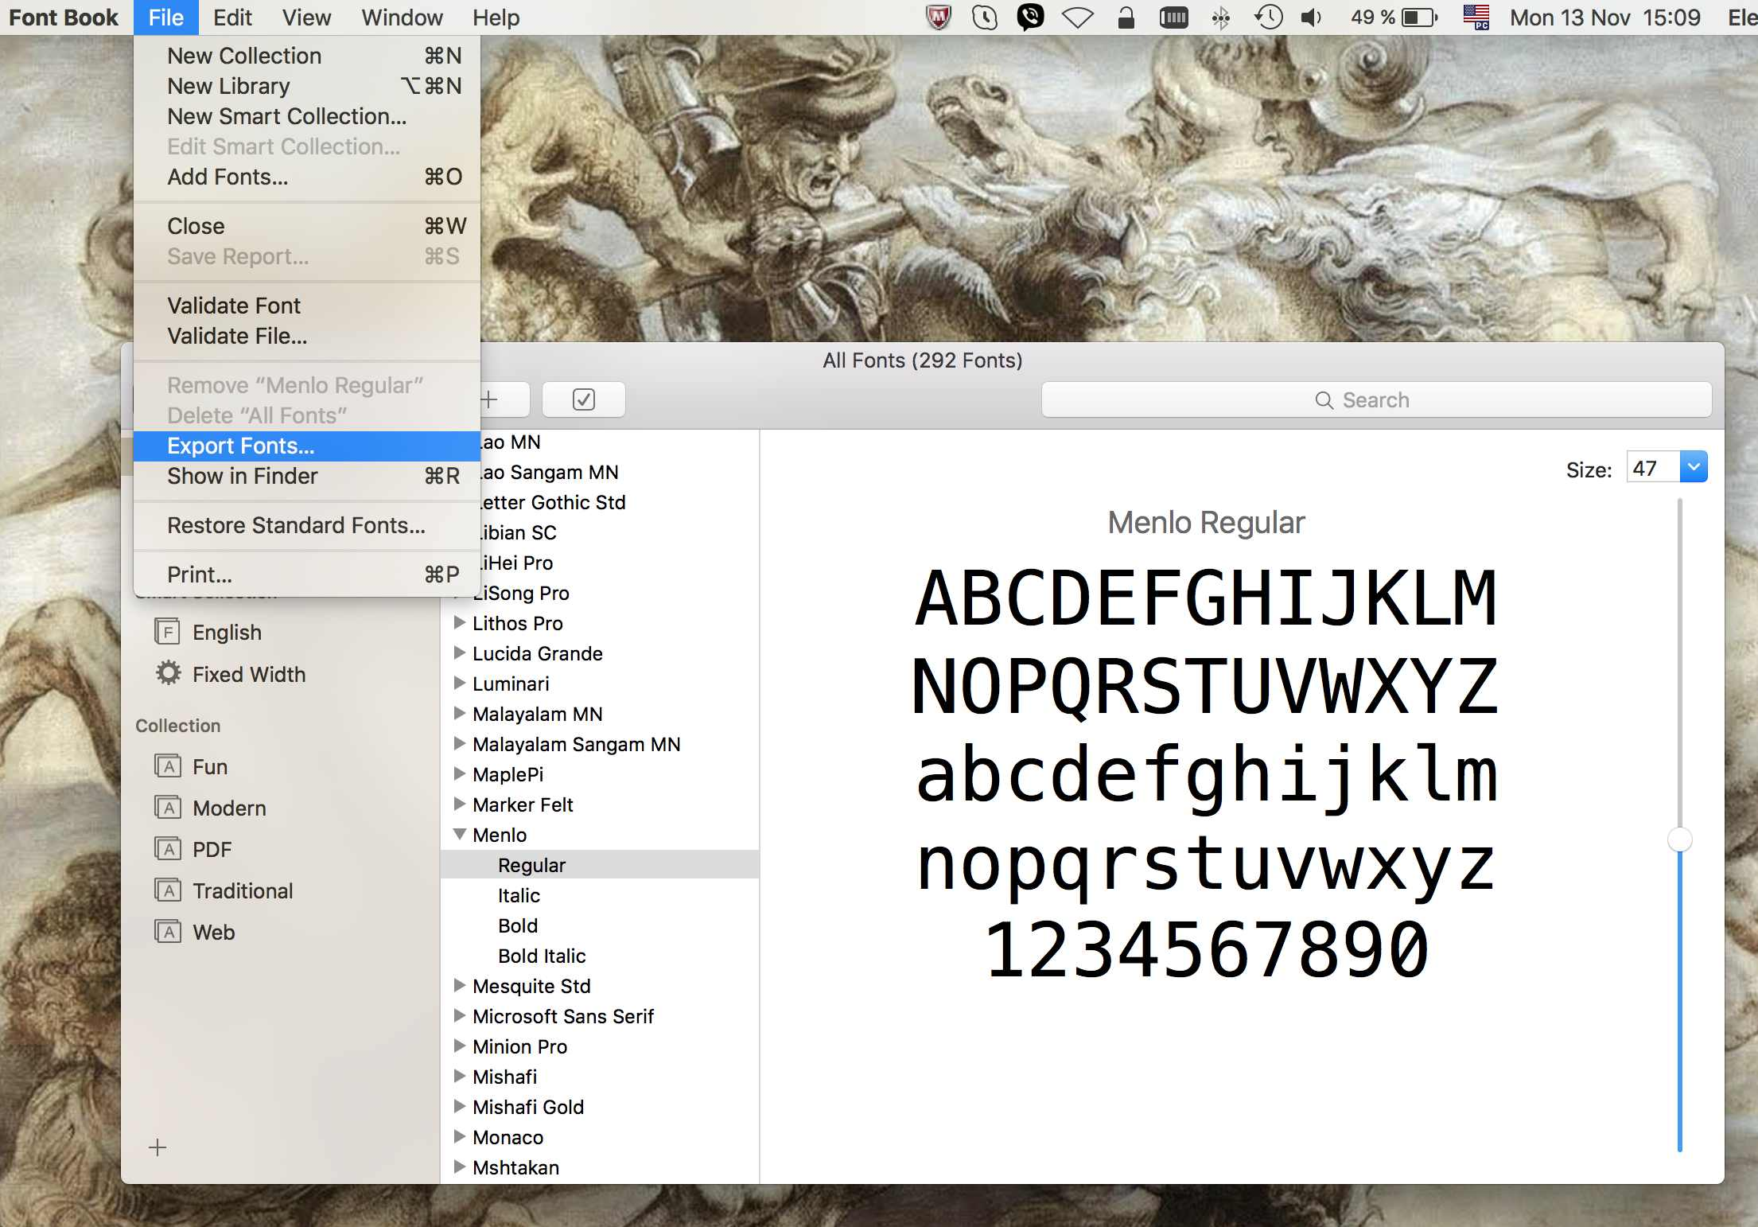
Macintosh fonts
 MAC fonts are typically not installed on a Windows PC in the proceedings office, therefore
the tranparency editor needs to install the MAC fonts by himself
 MAC fonts can be copied from every Macintosh computer, look for Library/Fonts and
System/Library/Fonts or export the fonts from the File menu
 copy the MAC fonts into folder C:\Windows\fonts on the Windows PC

Slide 11
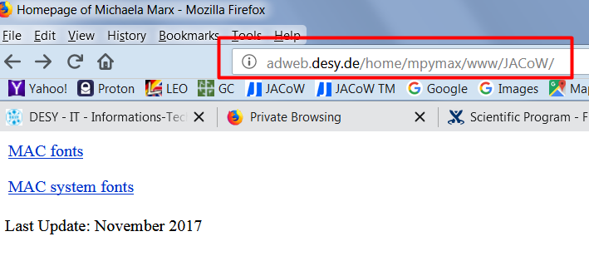
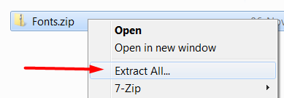
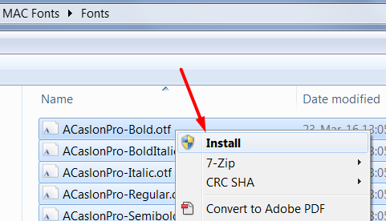
Installation of Macintosh fonts
 MAC fonts can alternatively be downloaded from Michaela’s JACoW web page
https://winweb.desy.de/home/mpymax/www/JACoW/
 download both zip files and do a right-mouse-click to extract the files
 do CTRL+a to select all files and do a right-mouse-click to install the fonts

Slide 12
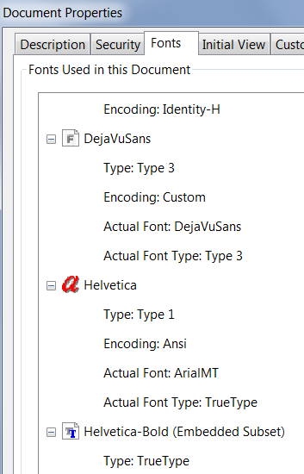
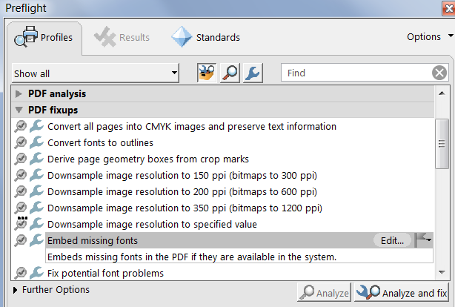
How to embed missing Macintosh fonts in a PDF file
(after the MAC fonts have been installed on your Windows PC)
 Check the font embedding with CTRL+d,
 here DejaVuSans and Helvetica fonts are no embedded
 do SHFT-CTRL-x, select “Embed missing fonts” and click
the button named “Analyze and fix”

Slide 13
Topics
◆ install video transcoder and flash player first
(Handbrake, Adobe Flash Player, Virtual Dub, Lightshot etc)
◆ PPspliT replaced the outdated Split Animations Macro
◆ Check PPT print options - printing slides in High Quality
(for conversion from PPT to PDF using the Adobe PDF printer)
◆ Embedding MAC Fonts on a Windows PC
◆ how to convert wide screen slides - 16:9 or user defined formats

Slide 14



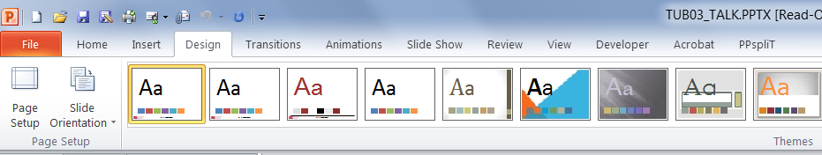
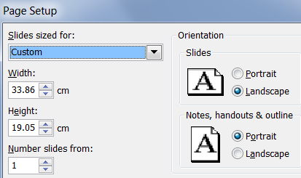
How to convert different slide formats (e.g. 16:9, 4:3 or custom defined)
custom format 16:9 On-screen show 4:3 On-screen show
◆ default slides format for PPT
◆ to check the format → go to Design → Page Setup
◆ the custom format is a special case where
you need to modify the Adobe Printer Properties
to define a new PDF Page Size

Slide 15
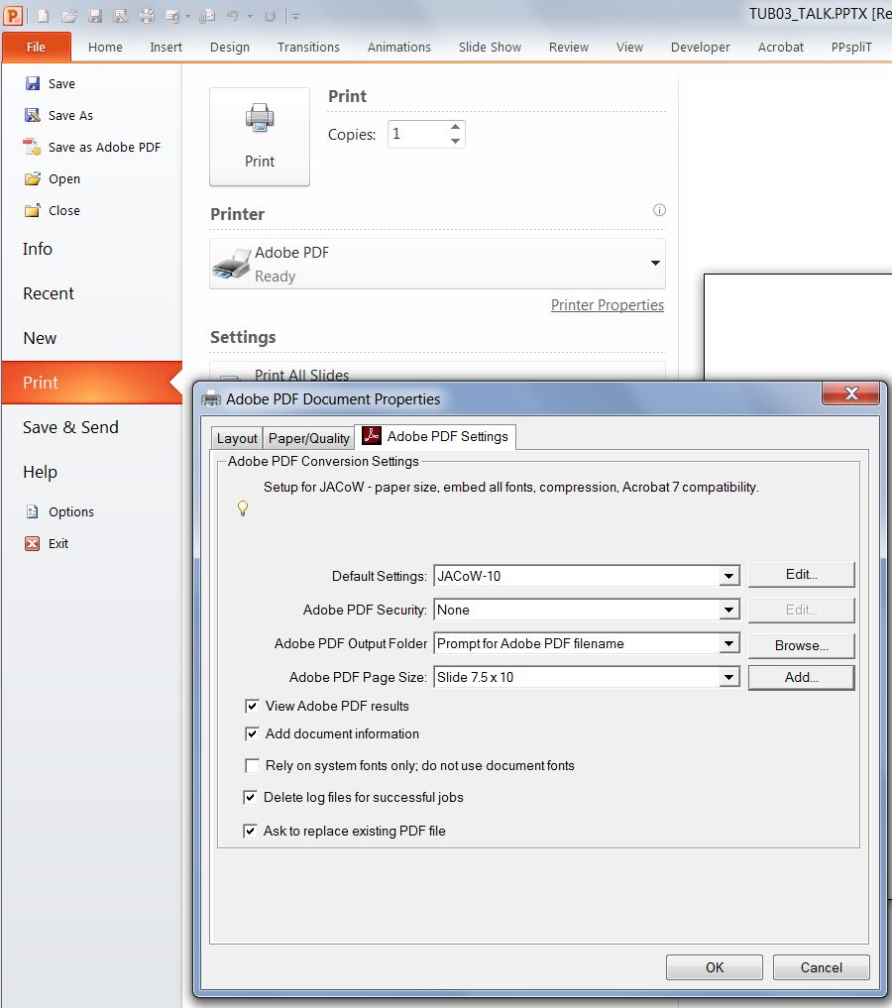
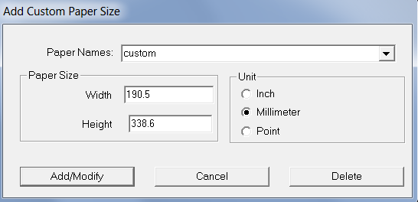
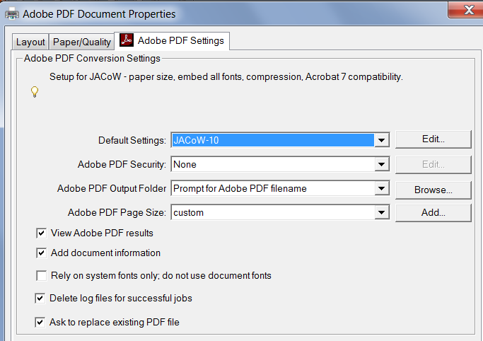
How to convert different slide formats (e.g. a custom defined format)
◆ Give the new PDF Page Size a name, e.g “custom”
and enter the values for width and height the
other way round, which means width will be
height and height will be width…
◆ select “custom” for the page size to print the slides

Slide 16

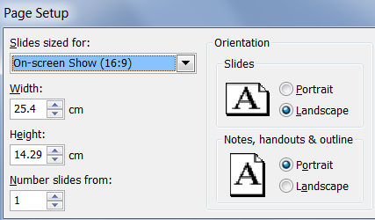
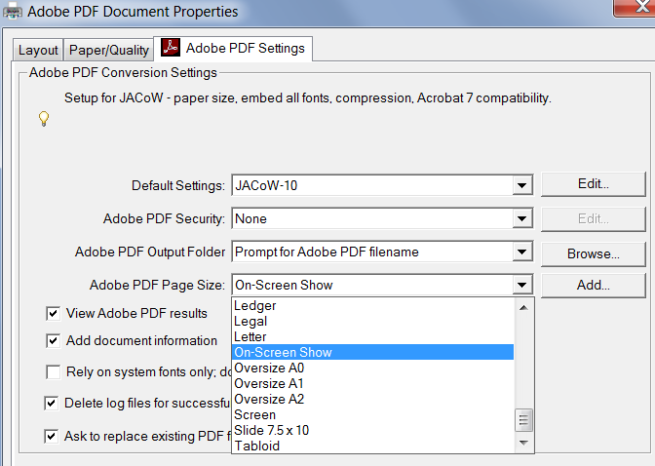
How to convert 16:9 slides
◆ for the On-screen Show (16:9)
select On-Screen Show from
the list of available formats

Slide 17

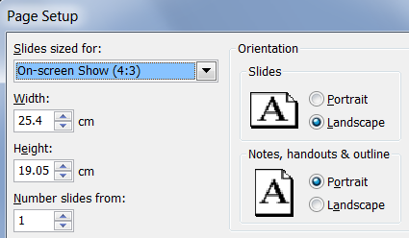
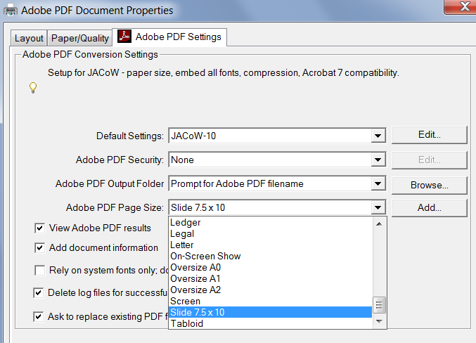
How to convert 4:3 slides
◆ for the On-screen Show (4:3)
select Slide 7.5 x 10 from the list of available formats
◆ this format (4:3) is the default PPT format for slides

Slide 18
JACoW TM 2018: Update on Processing Slides
- what to do before you start –
Topics
◆ install video transcoder and flash player first
(Handbrake, Adobe Flash Player, Virtual Dub, Lightshot etc)
◆ insert PPspliT
◆ print slides in High Quality
◆ install MAC Fonts on a
Windows PC
◆ convert slides to the
correct format
Thank you

