Slide 1
IPAC2016 IT Infrastructure Review
TM2016, Vancouver, Canada
Prepared by Dong-Eon Kim, PAL, POSTECH
Nov. 9 2016

Slide 2
Contents
Previous IT review: IT system is getting important in a conference.
  Extensive review by
  Anthony Cuffe, “Conference IT Systems”, TM2015, Padova, Italy.
Hardware issue:
  http://www.jacow.org/index.php?n=Editors.RecommendedHardware
  The requirements are set long time (?) ago, and it’s rather easy to meet the requirements.
  Required monitor resolution is QHD, minimum requirement is FHD.
  Fast high throughput network printers.
Software issue:
  Required software: http://www.jacow.org/index.php?n=Editors.RecommendedSoftware
  Software bundle (by Raphael) : http://www.jacow.org/index.php?n=Editors.HomePage
  SW licenses: Adobe Acrobat Pro 9
  Enfocus PitStop 12 - 30 day trial licenses http://www.jacow.org/index.php?n=Editors.JACoWSoftwareLicenses
Network bandwidth issue:
Space planning by using sweethome 3D.
We focus on the IPAC16 IT experiences.

Slide 3
Rented Equipment
- Author Reception : i7 desktop 7 sets, Color Printers 3 sets
- Speaker Preparation : i7 laptop 4 sets, Mac book 2 sets
- Editor Room : i7 desktop 22 sets, I Mac 2 sets
- Internet Café : i5 desktop 8 sets, 1 B/W Printer
- Auditorium A : i7 laptop 2 sets, i5 laptop 1 set, Mac book 1 set, 50” monitor 2 sets
- Auditorium B : i7 laptop 2 sets, i5 laptop 1 set, Mac book 1 set, 42” monitor 2 sets
- Dot Board : 42” PDP 5 sets, laptop 5 sets
Good thing about renting is that they installs and supports the installed equipment. Any trouble replacement was immediate. 90% of works are already done before our arrival.
(Of course, all the layout of the PCs, printers, networks are already sent)
Bad thing: it’s costly thinking about only using 2 weeks.

Slide 4
Equipment brought from lab
-Cafissimo capsule machine
-Jura espresso machine. (For proceedings office)
-Cukoo Hot Water Jar (Automatic)
-Hard disk copier
-WiFi Access Points X 5
-Various Cables.
-32” Samsung Monitor
-KP First 30” monitor
-Notebook X 2 (Samsung)
-Chromebook X 1
-Kensington Lock X4 (1:KimDongEon 3:PAL)
-Network HP Printer.
-Samsung Network Printer.
★High throughput expresso machine was very popular. All next IPAC conference should include the machine as a part of IT setup! (major IPAC16 contribution!)

Slide 5
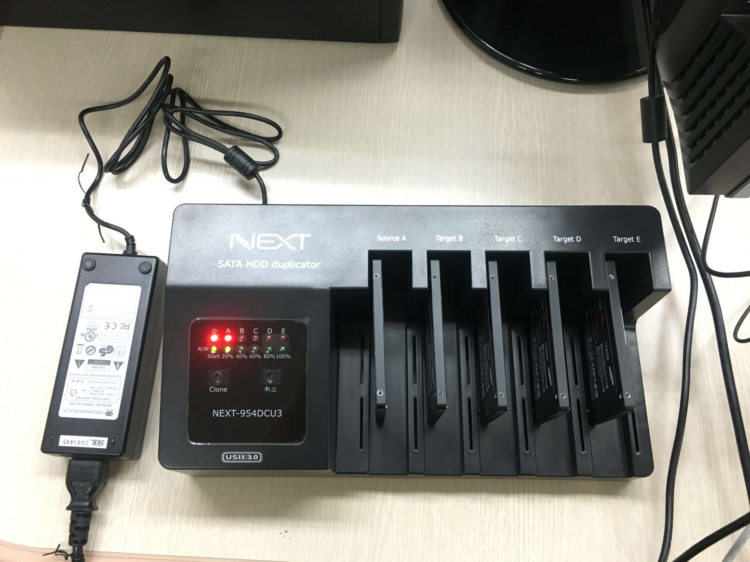
SSD Clone
One already setup ssd was cloned by a copying machine.
It takes about 40 minutes to copy 4 SSD using clone system (Max 6Gbps/min)

Slide 6
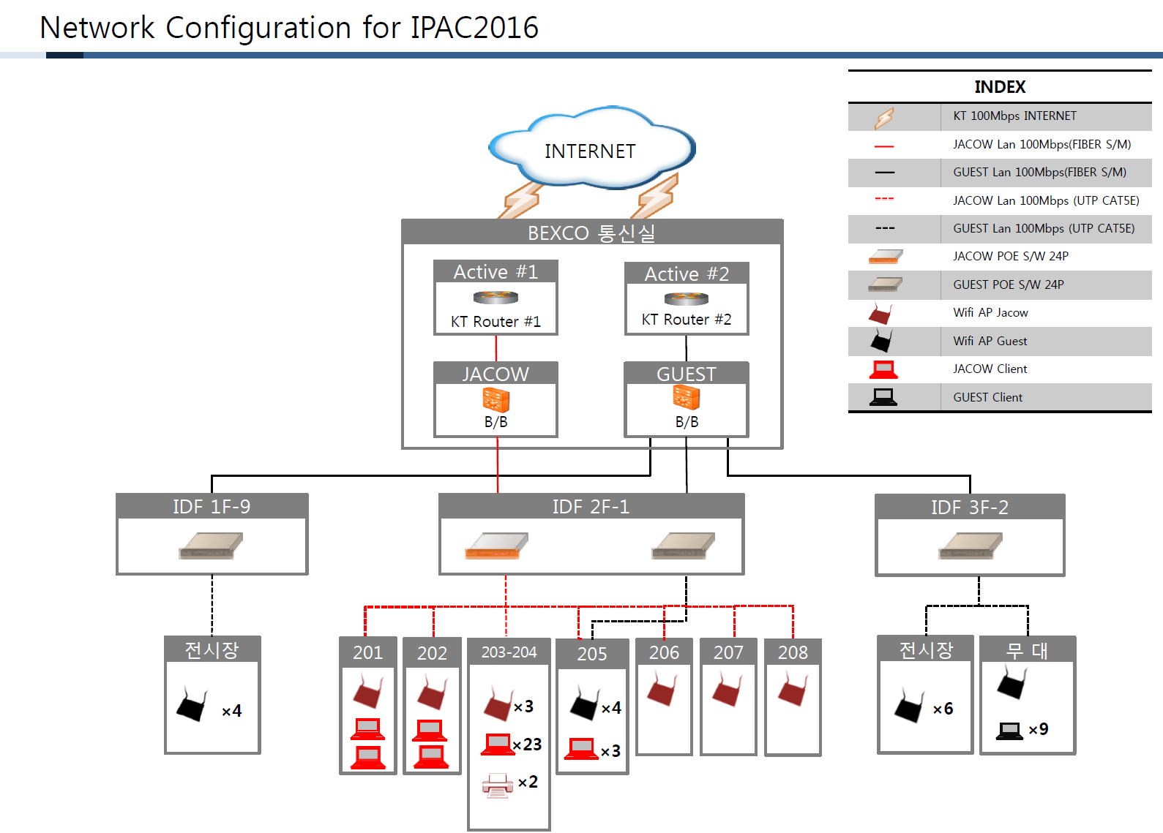
IPAC’16 Network Layout
Although BexcoFreeWiFi already exist, they said it’s not enough for the conference.
100 Mbps Dedicated Network for Proceeding Office and for Staffs.
100 Mbps public WIFI for general public and internet café.
24 Wired Network for Proceeding office, 6 for author reception, 6 for presentation managements. About 30$/port is charged for any additional port!
Total 21 AP all over the except auditorium A (minimizing distraction)
Didn’t have significant complaint about WiFi connectivity and speed.

Slide 7
Leased Network Equipment
Note: 1.1 kWon=about 1.0 USD
Item | Specification | Quantity | Unit | Costs (kWon)
Leased Data Link | KT 100Mbs | 2 | 1 | 5,000
Backbone Switch | 100MB SFP 24Port | 2 | 1 | 1,200
POE Switch | 24port 100Mb+ 2port 1G | 4 | 1 | 1,600
Wireless A.P(JACoW, Staffs) | 802.11A,b,g,n 20user | 8 | 1 | 2,000
Wireless AP(public) | 802.11A,b,g,n 20user | 17 | 1 | 4,250
UTP Wiring Costs | UTP Cabling | 44 | 1 | 1,540
Engineer Support | 2 personal | 2 | 5 | 1,500
Total costs reached 18.8 MWon=16.4 kUSD for the period (we’re paying for 1month)
The costs includes network switches, costs for the leased lines, WIFI AP, wiring costs, and engineer supports for installation and trouble shooting.

Slide 8
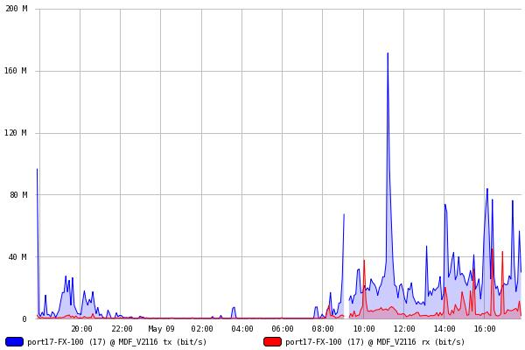
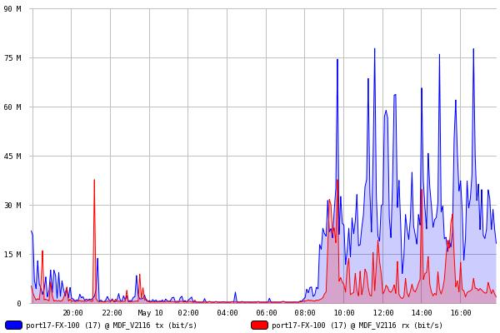
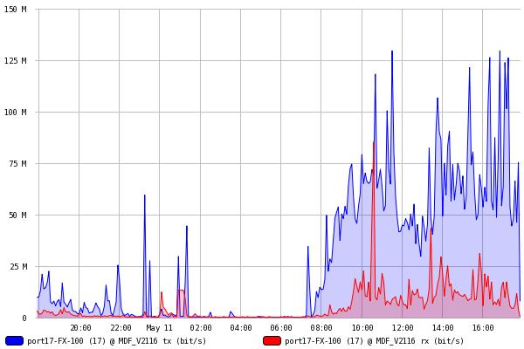
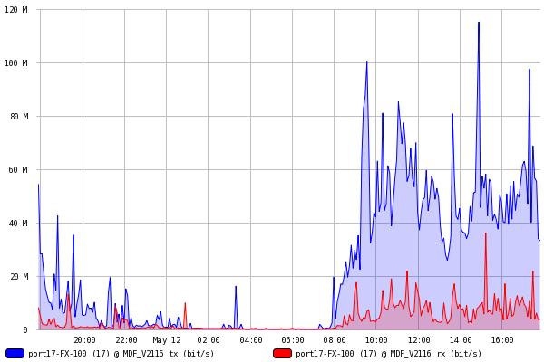
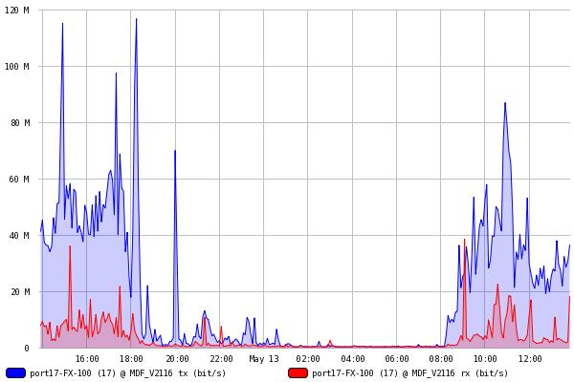
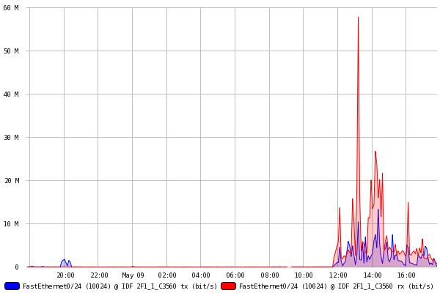
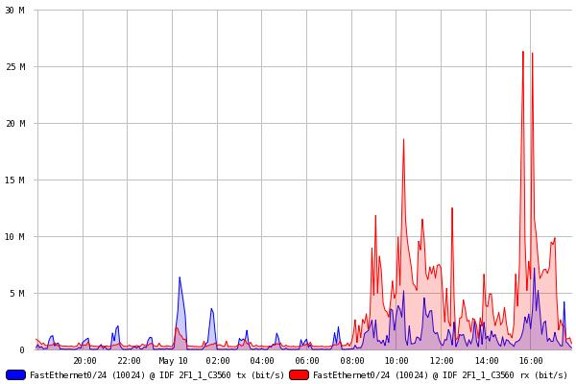
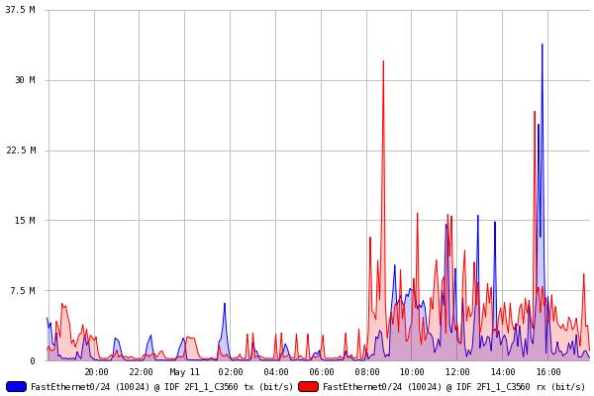
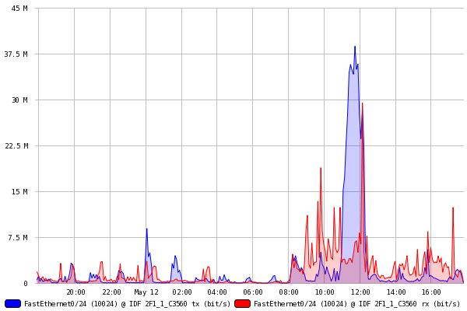
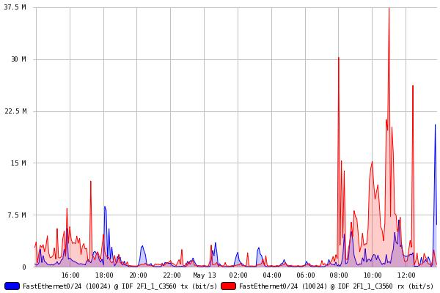
Network Usage from Mon. to Fri.
WiFi Public
WiFi JACoW (Staffs)
Both WiFi public and JACoW (staff) have 100 Mbps bandwidth.
WiFi public reaches full bandwidth sporadically but not saturated in most cases.
WiFi JACoW usage far less than the WiFi public, If bandwidth can be adjusted 50 Mbps+150 Mbps could be better.
In general, the network operated quite well without any congestions (in my mind).

Slide 9
PCs for the Editor room, Internet Café, Auditorium
Item | Key specifications | Quantity | Remark
DESKTOP | Intel i7-4770 (haswell,3.4GHz), 8G DDR3,ssd128G, gtx750,Giga Lan,Win7HPK(64bit) | 30 | For Editor room
MONITOR | 27", 2560*1440, 16:9 | 33 | For Editor room, Extra Monitor
I-MAC | MAC 27" / 4.0GHz4Core(i7)32GB/1TB Fusion/RadeonR9 M295X 4GB | 2 | For Editor Room
MAC PRO | MacBook Pro 15.4" R /2.3GHz 4Core(i7)16GB/256GB SSD/GT 6501GB | 5 | For Auditorium
DESKTOP | better than Intel i5, DDR32.8Ghz, 4G, HDD500G ,21"Monitor | 5 | For Internet Cafe
PDP | PDP 42” with stand (or LCD) | 6 | For E-dot Board
Notebook | Simple Min notebook | 6 | For E-dot Board
High Performance i7 class with 27” QHD monitor costs about 320$/Unit
iMAC for 330$/Unit
MaCBook Pro 250$/Unit
I5 class pc with 21” monitor costs=130$/week
Total Computer rental costs reached 15.1 MWon=13,200$
High performance printer rental cost was too high for the prices and purchase by us.
Low performance BW network printer for internet café is rented.

Slide 10
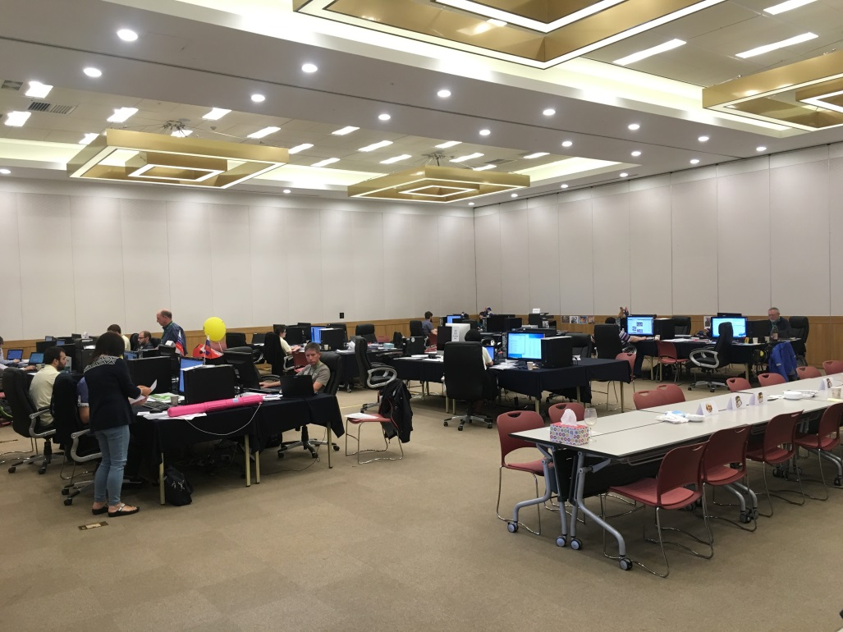
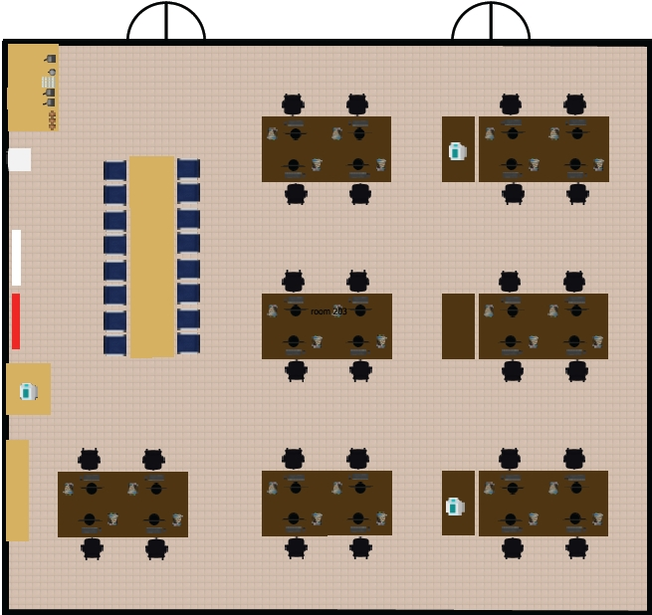
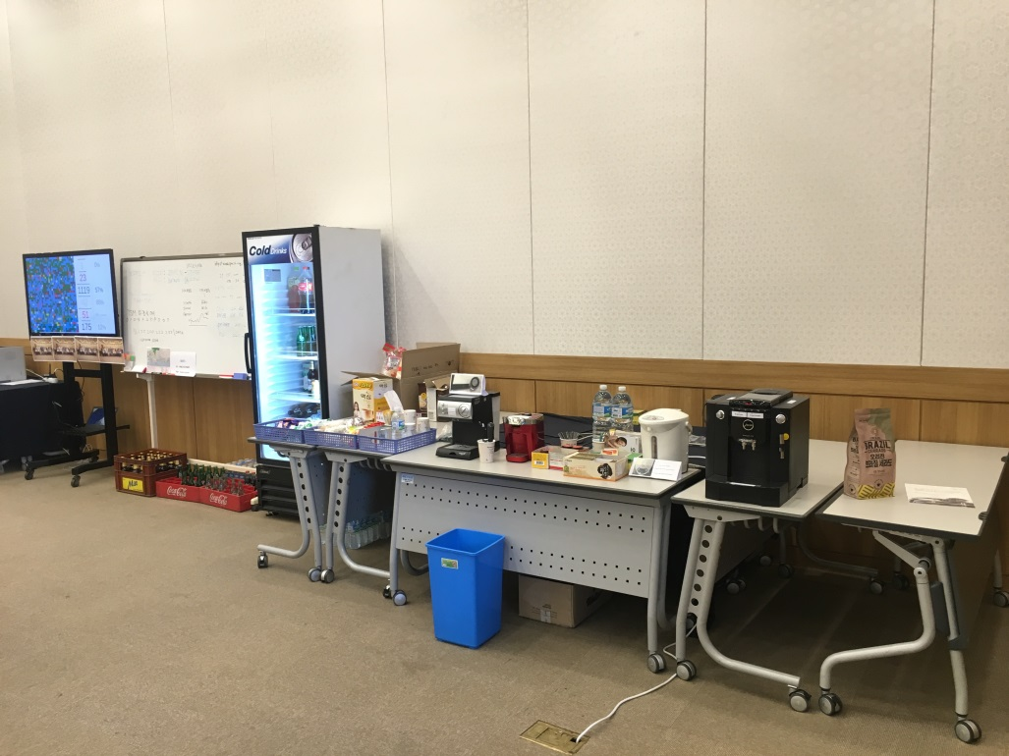
Proceedings Office

Slide 11
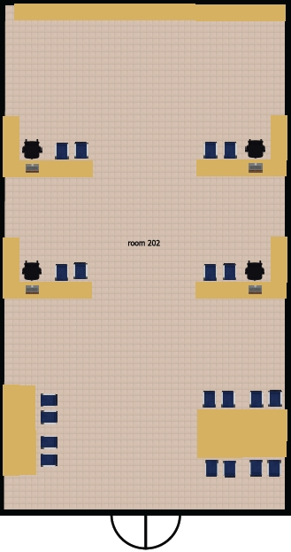
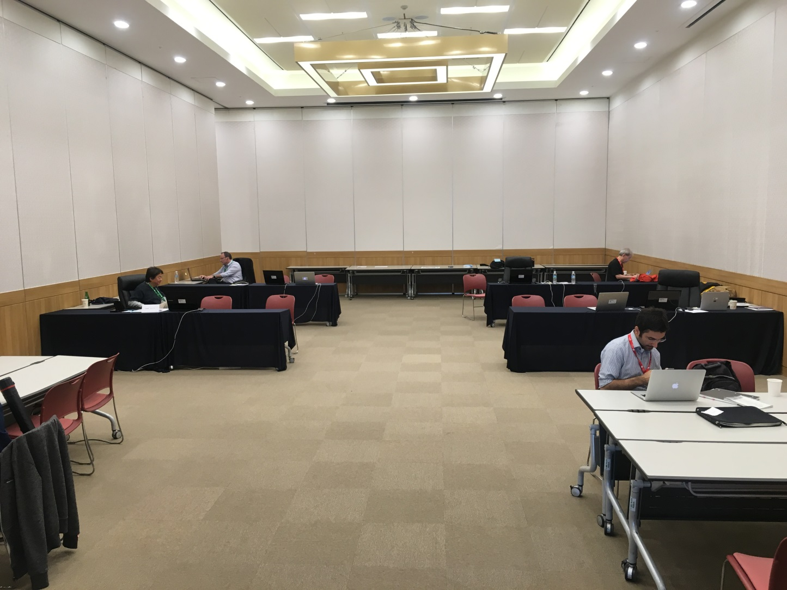
Speaker Preparation Room

Slide 12
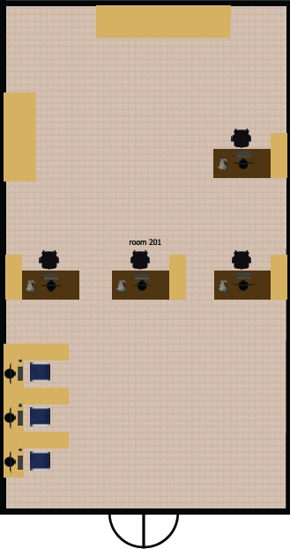
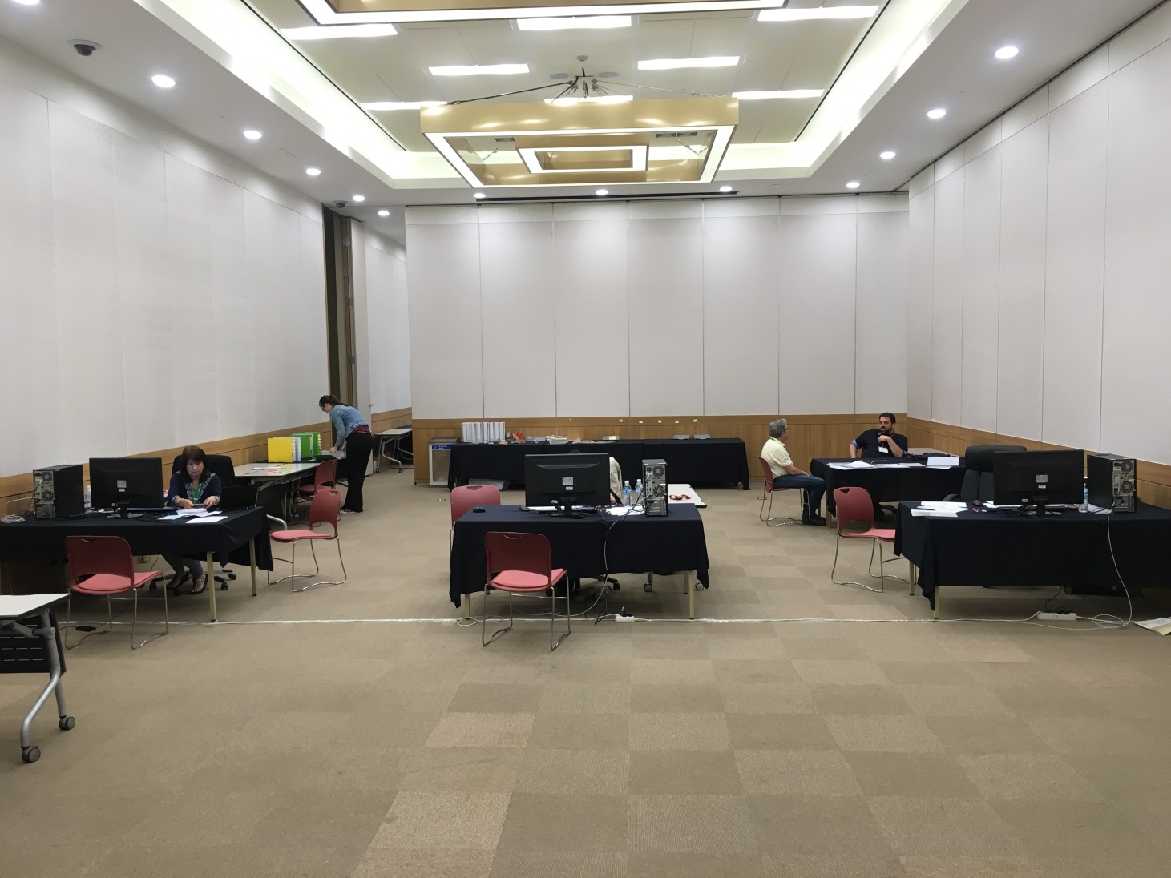
Author Reception

Slide 13
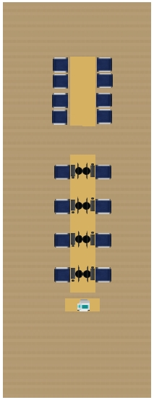
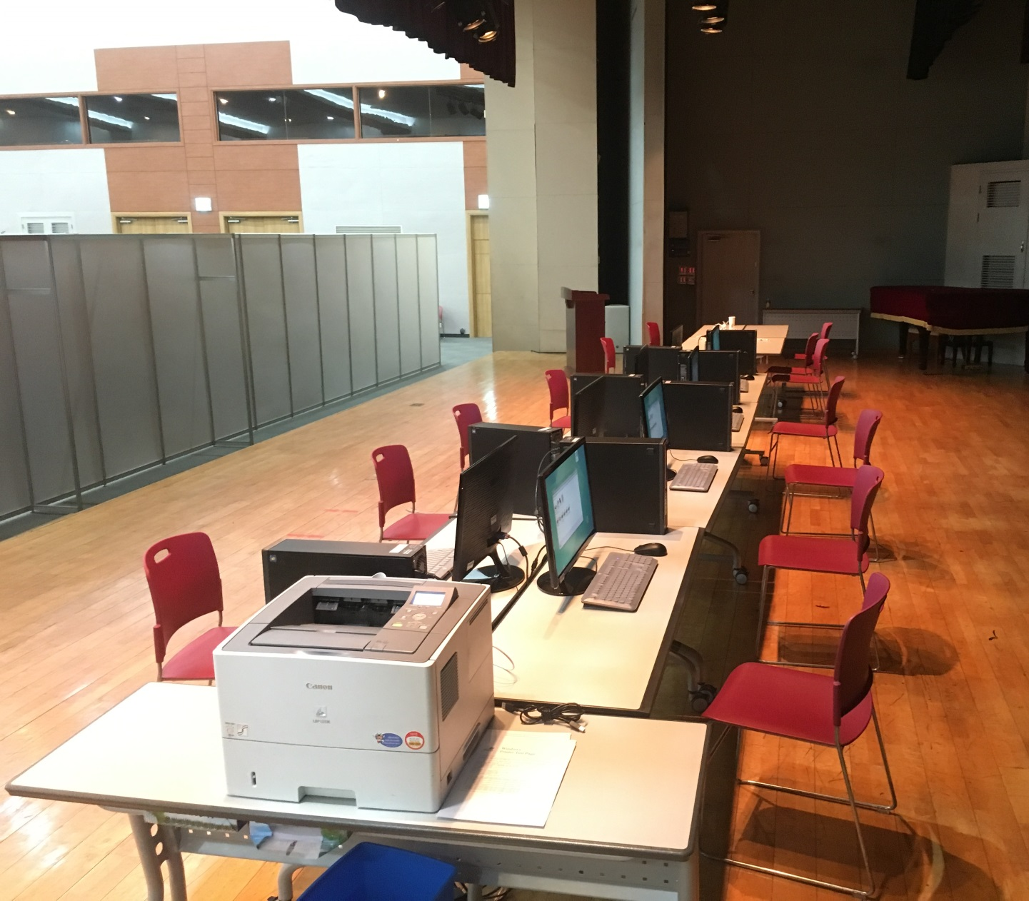
Internet Cafe

Slide 14
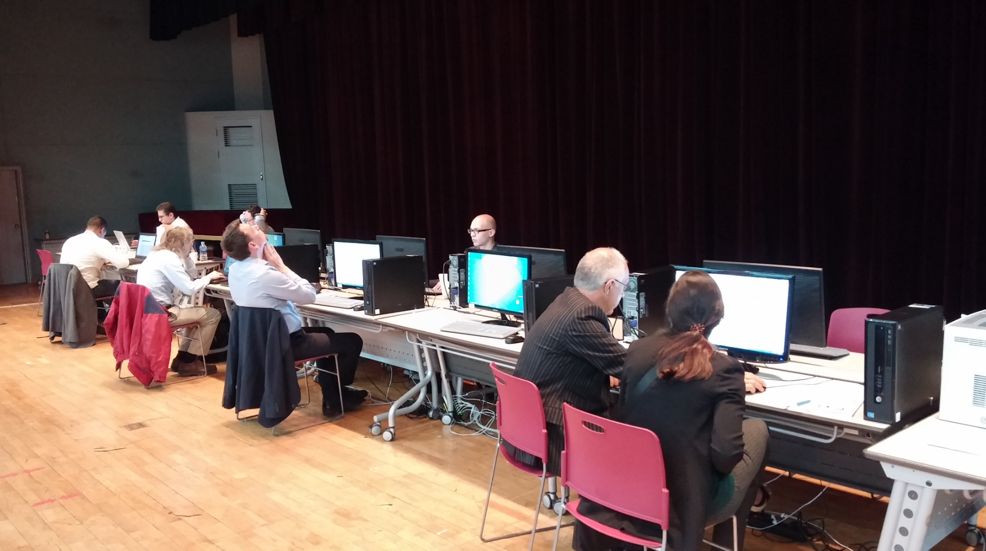
Internet Cafe
Internet Café was located at the 3rd floor stage
8 X i5 PC’s and one networked BW printer is setup. The PCs have security measure recovering back to original state after rebooting.
4 spaces for laptop user with WIFI accessibility is setup
10 mobile charging stops for android, iPhone are setup.
8 PCs are well utilized and 8 PCs are good number since most of the participants have their own laptop.
Delegate started to use the internet café from Sunday morning just after the installation. Installing, debugging on Saturday afternoon would be preferable.

Slide 15
8PCs can be good compromise. It would be better if we had more table’s and chair’s around the venue for laptop users. Some laptop users occupied table space at the presentation management for their work.
Proceeding office:
Some 22PC’s and 2 iMAC are rented, and printers are mostly purchased since the rental fee was too high compared to the costs.
SW : JACoW SW packages worked well.
While MS office 2010 is installed for the JACoW PCs, Presentation management and the laptops for the auditorium needed more upto date version of office. Since the rental company didn’t have more updated version, MS office 2013 is downloaded from the university (which has a site license) and installed for the presentation preparation.
Other SW setup, and the acrobat option settings survived after cloning. However, Imaging cleared the Pitstop trial license. Needed to pitstop 13 and re-input userid, password again to activate the 30day trial license for each computer.
Proceeding office mostly worked fine. # of pages printed reached 17000 pages. (That includes the booklet for student poster, and printing of title pages for author reception)
At the Sunday evening, 79% of the submitted papers are already processed. By Tuesday, we could finish 100% and already started QAing at the afternoon of the Tuesday. The progress looks OK.
Instead of the dot board in the SPMS system, a more developed version by Stefano is used.

Slide 16
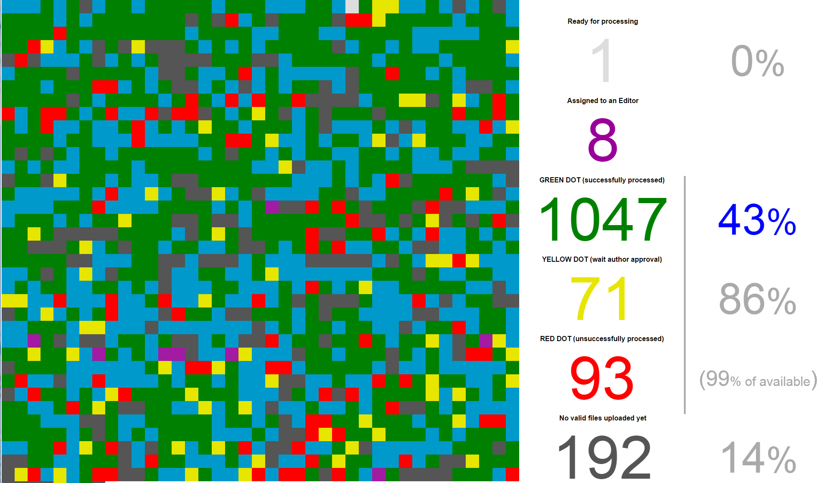
Stefano is watching our performance!
New status web screen by Stefano! Proceeding office at a glance.

Slide 17
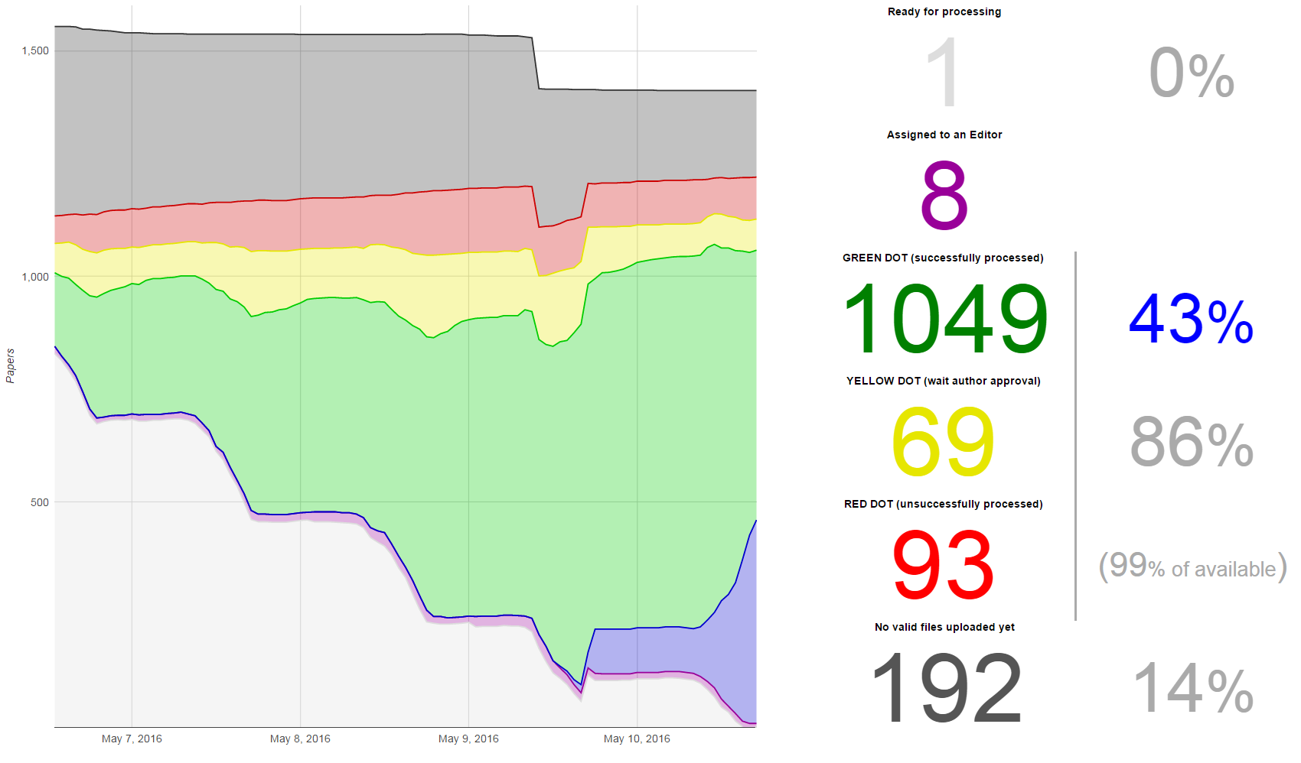
Stefano is watching our performance!
New status web screen by Stefano! Proceeding office at a glance.
Total submitted paper reached 1220 among 1412 maximum with submission rate 86.4%, still increasing…
Dip in the total paper number is due to the double counting of the student poster.
Processed 79% of the submission at the end of the Sunday, and processed 100% at the end of Tuesday and started QAing. (Very close to the Chris’s prediction and the previous conferences)

Slide 18
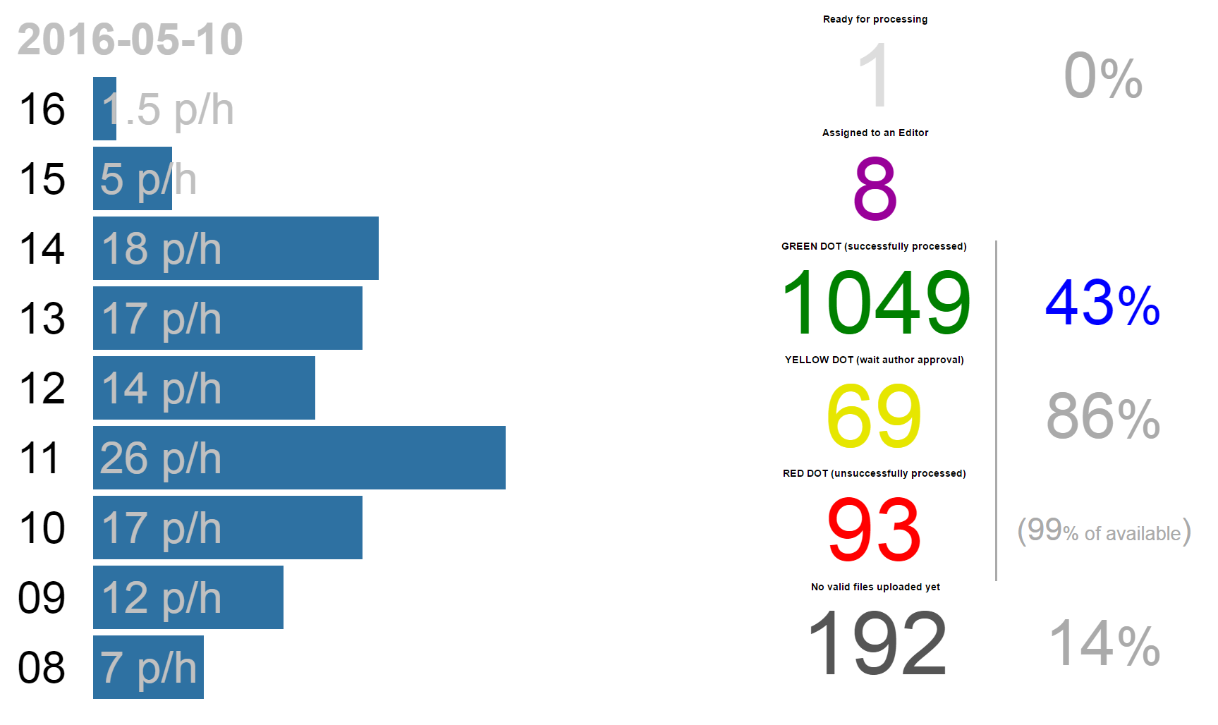
Stefano is watching our performance!
Proceeding office processing speed. Maximum reached about 40 p/h.

Slide 19
Issues or Summary
Conference IT worked mostly uneventful.
Cloning hard disks was helpful in saving efforts. To activate pitstop, it needed to reenter the email, and password again.
After installation at the proceedings office, it was found that the MS-related products (MS office) was not updated. The check button to update the “Update also MS-related products” was disabled. After some googling, it was found that we need to install “Silverlight” to enable the button. Therefore, after installing “Silverlight”, and checking the “MS-related…” button, all computers are updated again.
Bandwidth 100 Mbps for proceedings office is more than enough. 100 Mbps for delegates “WERE” barely enough but may require more for upcoming conferences!
Documents for IT setup, and SW setup were actually very good, but somewhat scattered in many places. It could be better if somebody can compile all the documentation in a single documents and maintain it for new conference.

Slide 20
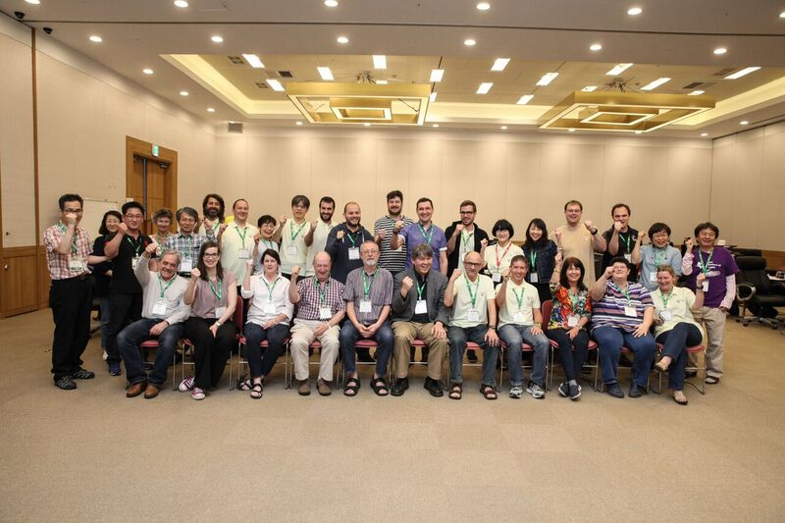
Group photo

Slide 21
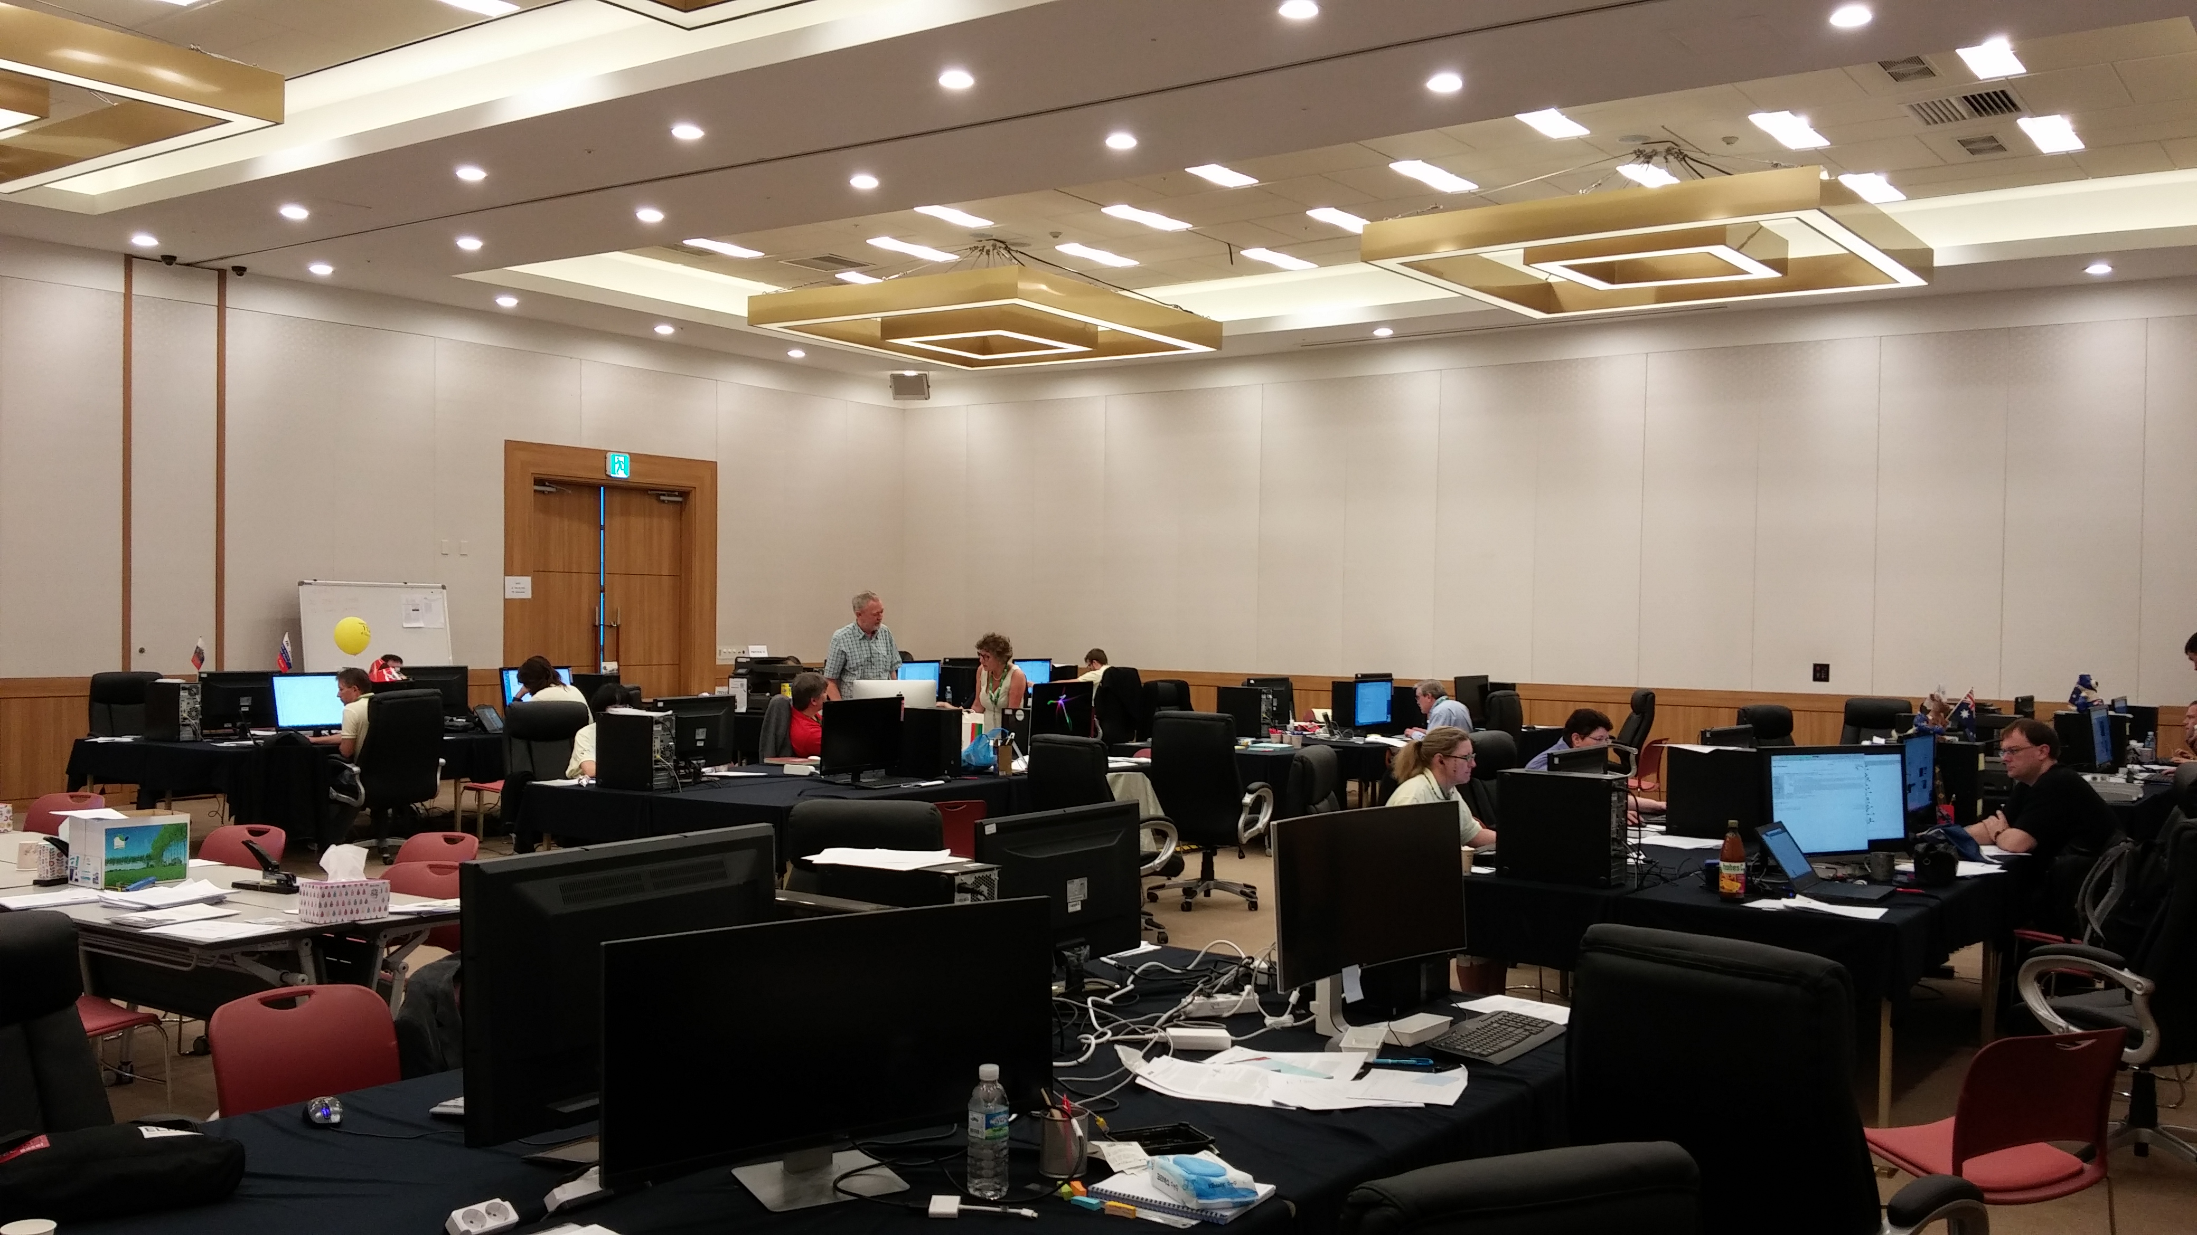
Photo of the Proceedings Office

Slide 22
