Slide 1
Collaborative Tools
Slack…Mattermost…Discourse
Adrian Mönnich, CERN JACoW TM 2017, Beijing

Slide 2
What everyone has
Email
Sometimes too formal
Not real-time
Limited audience vs spammy mailing lists
Phone
Very intrusive

Slide 3
Alternatives
Chats
Real-time
Usually informal, short messages
Social aspect
Little structure within a channel/room
Messages are (semi-)ephemeral

Slide 4
Alternatives
Forums
Not real-time
Usually somewhat informal
Topics well-structured
Topics/Posts kept for a long time
Usually searchable

Slide 5
Mattermost
Open Source (Enterprise edition available)
Self-Hosted
Free mobile app (Android & iOS)
Push notifications (Desktop & Mobile)
Very limited SSO and permission system

Slide 6
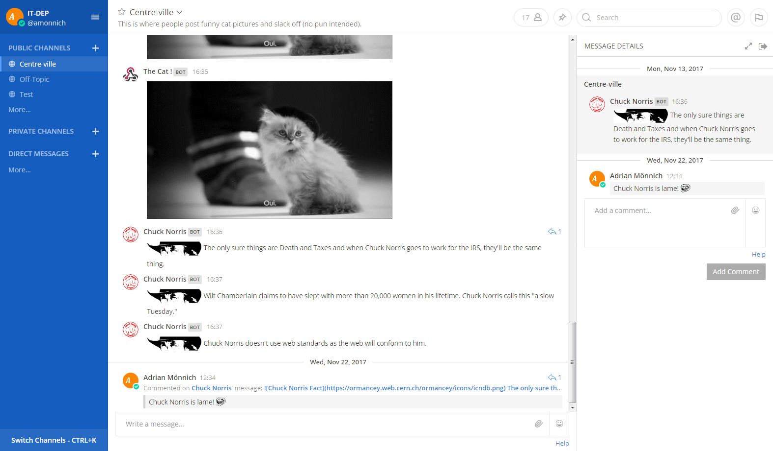

Slide 7
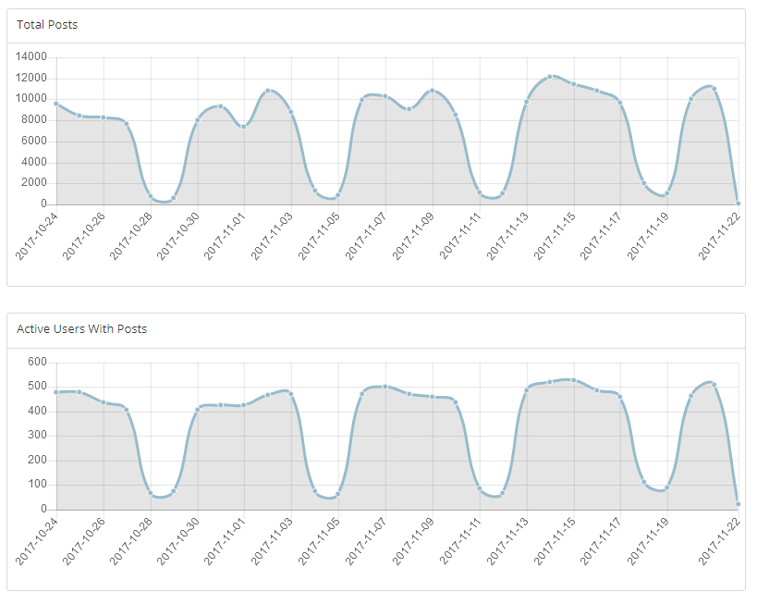
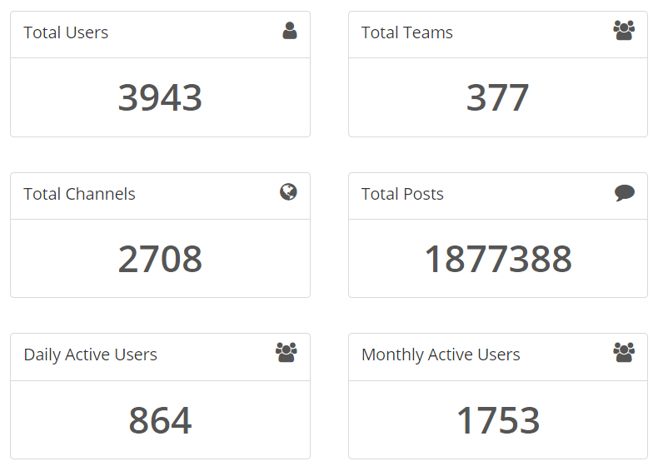
Mattermost at CERN

Slide 8
Messages per day

Slide 9
Slack
Cloud-based
Free and paid plans available
Free mobile app (Android & iOS)
Push notifications (Desktop & Mobile)
Want SSO? Have your credit card ready!
Very “in” nowadays!

Slide 10
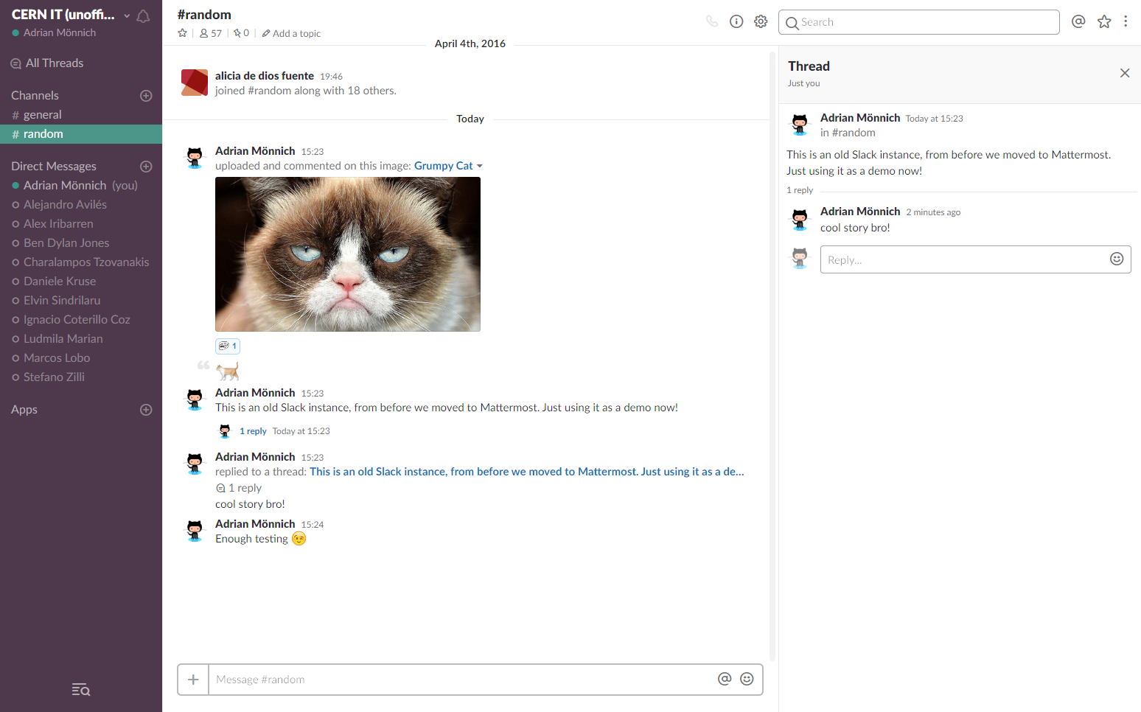

Slide 11
Integrations
Available in both Slack & Mattermost
External systems can react to messages and send messages on their own
Mostly useful for technical/development topics
Notifications about new tickets, issues, etc.
Chat messages can trigger external actions

Slide 12
Discourse
Forum, not a chat
Open Source (Cloud available)
No “cloud/enterprise-only” features
Mobile apps
SSO/Social login

Slide 13
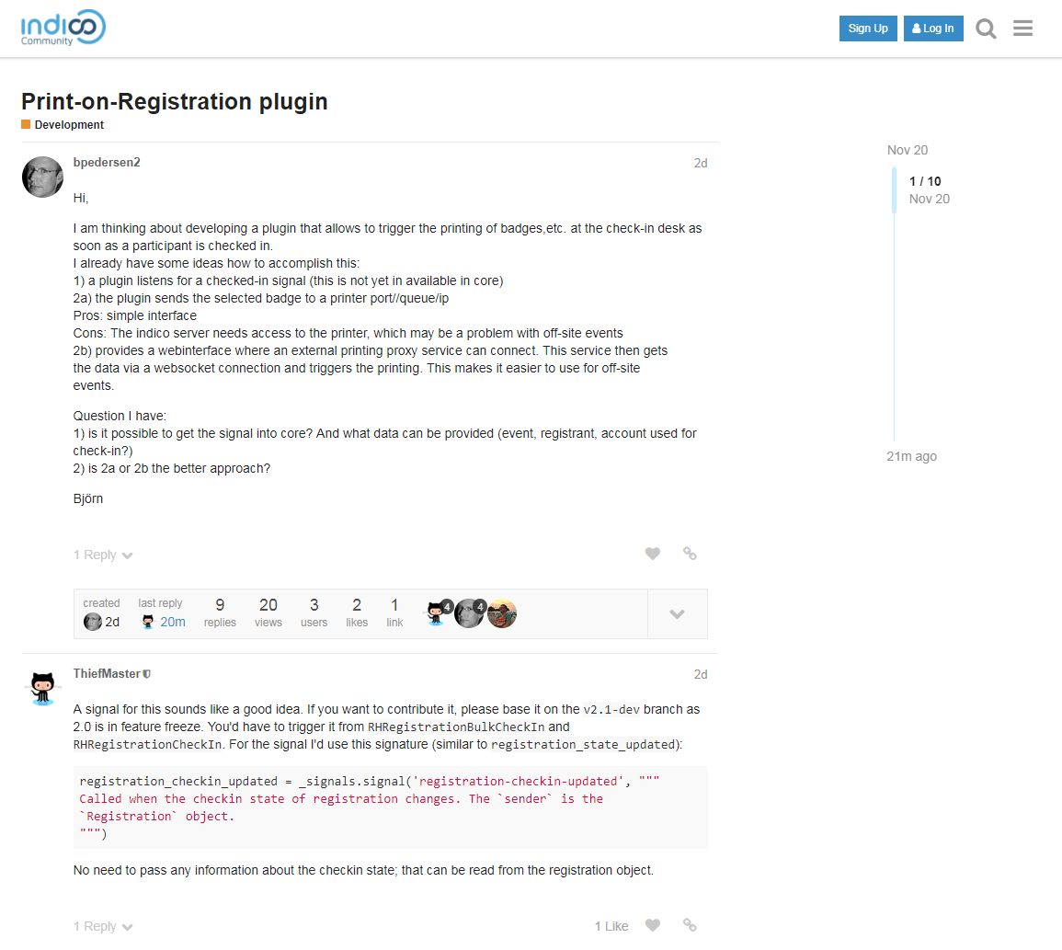
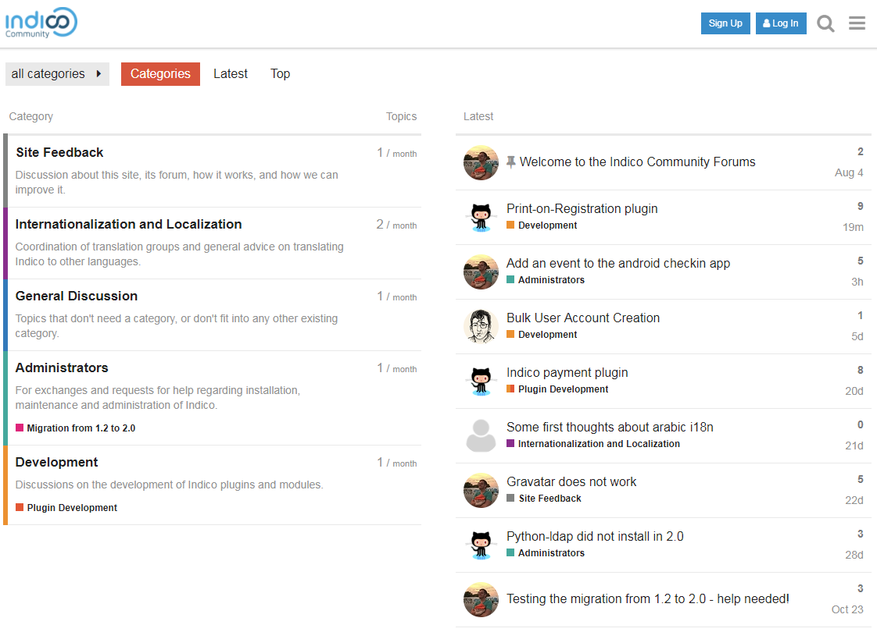

Slide 14
What is better?
Depends on your goals, users, and budget!
Mattermost / Slack
SSO? Many users? Hosted service?
Discourse
Many users with ‘staff’ privileges?
Hosted service?

