Slide 1

IPAC’17 Operations Review
Contact: Juliana Pranke / Johan Olander / Garry Trahern
IPAC'17, the Eighth International Particle Accelerator Conference, was held at Bella Center Copenhagen, Denmark, from May 14-19, 2017

Slide 2
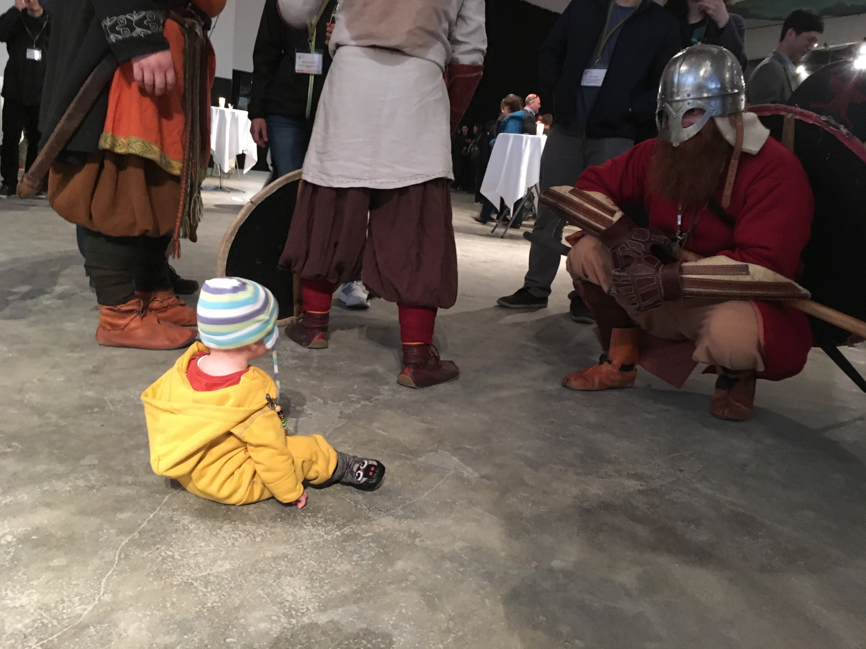

Slide 3
Work Distribution
IPAC’17 was organized by the LOC (with members from all three hosting institutions, i.e. ESS, MAXIV and Aarhus University as well as a Danish PCO (DIS Congress)). The PCO covered the following aspects:
  registration (all types, incl. exhibitors, except JACOW) online and on-site, incl. collection of all fees
  sending of invoices to the sponsors and collection of sponsor money
  block-booking and managing almost 700 rooms in the 6 conference hotels
  managing the companion programme (they outsourced this to a tour guide company)
  sending out official invitation letters (e-mail only) to those requesting it for visa
  initial exhibitor coordination

Slide 4
IPAC’17 LOC Members – contact us with questions if need be
Mats Lindroos (LOC Conference Chair)
Håkan Danared (Deputy LOC Chair)
Volker Schaa (Chief Editor)
Garry Trahern (Proceedings Office Coordinator)
Juliana Pranke (Project Leader and Scientific Secretary)
Caroline Prabert (Student Programme Manager)
Inga Tejedor (Technical Tours Manager)
Mikael Johansson (Presentation Manager)
Rob Yarbray (Industrial Exhibition Manager)
Roger Eriksson (Sponsoring and Industry Support)
Henno Gous and Daniel Friis (Website Support)
Johan Olander (IT Manager, AV coordination onsite)
Søren Pape Moeller & Sverker Werin (Public Lecture, Tour to ASTRID2)
Ann Frisenborg Marker & Tutti Johansson Falk (Public Affairs)
Dušan Stric (Satellite Meeting Manager)

Slide 5
IPAC’17 LOC Onsite Support and PCO
Alexandra Schmidli (Students, Posters, Session)
Caroline Holgersson (Students, Posters, Session)
Julia Öberg (Press)
Helle Klestrup (Overall PCO Support)
Peder Andersen (Industry Exhibitor Coordination)
Rikke Blæsberg (Visa, Registration)
Charlotte Nielsen (Accommodation)
Jørgen Nielsen (Poster Police)
Heine Dølrath Thomsen (Poster Police)

Slide 6
Chairs and other Functions
OC: Gianluigi Arduini (CERN)
SPC: Mike Seidel (PSI)
LOC: Mats Lindroos (ESS)
EPS-AG Prizes: Oliver Brüning (CERN)
PRAB Chief Editor: Frank Zimmermann (CERN)
Student Poster Session: Oliver Boine Frankenheim (GSI)

Slide 7
Timings and Milestones 2015
June: Formation of OC and SPC
September: Request for IPAC’17 SPMS instance
3-4 December: OC/1 and SPC/1 Meeting in Lund, Composition of SAB and IPAC’20 destination decision

Slide 8
Timings and Milestones 2016
February: Call for Proposals of Invited Orals sent to OC/SPC and SAB
April: First Conference Announcement sent to Industry
13-14 May: SPC/2 in Busan after IPAC'16 (Invited Oral Talks)
July: Invitations sent to Invited Oral speakers
August: EPS-AG Prize Committee Starts Activity, Call for Preliminary Proposals
11 October: Conference Announcement sent out via SPMS/Registration for Delegates and Abstract Submission open
7 November: Opening of Industry Exhibition Registration
2 December: Deadline of Abstract Submission, Prize and Student Grant Applications

Slide 9
Timings and Milestones 2017
18 January: EPS-AG Prizes Decision
19-20 January: SPC/3 Meeting in Caen, France (Contributed Oral Talks)
11 February: Grant Students informed
14 March: Early Registration is closed
24 April: Peer-Review Paper Submission deadline
10 May: JACoW Paper Submission deadline
18 May: OC/2 Meeting
19 May: Pre-Press Publication of JACoW Proceedings
21 June: Final Publication of JACoW Proceedings
12 July: 34 potential PRAB authors contacted

Slide 10
Registration Status (16 May 2017)
Early registration EPS members: 70
Late registration EPS members: 13
Early registration other: 732
Late registration other: 262
Grant students: 97
Exhibitor Full Delegate pass (incl. in booth): 174
Exhibitor Only pass (incl. in booth): 57
Exhibitor pass extra: 83 (+15 onsite)
Exhibitor Tuesday pass: 3
Fee waived: 3
JACOW: 25
other: 54
TOTAL: 1588
Companion: 66
Notes:
Devil is in the details, exceptions, cancellations etc.

Slide 11
Visa
Official letters to all participants requesting them for visa purposes were sent by the PCO, by e-mail only, after the PCO had been assured by the Danish Embassy in Beijing that an electronic copy is sufficient if it is obvious that is was sent from an official source (like DIS Congress Service).
This saved time, money, and the rainforest, and is recommended for future practice.
Notes:
Devil is in the details, exceptions, cancellations etc.

Slide 12
Social Events
Welcome Reception: 1382 (approx. 800 showed)
Chairman’s Cocktail: 205
Conference Reception (DOCKEN): 1357
OC Dinner: 44
Banquet: 1321 + 20 onsite bookings (approx. 1250 showed)
Technical Tours: 306 (sold out)

Slide 13
Companion Programme
City and Harbour Tour – Sunday 14 May, 14:30 – 2,5 hours: 47
Castle tour of North Sealand – Monday 15 May, 9:00 – 7 hours incl. lunch: 34
Walking Tour – Tuesday 16 May, 9:00 – 4 hours incl. lunch: 26
Karen Blixen Museum and Louisiana Art Tour – Wednesday 17 May, 9:00 – 5 hours incl. lunch: 19
Royal Copenhagen Tour – Thursday 18 May, 9:00 hrs. – 5 hours incl. lunch: 34

Slide 14
Delegate Origin per Country
(status 12 May)
Notes:
1551 participants from 34 countries

Slide 15
Spain | 39
The Republic of Korea | 36
Russia | 27
The Netherlands | 25
Canada | 21
Taiwan | 13
Slovenia | 12
Poland | 11
Austria | 7
Thailand | 7
Armenia | 4
Australia | 4
Finland | 4
Norway | 4
Belgium | 3
Jordan | 3
Turkey | 3
Ukraine | 3
India | 2
Iran | 2
The Republic of Belarus | 2
Brazil | 1
Czech Republic | 1
Mexico | 1

Slide 16
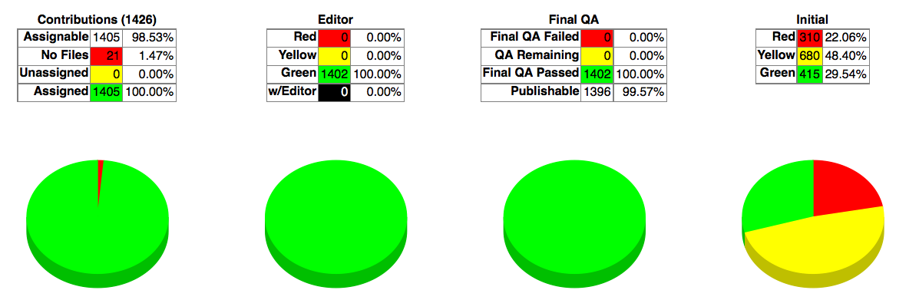
JACoW Statistics

Slide 17
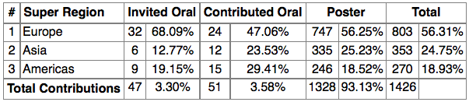
JACoW Statistics

Slide 18
Grant Students
97 grant students (out of 203 applications)
41 Asian
42 European
14 American
1 student from Iran not attending because of visa delay
124 posters at Student Poster Session
Notes:
1 grant student could not make it due to visa delay
1 chinese not attending due to travel delay
Handing out of per diems took way longer than expected
Scient tasks - kept it at a minimum

Slide 19
Industry Exhibition
Single Booths: 68 + 16 (for Swedish Delegation)
Double Booths: 17
Islands/Delegations:
  Dutch
  Danish
  Swedish
  Spanish
TOTAL: 115 Companies from 16 countries
Booth Sales: 580 000 EUR
9 desk spaces for Learned Societies, IPAC’18 etc.

Slide 20
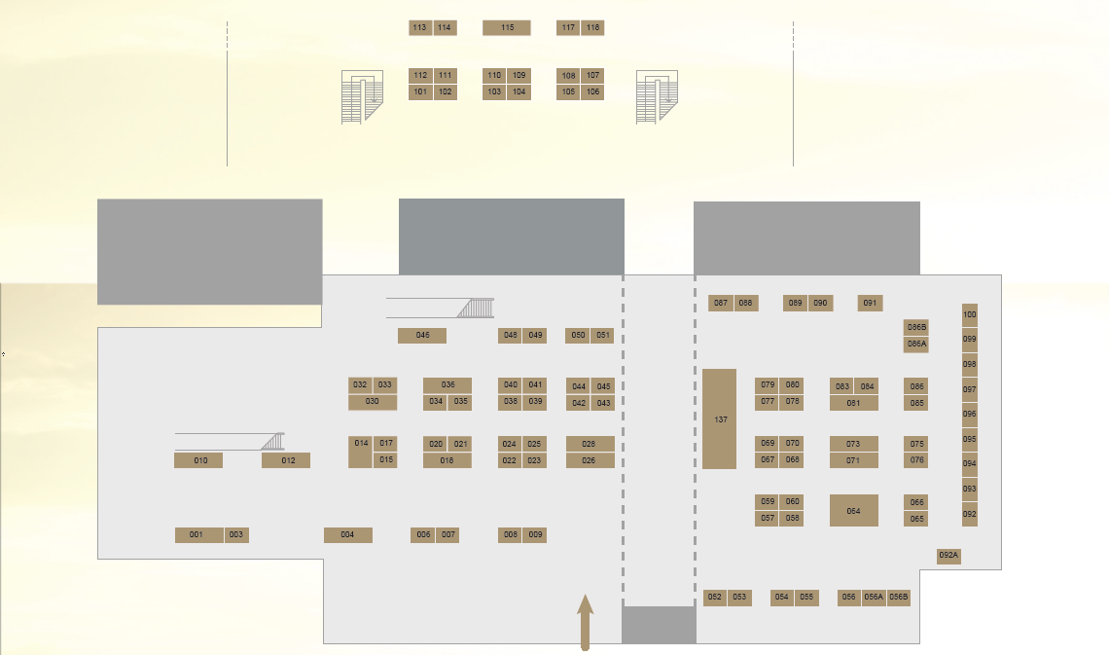
Industry Exhibition Layout

Slide 21
Sponsoring
Ampegon | Bag and IC membership
Betsa | Promo Tool and Insert in Bag
CPI | Industry Committee membership
Copenhagen Capacity | Lunch&Learn
Cosylab | Bag
Danfysik | IC membership
Danish Technological Institute | Public Lecture Support
Dimtel | Lanyard
Research Instruments | Bag and IC membership
Rhode & Schwartz | Lunch & Learn, Insert in Bag, App splash
Scanditronix | Company Ad Back Cover
SigmaPhi | Notepad
Tesla | Company Ad Interior Page
Capital Region of CPH | Conference Support
Wonderful Copenhagen | Public Lecture and Reception
TOTAL SALES | 80 000 EUR

Slide 22
Poster Exhibition
Session Date |  | Planned | Actual Count
Sunday (Student Session) | 14-MAY-17 | 120 | 124 (posters)
Monday | 15-MAY-17 | 406 | 328 (papers)
Tuesday | 16-MAY-17 | 420 | 345 (papers)
Wednesday | 17-MAY-17 | 398 | 313 (papers)
Thursday | 18-MAY-17 | 435 | 342 (papers)
Total |  | 1659 | 1452 (87.5%)
The initial number of posters abstracts (in February 2016) was 1973.
Notes:
There were 4 last minute Student Posters from non-Grant Students which were allowed into the Student Poster Session.
I do not have the actual number of posters, but there were many withdrawals and no-shows after the poster code assignment..

Slide 23
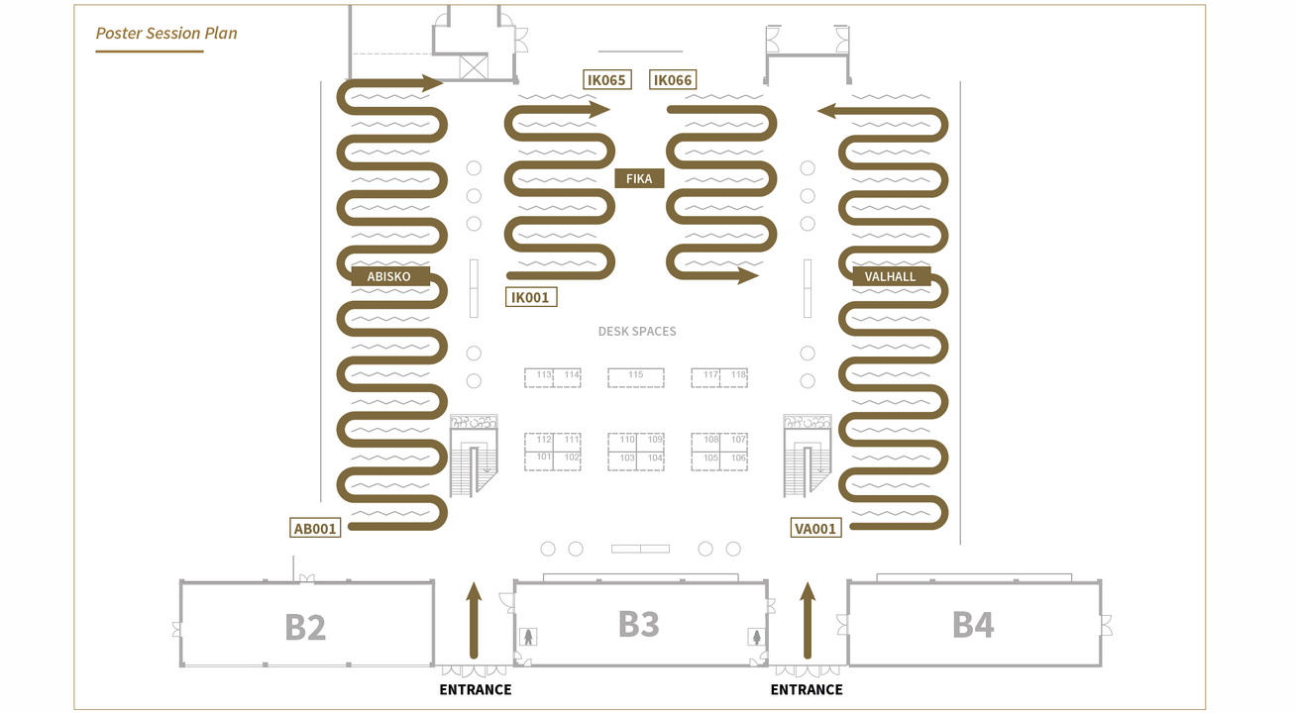
Poster Exhibition Layout
Notes:
There were 4 last minute Student Posters from non-Grant Students which were allowed into the Student Poster Session.
I do not have the actual number of posters, but there were many withdrawals and no-shows after the poster code assignment..

Slide 24
Cost distribution

Slide 25
Voices
I am continuously receiving VERY POSITIVE feedback about the conference. Many thanks!!! (OC Chair, CERN)
Let me congratulate you on a terrific conference, it was so smooth, interesting and well performed. (MAX IV)
Many thanks for a wonderful IPAC conference! I have never seen so perfect an organization. (PRAB Editor-in-Chief, CERN)
Many people are saying it's the best IPAC they've ever been to. (IPAC’18 Scientific Secretariat, JLAB)
The logistic of IPAC'17 was one of the worst ever. (unknown from the Evaluation form)
Notes:
First known evaluation that has been performed on an IPAC AFAIK,

Slide 26
Learnings
No 1 “learning” is the same as at IPAC’16 > quote from Kyung Sook’s presentation last year:
Most people (speakers, session chairs, exhibitors ...) don't like to reading "Guidelines".
Copy that. Most people do not read. Period. Embrace the frustration.

Slide 27
Timings and Deadline
Peer review makes tight process even tighter
“Please register or withdraw” mails were sent after the early bird deadline (14 March):
  on 20 March to approx. 550 unregistered authors
  on 27 March to approx. 350 unregistered authors
  on 5 April to approx. 250 unregistered authors.
9 April there were still approx. 130 unregistered
Japanese fiscal year starts in April > can’t register before that, and other reasons

Slide 28
Timings and Deadline
Wanted to send programme codes min. 2 weeks before submission deadline
Created poster codes on 10 April and sent out paper codes on 11 April (13 days before Peer Review deadline)
I had zero disjointed authors when I informed all 1700 poster authors of their poster codes and the fact that paper upload was enabled
This mail has resulted (as expected) in a number of additional withdrawals.
Notes:
1683
1455 posters today
Todd: How many withdrawls this morning? – approx 50

Slide 29
Registration
Exhibitor registration via SPMS and external provider is less than ideal (data does not flow back into SPMS, exhibitors do not appear on delegate list)
Some of them have papers, so that creates a problem (shows paper as unregistered)
Close registration 1 week before the conference

Slide 30
SPMS
People expect a confirmation when they have uploaded papers > add note: there will be no confirmation?!
Return mails when people have updated something in their registration are pointless (“Your registration has been updated.”)

Slide 31
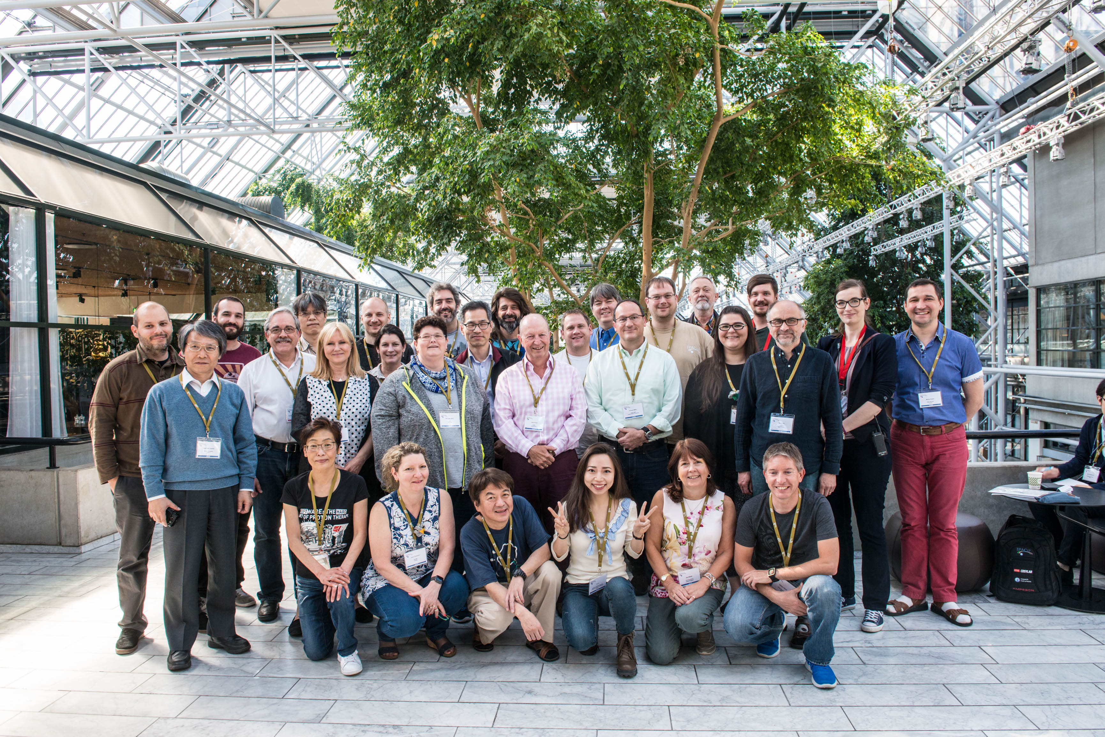
Thank you!

Slide 32
