Slide 1


JACoW Support for SPMS and Conference Proceedings at the Regional Support Center - Europe
Ronny Billen
JACoW Pre-Team-Meeting, Beijing, 26 November 2017
JACoW SPMS Regional Manager Europe
JACoW Conference Proceedings Web-Publisher

Slide 2
Outline
Support Activities of the RSC-Europe
SPMS Database
Web-publishing
SPMS support activities
Lifetime of an SPMS Instance for a Conference
SPMS Support: Instantiations since last Team Meeting
SPMS Incidents and Problems
JACoW Publications
A Reminder and Current Status
Support issues
Conclusions

Slide 3
Support Activities of the RSC-Europe
SPMS Database Administrator
Setup SPMS database instances for each conference, hosted by the Regional Support Centre Europe – requiring IT/DB DBA actions
Provide first-line technical support for SPMS questions, issues and problems – usually requiring 2nd and 3rd line support from IT
Ensure connectivity to RSC-NA and RSC-Asia via a unique bridging account to the central repository, for all their hosted conferences
Interact and communicate with other SPMS DBAs at RSCs
JACoW Conference Proceedings Web-Publisher
Receive, Check and Publish Conference Proceedings on JACoW
Files from zip on server @CERN, final quality check
Update metadata & news on jacow.org on server @Elettra
Provide technical support for website questions, issues and problems (mainly on search, find and to-be-corrected papers)

Slide 4
Lifetime of an SPMS Instance for a Conference
Creation after formal acceptance of Terms and Conditions
Creation of dedicated database account on JACoW-DB
Creation of database objects (latest SPMS version from SF)
Creation of web accessibility (Database Access Descriptors)
Initial configuration (title, dates, logo, admin roles,…)
Hand over SPMS administration to conference coordinator
During the period of exploitation
Access via web interfaces for Administrator and Users
Automatic synchronization with central repository
Assistance from Regional Support Center and experts
Feature requests (and bug reports) via tickets on SourceForge
After the conference
Conference proceedings generation
Repatriation: upload essential data; library data extraction to Inspire
Disable synchronization jobs; disable access to normal users

Slide 5
SPMS Support: Instantiations since Nov-2016
Deployment | Conference | Start Version | Patched to | Sync. | SPMS hosting
30-Nov-2016 | ERL-2017 | 10.5.2 | 11.1.04 | ✓ | RSC Europe
6-Dec-2016 | MEDSI-2018 | 10.5.2 | 11.1.04 | ✓ | RSC Europe
3-May-2017 | COOL-2017 | 11.0.6 | 11.1.04 | ✓ | RSC Europe
8-Nov-2017 | ECRIS-2018 | 11.1.01 | 11.1.04 | ✓ | RSC Europe
Deployment | Conference | Start Version | Patched to | Sync. | SPMS hosting
 | SAP-2017 |  | 11.1.04 | ✓ | RSC Asia
 | FLS-2018 |  | 11.1.04 | ✓ | RSC Asia
 | HB-2018 |  | 11.1.04 | ✓ | RSC Asia
 | LINAC 2018 |  | 11.1.04 | ✓ | RSC Asia
 | PCaPAC-2018 |  | 11.1.04 | ✓ | RSC Asia
 | IPAC-2019 |  | 11.1.04 | ✓ | RSC Asia
Deployment | Conference | Start Version | Patched to | Sync. | SPMS hosting
 | FEL-2017 |  | 11.1.04 | ✓ | RSC North-America
RSC Europe hosted at CERN managed by Ronny Billen
RSC North-America hosted at FNAL managed by Matt Arena
RSC Asia hosted at KEK managed by Takashi Kosuge

Slide 6
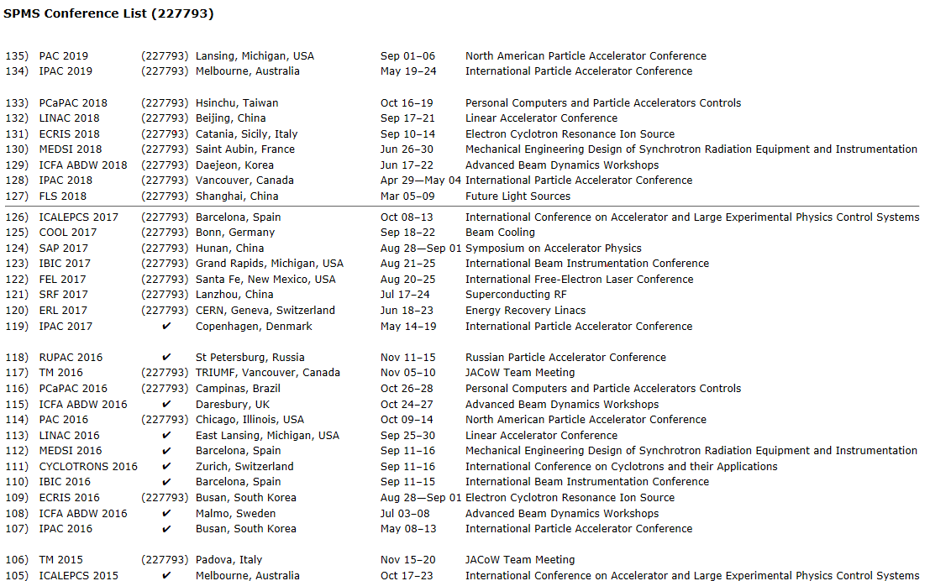
SPMS instances - status board
https://oraweb.cern.ch/pls/jacow/conf_list.html
Synchronisation tag
Synchronized !
Repatriated !

Slide 7
SPMS Incidents and Problems (1/2)
Difficult to debug – consequence of increased security
Need to be within CERN firewall
Registered Matt to have a CERN account
Oracle errors obscured by additional layer of the application Server
IPAC’17 error messages
Reserved word “add”, Matt modified all instances
Access problems: page level privileges
Unable to delete wrong profile: manual intervention by Matt
Multiple ICFA ABDW per year (HB, FLS in 2018)
Single classification inhibits initial sync
Sub-classification?
Export IPAC’17 into test instance not straightforward
IT/DB required, still problematic
Network problem towards cluster at CERN (Apr 2017)
Solved by IT

Slide 8
SPMS Incidents and Problems (2/2)
Old e-mails resent
E-mail jobs were running on old conferences (EPAC’08, EPAC’06)
Stopped all jobs
FEL’17 profile and affiliation problems
Erroneous privileges fixed by Matt
Password reset doesn’t work (upgraded web configuration), reset in central repository
IPAC’18 profile and affiliation problems
Workaround by providing admin role to Todd
Configuration security setting issue (CERN ticket issued)
Web server does not allow Form actions: Matt modified all screens writing to central repository (August 2017)

Slide 9
JACoW Publications
JACoW’s Mission = Publishing Conference Proceedings
Currently 197 conferences published (~133GB)
18 since the last Team Meeting
Of which 7 scanned, processed LINAC proceedings from the ‘60-ies
DOIs provided for each of the recent conferences

Slide 10
Publication Date | Conference | Papers (count) | Talks (count) | Posters (count) | Photos (MB) | Total (MB) | Problems, Issues, Comments
16-Dec-2016 | LINAC-1964 | 54 |  |  |  | 117 | Scanned (John)
16-Feb-2017 | Cyclo-2016 | 112 | 61 | 22 | 7 | 648 | Volker
6-Mar-2017 | COOL-2015 | 42 | 54 | 3 |  | 687 | Todd
7-Mar-2017 | RuPAC-2016 | 235 | 64 | 18 | 25 | 1198 | Maxim
29-Mar-2017 | IBIC-2016 | 222 | 36 | 91 | 2 | 1618 | Volker, 1 update
5-Apr-2017 | LINAC-1970 | 79 |  |  | 3 | 94 | Scanned (John)
5-Apr-2017 | LINAC-1979 | 91 |  |  |  | 92 | Scanned (John)
26-Apr-2017 | LINAC-1961 | 17 |  |  |  | 18 | Scanned (John)
26-Apr-2017 | LINAC-1962 | 35 |  |  |  | 20 | Scanned (John)
26-Apr-2017 | LINAC-1963 | 39 |  |  |  | 73 | Scanned (John)
26-Apr-2017 | LINAC-1968 | 80 |  |  |  | 102 | Scanned (John)
6-Jun-2017 | LINAC-2016 | 296 | 79 | 73 | 43 | 2028 | Volker
20-Jun-2017 | IPAC-2017 | 1396 | 96 |  | 87 | 2867 | Volker, 2 updates
28-Jun-2017 | NA-PAC-2016 | 373 | 131 | 67 |  | 2560 | Volker
29-Jun-2017 | MEDSI-2016 | 115 | 48 | 66 | 113 | 1239 | Volker,1 update
5-Jul-2017 | eeFact-2016 | 47 |  |  | 4 | 130 | Volker,1 update
2-Oct-2017 | ECRIS-2016 | 35 | 32 | 2 | 117 | 646 | Volker
2-Oct-2017 | PCaPAC-2016 | 43 | 19 | 17 | 12 | 256 | Volker

Slide 11
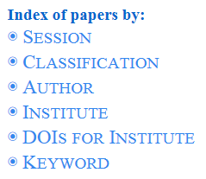
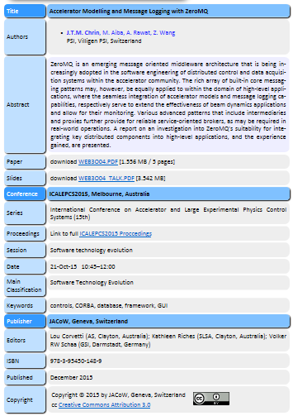
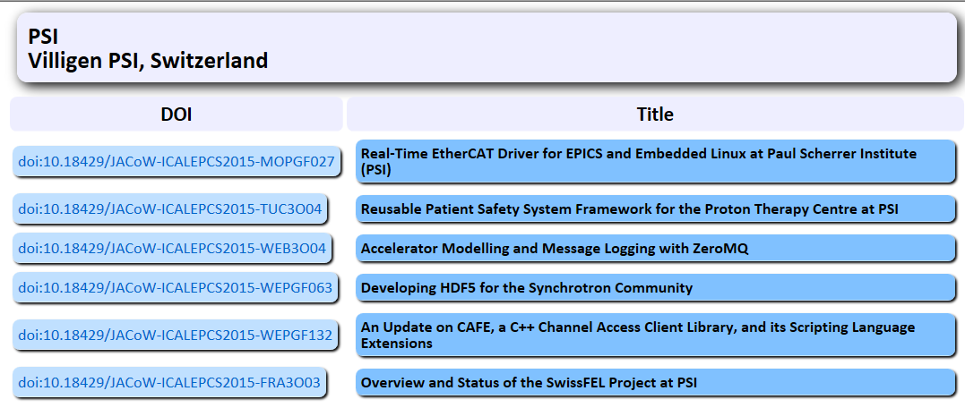
DOIs

Slide 12
JACoW Publication Incidents and Questions
Updates after publication
Linac’16 missing figure in paper
RuPAC’16 wrong title in paper
MEDSI’16 incomplete committee file
IBIC’16 wrong editor list in data set for DOIs and Inspire
eeFact’16 wrong config file impacting metadata for Google Scholar, figure graphics and DOIs
DOI related problems
Cyclotrons’16, new directory layout (Feb 2017)
IPAC’16 retrofit with new DOI structure (May 2017), n^{th} update
IPAC’14 introduced DOIs as well (Oct 2017)

Slide 13
Conclusions
SPMS
Setup & support for 4 live conference instances at RSC-E, 11 worldwide
Substantial number of incidents requiring support
Consequences remain of gateway upgrade, web server upgrade and increased security
Debugging of incidents is non-trivial
Publications
18 additional conferences published
Smooth procedure, nevertheless iterations required
DOIs in all new proceedings now
Most support issues are redirected to Volker
Proceedings re-generation, references, DOIs, copyright,…

