Slide 1

Report from the Scientific
Secretariat of IPAC’18
Todd Satogata
Jefferson Lab and Old Dominion University
JACoW Team Meeting 2018
Cape Town, South Africa
6 December 2017
Credits: Jana Thomson, Cornelia Hoer, Tor Raubenheimer

Slide 2
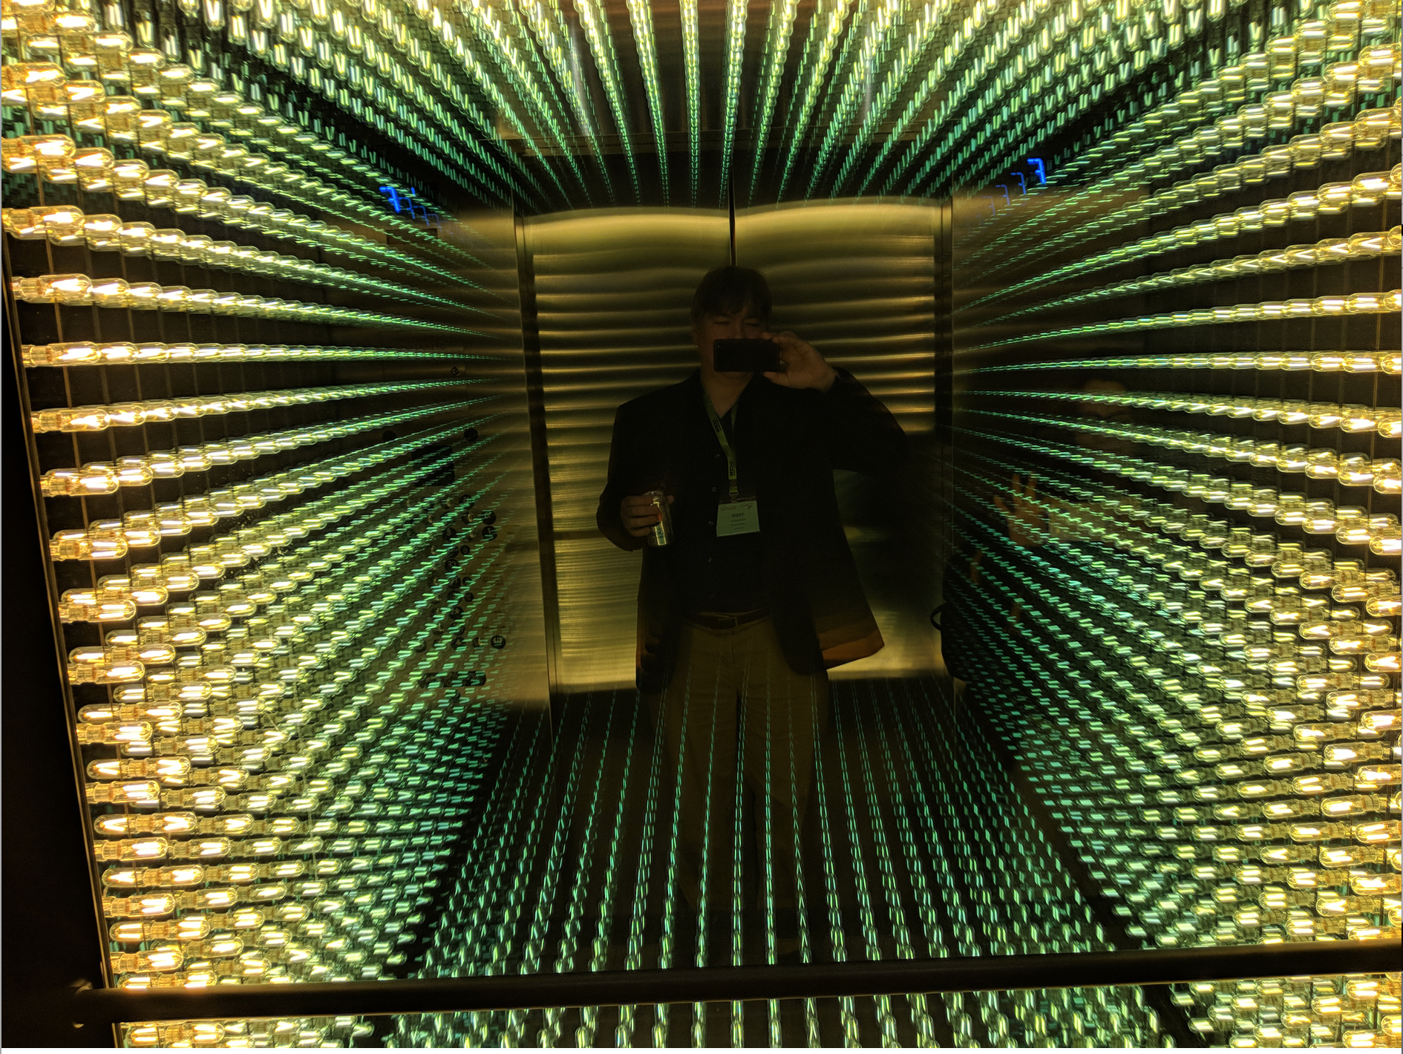

Slide 3
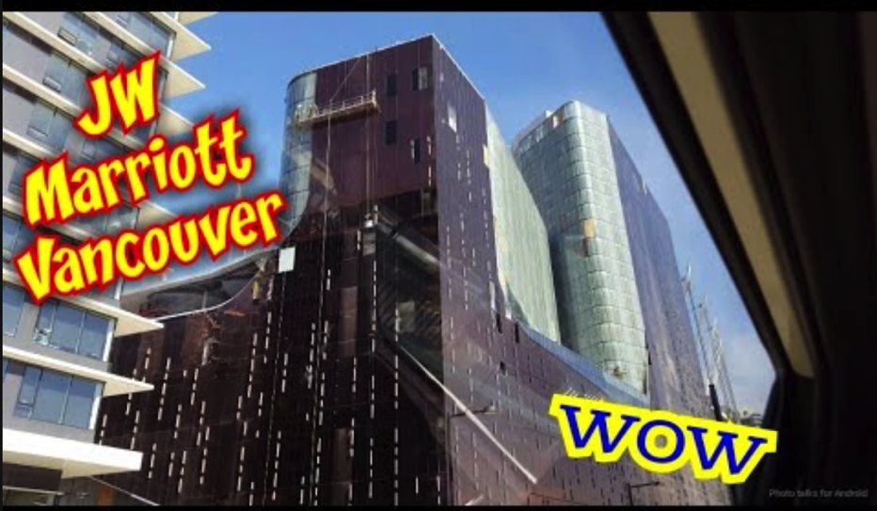
Venue
Venue selected 2.2y before conference
  Under construction, opened 7m before conference
  Room capacities tighter than originally advertised
  Created challenges for high-demand registration
Limitations on registrations established Mar 2018
  Established overflow presentation room (cap. 150)

Slide 4
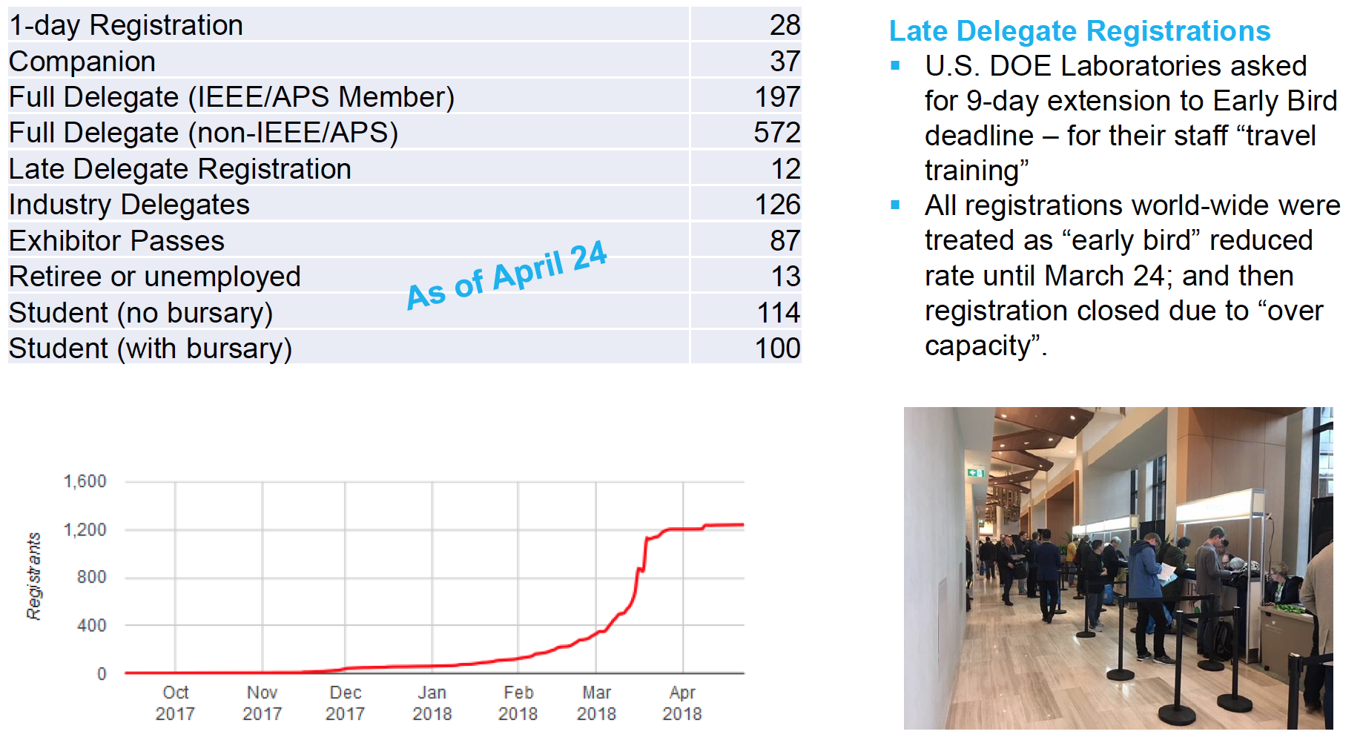
Registration

Slide 5
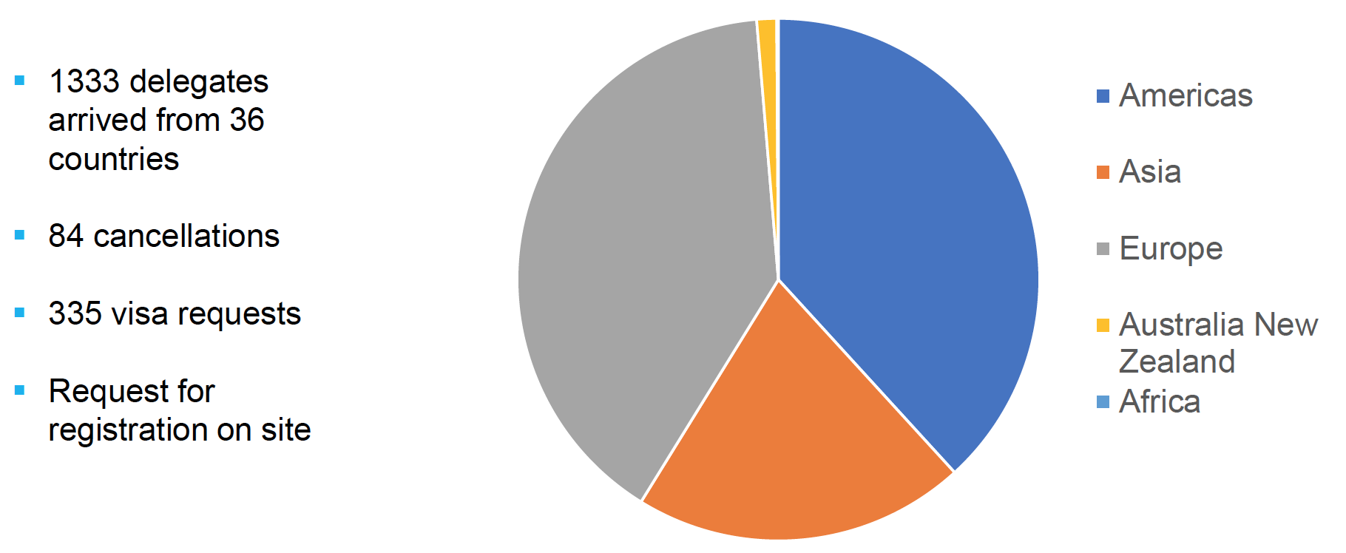
Registration

Slide 6

Mobile App
Same vendor as IPAC’17
  6 kEuro contract cost
  Small bugs fixed
  Feedback positive
1 push notification sent
  Lost mobile phone
728 devices installed
  IOS: 369
  Android: 413
Johan discusses later ☺

Slide 7
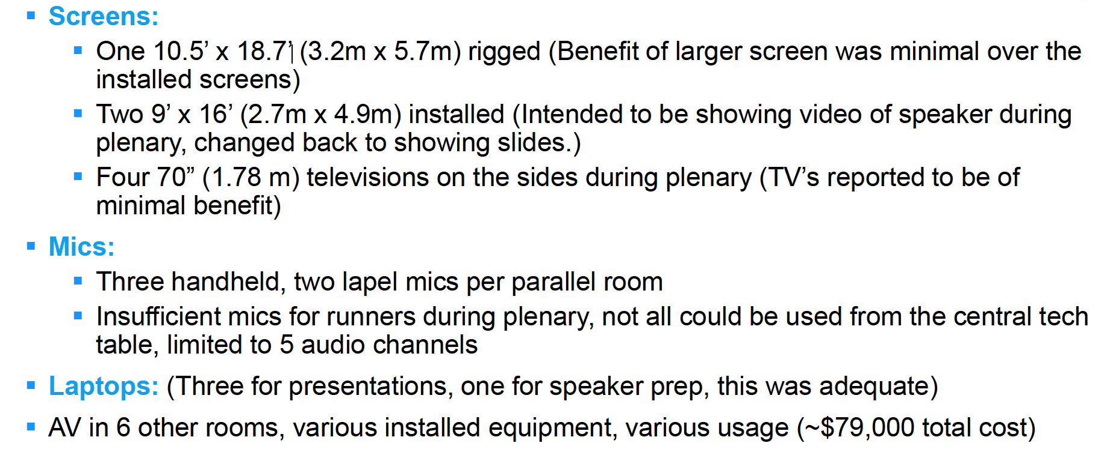
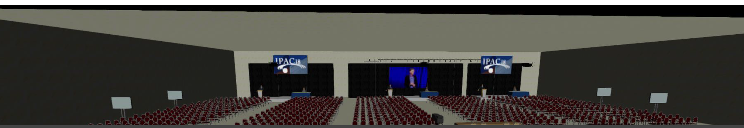
Audio/Visual

Slide 8
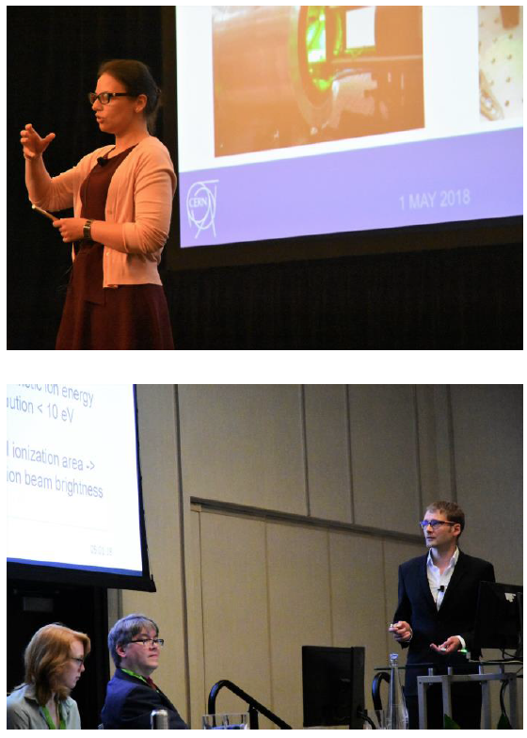
AV Problems and Lessons
Inadequate mic channels for plenary runners
Wrong audio/video piped to overflow room
Logitech Spotlight controllers confusing
Speaker timing required A/V tech to start/stop
Pushed back on costs
  Initial quotes for less equipment was >$100k

Slide 9
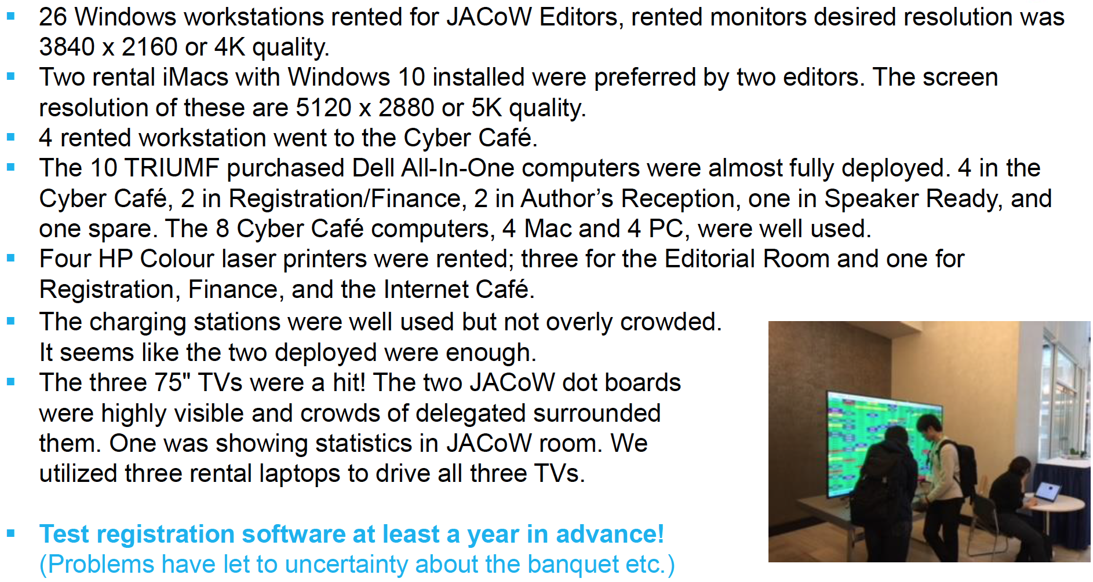
IT

Slide 10
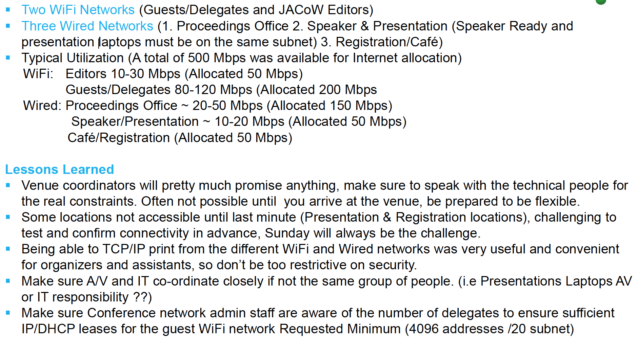
IT

Slide 11
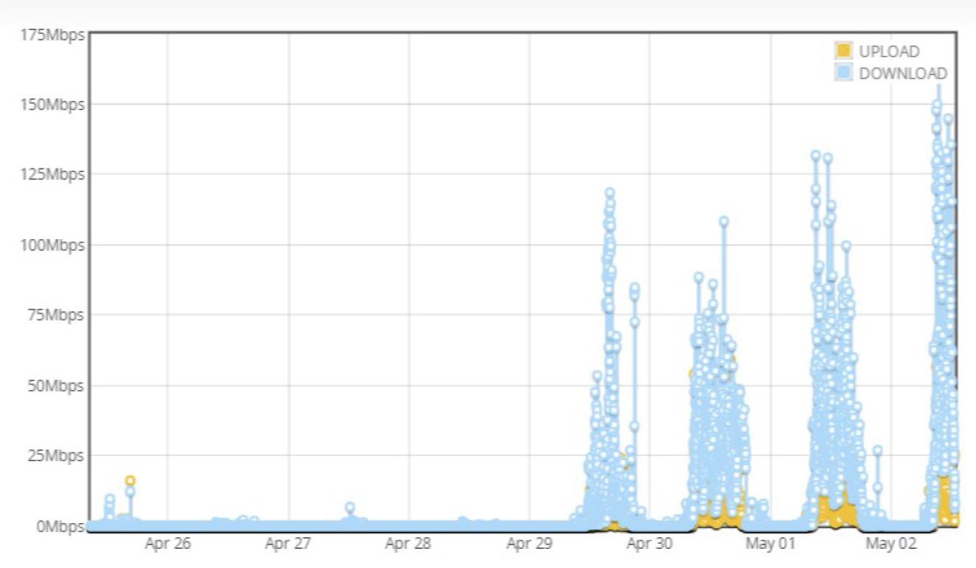
Conference Bandwidth

Slide 12
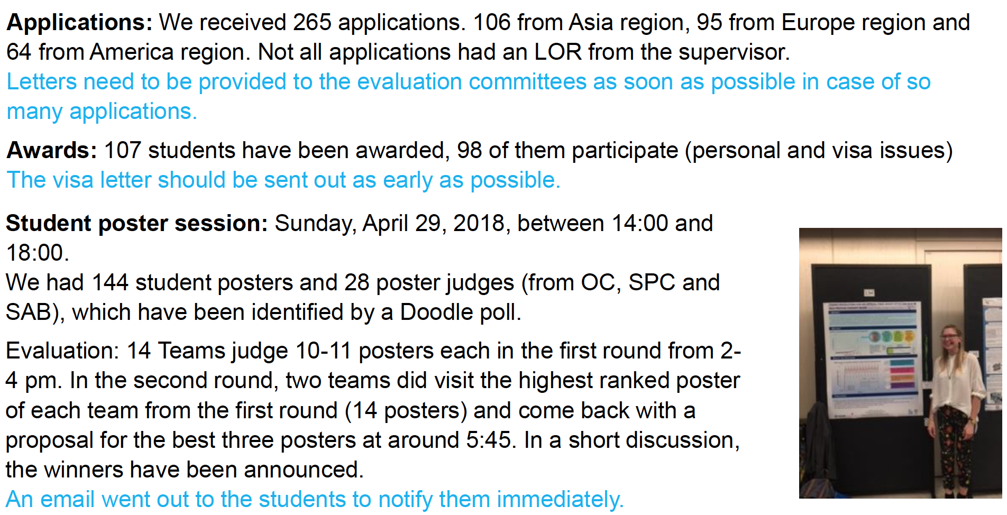
Student Grants

Slide 13
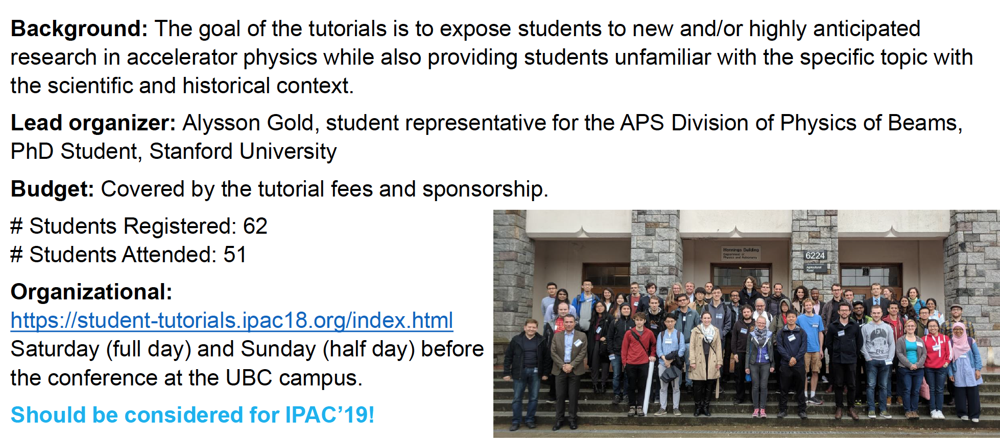
Student Tutorials

Slide 14
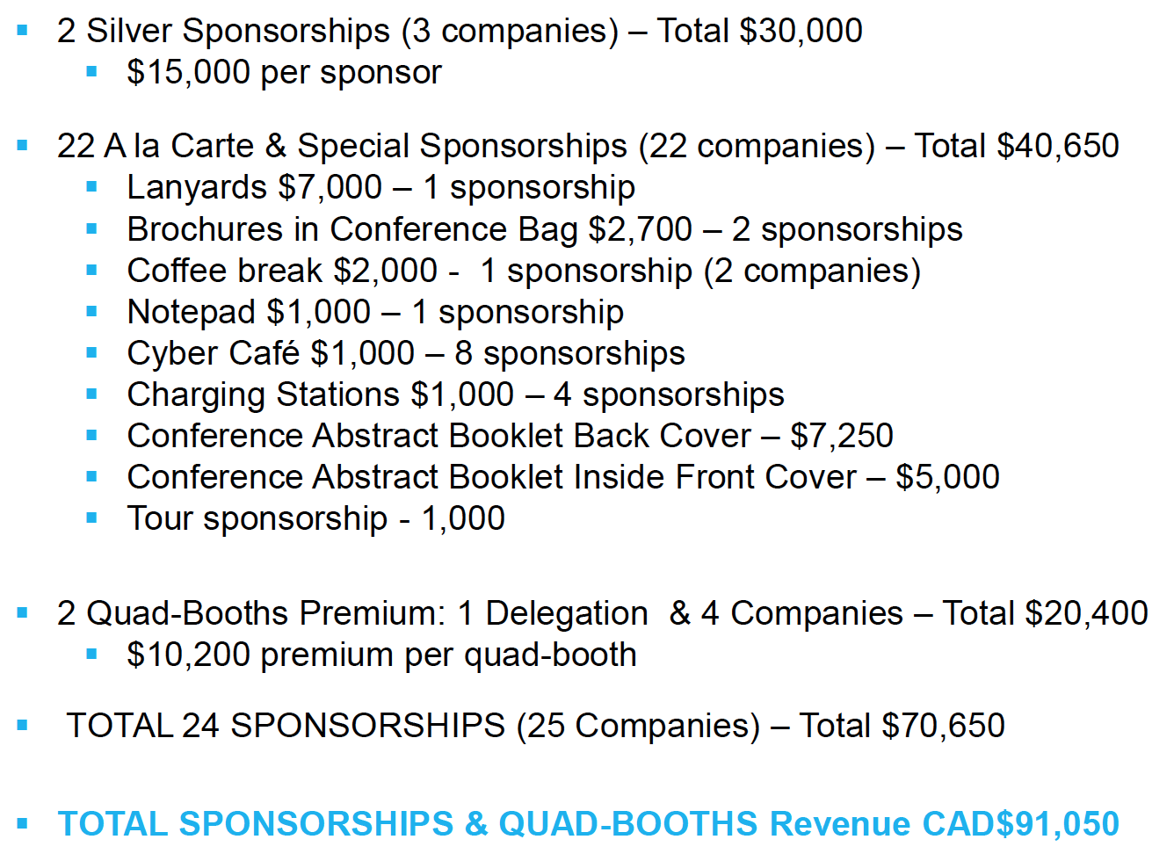
Industry Exhibition Revenue

Slide 15
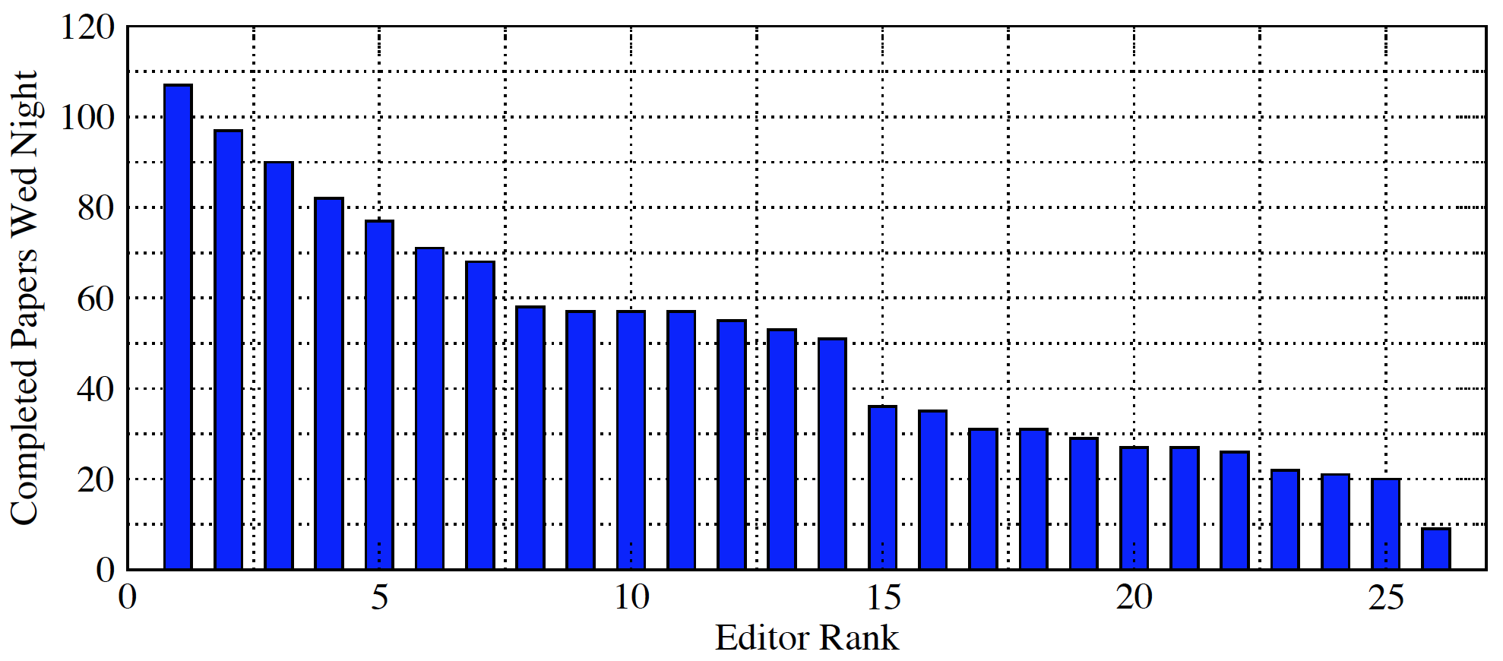
Editorial Team Staffing
Total Team: 35
Speaker Ready: 2 people + IPAC’19 IT
Transparency Processing: 2 people
Author Reception: 3 people
Editors: 28: including future conference editors
and editor training
Wed PM: 1364 papers
694 papers 50.9% Word
660 papers 48.4% LaTeX
10 papers 0.07% Open Office
A trend to have more LaTeX papers?

Slide 16
Proceedings Office / Software
Do not use the old JACoW bundle! (discontinued)
We needed to make a decision much sooner than we did to rent or own computers. This process was stalled and impacted the proceedings office set up.
We used a new supplier for the Acrobat licenses.
    Acrobat 2017 – we were able to purchase 1-month licenses for the machines. We did not received the licenses in time to install before sending the machines out.
    MSWord was available using the site license we have for Outlook 365.
We had to make a decision to have something on the machines, and in the end installing the bundle caused more work for the proceedings office.
Acrobat needed to be un-installed and Acrobat 2017 installed
Acrobat and Distiller settings needed to be set at the conference.
Pitstop needed to be re-installed and settings configured
MSWord settings needed to be configured

Slide 17
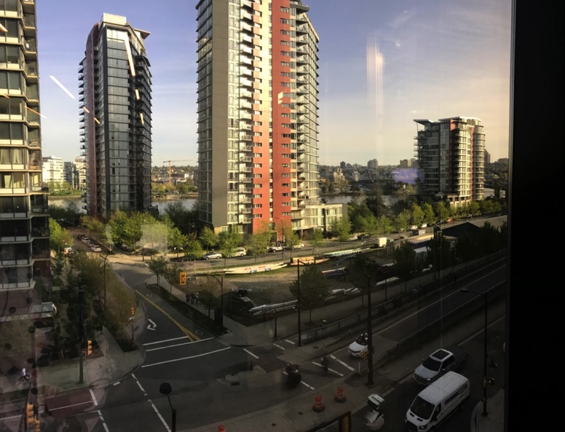
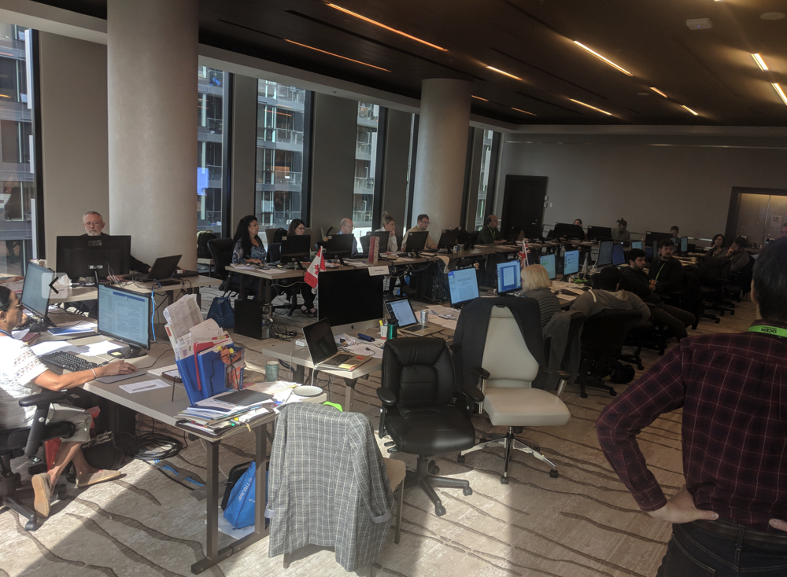
Proceedings Office
A large flat screen TV was used to show the statistics
  paper processing, dot assignments from SPMS scripts
The room setup was bright and may have been distracting.
  But at least there are windows with a view!
The temperature of the room was not able to be raised to satisfy everyone.
Good table real estate
  room to spread out with additional equipment on the desk
  i.e. personal laptops
Jana discusses later ☺

Slide 18
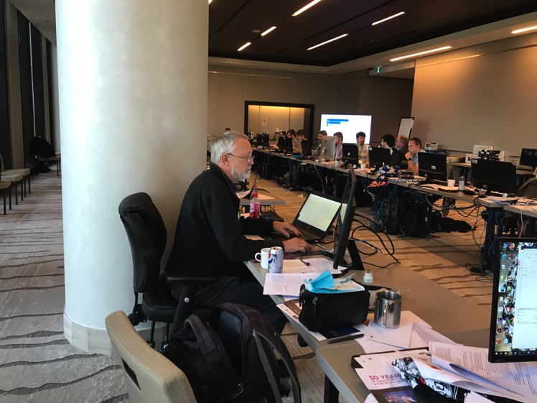
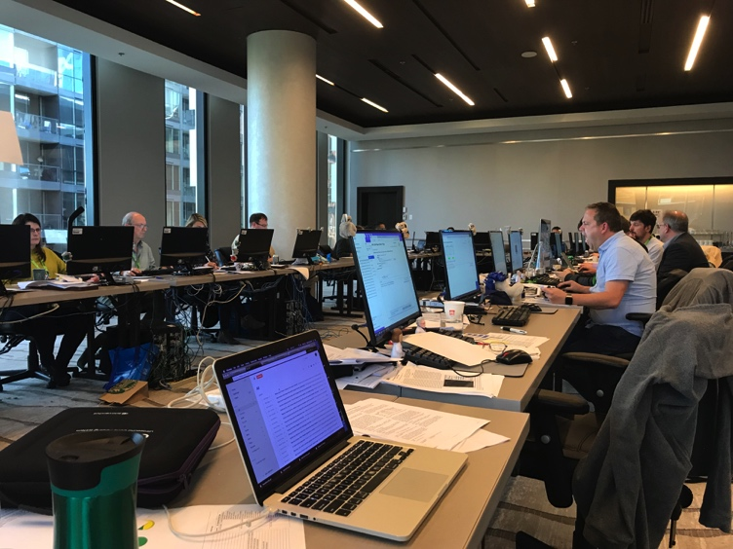
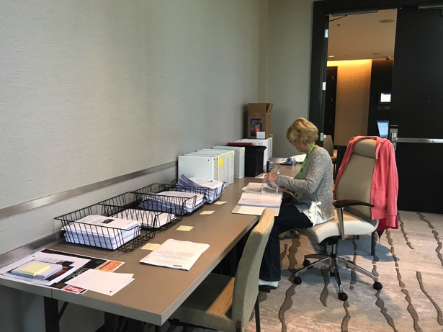
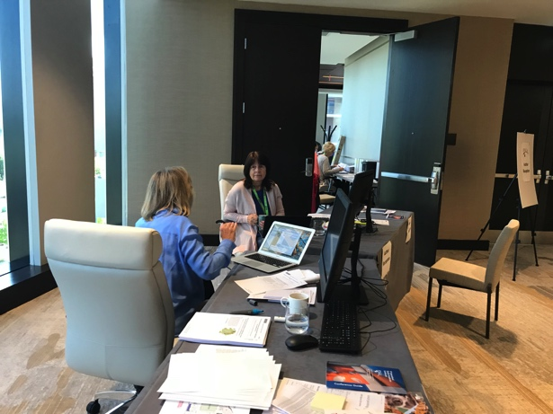
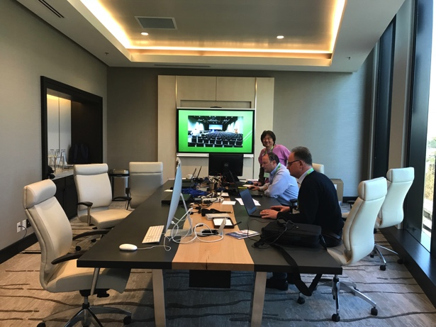
Room Configurations
Proceedings Office
Paper File Management
Author Reception
Speaker Ready

Slide 19
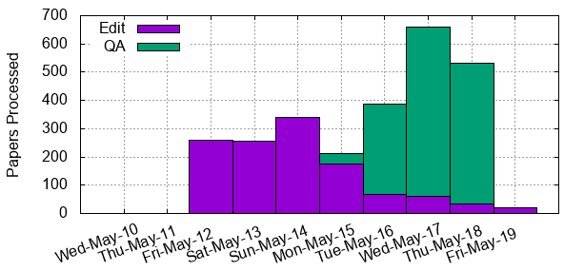

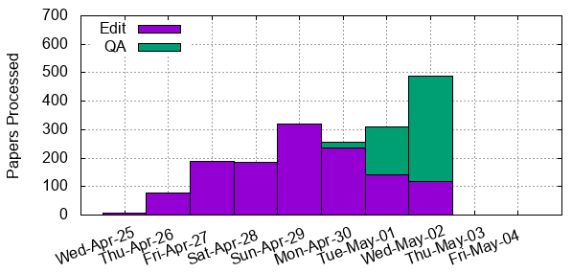

Paper Processing
Paper processing slow to get to speed
  IT setup issues?
Fri/Sat ~50 papers/day lower than IPAC’17
Sun/Mon comparable to IPAC’17 peak rates
QA speed significantly behind IPAC’17
A fair bit of post-conference QA work to do for proceedings
???
???

Slide 20
Editor Notes (Jana)
Common errors made by authors that merited comment were: incomplete references, un-cited references, un-cited figures/tables in the text, incorrect formatting of main and sub-headings .
The ‘quality’ bar became inconsistent. Up until Sunday we were processing with a high bar. We were needing to get more papers processed so the bar was relaxed. At this time we may have started to be less critical of the formatting of the references. Reference formatting is important for Reuters for searching.
At QA there were oversights revealed. More time is being spent on the references – less time is being given to JACoW paper formatting.

Slide 21
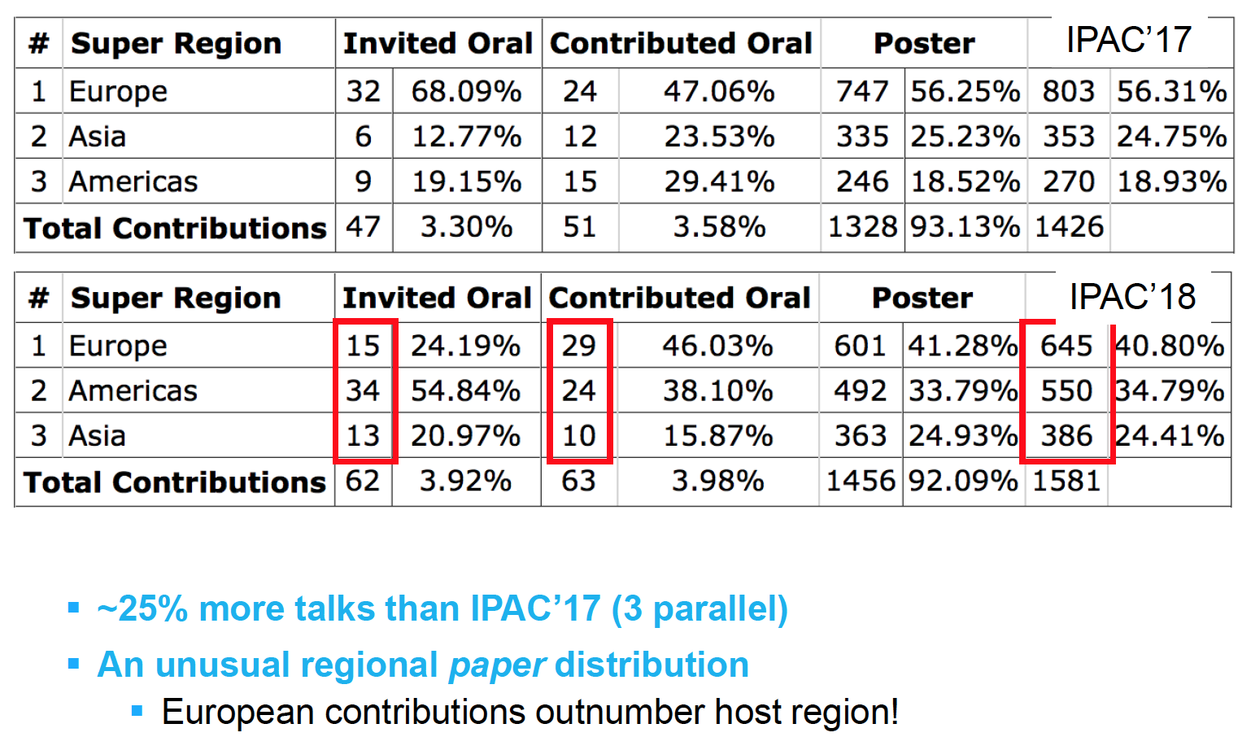
Classification By Region

Slide 22
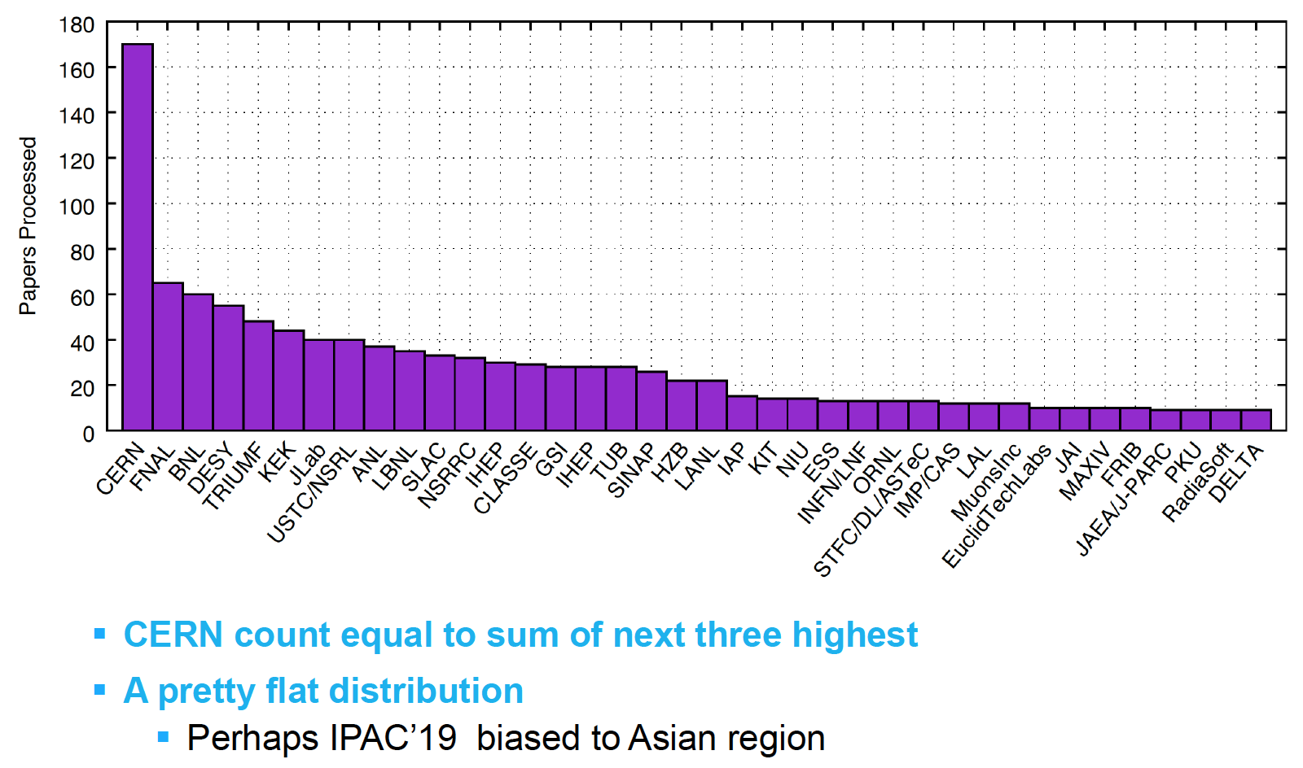
Contributions by Institution

Slide 23
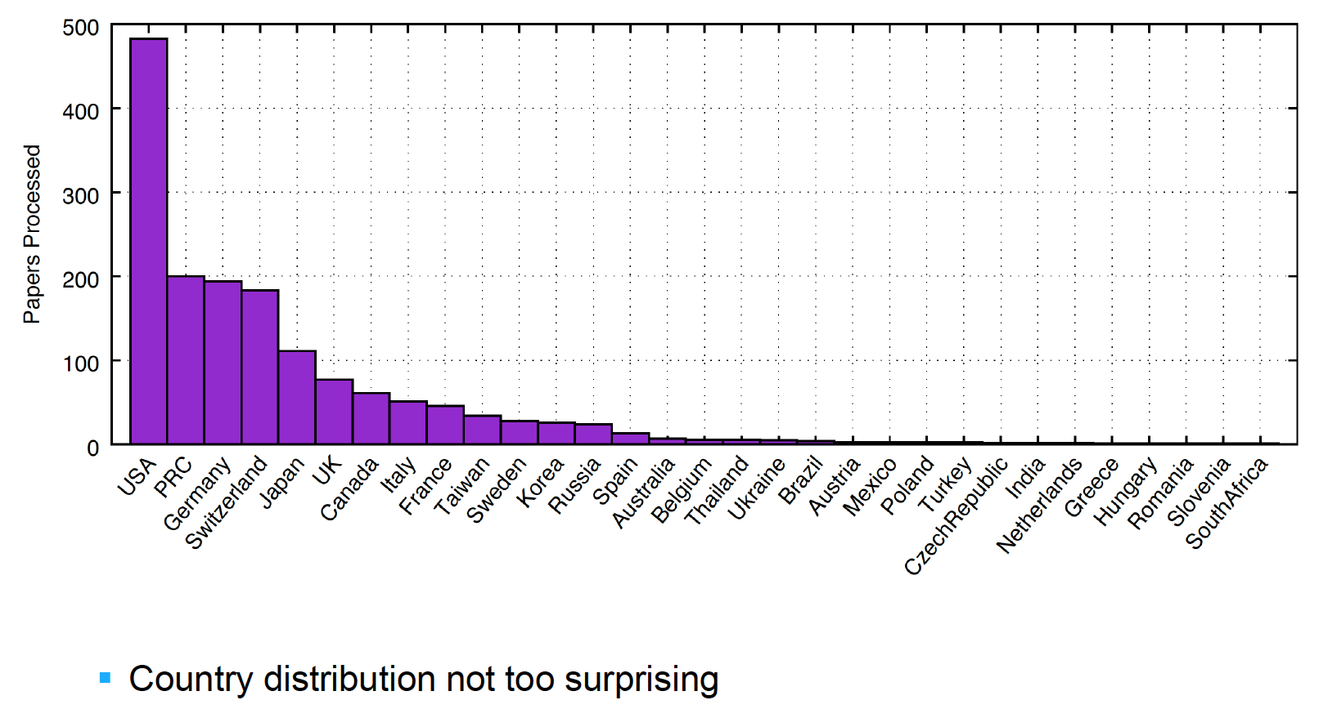
Contributions by Country

Slide 24
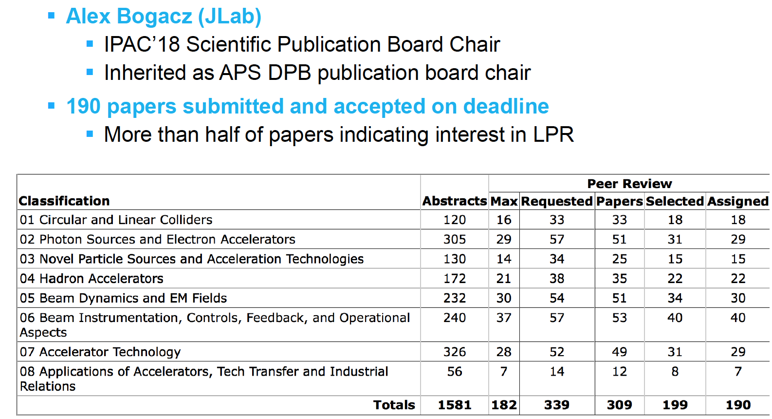
Light Peer Review

Slide 25
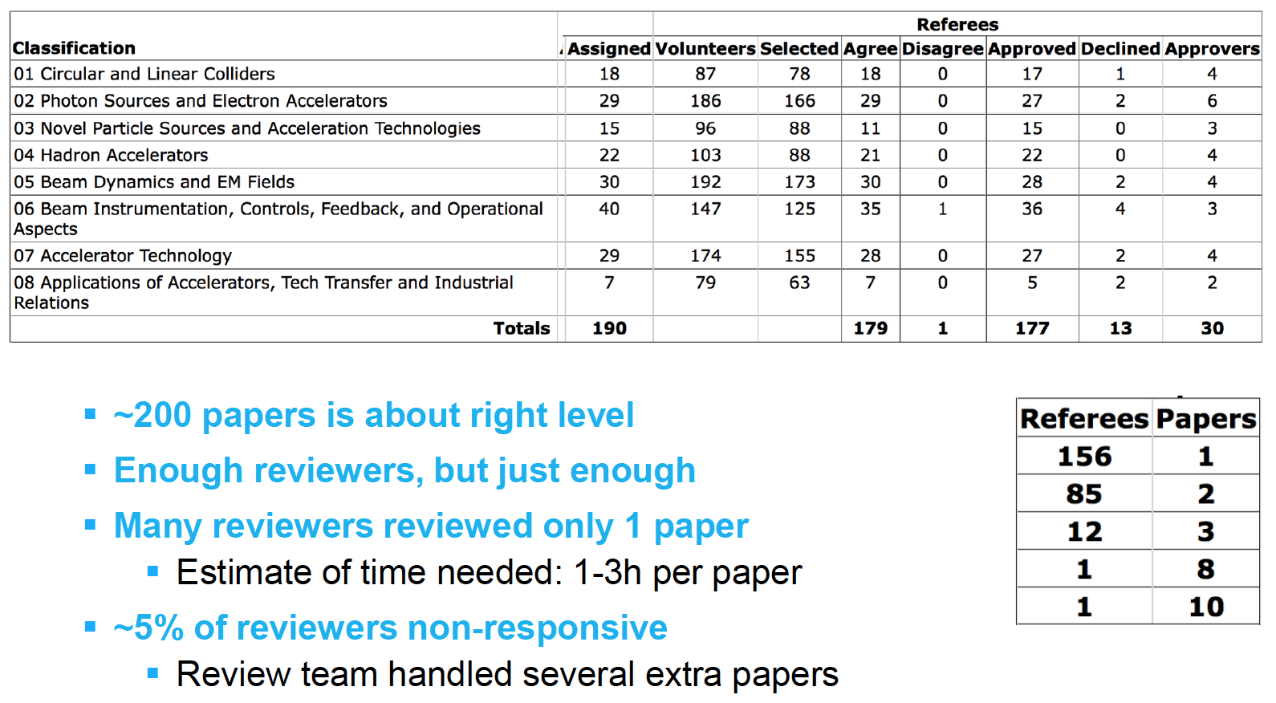
Light Peer Review

Slide 26
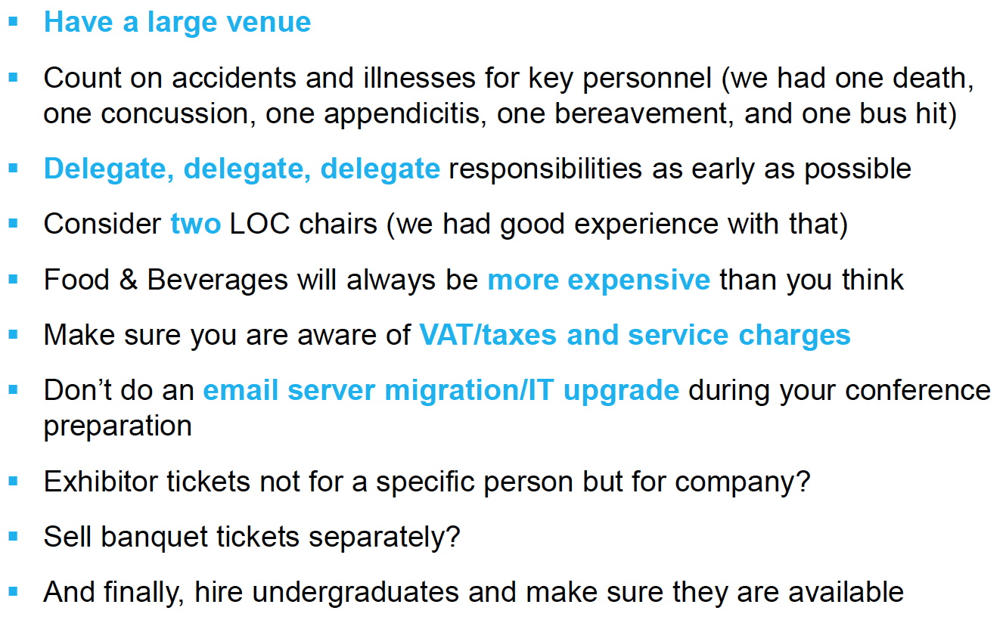
LOC Suggestions

Slide 27
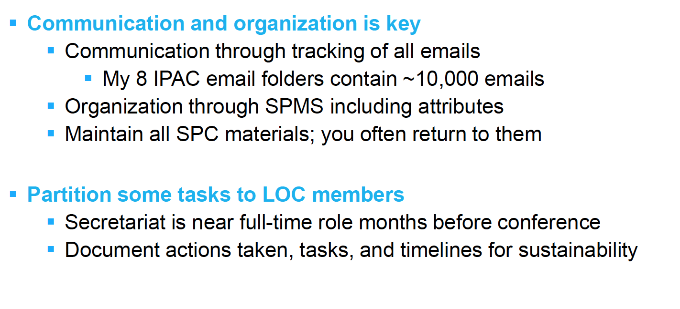
Secretariat Suggestions

Slide 28
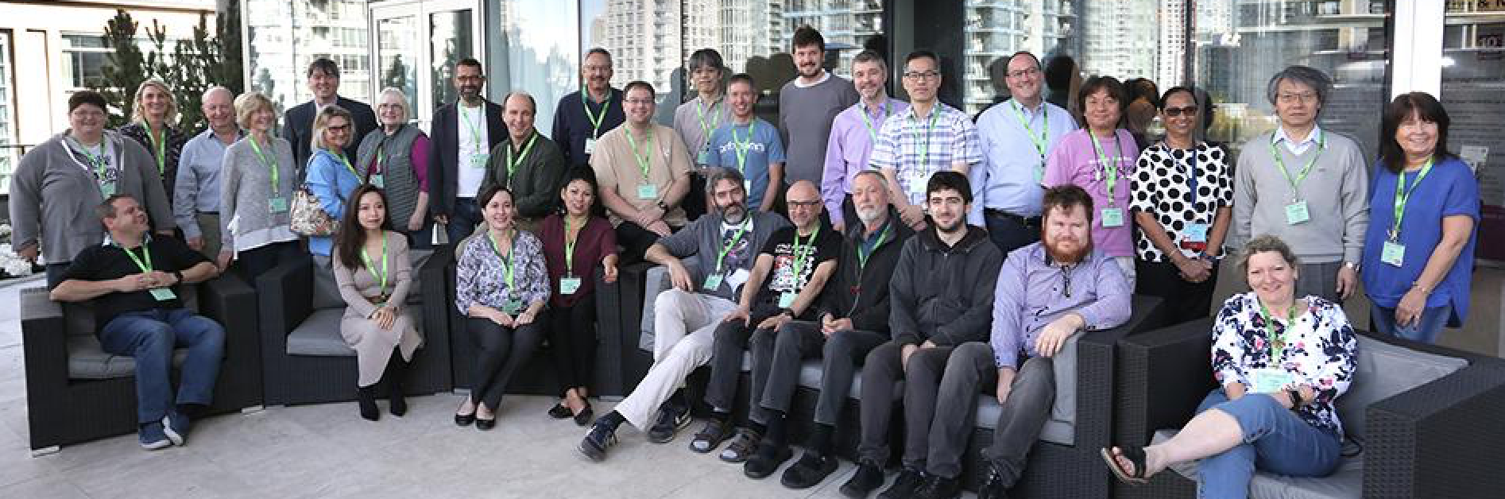
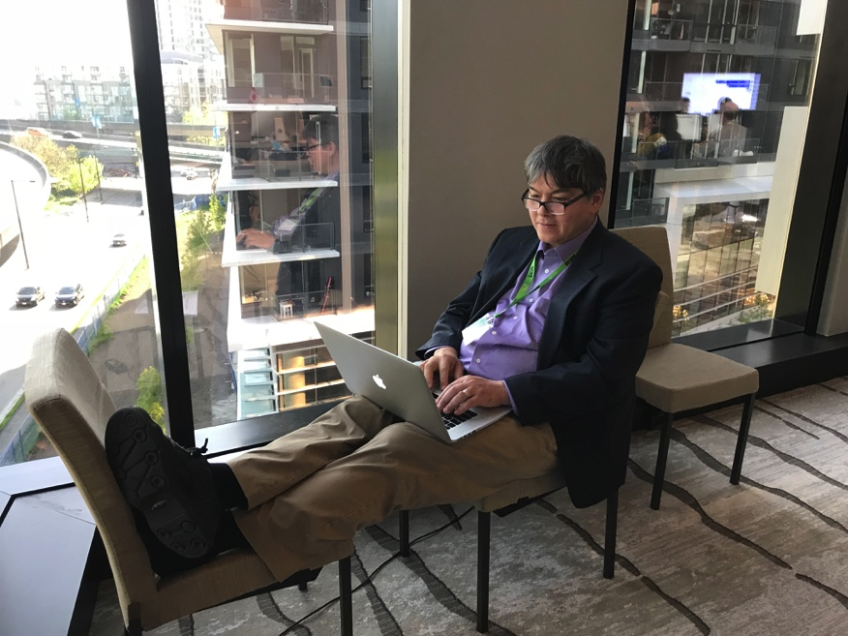
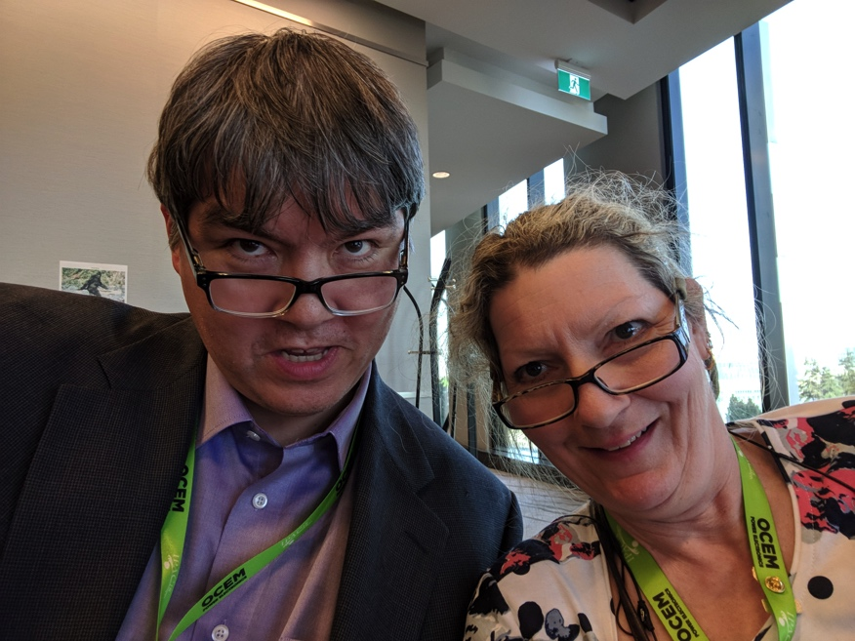
Thank You!

