Slide 1
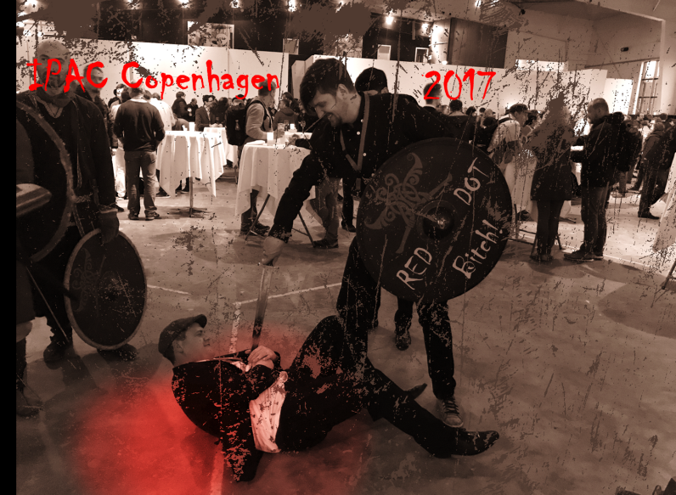

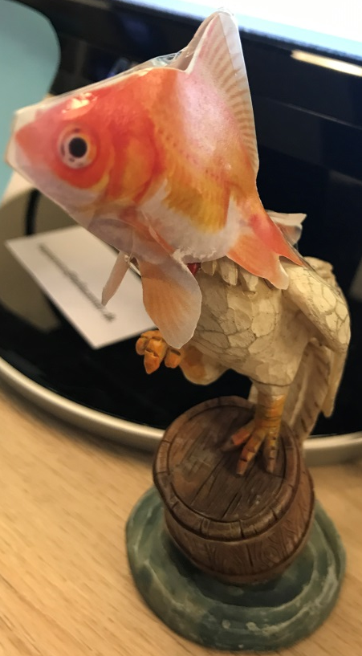
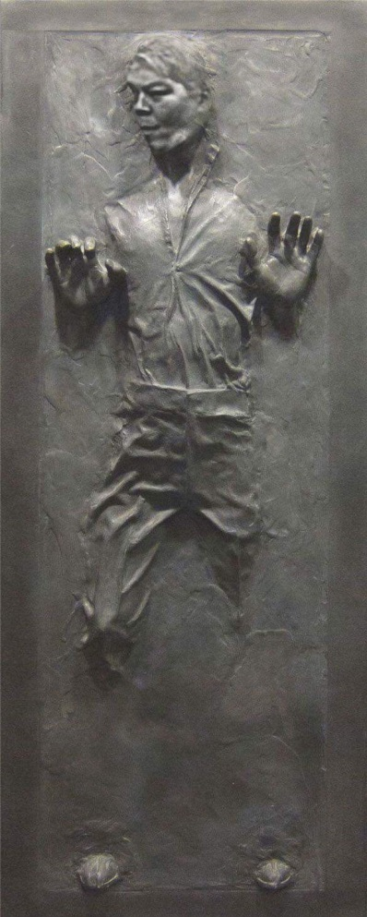

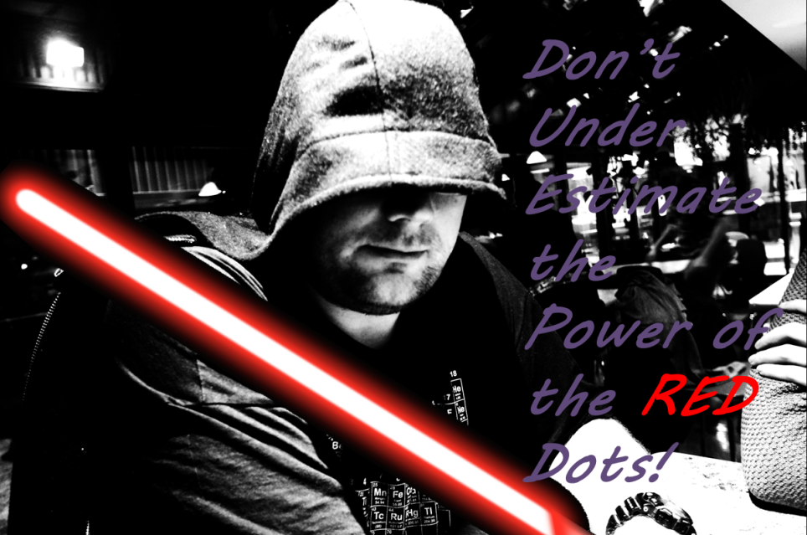

Slide 2
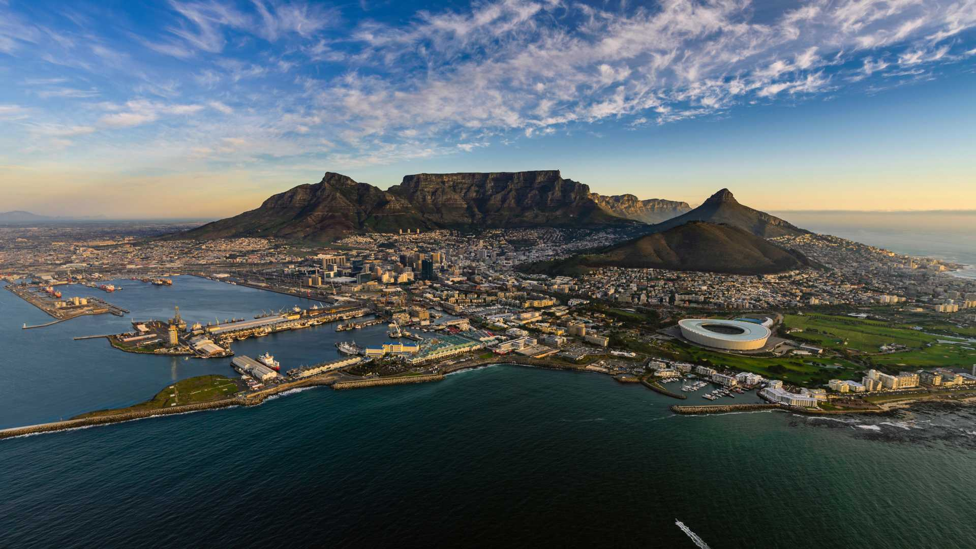


JACoW Team Meeting 2018 Cape Town, South Africa

Slide 3
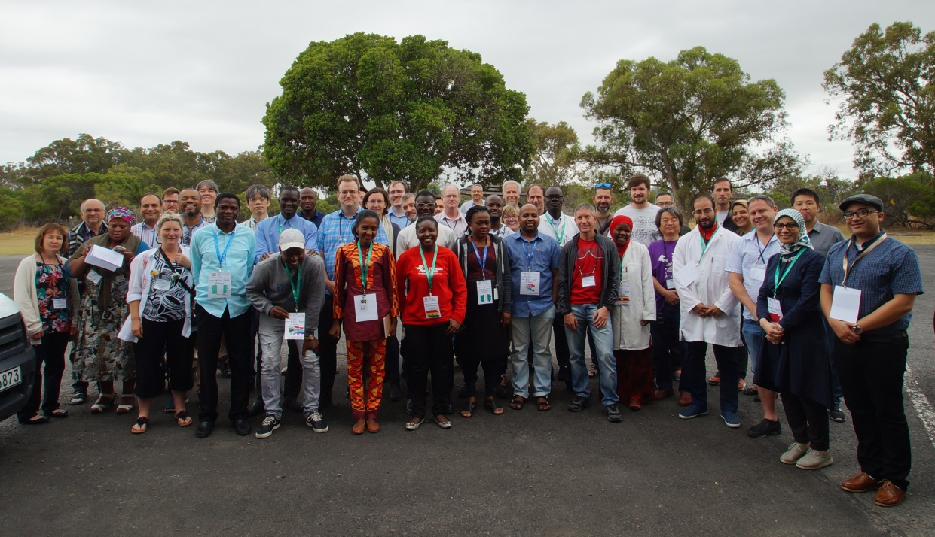
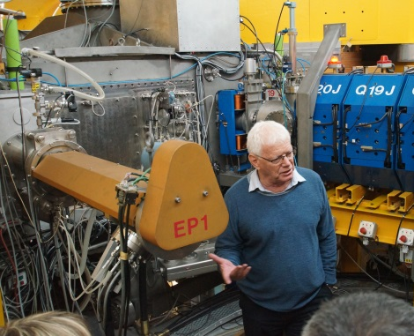
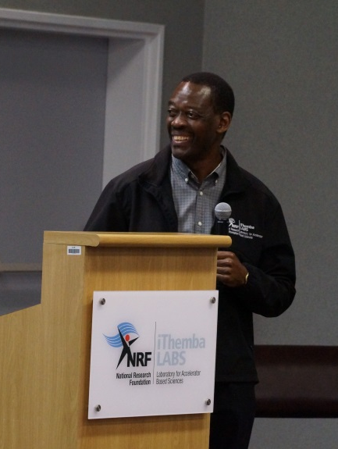
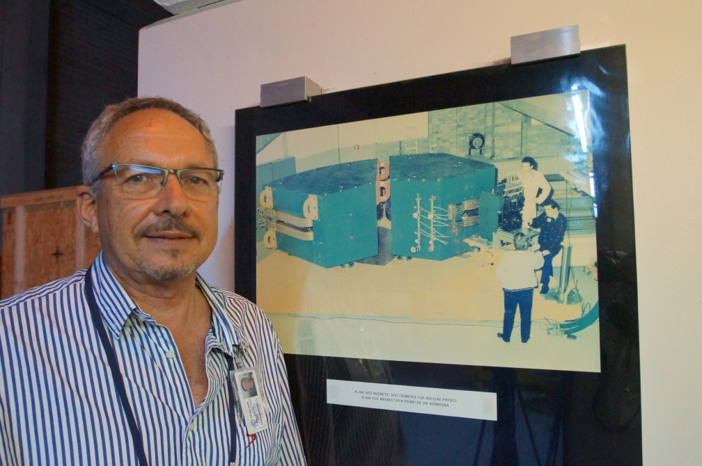
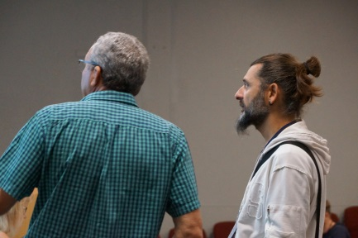
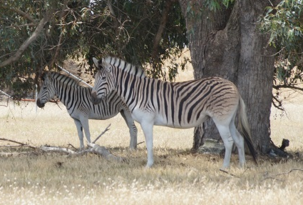
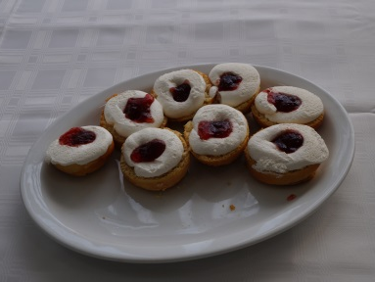

Slide 4
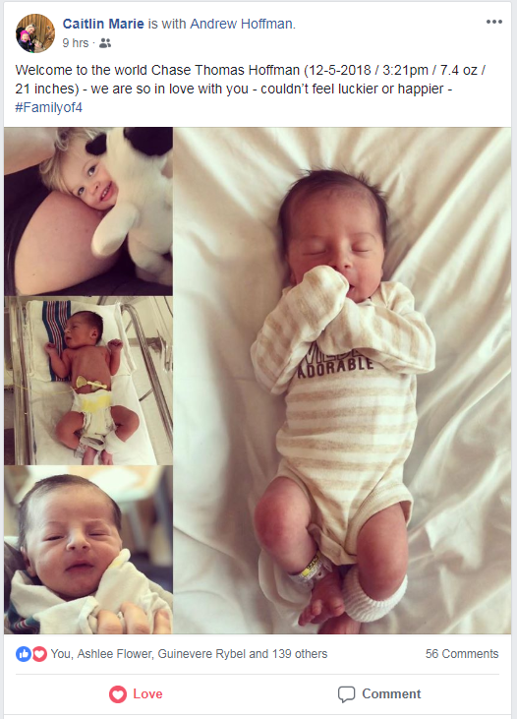
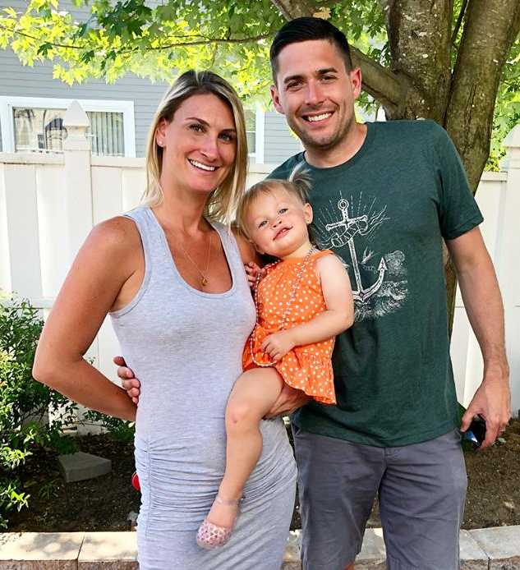
Breaking News!

Slide 5



Team Meeting
Oral Presentations
Tutorials
Working Groups
One-on-one
Mateship/Friendship/Social Interactions/Relationships
(Remember you are dealing with people)
Good Will

Slide 6
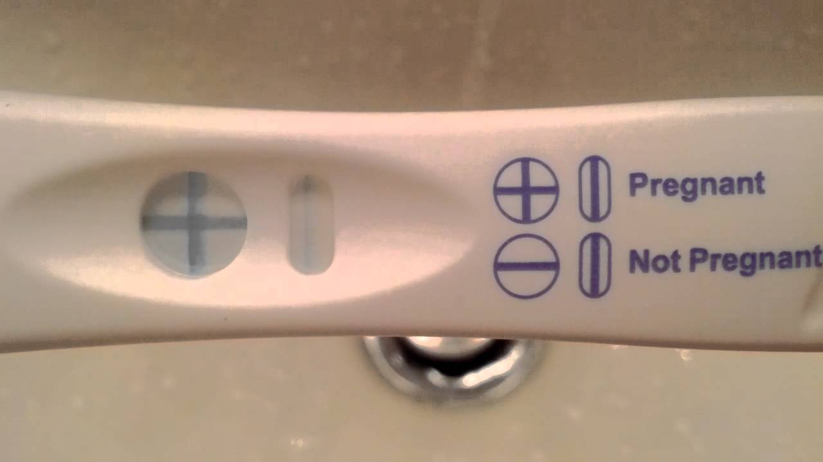


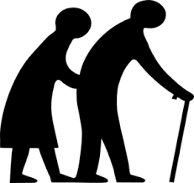
Delegates that Attending
1
JACoW Conf
Relax
You are having a JACoW Conference!
2
3
>3

Slide 7
Host – iThemba LABS
Contributors - Presenters, Tutors, Work Group
Jana Thomson | Adrian Monnich | David Button
Ivan Andrian | Volker Schaa | Sue Waller
Ronny Billen | Charlie Horak | Takashi Kosuge
Todd Satogata | Christine Petit-Jean-Genaz
Jan Chrin | Rohan Dowd
Johan Olander | Stephano | 15 Presenters
37 - Registrants
24 – Different Affiliations
By Regions: 7 Asia, 13 Europe, 1 Britain, 8 North America,
2 South America, 6 South Africa
Indico Development Team – CERN
MEDSI Conference Chair - SOLEIL

Slide 8
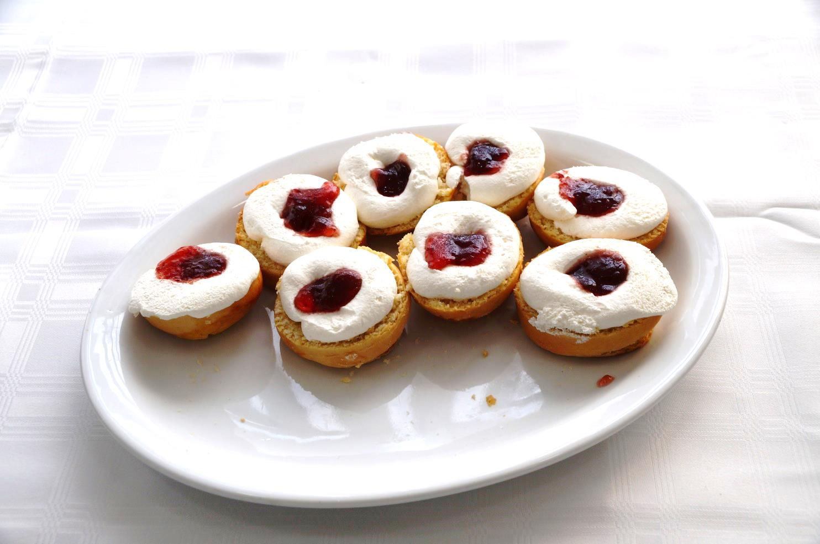
Lessons for next Team Meeting Feedback
34 Invited Oral Presentations
1 Poster Session 26 Invited Posters
4 Tutorials
4 Working Groups
5 Opportunities for 1-on-1 Meetings
0 Open Discussion
3 Functions (Reception & Dinner)
0 Kick-off session
0 Elections

Slide 9

Chief Editor/JACoW Team Member Life Cycle

Slide 10


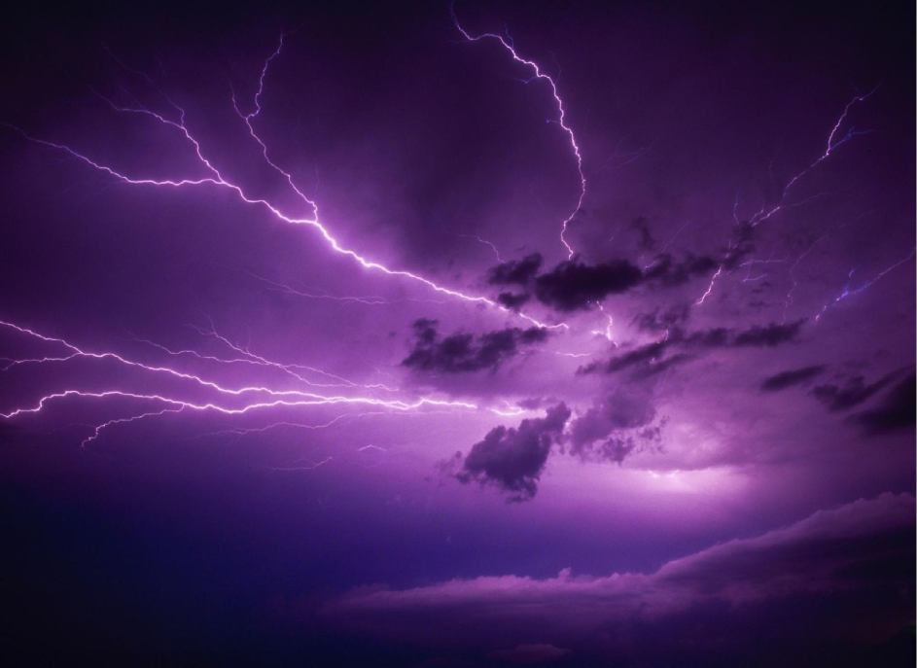

JACoW Team Meeting Planning
Vancouver IPAC’18
Melbourne IPAC’19
Who Will be Our Next Host???
Who would like to help plan the next meeting????

Slide 11
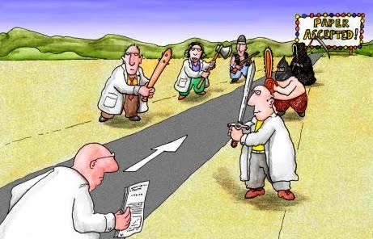




Areas of Focus
How to work with the wiki
Refereeing in SPMS recent experiences
Indico Latest developments
Updates, Templates, Editing, Transparency Conversion, Mobile App, etc.
IPAC’18 Experiences, lessons learned
Past, Present, and Future JACoW Conferences
Welcoming and transitioning new members of the JACoW team

Slide 12
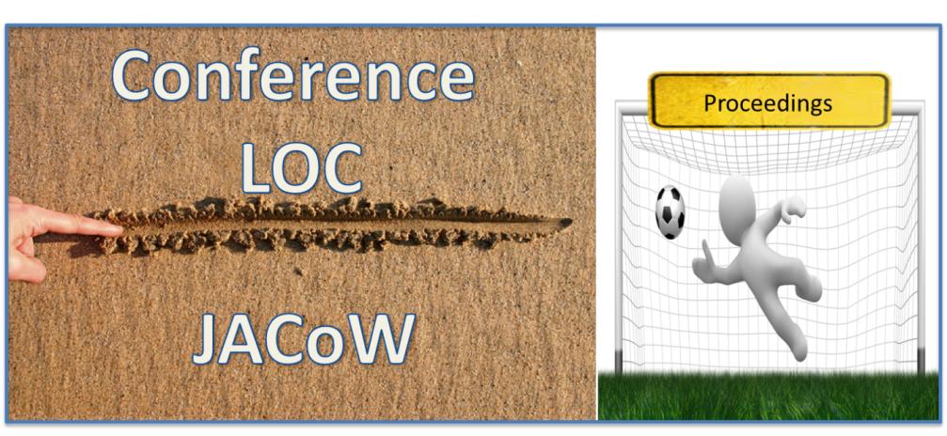
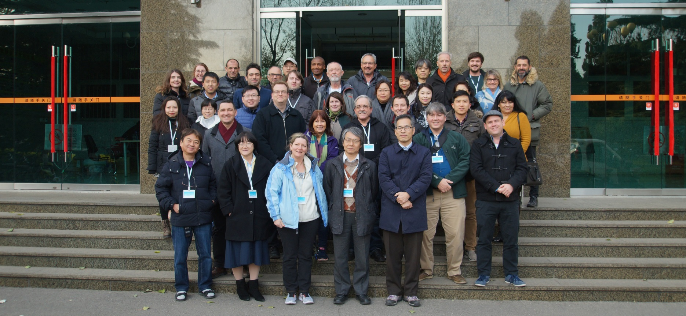
Education Goal

Slide 13
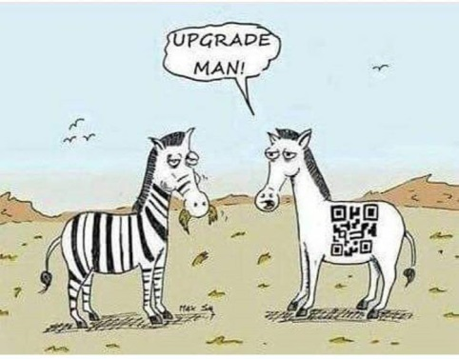
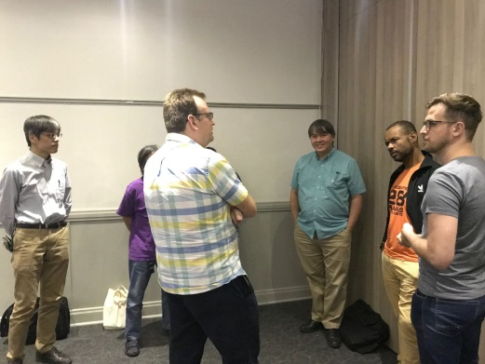
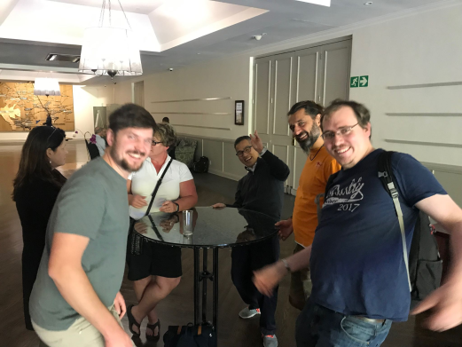
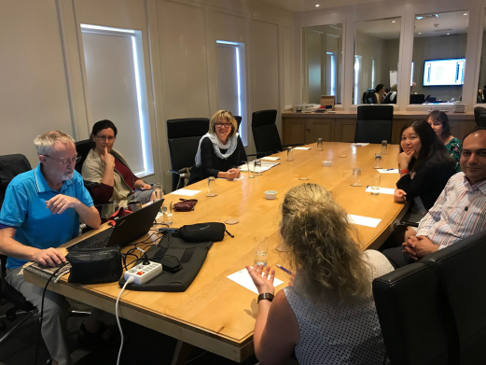
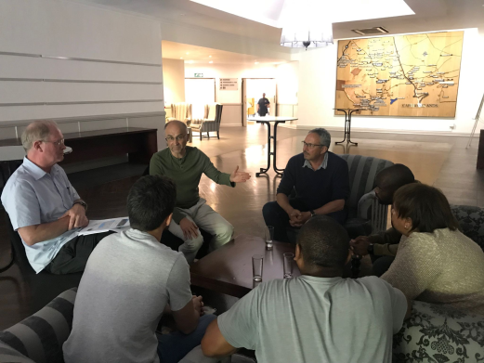
Feedback on Programme Kick-off Session
Group 1
Group 2
Group 3
Group 4

Slide 14
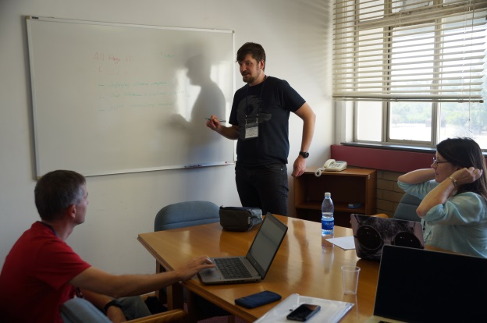
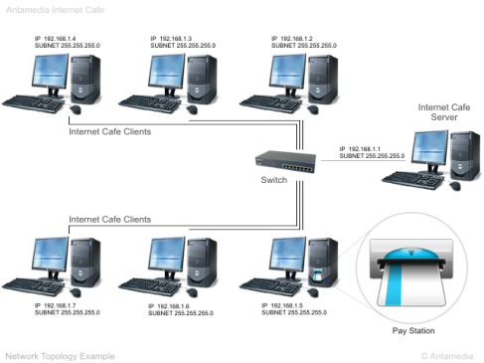
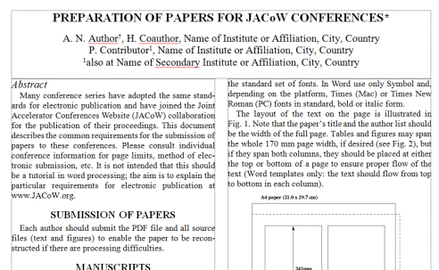


Feedback on Programme Working Groups
Wiki Help
IT Setup
Mobile App
JACoW Template
Need to co-opt new and old team members into attending at least 1 working group per meeting?

Slide 15
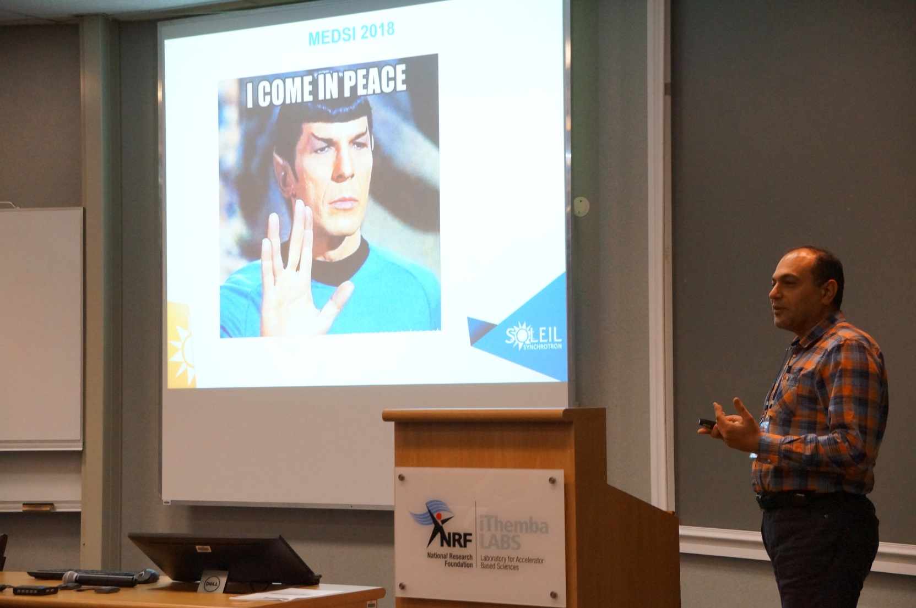
Stake Holder Feedback

Slide 16
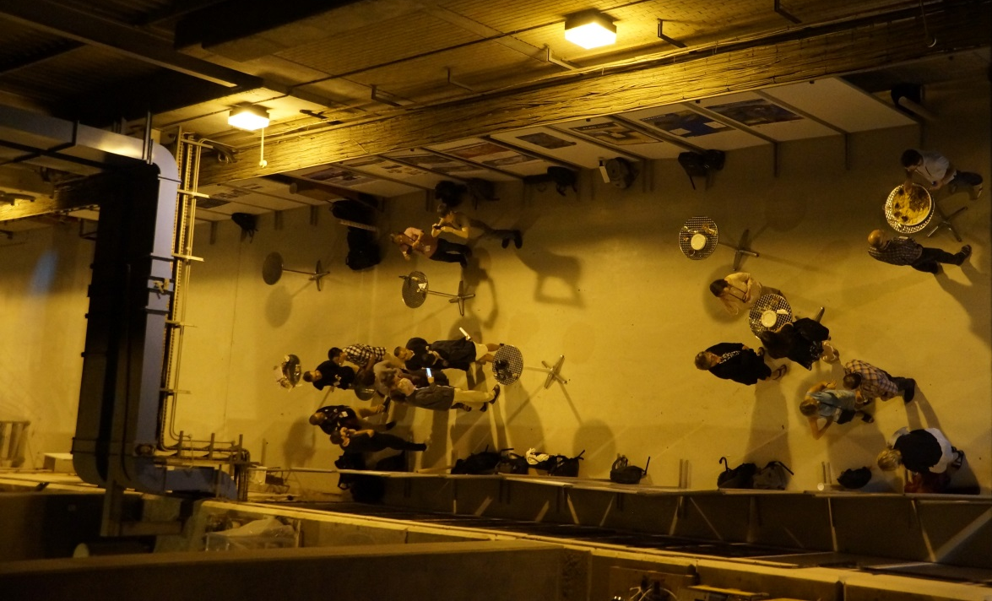
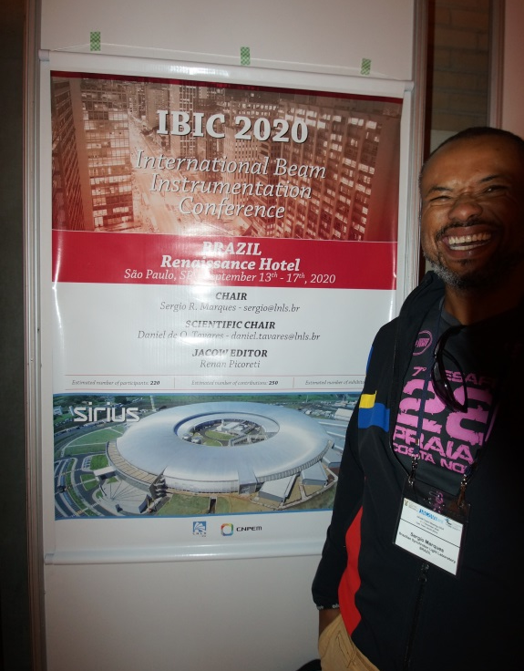
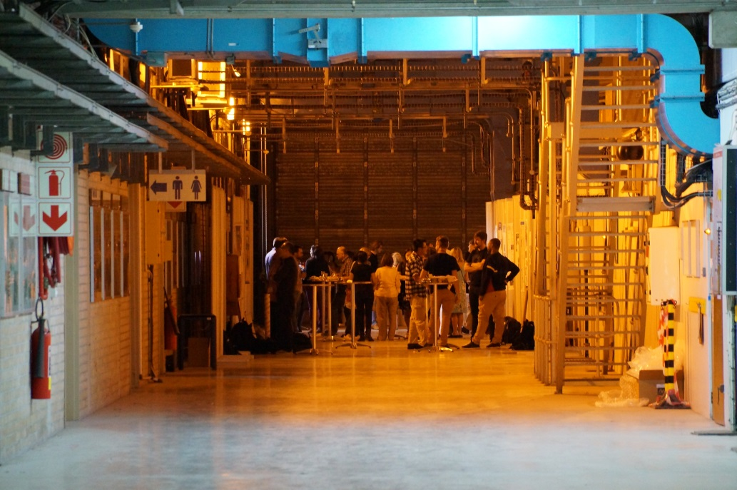
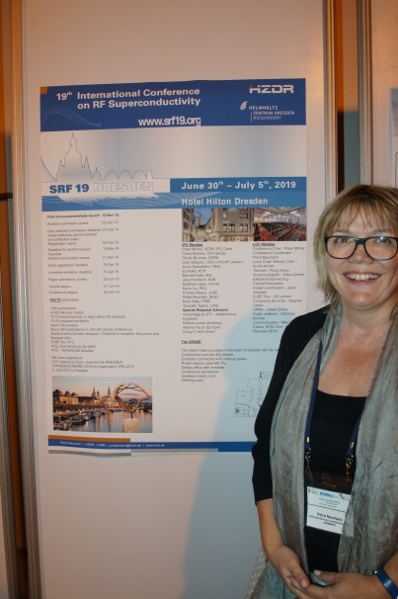
Feedback on Programme Poster Session (22)

Slide 17

Feedback on Programme 1-on-1 Meeting Times and Facilities

Slide 18
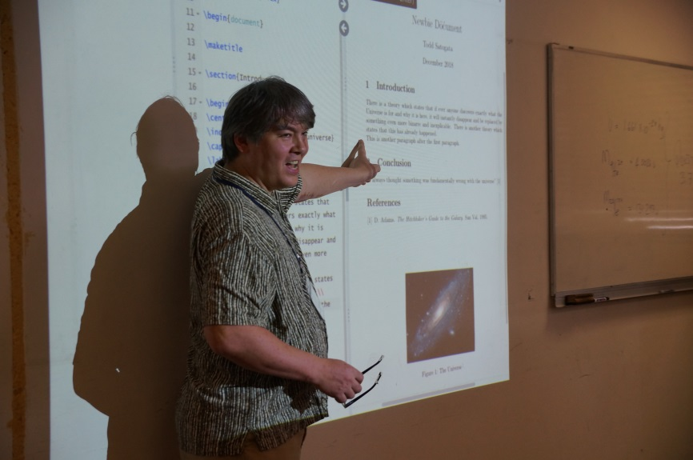
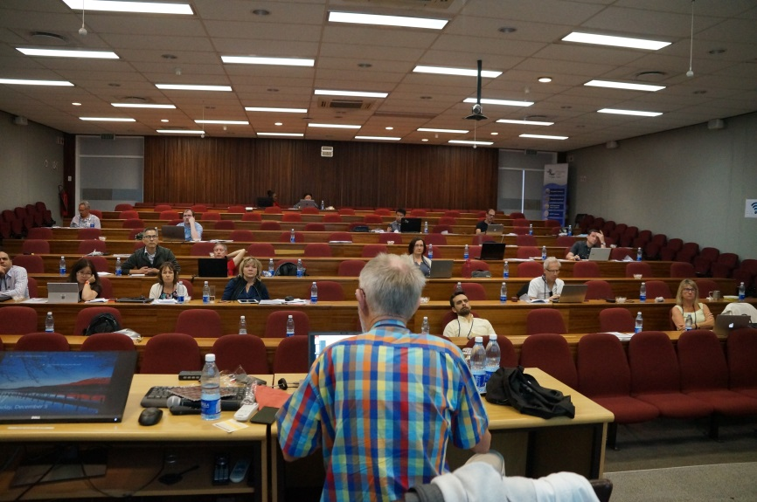
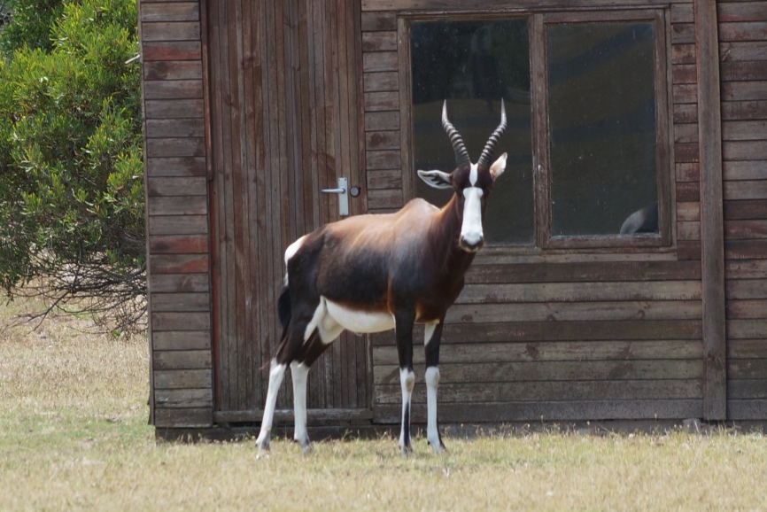
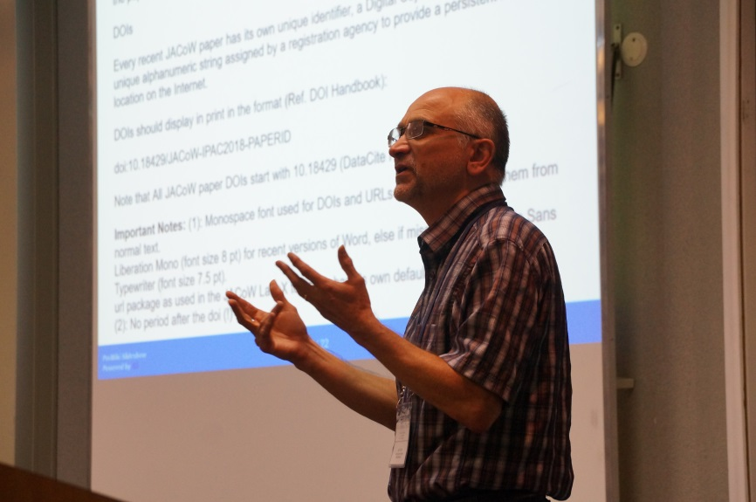

Feedback on Programme Tutorials
Advanced LaTeX
PitStop
Indico
Slide Conversion

Slide 19

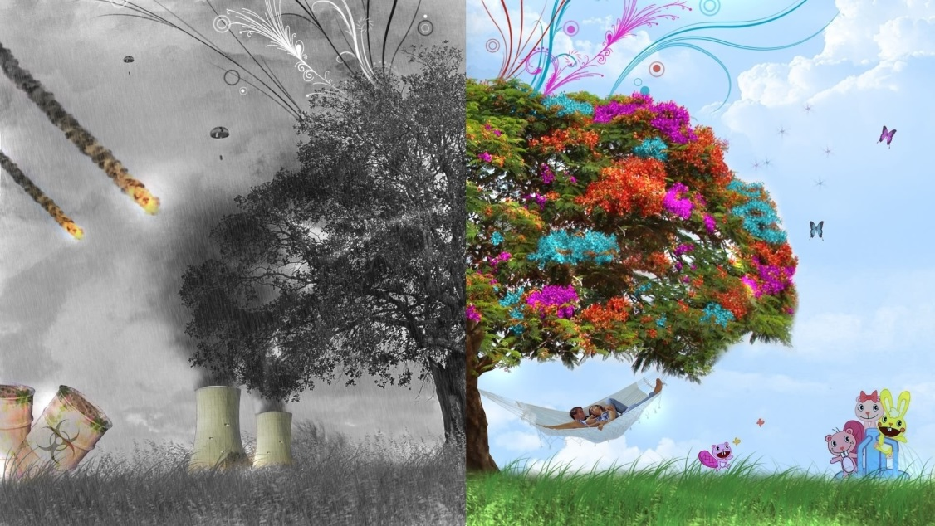
Feedback on Programme
Kick-off session
Work Groups?
One – on – one Times?
Tutorials?
Overview talks detail
Sequence?

Slide 20

Presentation Content?
Wiki?
Details?
Pace?
Break Sizes?
Etc…?

Slide 21
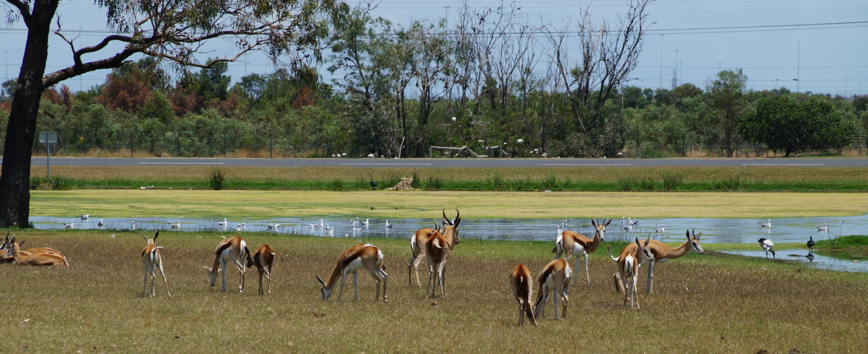
Thank You All Again ☺
Safe Travels!!
Look forward to see you all at the next Team Meeting, where ever that is!!!
David Button dbu@ansto.gov.au

Slide 22

