Slide 1


IPAC’19 Facilities & Preparation Presentation to the JACoW Team Meeting 2018
Rohan Dowd, IPAC’19 LOC Co-Chair
On behalf Greg LeBlanc, IPAC’19 LOC Chair
And IPAC’19 LOC

Slide 2

IPAC’19 Melbourne Australia 19-24 May 2019
Timings & Milestones 2017
DATE | ACTIVITY
February 2017 | Invitation to LOC members
October 2017 | Basic website information
October 2017 | Formation of OC and SPC
October 2017 | Request for IPAC’19 SPMS instance
20 & 21 November 2017 | OC1 and SPC1 Meeting in Melbourne Formation of SAB, decided MC, LOC update, draft synoptic table

Slide 3
IPAC’19 Melbourne Australia 19-24 May 2019
Timings & Milestones 2018
DATE | ACTIVITY
24 February 2018 | Call for proposals of Invited Orals sent to OC/SPC and SAB
31 May 2018 | First Conference Announcement sent to Industry via SPMS.
14 August 2018 | Opening of Industry Exhibition Booth Sales
4 & 5 May 2018 | SPC2 in Vancouver after IPAC’18 (Invited Oral Talks)
June 2018 | Invitations sent to Invited Oral Speakers
5 October 2018 | Official IPAC19 website launch
October 2018 ? | Accelerator Awards Committee, call for proposals
5 October 2018 | Conference Announcement sent with Registration for Delegates Abstract Submissions open
5 December 2018 | Deadline for Abstract Submission, Accelerator and Student Grant Applications

Slide 4
IPAC’19 Melbourne Australia 19-24 May 2019
Timings & Milestones 2019
DATE | ACTIVITY
Jan 2019 | Accelerator Awards Decision
10-11 January 2019 | SPC3 Meeting in Bangkok, Thailand (Contributed Oral Talks)
Jan 2019 | Grant Students informed
1 March 2019 | Early Registration close
 | Light Peer- Review Paper Submission deadline
19 May 2019 | IPAC19 in Melbourne
22 May 2019 | OC2 Meeting, IPAC19 Melbourne
24 May 2019 | Pre-Press Publications of JACoW Proceedings
~24 May 2019 | Potential PRAB authors contacted
1 June 2019 | Final Publication of JACoW Proceedings

Slide 5
IPAC’19 Update Highlights
LOC have meet monthly since Nov 2017.
Key positions in place for Editor, SPMS coordinator, Scientific Publications Board for light review process.
12 people from the IPAC’19 team attended IPAC’18 in Vancouver to shadow their equivalent role.
Larger dedicated exhibition space is being used to maximise the number of posters, networking opportunities and industrial exhibition booth.
Website up and running at http://ipac19.org
Speakers confirmed for Opening, Closing, Entertainment Talk, plenaries and SPC invited talks.
Abstract submission currently open, 190 abstract submitted as of 25 Nov – waiting for the usual exponential rise before the 5 Dec deadline!
Welcome Reception and Conference Banquet organized, both events to be located at the conference venue. Chairmans Reception organised at Metropolis Events, Southbank.
Slightly behind on the ACFA IPAC prize process however aim to be back on track after Jan 2019 SPC3 in Thailand.

Slide 6


Website http://ipac19.org
Website

Slide 7

‘In Unity’ – Kelly Saylor
Website
Commissioned artwork by Kelly Saylor representing the JACoW collaboration through connecting country to country.

Slide 8
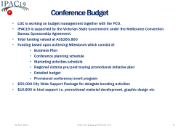
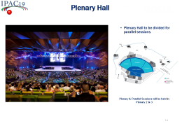
Local Organising Committee (LOC)
LOC meeting monthly.
Key responsibilities have been assigned
Members coordinate with other IPACs for knowledge transfer and best practice.
Greg LeBlanc, Chair
Head of Accelerator Science and Operations
Australian Synchrotron – ANSTO
Rohan Dowd, Deputy Chair, SPMS Administrator
Senior Accelerator Physicist
Australian Synchrotron – ANSTO
Nicole White, Project Manager, PCO Support and Scientific Secretary
Nicole A. White Projects
Melbourne
David Button, Proceedings Manager
Senior Instrumentation Scientist
Centre for Accelerator Science – ANSTO
Eugene Tan, Student Coordinator
Senior Accelerator Physicist
Australian Synchrotron – ANSTO
Mitchell Hewes, IT Manager
Technical IT Security Officer
ANSTO
Nick Hauser, IT Manger
Leader, Computing and Electronics
Australian Centre for Neutron Scattering - ANSTO
Mike Lafky, Technical Tour Manager
Group Leader, Accelerator Operators
Australian Synchrotron – ANSTO
Jaye Muir, Public Affairs
Stakeholder Relations Advisor
Australian Synchrotron – ANSTO
Kerry Hayes, Industry and Sponsoring
Group Leader, Industry Engagement
Australian Synchrotron – ANSTO
Dieter Pelz, Industry and Sponsoring
Research and Development Manager
Radio Frequency Systems Pty Limited (Retired)
Dean Morris, Conference Support
Head of Operations
Australian Synchrotron – ANSTO
Roger Rassool, Conference Support
Associate Professor
School of Physics - University of Melbourne

Slide 9
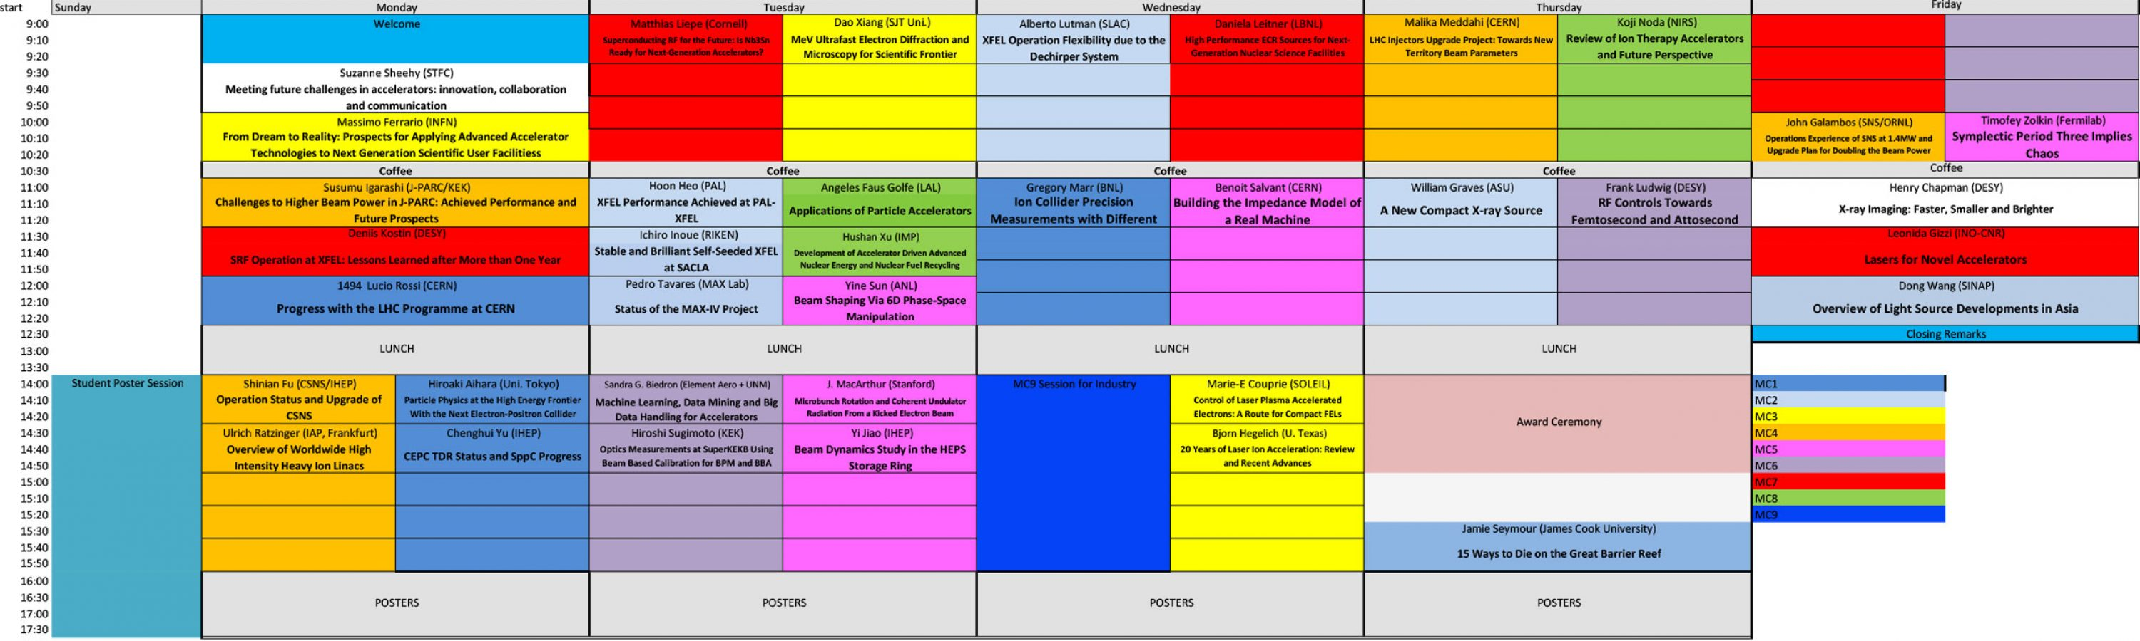
Program
Website

Slide 10
Abstracts created as of 1/12/18

Slide 11
Conference Budget
LOC is working on budget management together with the PCO.
IPAC19 is supported by the Victorian State Government under the Melbourne Convention Bureau Sponsorship Agreement.
Total funding valued at AU$266,800
Funding based upon achieving Milestones which consist of:
Business Plan
Conference planning schedule
Marketing activities schedule
Regional Victoria pre/post touring promotional initiative plan
Detailed budget
Provisional conference/event program
$50,000 City Wide Support Package for delegate boosting activities
$16,800 in kind support i.e. promotional material development, graphic design etc
The budget has been developed for conservative numbers of 900 delegates and 70 exhibition booths, however there are currently good indications of exceeding these numbers.

Slide 12
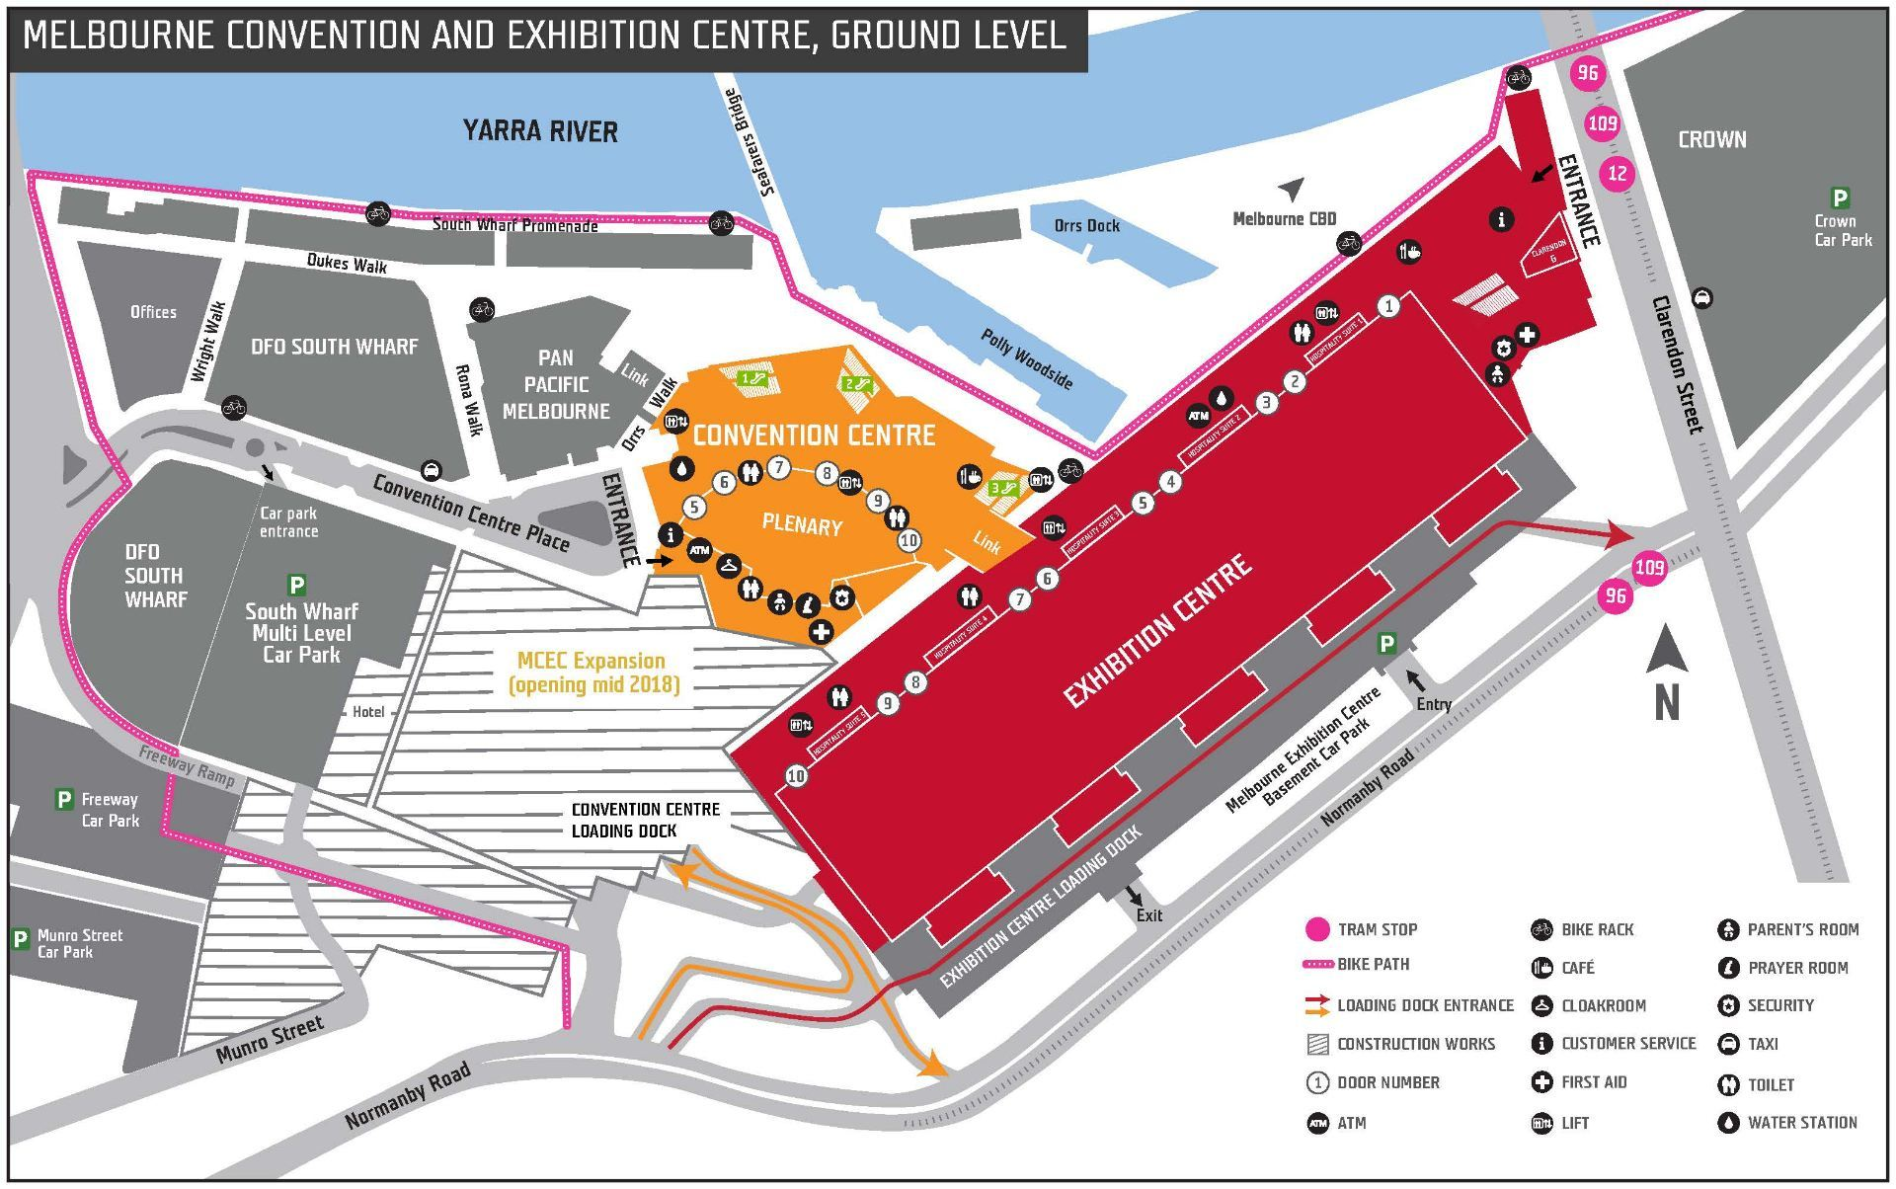
Melbourne Convention & Exhibition Centre A world class venue on the Yarra River!

Slide 13
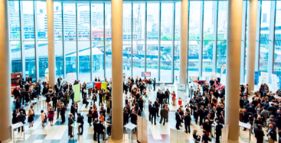
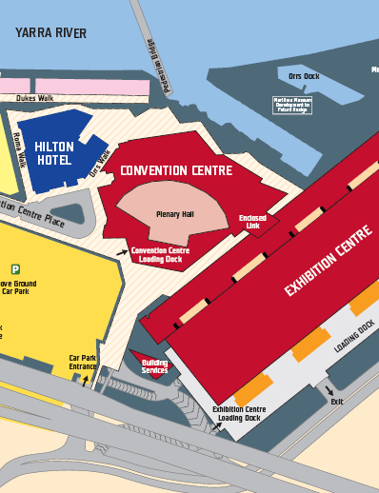
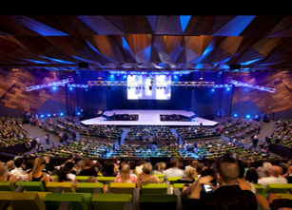
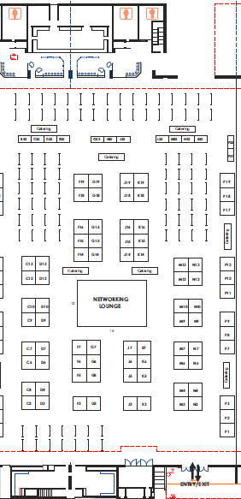
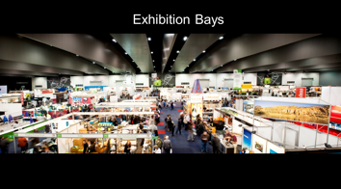
New for IPAC19. Exhibition & poster sessions combined
Former exhibition space. Will now be used for registration, Welcome Reception & Student Poster Session
Pan Pacific
Hotel
Flexible plenary hall, will be divided into two plenary session theatres.
Larger dedicated
Exhibition space now
being used to include posters and catering breaks.

Slide 14
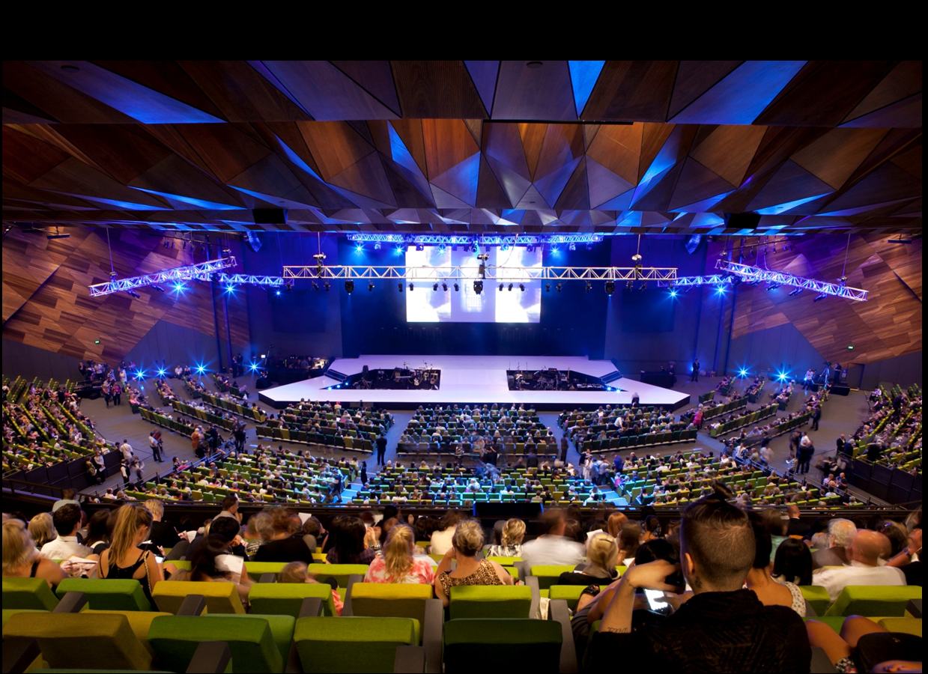
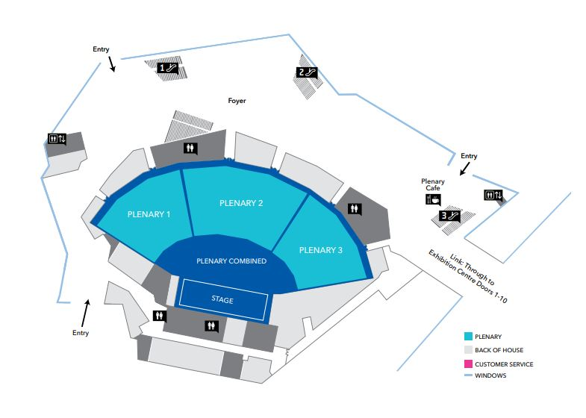
Plenary Hall
Venue
Plenary Hall to be divided for parallel sessions.
Plenary & Parallel Sessions will be held in Plenary 2 & 3

Slide 15
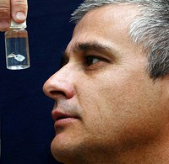
Entertainment Talk
Venue
15 ways to die on the Great Barrier Reef
Associate Professor Jamie Seymour
Date: Thursday 23rd May 2019 Time: 3:30 – 4:00 pm Location: Plenary 2
Institute: Australian Institute of Tropical Health and Medicine, Centre for Biodiscovery and Molecular Development of Therapeutics, James Cook University

Slide 16
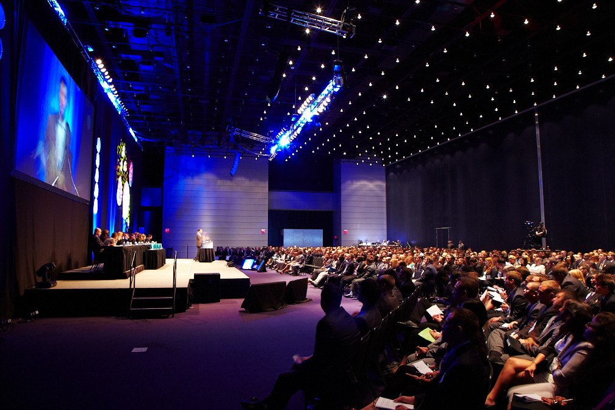
Session for Industry
Venue
Proposed format of three industry speakers with an industry moderator.
A brief has been sent to three prospects however response has not overwhelming.

Slide 17
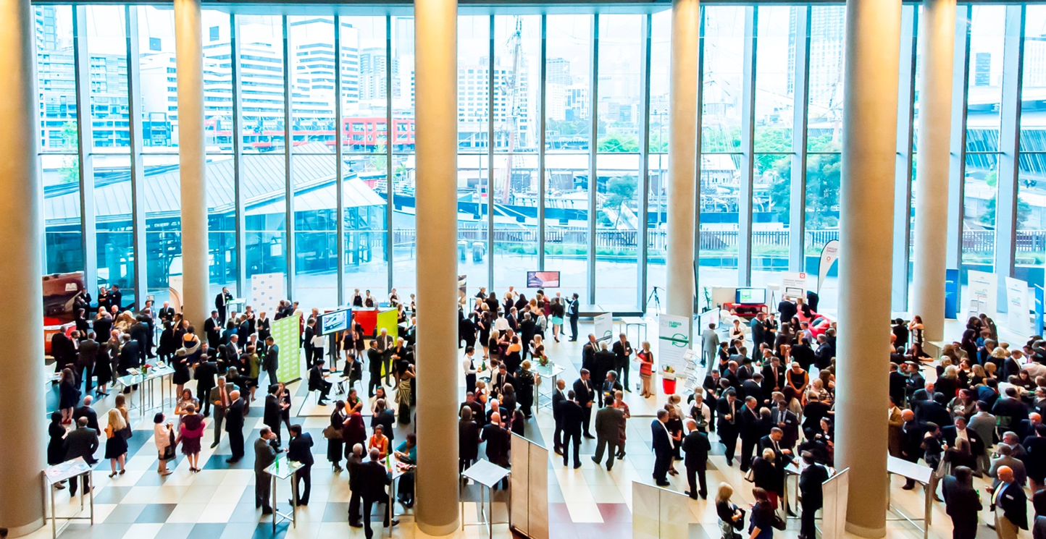
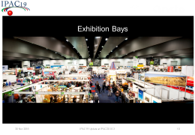

Plenary Hall Foyer Welcome Reception & Student Poster Session Venue
Venue

Slide 18
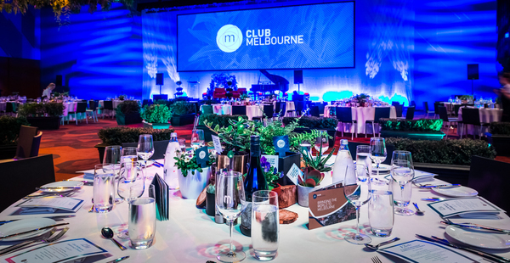
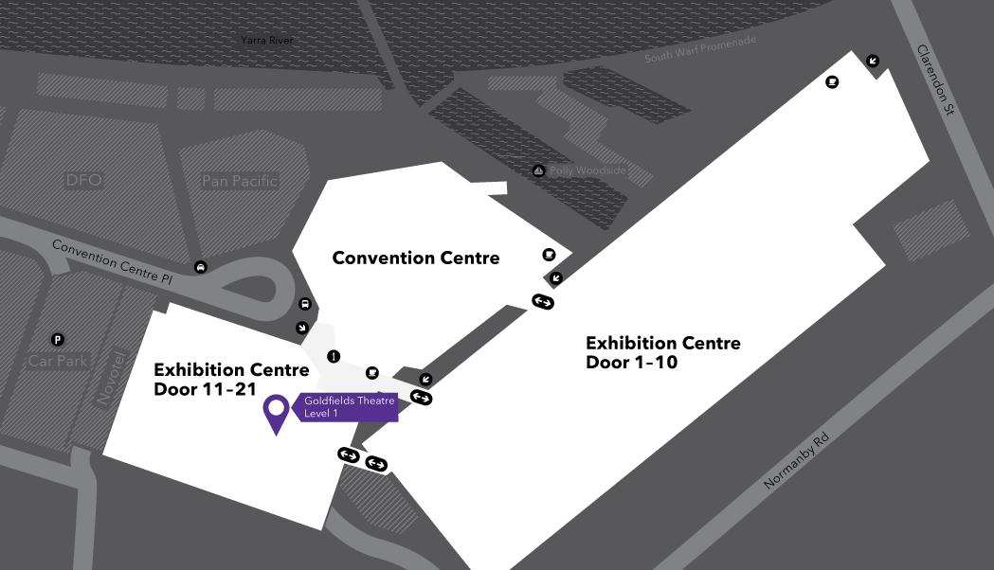
Goldfields Theatre Conference Banquet Venue
Venue
Goldfields Theatre adjoins the Plenary in the Convention Centre and the to Exhibition Centre.

Slide 19
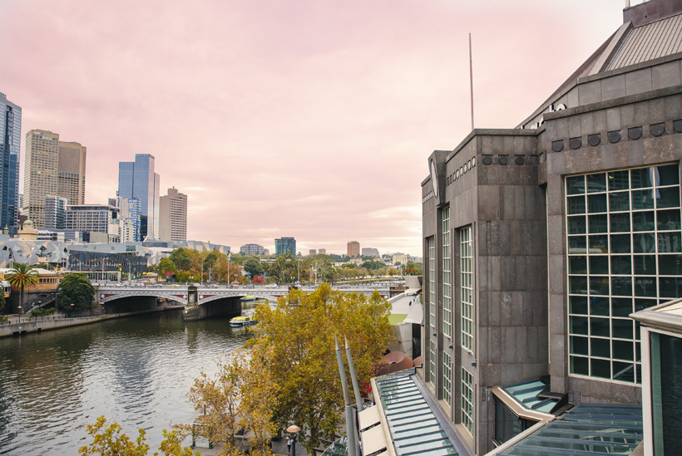
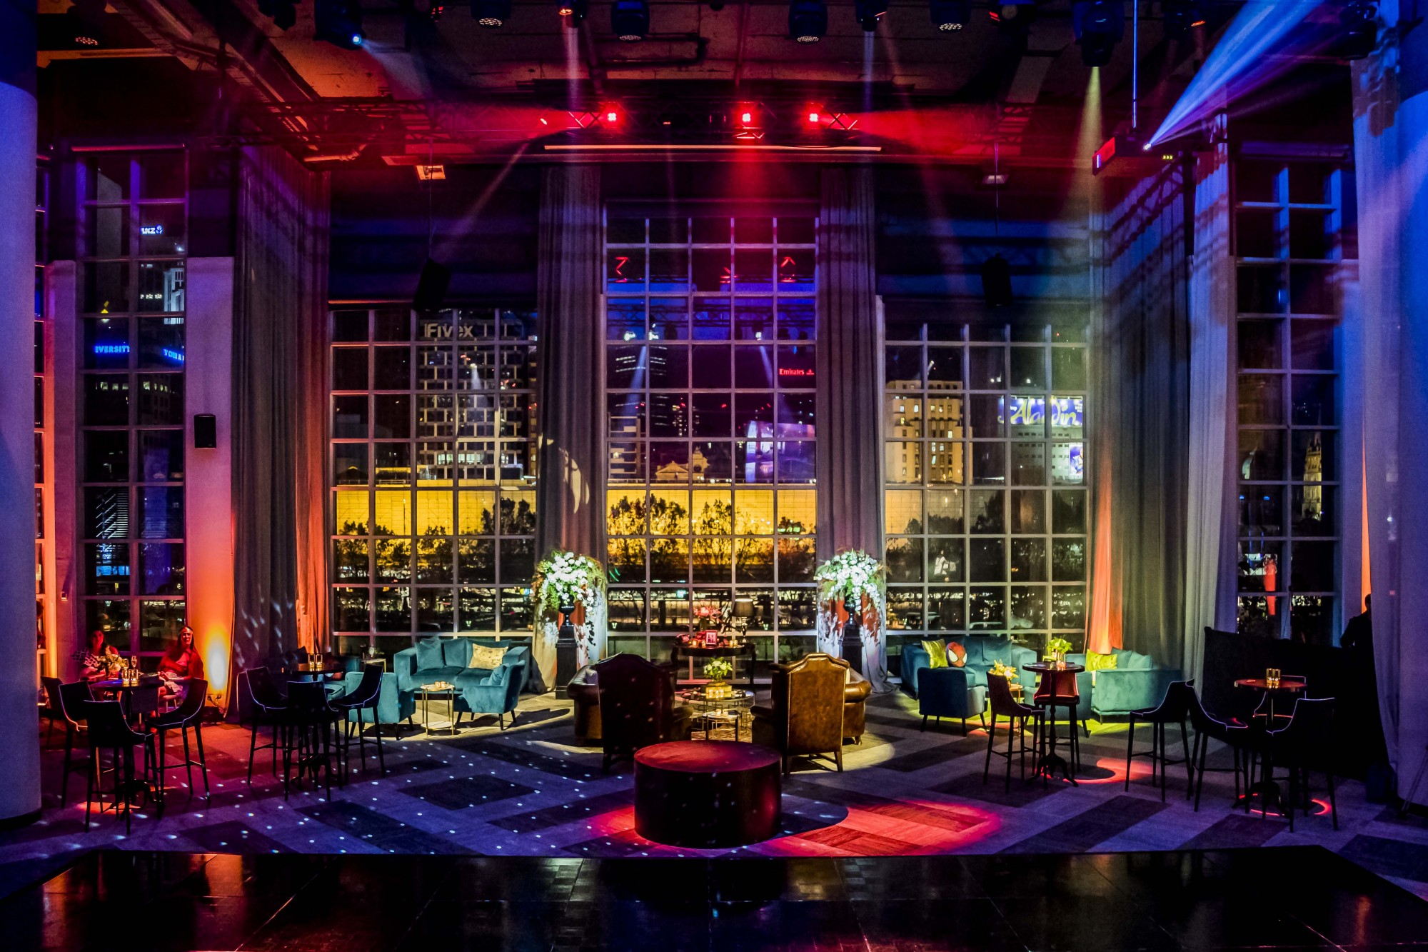
Metropolis Events, Southbank Chairman's Reception Venue
Venue
Spectacular venue overlooking the iconic Melbourne Flinders Street Train Station.
Even more spectacular in the evening!
15 minute walk down Southbank Boulevard to Metropolis Events.

Slide 20
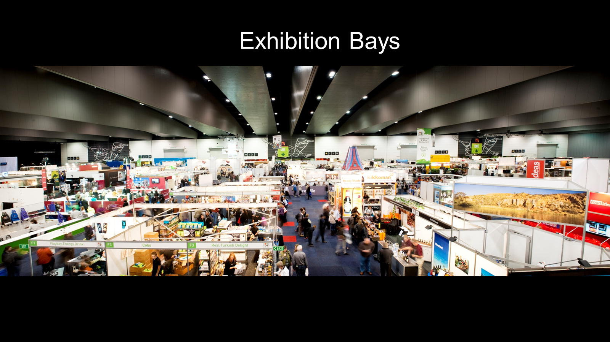
Venue

Slide 21
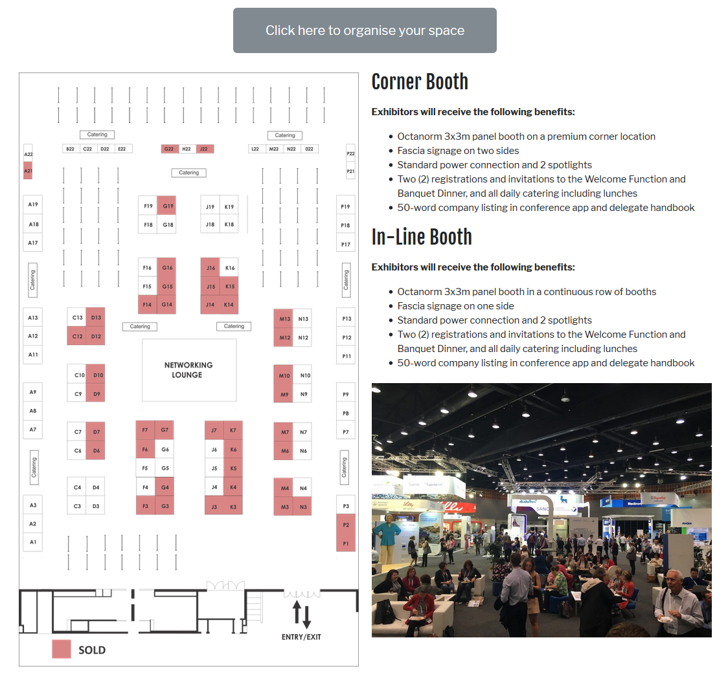
Exhibition and Poster Space
Venue
Exhibitor and catering areas combined with posters, all in one dedicated space.
Connected walkway between Plenary, to Exhibition and Poster Space and all catering breaks.
96 large booths, 41 sold as of 25 Nov 2018.
Small tables available for Learned Societies, journals and future conferences.

Slide 22
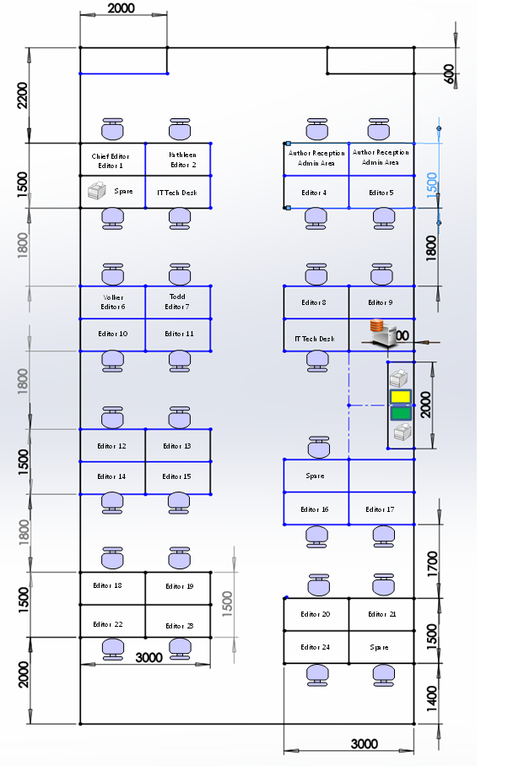
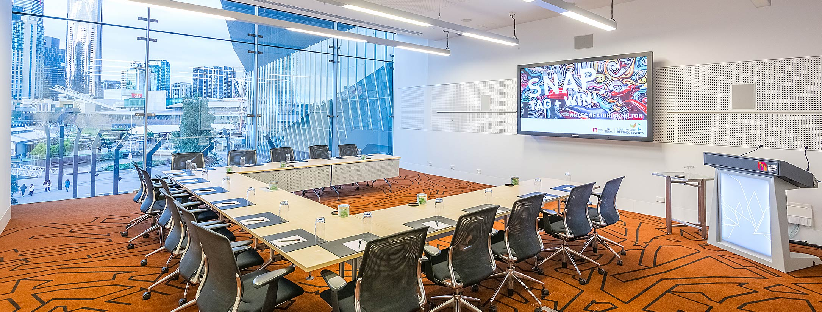
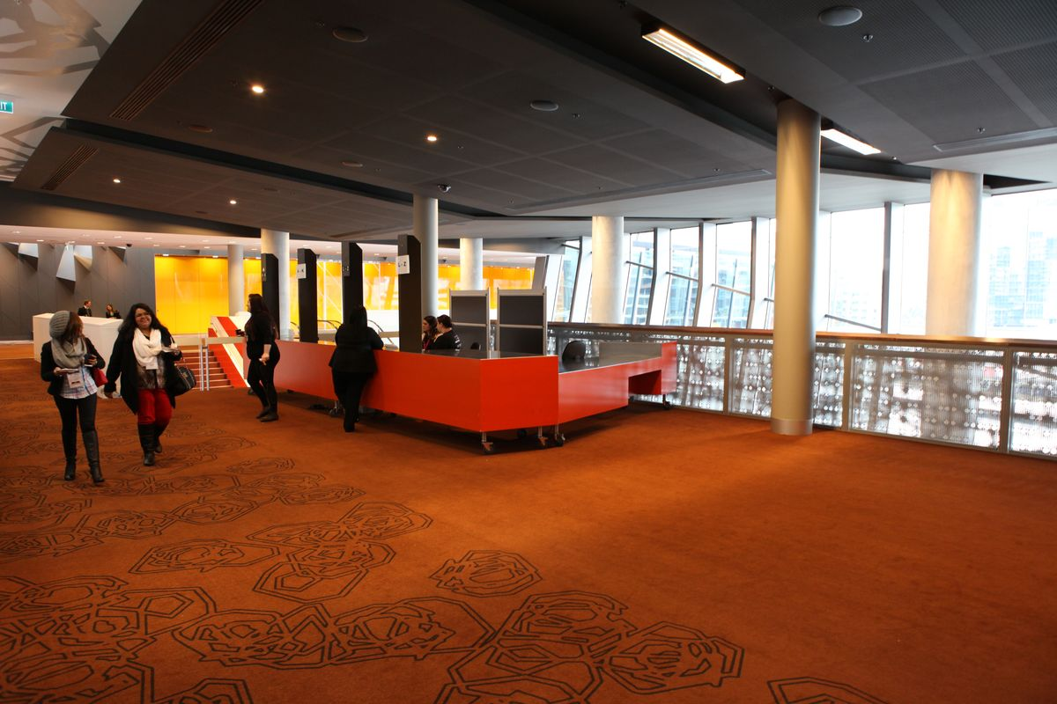
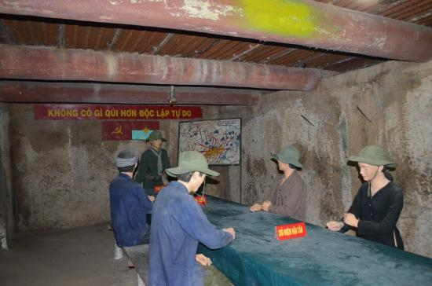
Proceedings Office, Speaker Prep & Author Reception
Venue
Level 2 with floor to ceiling views overlooking Southwharf precinct.
Room 215 - Speaker Ready.
Foyer - Author Reception.
Room 218 - Proceedings Office.

Slide 23


Invitation from IPAC’19 Chief Editor
It would be impossible for IPAC’19 to be as organised and ready to undertake this annual event without building on the amazing good will and support of both IPAC’s that have come before us, and the efforts of the JACoW collaboration and team members within.
The organisation of IPAC’19 and production of the proceedings is highly dependent on the unique and reliable IT, and the knowledgeable application of the JACoW process and SPMS administration. IPAC’19 wished to pass on this good will to assist future IPAC’s by inviting them to be part of the IPAC’19 team in Melbourne to get first hand experience.
Activities/Roles of interest:
IT Management
Chief Editor
Author Reception
If you have any team members who you wish to be involved please contact David Button to discuss further, email: david.button@ansto.gov.au.”

Slide 24
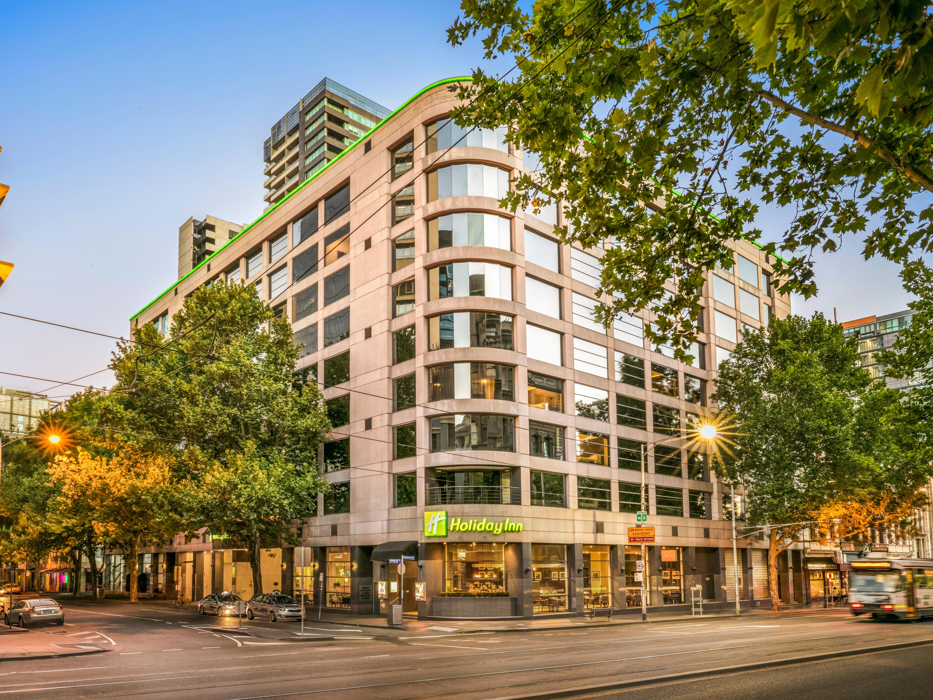
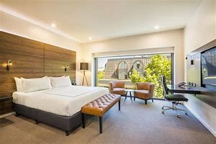
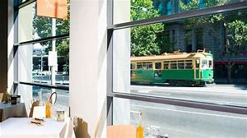
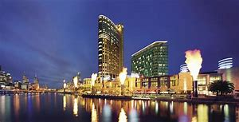
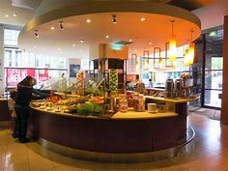
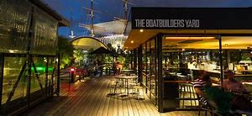
Proceedings Team HQ Hotel
Venue
Holiday Inn Melbourne on Flinders.
7 minute walk to MCEC.
Short walk to Crown Ca$ino, restaurants, bars, cafes and Factory Outlet stores.

Slide 25
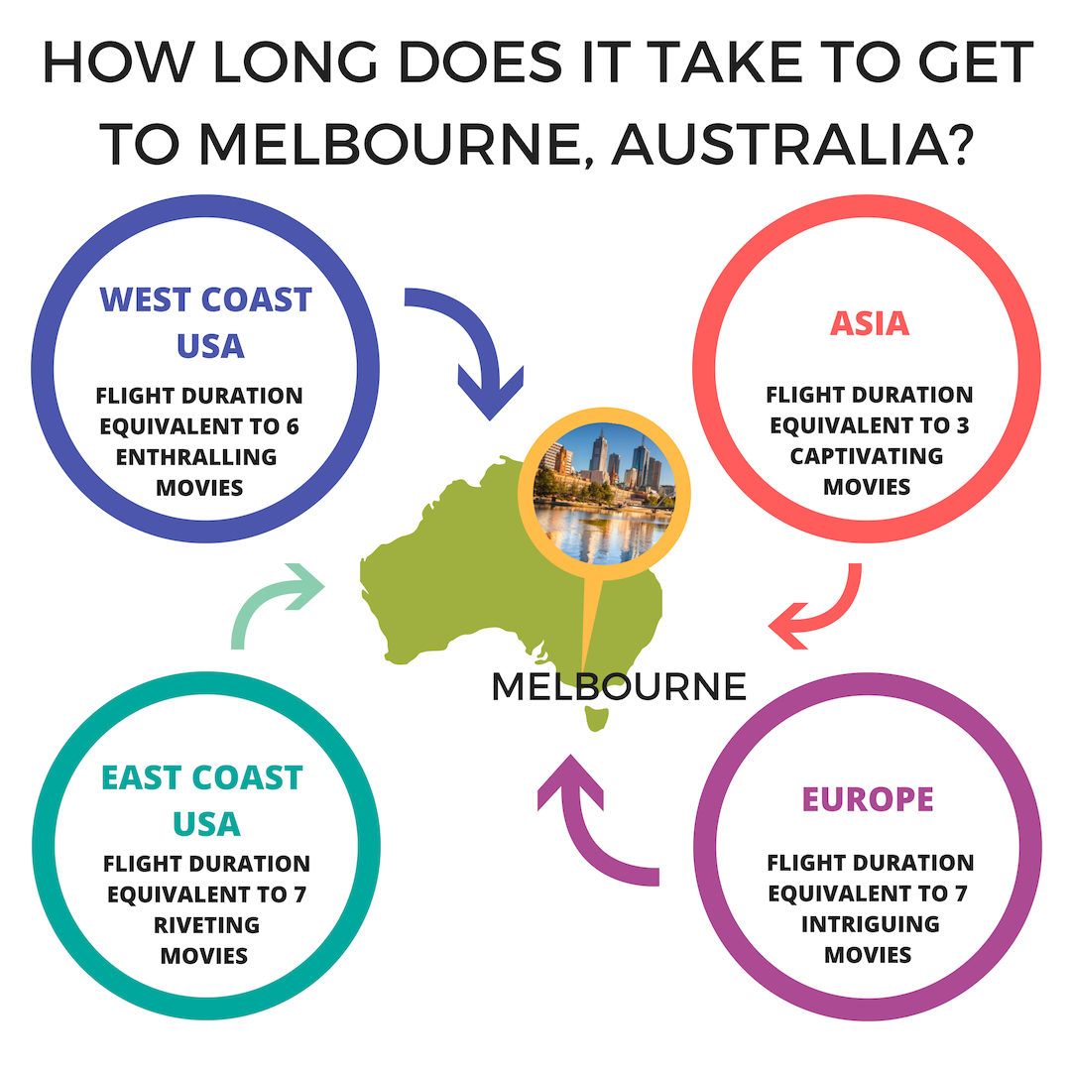

To clarify….

Slide 26
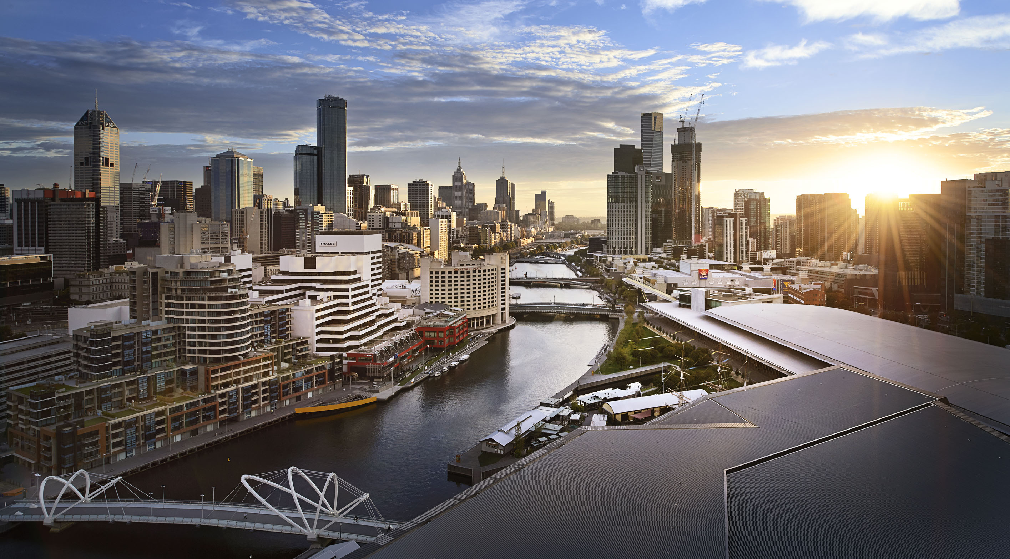
We look forward to welcoming you to Melbourne, Australia, 19-24 May 2019

