Slide 1

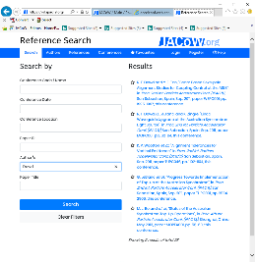
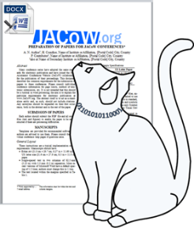
JACoW Developments
Impacts and outcomes:
Reference Search Tool & Cat Scan Editor
Presented by
David Button

Slide 2
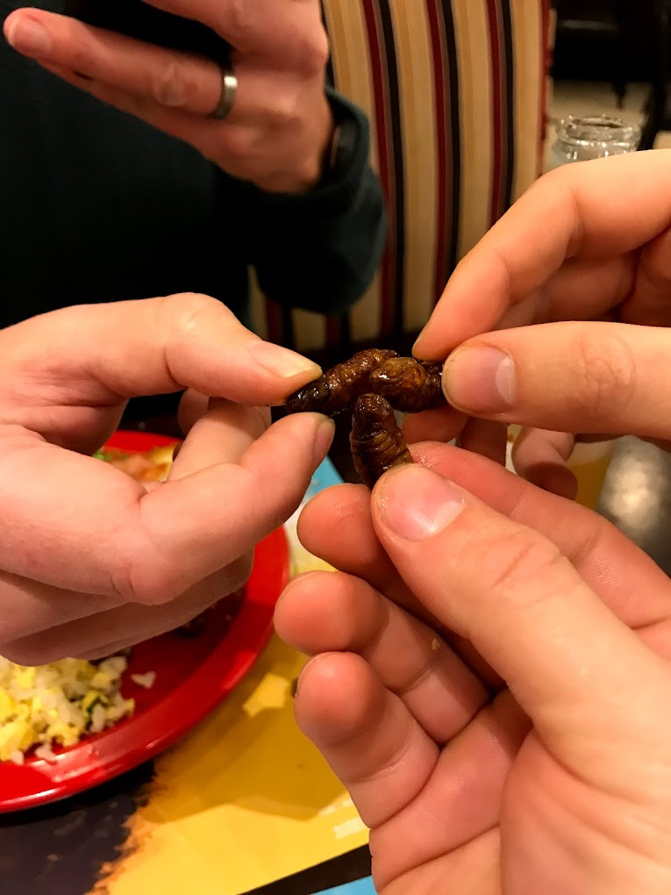




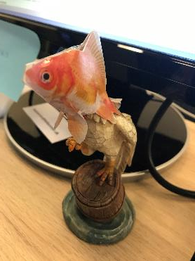


Slide 3
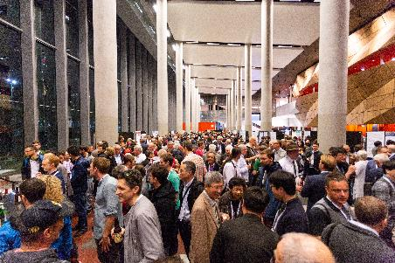
IPAC’19
Total 1,135 Attendees

Slide 4

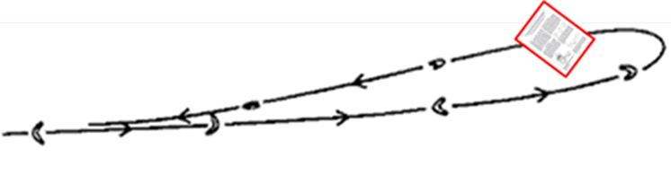
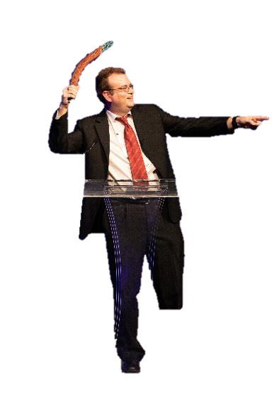
Problems with Proceedings Production
with small edits to PDF QA ready
modified source file and re-produced PDF, green on author acceptance
returned to author for correction
Resource Draining Problems
Poor quality, incomplete, and incorrect referencing formatting
Poor preparation of Word documents with technical faults
References/Figures/Tables not sighted in main text, out of sequence
Section heading errors
Different Title and Author list to that of the SPMS management system.
Etc…

Slide 5

Problems with Proceedings Production
Resource Hungry Activities:
References
Poor Preparation
Cost Per Editor
≈ $3,100 for IPAC’19
Inclusive of workstation hire, delegate events etc…
High Quality
Low Resourced
Low Quality
High Resourced
$$$

Slide 6
Resourcing Trend
Added 4th Page for References
References
Take
More Time

Slide 7
Resourcing Trend (References)

Slide 8
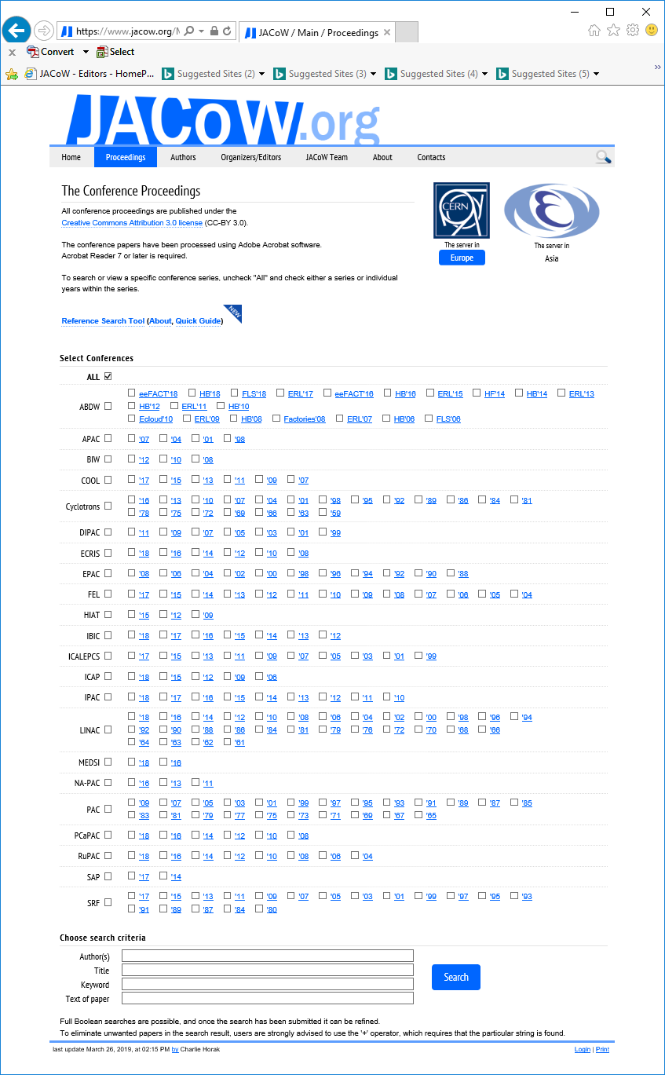
JACoW Proceedings
Who is JACoW
International collaboration for the electronic publication of accelerator conference proceedings
Website
Proceedings
Documentation
Tools
Team
People actively working on it
232 Proceedings published and searchable free to the community
70,466 Individual papers 15 Dec 2021

Slide 9




1. Quality References
Proposed Development
Stakeholder recognition of contribution to the community, KPI’s, Impact Factors….
D05 Development of Supporting Applications for IPAC19
D05.1 Reference Parser/SPMS Search Tool
ANSTO IPAC Contact – David Button
Description: The editorial board for IPAC19 requested the development of a tool that allowed searching through papers within the SPMS system and the automatic generation of references within the approved style. It was estimated that 25% of the time spent by editors in the proceedings office is spent generating reference corrections manually from papers already indexed by SPMS.
Source

Slide 10


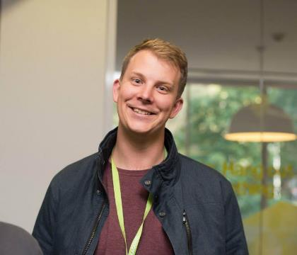



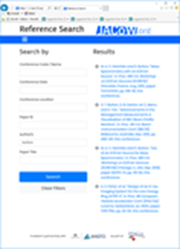








References Search & Generation Tool
Ronny Billen
David Button(CAS)
Volker Schaa
Todd Satogata
Josh Peters (IDS)
Jan Chrin
Ivan Andrian

Slide 11
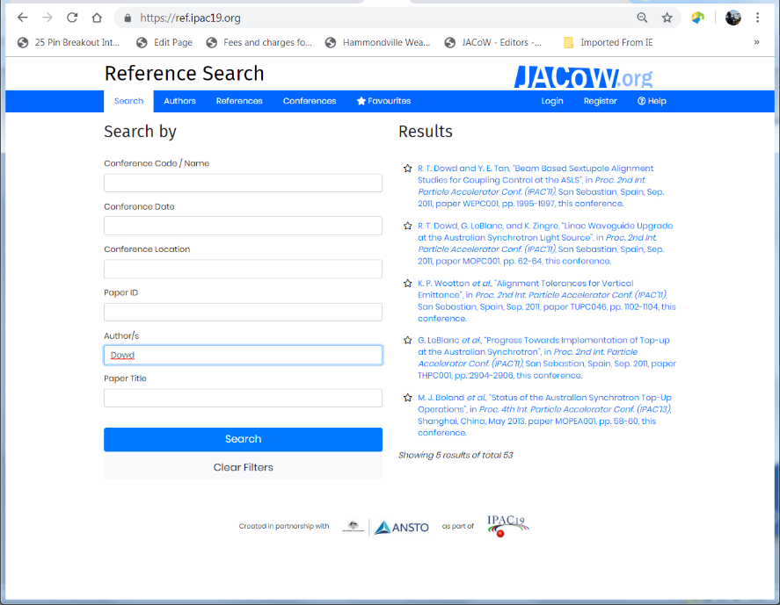
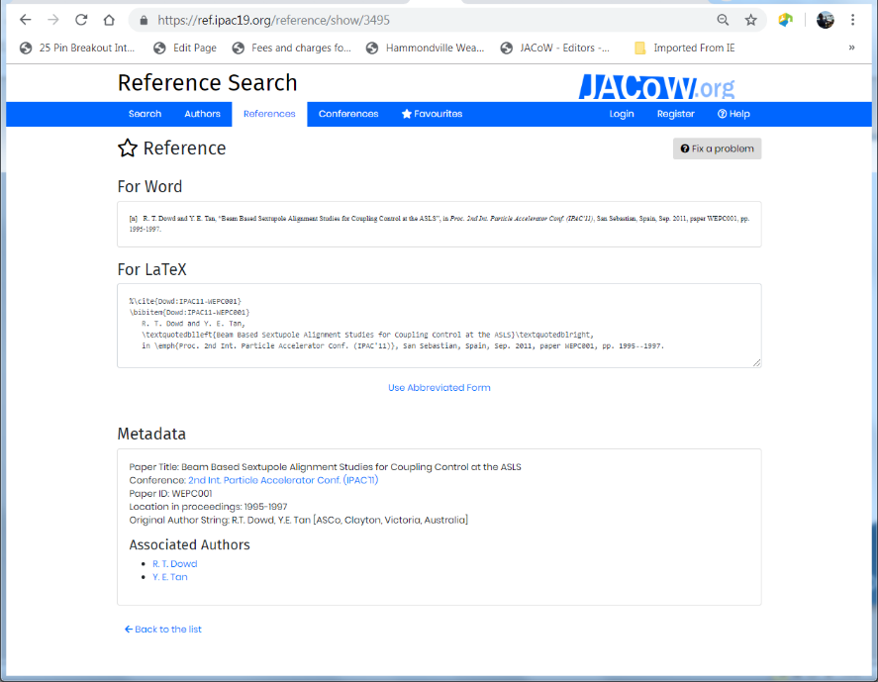
refs.jacow.org
Online Help: http://www.jacow.org/Authors/RefSearchToolHelp

Slide 12
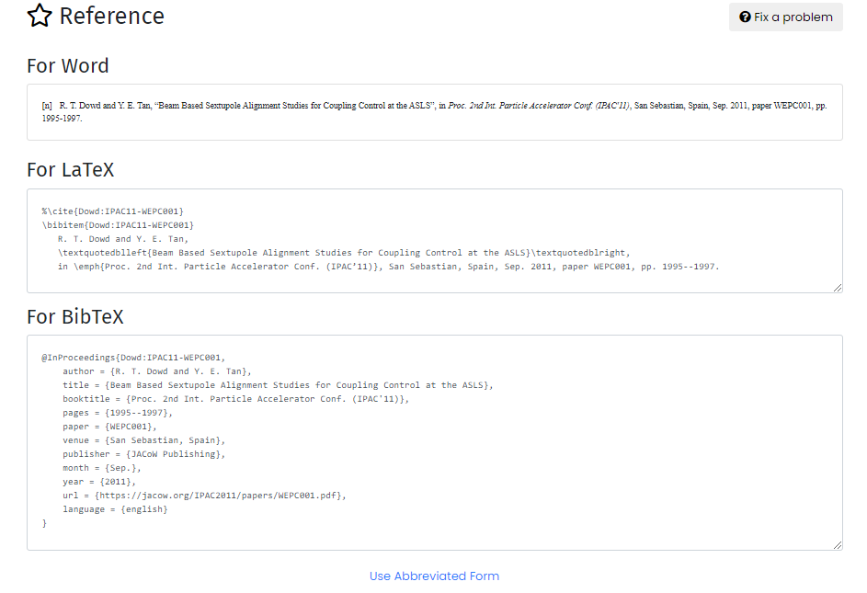
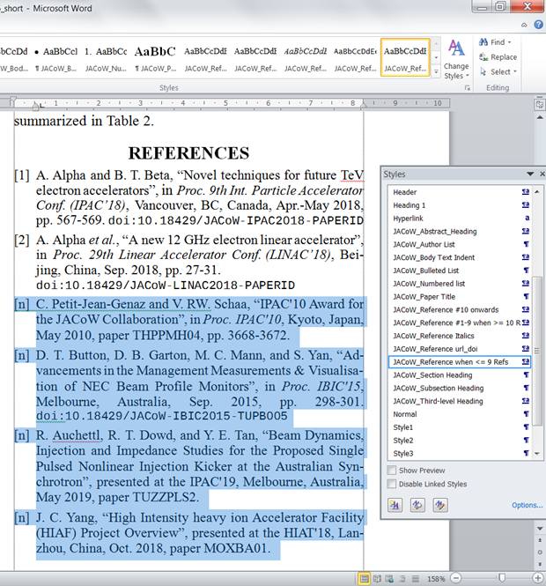
refs.jacow.org
Total number of References in Database: 70,466
Total number of Authors: 55,463
Proceedings: 232
(As of 14 Dec 2021)

Slide 13
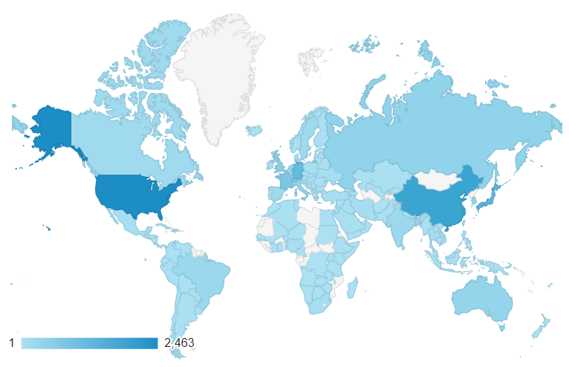
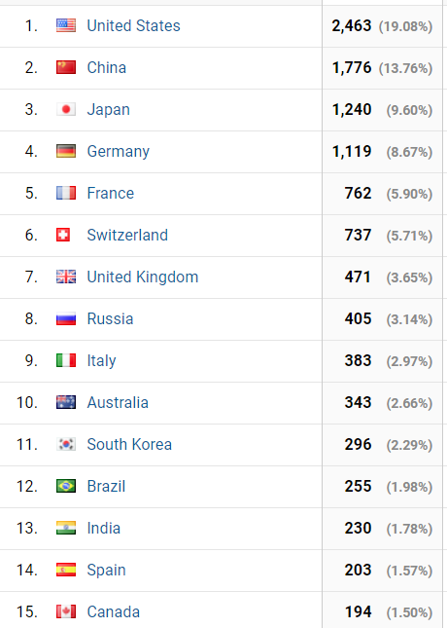
World Domination
As of 14 Dec 2021
34,053 Page Views
22,000 Sessions
13,000 Users
Used in 143 Countries!

Slide 14

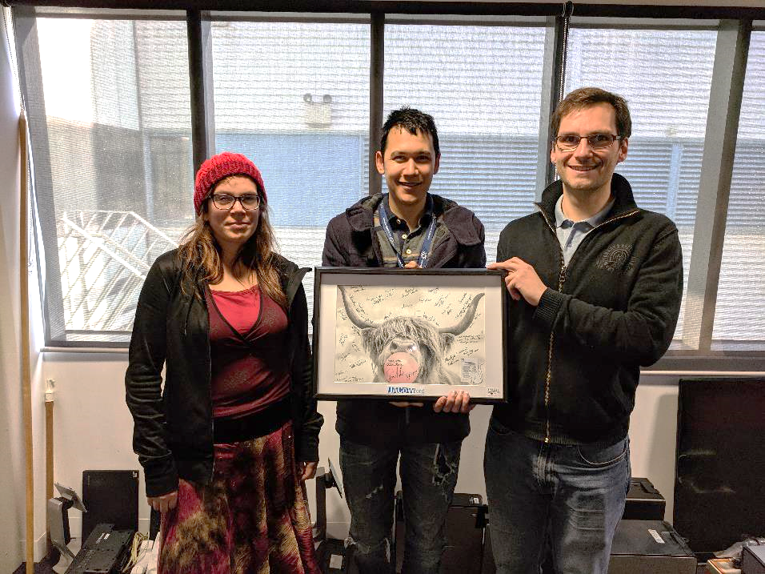
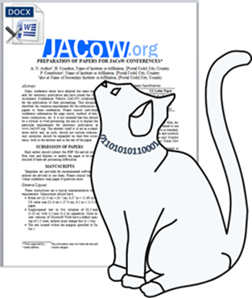
2. Better Paper Preparation
Scientific Computing Group (Synch)
Rosemary Waghorn
Alex Palma
Andreas Moll

Slide 15
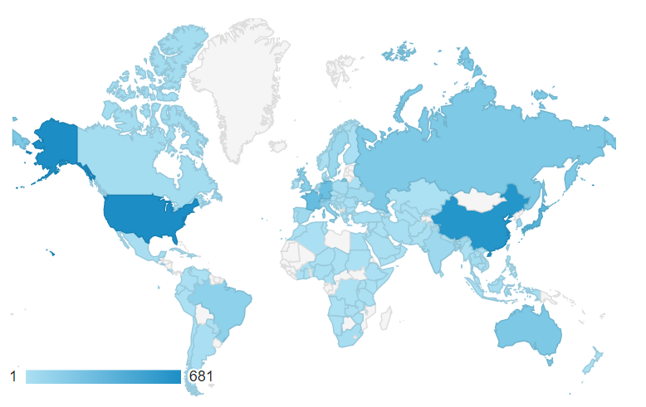
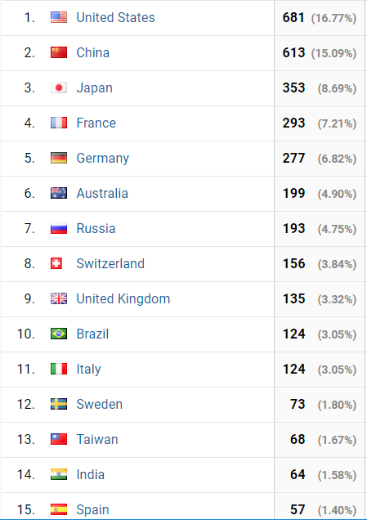
World Domination
As of 14 Dec 2021
4,000 Users
12,636 Scans
118 Countries

Slide 16
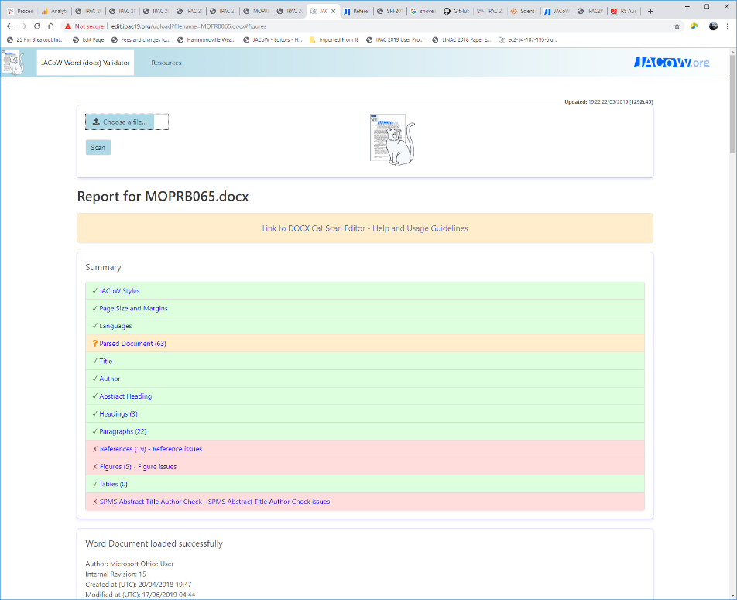
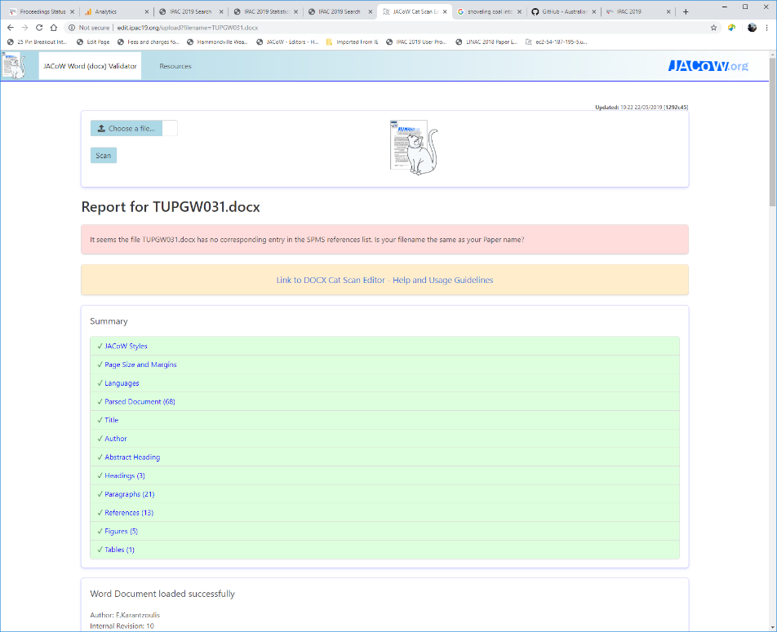
JACoW Cat Scan Editor
Online Help: http://www.jacow.org/Authors/CSEHelp

Slide 17
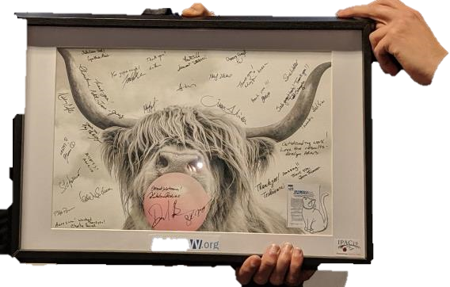


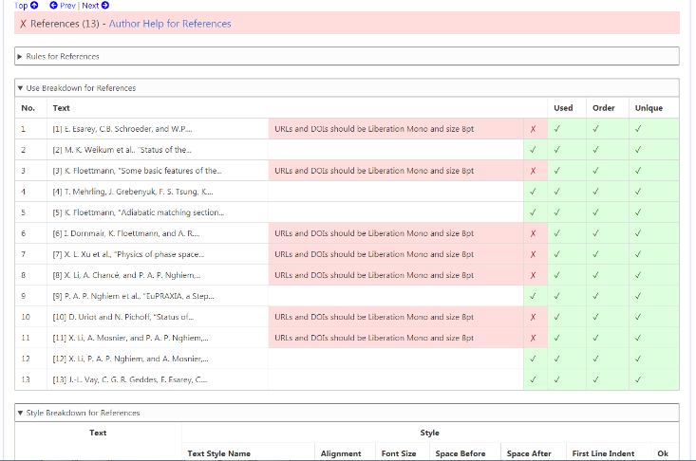
JACoW Cat Scan Editor
Features
Check for JACoW Styles and Template usage
Check Paper and Margin Settings
Check Proofing Language Settings of Content
Checks Formatting of Paper Title
Checks Formatting of Author List
Checks Presence of Abstract
Checks Section, Sub-section, and Third Level Heading Formatting
Checks Paragraphs have initial indent and aligned justified
Searches Document for, Existence, in Text Reference, Sequential Order, Missing, and Duplicated References
Searches Document for, Existence, in Text Reference, Sequential Order, Missing, and Duplicated Figures
Searches Document for, Existence, in Text Reference, Sequential Order, Missing, and Duplicated Tables
Checks Formatting of Figure Captions
Checks Formatting of Figure Tables
Checks Paper Title Against SPMS Abstract Title
Checks Author List Against SPMS Abstract Author List
Generate instant feedback reports to educate authors, and to assist editors.
Online Help: http://www.jacow.org/Authors/CSEHelp

Slide 18
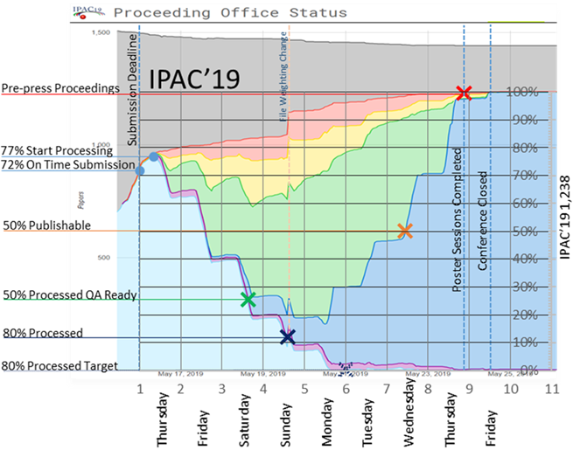
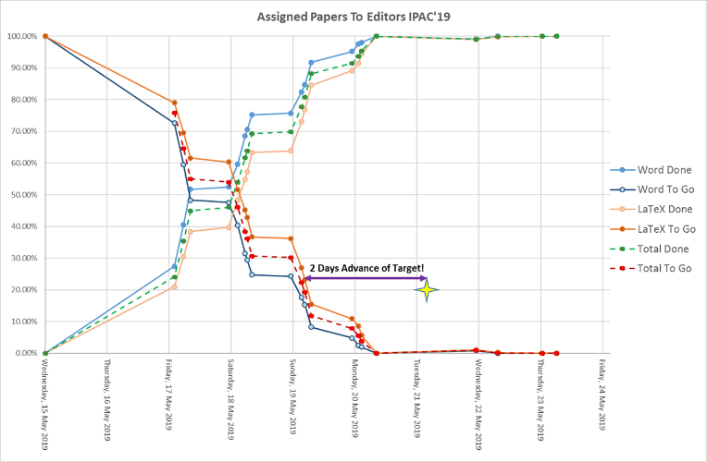
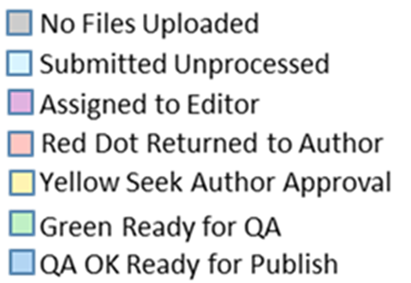
Game Week -Running Stats

Slide 19
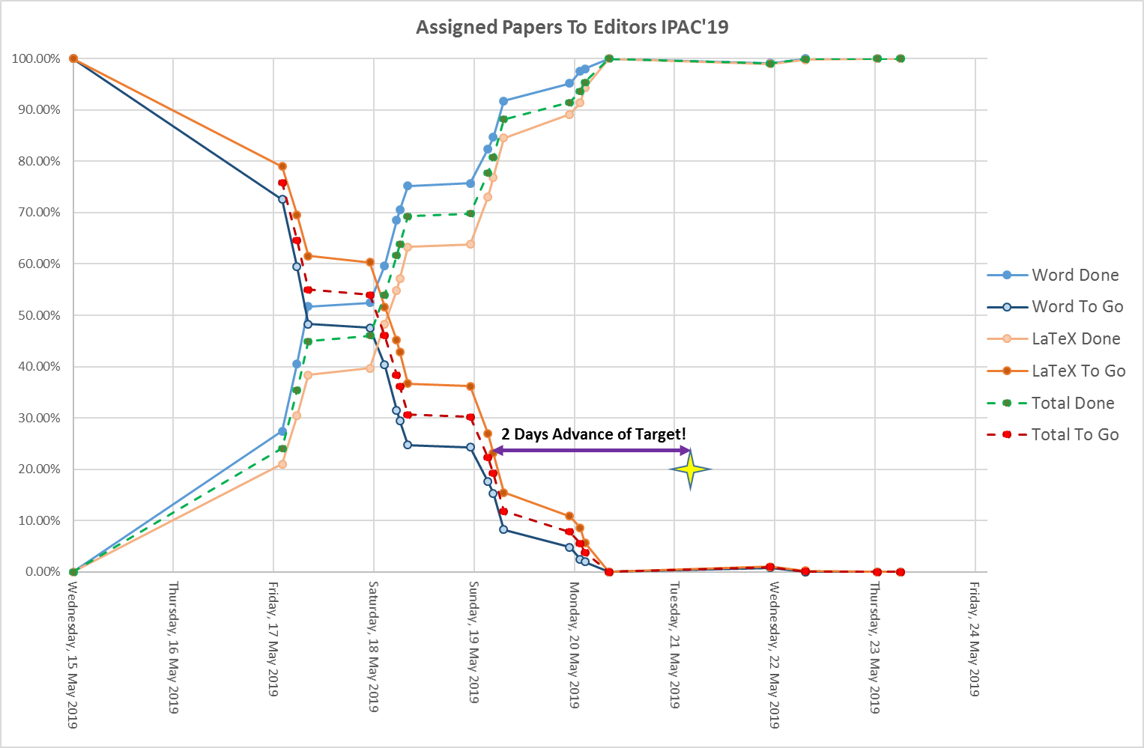
Running Stats

Slide 20
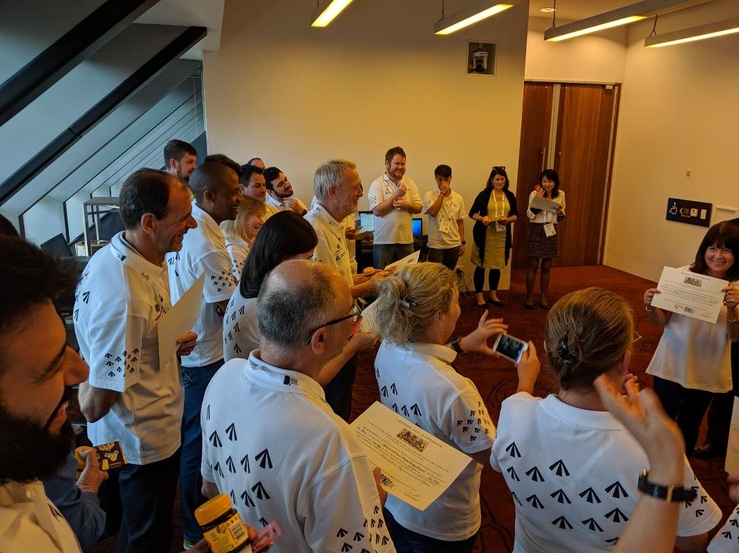

Freedom Earlier!
Certificate of Freedom

Slide 21
Thank you
I hope to see ANSTO continue to support these successful tool into the future

