Slide 1



Word Editing Tips and Tricks
David
Button
JACoW TM 2022 Knoxville
WORD

Slide 2
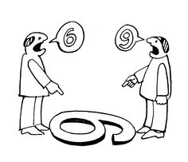
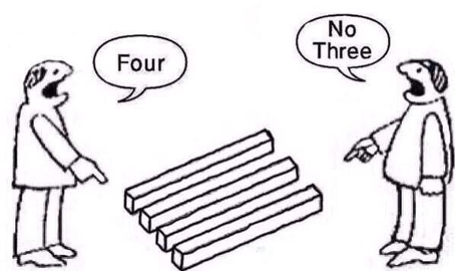
Method Disclosure Statement

Slide 3
Overview
Prerequisites
Template
Common Oversights/Mistakes
Must fix vs Time Dependant fix
Visualisation
Print Layout View (default)
Outline View
Text Boundaries
Punctuation and hidden symbols
Red Dot is a Red Dot
Search's
Find
Find and Replace
Formatting
Styles
Format Paint Tool
Fudging Line Spacing's (Shift + Ctrl + “<“ OR “>”)
Insert Objects Inline with Text
Remove Hyper Links
Breaks
IPAC’17 Stats

Slide 4

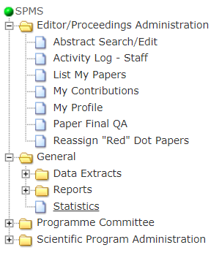
Prerequisites Resources
JACoW Template | http://www.jacow.org/Authors/MSWord
Citation Information | http://www.jacow.org/Authors/FormattingCitations Annex B of Full Template
Statistic of paper errors
“Arm Yourself with Knowledge”
https://[your_previous_instance]/rpt_stats.html

Slide 5
Prerequisites - Resources Common Errors
23.44% | TC06 Reference or Reference formatting incorrect (missing, multiply defined, wrong order, indentation, hyperlink, inconsistent, wrong, incomplete)
13.65% | TC04 Figure formatting incorrect (caption missing, outside margins, single/multiple line caption not centred/justified/placed above, caption wrongly labeled [abbreviated, colon missing, wrong font size, bold/italic])
12.25% | TC02 Text formatting incorrect (paragraphs, section/sub-section headings, indentation, column/intercolumn width, wrong text flow, number/unit split over lines)
10.00% | TC03 Table formatting incorrect (not centered, outside margins, caption below table, wrongly labeled, not in Initial Caps, single/multiple line caption not centred/justified)
8.16% | TC01 Incorrect Title, Authors, Affiliation formatting (size, full UPPER/lowercase, not in required lowercase [MHz], country missing)
5.07% | TC08 Figure/Table/Reference not referenced in text or missing
3.83% | TC00 General Problems related to formatting
3.80% | TC05 Footnote formatting incorrect (outside margins, no line above, not at bottom/first column, missing)
2.64% | MP04 Comments to the Author/Editor in Chief
1.99% | MP00 Miscellaneous or Formatting Problems
1.93% | TC09 Equation/Eq., Figure/Fig., Table wrongly used in text (lower case, abbreviated, period missing)
1.63% | TC07 Figure/Table/Equation/Reference numbers not in sequence
1.45% | MP02 Spelling Corrections
1.33% | MP03 Too many pages, blank pages
1.28% | UT00 General problems with template usage
1.16% | UT01 Template not used or parameter change; Bounding Box wrong; Incorrect column and/or intercolumn widths; old template used
1.13% | FC01 PS/EPS/PDF/source or supporting file(s) missing
1.07% | FC06 LaTeX (error: not compilable, package missing, multiply defined labels, or other infos)
1.04% | FC00 General Problems with files
0.77% | FP01 Font Problems (wrong font, wrong font size, not embedded, Type3/bitmap font as main text, too many fonts >50))
0.68% | TC11 Equation formatting incorrect (outside margins, Eq. number outside, not Eq. (x))
0.62% | FC02 Problem with pictures (too big, color conversion in PDF fails, lines/colors disappearing, numbers not readable, internal problems)
0.30% | FP00 General Problems with Fonts
0.24% | TC10 Graphics problem (too slow displaying, too small, resolution too low/high, text not readable)
0.18% | FP02 Font Problems (missing character, unknown glyph, unknown encoding: PDF doesn't contain readable text for search/export)
0.15% | FC04 Multiple or Unusable Files
0.12% | FC05 Bad EPS/PS/PDF: Scale to fit; Colour image printed B/W; PostScript/EPS doesn't distill
0.12% | UT02 A4 on US or US on A4 to produce PostScript/PDF
Top 5 IPAC’17 Errors

Slide 6

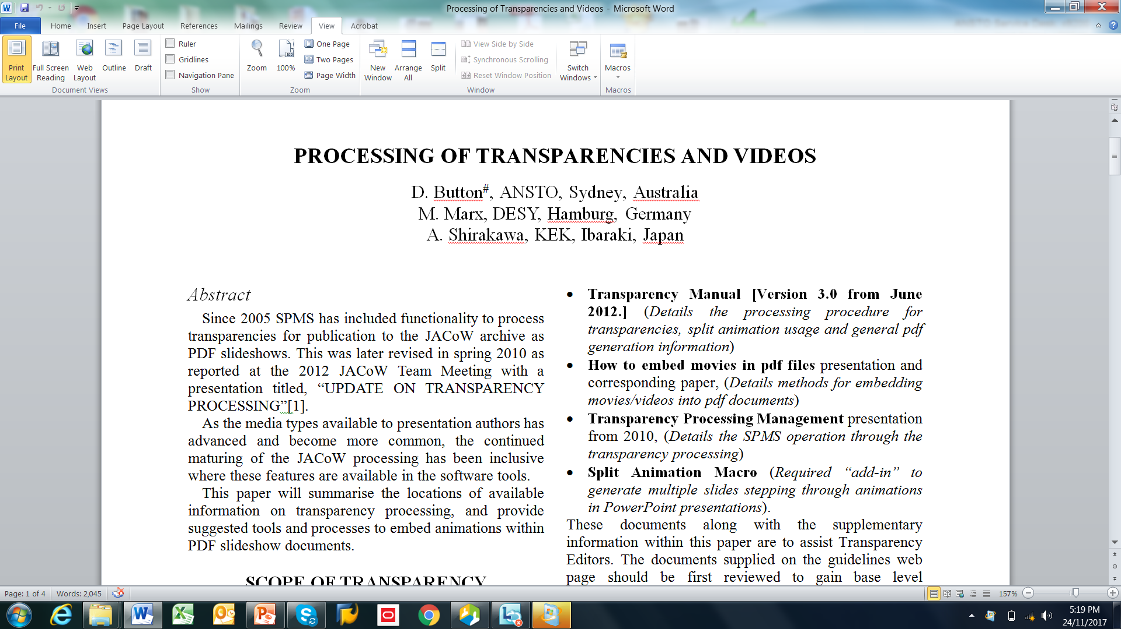
Visualisation Print Layout View
Default view we are all use to viewing
Gives as name suggests the view of what the document will look like when printed.

Slide 7
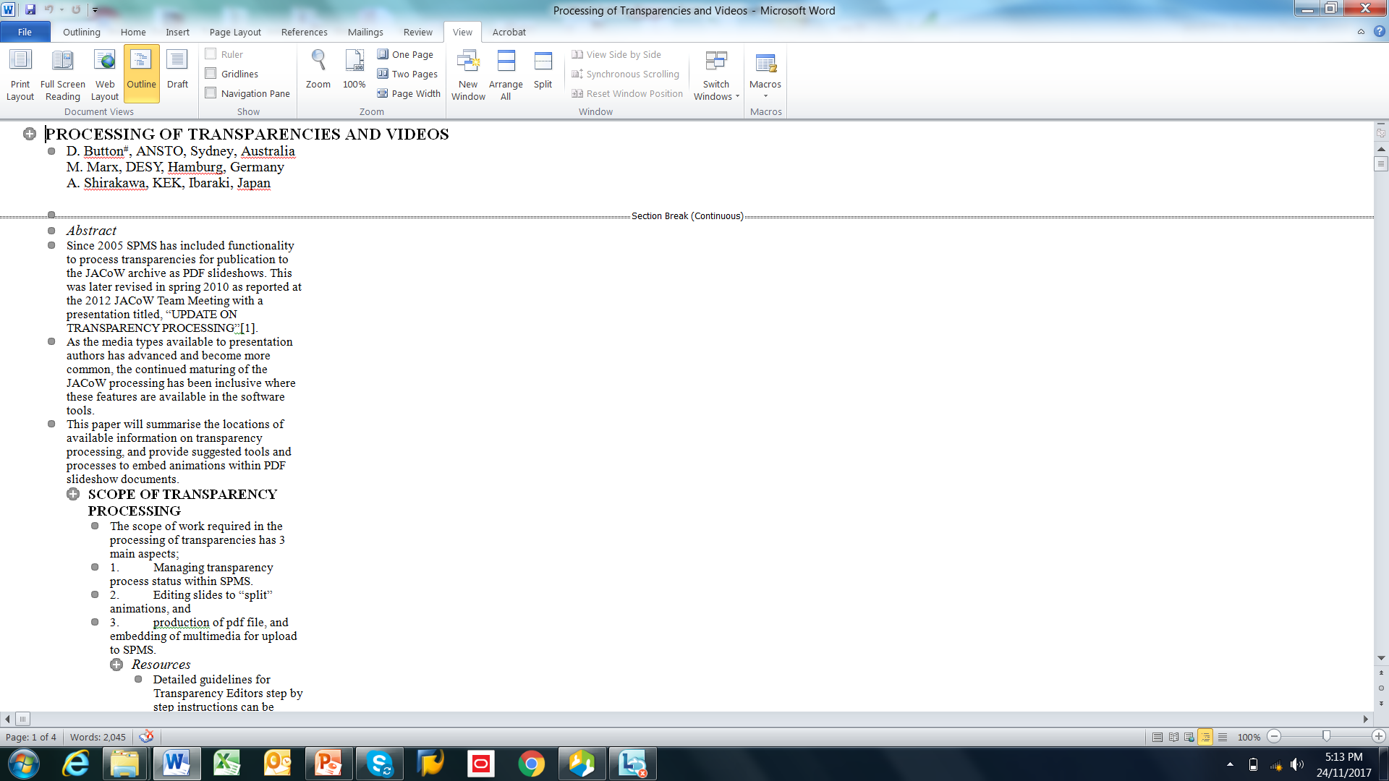
Visualisation Document Outline
Flattens document into linear sequence
Good for finding tricky formatting issue in the document, elements which have moved outside of workable view.

Slide 8
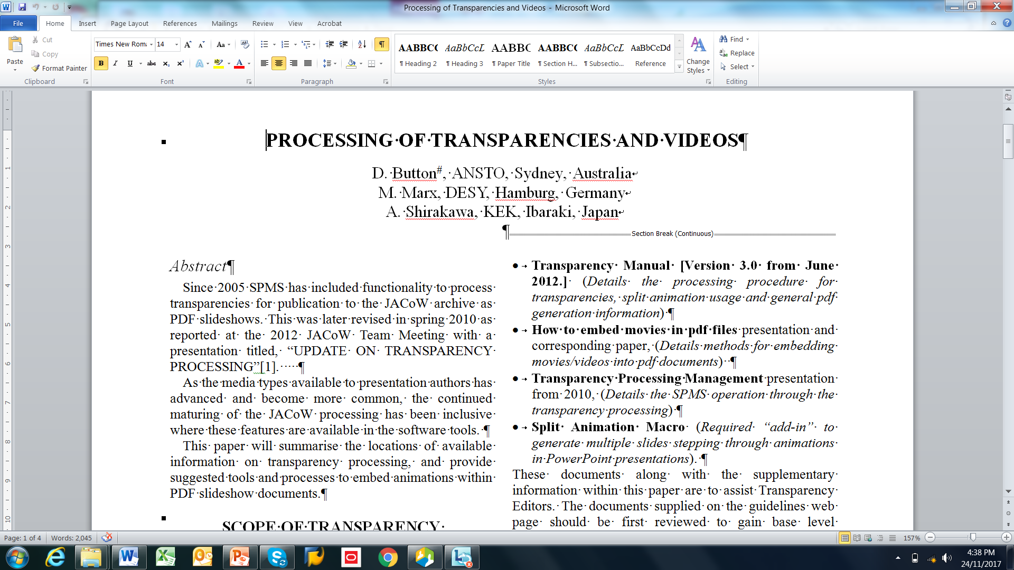
Visualisation Punctuation and hidden symbols
Displays non-visual text layout and punctuation characters as symbols
Can give editor clues as to what the author has don during construction of their document, can however flow your view.

Slide 9

Visualisation Show Text Boundaries
Shows the boundaries to which sections of text can exist within
Good for giving simple clues to the layout problem in document such as figure and table placement and oversize, indenting in place of cantering, etc.

Slide 10
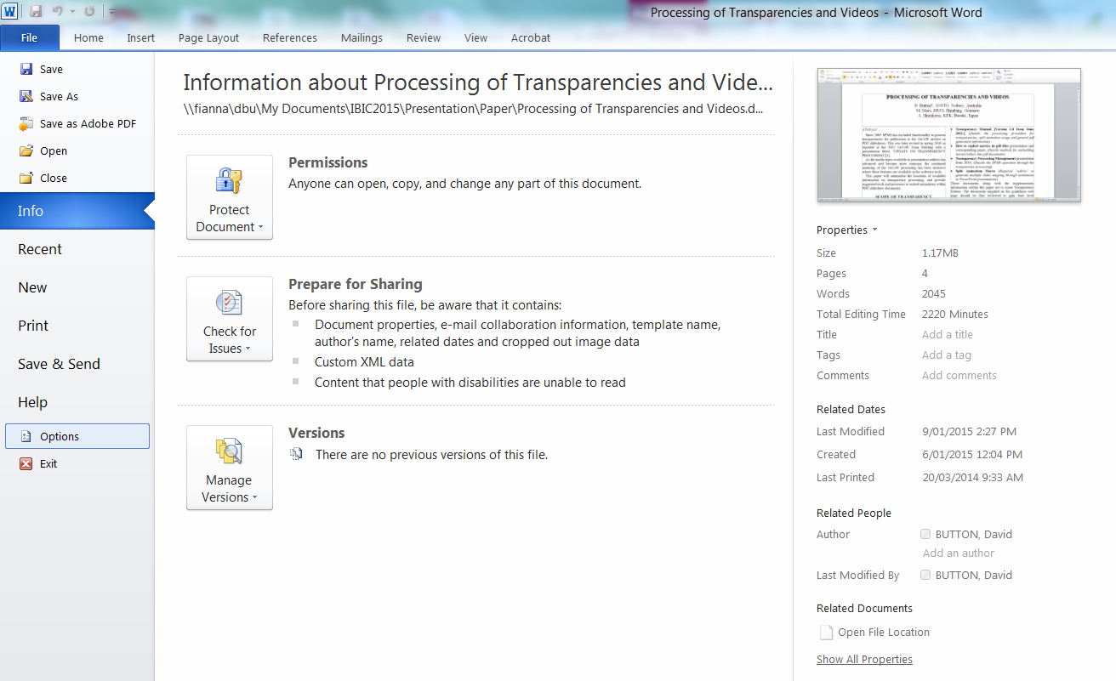
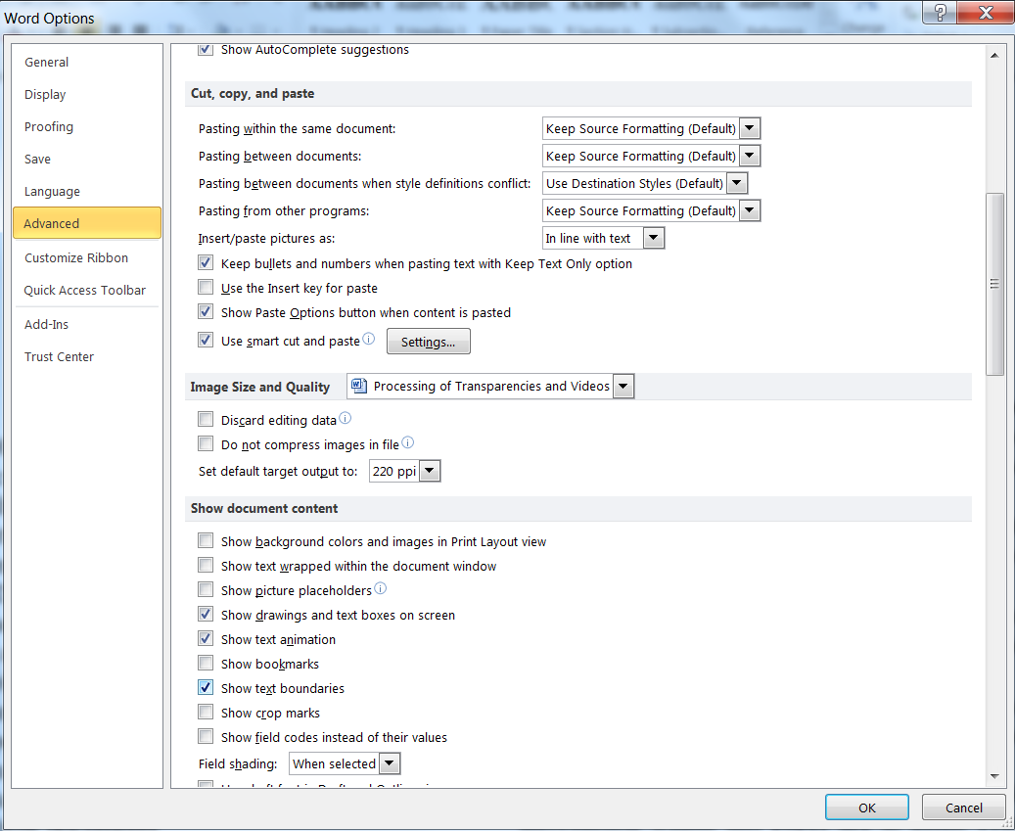
Visualisation Show Text Boundaries
How to Turn On Text Boundaries
1
3
Scroll
Down
2
4
File > Options > Advanced > (Check) Show Text Boundaries

Slide 11


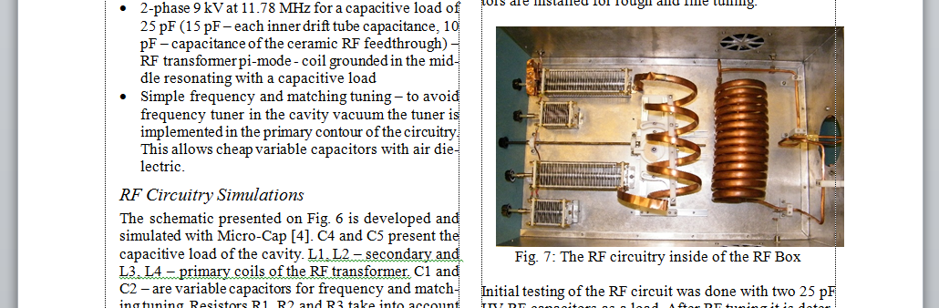
Visualisation Show Text Boundaries
Outside Margin
Indented

Slide 12



Red Dot is a Red Dot
2x Resources
Author + Editor
Editors Time is a Premium!!!
Send Clear instructions back to the author
TUPAB044 - RED
* Please download and use the current template and copy and used the paste as unformatted feature to each section so that the formatting of the template is correct.
* Abstract title formatting wrong, this should be Title case not All Uppercase.
* Footnote formatting wrong. see JACoW template.
* Do not use hyperlinks in the document, remove using "control + k".
* Margin and column widths are different to the template.
* Figure caption formatting incorrect, see template.
* In text figure references wrong, see template.
* Wrong font sizes and types used throughout document, and paragraph line spacings, see template.
* Figure 11 split across pages.
* Reference list formatting wrong, see template, and JACoW website references and citations.
* You are allowed 3 pages + 4th page for references only.
* Figure 12 not referenced in main text.

Slide 13
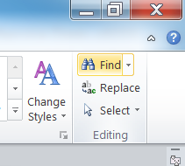

Search’s Find (ctrl – f)
The find tool can be use to locate existence of in text references such as;
Figure references (search for “fig.”)
Sighting of reference in text (search for “[”)
Table references (search for “table”)
Etc.
Home Ribbon
TUPIK103 - RED
* Figure captions.
* Title text spacing between Author list and text paragraphs.
* Sub Section Headings
* Reference list indenting and formatting.
* Random line next to abstract.
* Figure 1,4,6,7,8,9, and 10 not referenced in text.

Slide 14

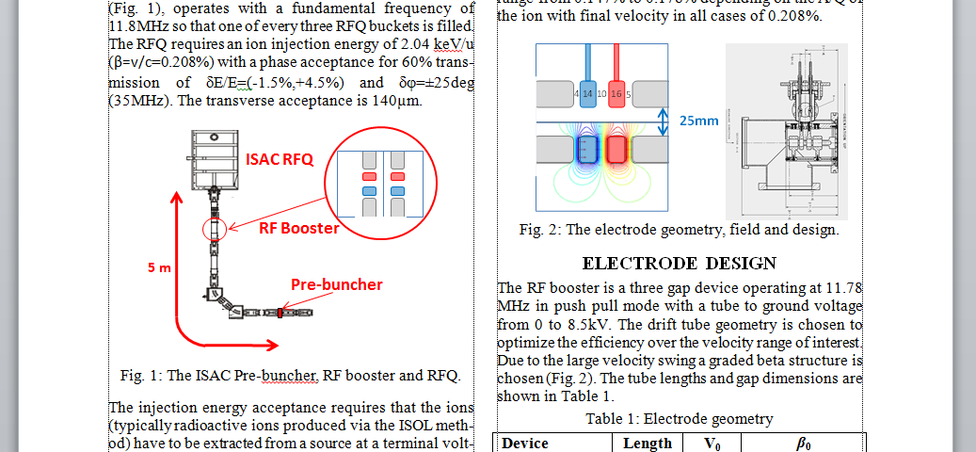
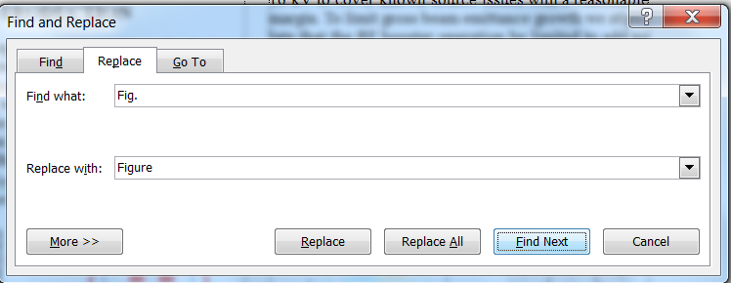
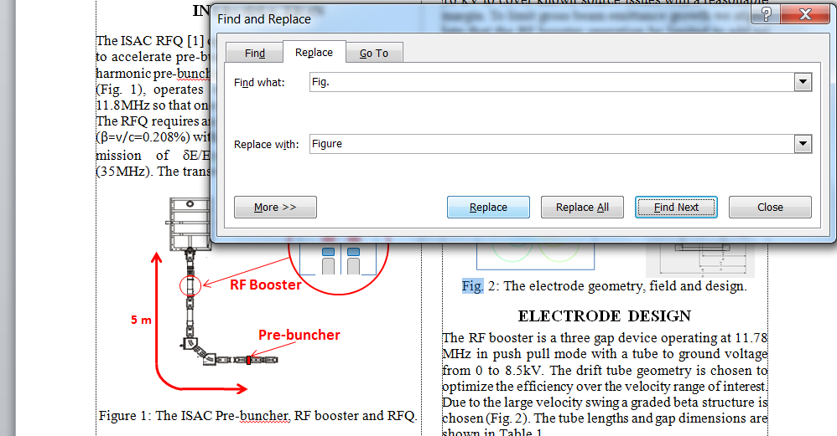
Search’s Replace (ctrl – h)
Find What: “Fig.”
Replace With: “Figure”
Can iterate through document, and replace appropriate as “Found” in sequence, only replace the ones required.
More accurate than scanning and replacing by eye…
Note: Do Not use “Replace All”
THPIK003 - RED
* Indent missing at start.
* Figure Captions wrong.
* table title wrong.
* Figure 4 caption indented, remove.
* Figure 3 formatting really wrong.
* Figure 5 indented not centred, center as per template descriptions.
* Figure 7 hanging outside margin, center to column.
* Equations, there is a section on this in the template as well, consider using same method as that of eq(1).

Slide 15
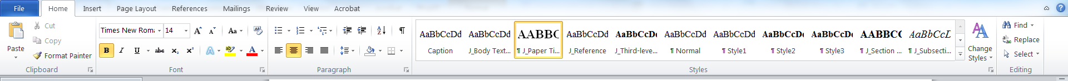
Formatting Styles
The template comes with JACoW required styles as displayed on the Home Ribbon
Style | Font | Space Before | Space After
PAPER TITLE | 14 pt UPPERCASE EXCEPT FOR REQUIRED lowercase letters Bold | 0 pt | 3 pt
Author List | 12 pt UPPER- and lowercase | 9 pt | 12 pt
Abstract Title | 12 pt Initial Caps Italic | 0 pt | 3 pt
SECTION HEADING | 12 pt UPPERCASE Bold | 9 pt | 3 pt
Subsection Heading | 12 pt Initial Caps Italic | 6 pt | 3 pt
Third-level Heading | 10 pt Initial Caps Bold | 6 pt | 0 pt
Figure Caption | 10 pt | 3 pt | ≥3 pt
Table Caption | 10 pt | ≥3 pt | 3 pt
Equation | 10 pt base font | 12 pt | 12 pt
References¹ when ≤ 9 | 9 pt, justified with 0.52 cm (0.2 in) hanging indent | 0 pt | 3 pt

Slide 16
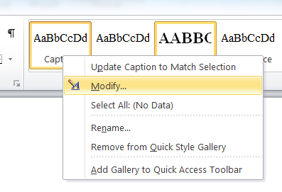
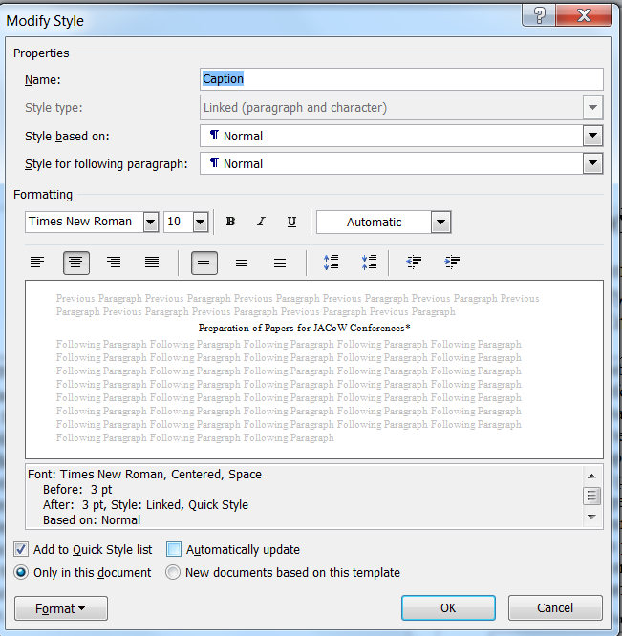
Formatting Styles
The template comes with JACoW required styles as displayed on the Home Ribbon
Right Click
If “Automatically update” is checked then every time you modify the justification of one caption, it will change for every caption in the document of that type. Un-Check if Checked.

Slide 17

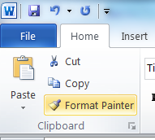
Formatting Format Painter Tool
Highlight the text which is formatted the way you want to copy.
With the select brush paint the text you want to have the same formatting.
TUPAB044 - RED
* Please download and use the current template and copy and used the paste as unformatted feature to each section so that the formatting of the template is correct.
* Abstract title formatting wrong, this should be Title case not All Uppercase.
* Footnote formatting wrong. see JACoW template.
* Do not use hyperlinks in the document, remove using "control + k".
* Margin and column widths are different to the template.
* Figure caption formatting incorrect, see template.
* In text figure references wrong, see template.
* Wrong font sizes and types used throughout document, and paragraph line spacing's, see template.
* Figure 11 split across pages.
* Reference list formatting wrong, see template, and JACoW website references and citations.
* You are allowed 3 pages + 4th page for references only.
* Figure 12 not referenced in main text.

Slide 18
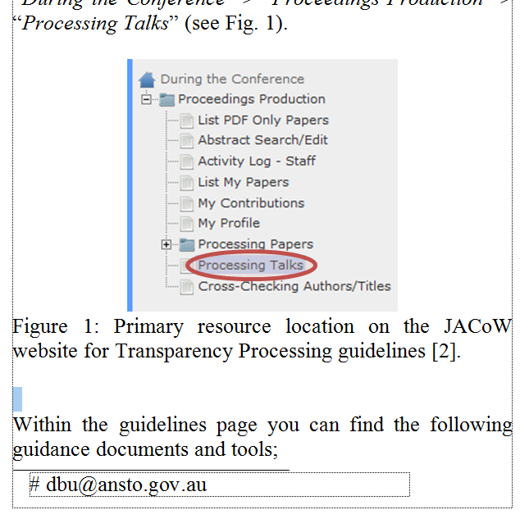
Formatting Fudging Line Spacing's (Shift + Ctrl + “<“ OR “>”)
In Pitspot the editor will use the move tools to improve the layout and distribution of text. You can use a small trick to do this in word. This is done by increasing or decreasing the font size on a line.
1. Select Blank Line
2. Use Shift + Ctrl AND “<“ or “>”

Slide 19
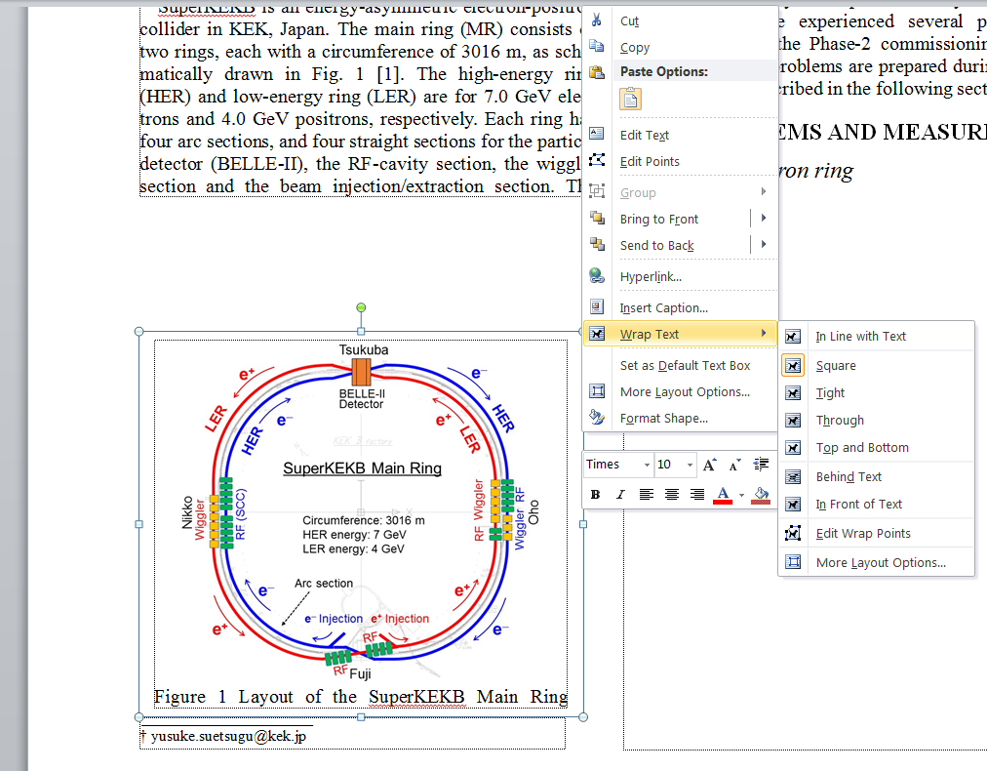
Formatting Inline with text
Documents which have figures or objects which are not inline with text are highly unstable and almost impossible to edit without document layout changing unpredictably.
You need to place the figures/objects inline with text.
Note: You may have to use the “Group” tool if the figure are made up of a number of objects.
Author has constructed figure in a text box
with text wrapped around the shape.
(To Get Menu: Select Shape/Object, Right Click)
WEPIK008 - YELLOW
* Sub-section headings.
* All figure captions. All were text boxes, content moved inline with text.
* PRESENT STATUS AND PLAN make bold.

Slide 20
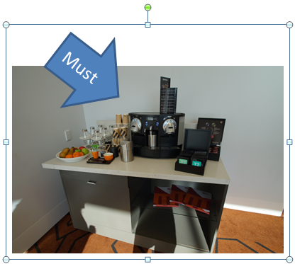
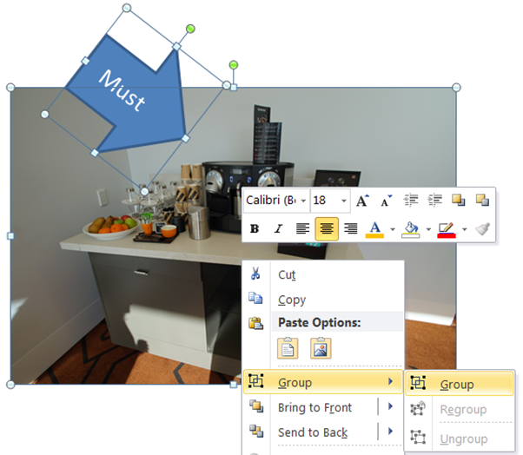
Formatting Inline with text -Grouping
Objects to Group
Can now be place inline with text
WEPIK008 - YELLOW
* Sub-section headings.
* All figure captions. All were text boxes, content moved inline with text.
* PRESENT STATUS AND PLAN make bold.

Slide 21
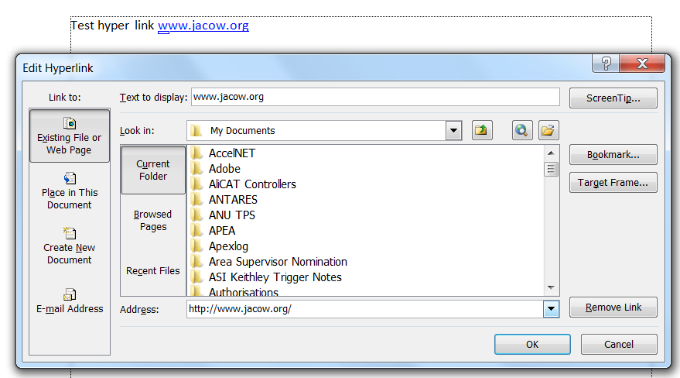
Formatting Removing Hyperlinks (ctrl + k)
The final PDF JACoW format document should not have any hyper links. To remove hyperlinks in the word document use the “Ctrl + K” Edit Hyperlink menu, click “Remove Link”.
www.jacow.org

Slide 22

Formatting Breaks
Paragraph Break New Line | Enter | Standard carriage return
Line Break | Shift + Enter | Goes to next line without new paragraph
Page Break | Crtl + Enter | Starts text on next page
Column Break | Ctrl + Shift + Enter | Starts text in top next column
Section Break (Continues Break) | Page Layout Page Setup Breaks | Used when changing from column sections
Unbreakable Space | Ctrl + Shit + Space | Use to adjoin item such as units which should remain to adjacent values

Slide 23

Thank You

